Slide 1
Retail Shop Management
Rifah Tasnia Joita
Roll: 1909005
Dept: ECE

Slide 2
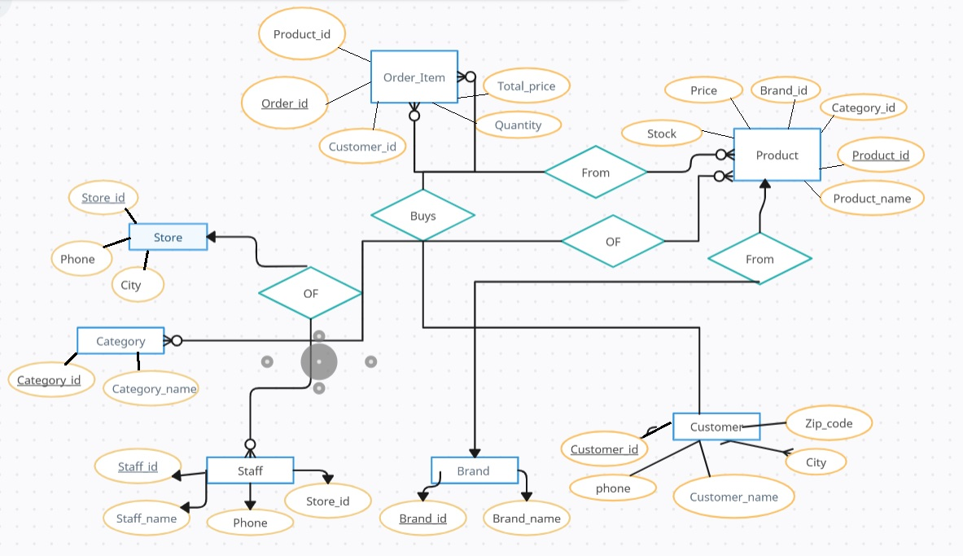
Figure: ER Diagram of the DBMS

Slide 3
Entities are: -Customers -Staff -Store -Category -Brand -Product -Order Item

Slide 4
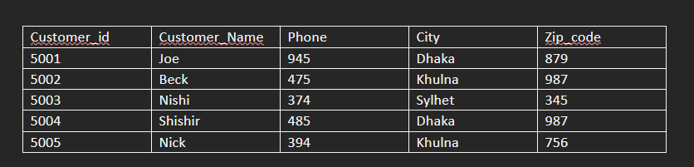
Customer Table:

Slide 5

Staff Table:

Slide 6

Store:

Slide 7

Category Table:

Slide 8

Brand Table:

Slide 9
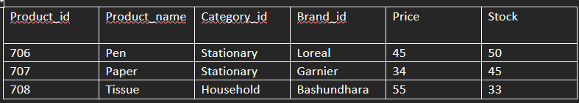
Product Table:

Slide 10

Order Items Table:

