Slide 1
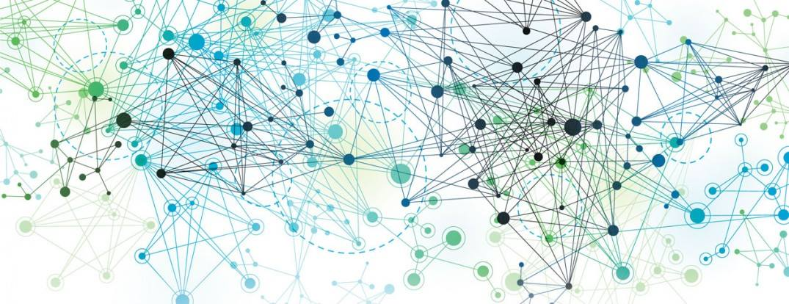
Network Flow
By
Rifaq Ajmal
Rohail Muneer

Slide 2
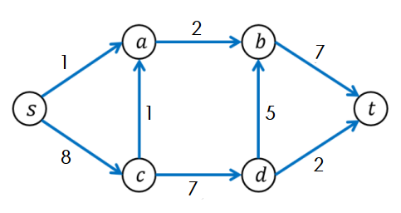
What is a Network Flow?
A network flow represents the movement of something.
(like water, data, or traffic) through a network.
e.g

Slide 3
Network flow consists of:
Nodes
Points where the flow enters, exits, or passes through.
Edges
Connections between nodes, with a maximum capacity indicating how much flow can go through.

Slide 4
Maximum Flow
The maximum flow is the largest amount of flow that can be transported from a source node to a sink node in a network.
Example
Imagine a network with 4 nodes:
Source (S), Intermediate (A, B), and Sink (T).
The edges between the nodes have capacities:
- S → A (capacity 10)
- S → B (capacity 5)
- A → T (capacity 5)
- B → T (capacity 10)

Slide 5
The maximum flow is the largest amount of flow that can move from S to T.
One solution is:
From S to A to T, using the full capacity of 5.
From S to B to T, also using a capacity of 5.
Thus, the maximum flow from S to T is 10 (5 + 5).
- S → A (capacity10)
- S → B (capacity 5)
- A → T (capacity 5)
- B → T (capacity 10)

Slide 6
Minimum Cut
The minimum cut is the smallest set of edges
if removed, would disconnect the source from the sink.
Example
S → A (capacity 10)
S → B (capacity 5)
A → T (capacity 5)
B → T (capacity 10)
In our network, if we cut the edge S → A, the maximum flow from S to T would drop significantly. Similarly, if we cut S → B, the same thing happens.

Slide 7
Another way to see the minimum
cut is to imagine a wall between
nodes. If you place the wall
between S and A, and S and B,
the flow from S to T is completely
stopped. This is a minimum cut.
- S → A (capacity10)
- S → B (capacity 5)
- A → T (capacity 5)
- B → T (capacity 10)
Now where does it occur?

Slide 8

Electricity Network – that how much electricity can go through the grid

Slide 9
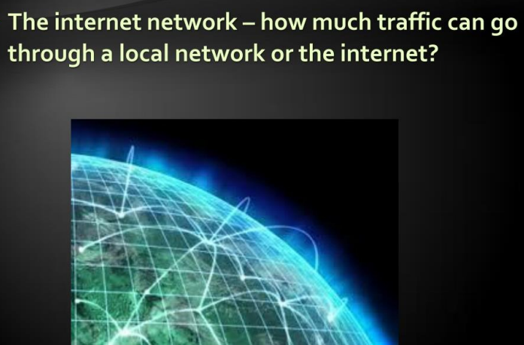
The Internet Network
How much traffic can go through a local network or the internet.

Slide 10
Conclusion
Understanding maximum flow and minimum cut can help in many scenarios.
from optimizing networks to planning logistics. With these basic concepts, we can analyze the flow and capacity of any network.
Thank You

