Slide 1
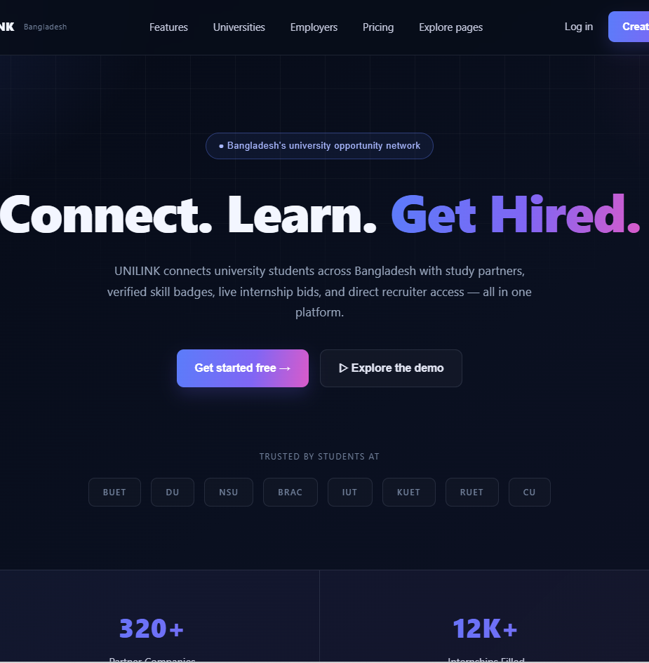
UNILINK
Connect. Learn.
Get Hired.
A university opportunity network for students, clubs, recruiters, and institutions across Bangladesh.
Platform overview
SEPTEMBER 2026

Slide 2
UNILINK
02
The gap between campus life and career opportunity
Students use disconnected tools to study, build proof of skills, and find relevant work.
Campus today
UNILINK
Career outcomes
Scattered groups
Unverified claims
Hidden opportunities
Slow coordination
Relevant matches
Credible profiles
Faster hiring
Measurable progress
One trusted network
Academic identity connects collaboration, verified skills, opportunities, and hiring workflows.

Slide 3
UNILINK
03
One platform, four connected roles
Each role gets a focused workspace while contributing to the same verified network.
01
02
03
04
Students
Clubs
Recruiters
Universities
Find study partners, build a verified profile, join clubs, and apply for opportunities.
Manage members, publish events, collect dues, and communicate with the campus.
Search verified candidates, post opportunities, and contact qualified students.
Manage partnerships, review outcomes, and support students who need attention.

Slide 4
UNILINK
04
Study Partner matching
Students discover peers by course, skill, university, and study preference.
Better matches start with useful context
MATCH SIGNALS
Profiles show the subjects a student can teach, the help they need, availability, and preferred session format.
Course overlap
Availability
Study format
Verified university
Students can move from discovery to a scheduled session without leaving the platform.

Slide 5
UNILINK
05
Campus feed, notices, and events
A single English language feed keeps university life organized and easy to scan.
01
02
03
Notices
Events
Notes
University and club announcements appear in one structured feed with clear categories.
Students can discover academic, club, and recruiting events by date and organizer.
Shared learning resources stay attached to courses, groups, and study activity.

Slide 6
UNILINK
06
Verified profiles and SkillCheck badges
Academic identity and assessed skills give recruiters stronger evidence than a résumé alone.
A profile combines
VERIFIED STUDENT
Academic email verification
University and department
Course and club participation
SkillCheck results
Project and internship activity
Arif Jahan
Computer Science · BUET
3 verified skill badges
Profile evidence supports faster shortlisting.

Slide 7
UNILINK
07
Live Bid opportunity marketplace
Students compete for internships, project work, hackathon bounties, and exclusive recruiter access.
Opportunity types
How it works
Internships
Hackathon bounties
Project work
Exclusive candidate access
Recruiters publish a clear brief
Eligible students submit verified bids
Teams shortlist and communicate in one place
The result: opportunity discovery and candidate evaluation share the same workflow.

Slide 8
UNILINK
08
Recruiter search and hiring workflow
Recruiters filter candidates by verified education, skills, CGPA, and availability.
01
02
03
Search
Evaluate
Contact
Find candidates with useful filters instead of reading unstructured applications.
Review badges, academic context, and engagement signals in one profile.
Save candidates, start conversations, and invite the strongest matches.
Verified data helps teams spend more time on strong candidates and less time checking claims.

Slide 9
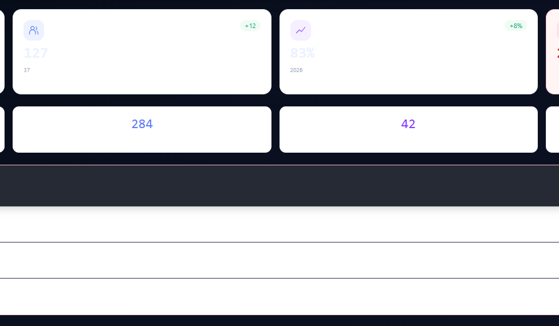
UNILINK
09
Administration and campus operations
The admin dashboard brings partnerships, platform health, student support, and reporting into one view.
18,432
verified student accounts
83%
graduate placement rate
23
students requiring support

Slide 10
UNILINK
10
A complete platform foundation
UNILINK combines a consistent interface with a Node.js backend and role based access.
Student experience
Career marketplace
Administration
Study matching
Campus feed
Events and notes
Verified badges
Live opportunities
Candidate search
Recruiter contact
Hiring activity
Partnerships
Announcements
Analytics and reports
Student support alerts
Connect. Learn. Get Hired.

