Slide 1
Meet Dr Scott
Notes:
Hello every one meet dr scott

Slide 2
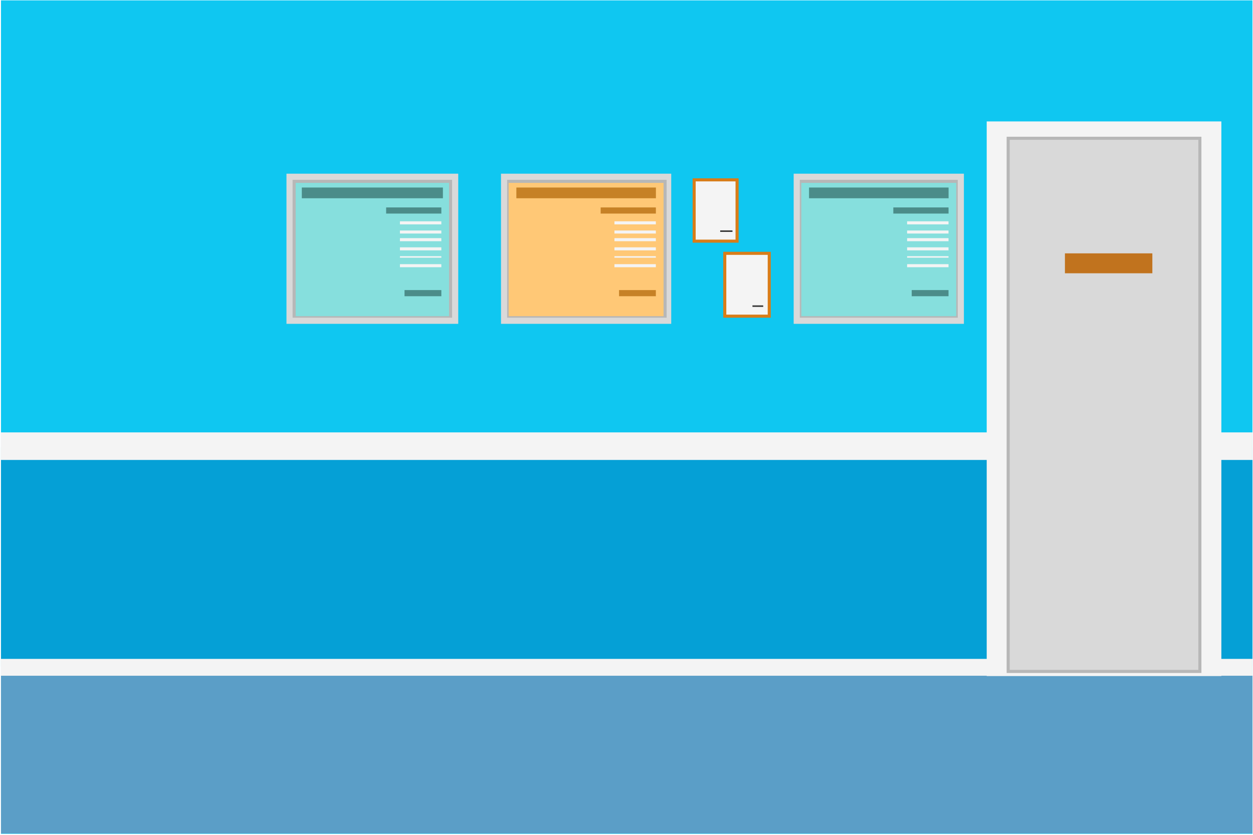
He is a Radiologist
Notes:
He is a radiologist. And he love his job

Slide 3
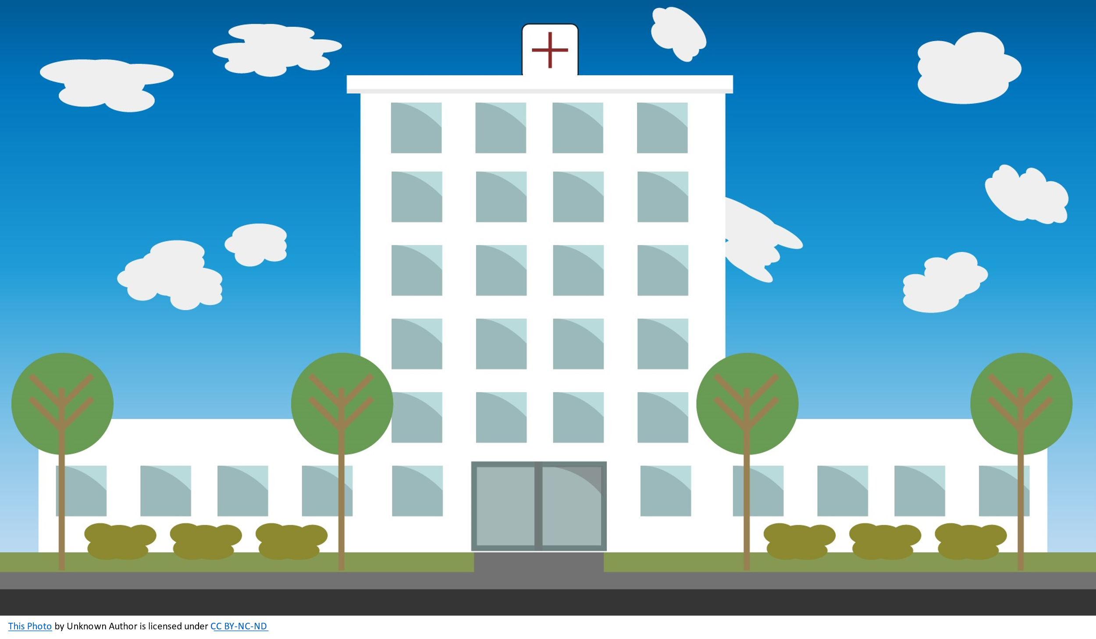
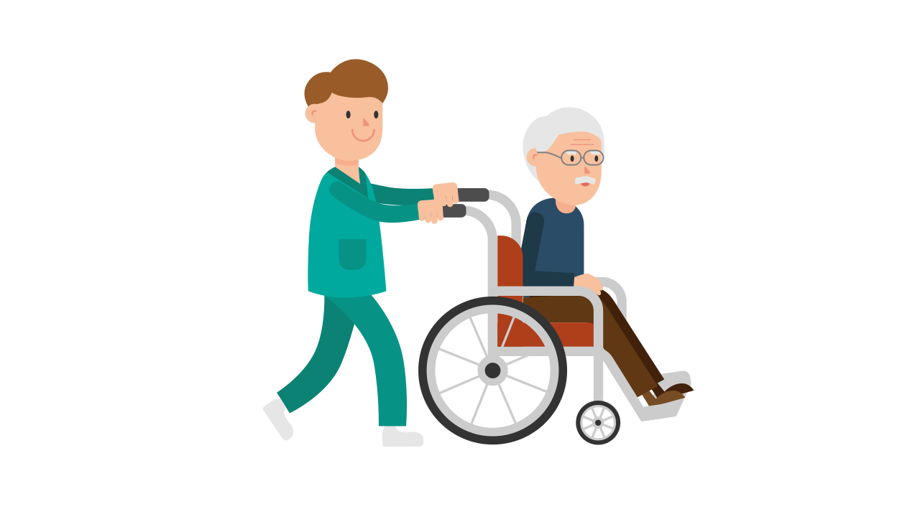
Notes:
Dr scott is working in a city hospital. Where his day is quite busy in scheduled and emergency appointments

Slide 4

The problems
Notes:
As the time pases doctor scott faced some problems with the process

Slide 5

This Photo by Unknown Author is licensed under CC BY-SA
Notes:
His major concerned is about emergency appointments.
He is worried about the current method of dealing with emergency. The emergency appointment is not like the emergency app

Slide 6
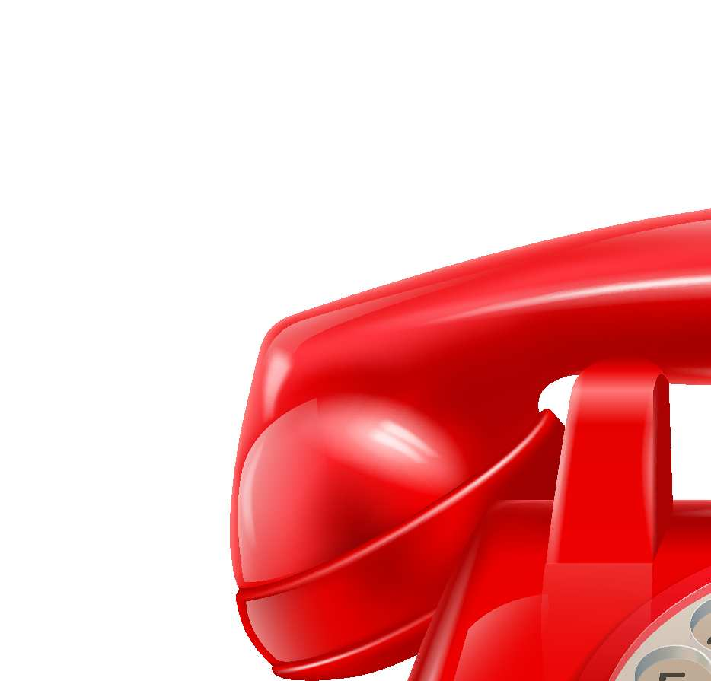
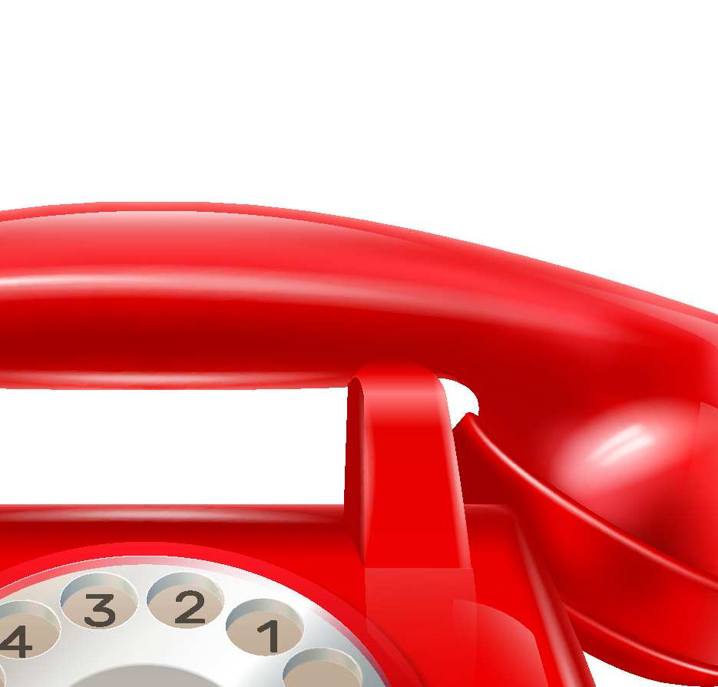

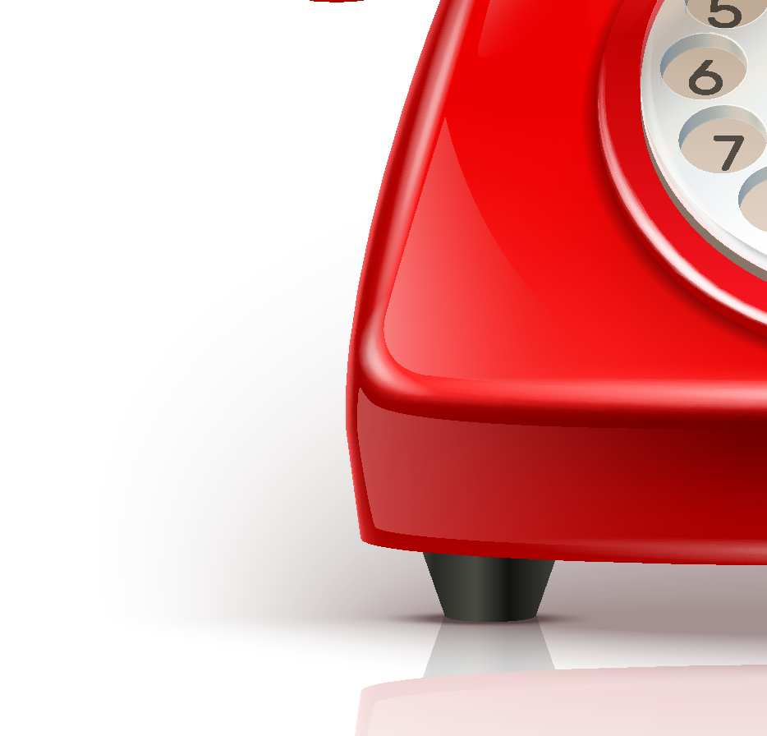


He spend three hours of his time on phone.
Notes:
He spend three hours on phone while adjusting the appointment because of the emergency cases that come in between the scheduled appointments and most of the time the emergency cases or only taken in a specific time.

Slide 7
Notes:
Due to such conditions his patients end up waiting for the slots and most of the time they leave the hospital with an angry expression on their faces.

Slide 8
Loss of revenue
Notes:
Unsatisfied patients lead to the revenue loss. That is a big problem for the hospital management.

Slide 9
needs
What he needs

Slide 10
An application that help him while he work on the emergency cases
Notes:
An application that help him while he is working on the emergency case

Slide 11

Notes:
And by help I mean not effecting his scheduled appointments

Slide 12
So that he can take out time for patient consultation
Notes:
So that he can give proper time to patients and have enough time for case discussion.

Slide 13

Patients satisfaction
That will increase hospital revenue
Notes:
That means if he can focus more on patients that will definitely a patient satisfaction. Which can also increase hospital revenue.

Slide 14

Our solution

Slide 15
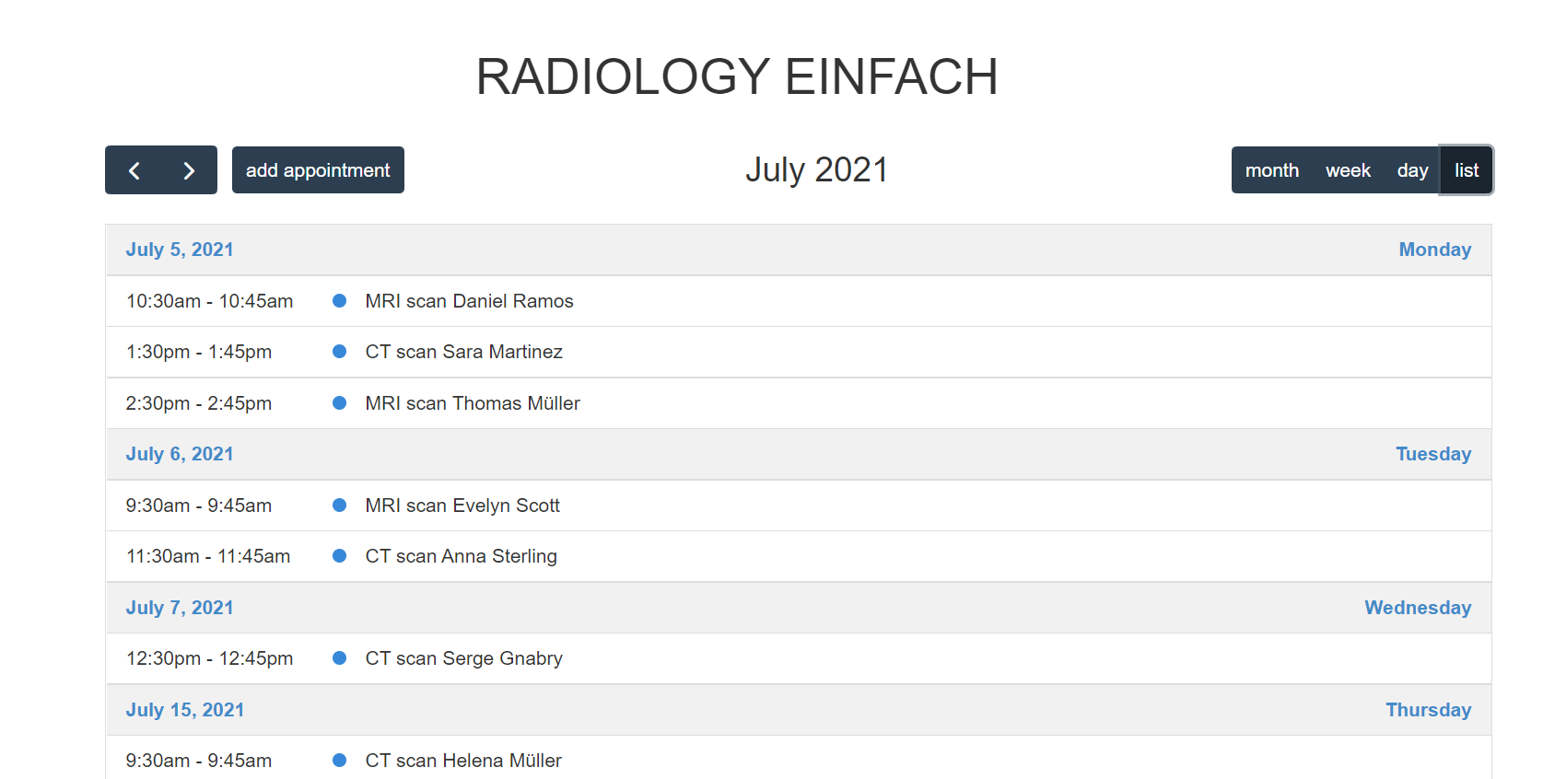
A simple application
which shows the appointment in calendar view
Where he can just drag
and drop the slot to delay or make it earlier.
Notes:
A simple application which shows the appointment in calendar view. Where he can just drag and drop the slot to delay or make it earlier. Something like this

Slide 16
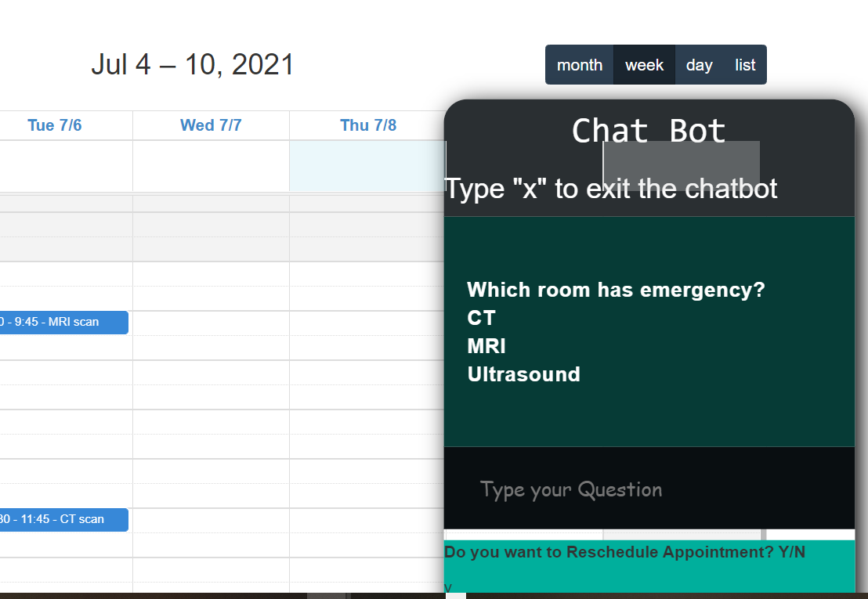
While he drag and drop the appointment
The chat bot open up!
The chat bot suggest time of delay
Based on the data feed by the
Previous activities
Notes:
While he drag and drop the appointment the chat bot get activated.
The chat bot pass on suggestion for the different room where emergency occur. And that suggestion is in form rescheduling time.
The suggested rescheduling time feed by the previous activities.

Slide 17
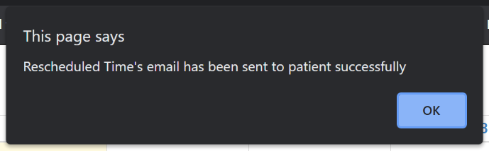
Notes:
After the time is decided it simply send a notification to the person email address who's slot is rescheduled.

Slide 18
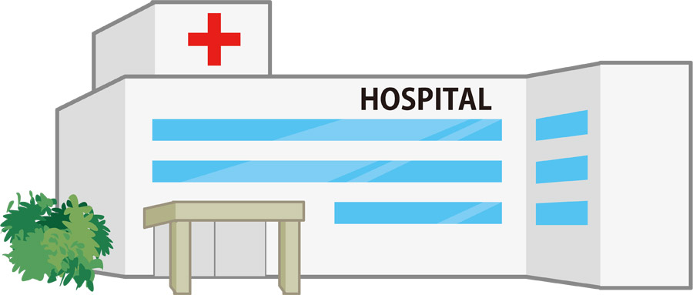
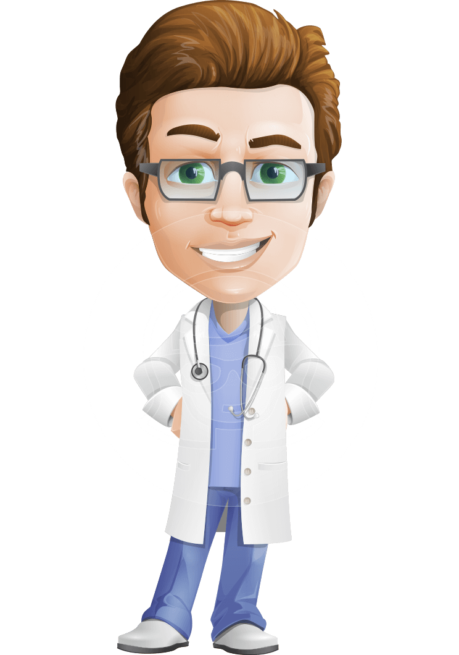
Now doctor Scott is happy and love his work
This Photo by Unknown Author is licensed under CC BY-NC
Notes:
Now doctor scott is happy and he handle emergency cases with no worries

