Slide 1
A real time reporting system of pharmacovigilance of prescription opioids
from social media using artificial intelligence

Slide 2
Data collection from twitter
We have taken the prescription opioids for our work and primarily taken 48 drugs to use as keyword for downloading the tweets.
As twitter contains unstructured data and it is very prone to have misspelled words so we generate word variants.
Generate words using 1 edit distance algorithm
Keep those words with similar pronunciation of root word using python metaphone library
Final word variant list after counting the google hits using custom search engine API

Slide 3

Finally 167 names were used as keyword.
Both Stream API and Search API were used to download tweets.
From the downloaded tweets the text and demographic information had bee extracted.
Annotation of tweets
The tweets are annotated by two point of interest in two separate files. One is for ADR annotation,
other is to explore social impact.
ADR Annotation:
The annotated file contains drug name , annotated text and semantic type. Semantic type can
Be ADR when it is an after effect or indication when drug is consumed for that adverse effect.

Slide 4

Social impact annotation:
Sometimes prescription opioids leads to illegal business marketization and people can consume it without having any authorization out of depression and community influence.
Finding these relationship from twitter is very troublesome for manual annotation so we are now trying to use Machine Learning for automatic detection of illicit usage.

Slide 5
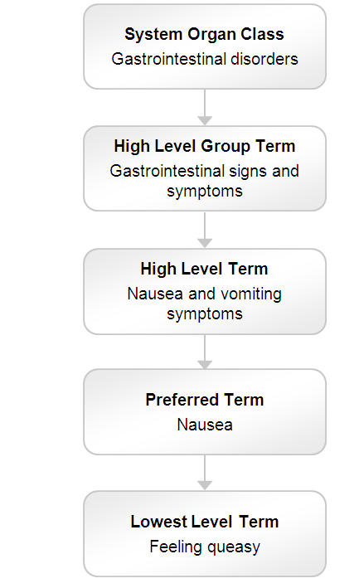
Mapping To MedDRA Term
It is an international medical terminology dictionary which is used by regulatory authorities in the pharmaceutical industry during the regulatory process, from pre-marketing to post-marketing activities, and for data entry, retrieval, evaluation, and presentation. It is mostly renowned for adverse event classification.
This classification structure is staged in five parts. In our work we will try to explore the LLT if possible then PT term.

Slide 6

MedDRA is a medical dictionary for regulatory activities which is widely Used for ADR encoding. Different pharmaceuticals company may define the adverse effect differently which can create ambiguity. So for an ideal standard they all use the adverse term encoded in MedDRA. The MedDRA is accepted all over the world.
Why
To
Choose
MedDRA

Slide 7
Using the UMLS REST API we have mapped our annotated text with the MedDRA term and later for each CUI found several LLT and PT term.
Generate tgt using the api key which will be validate for 8 hours.
Using that tgt we need to generate a st/ticket for each call for the api and it is active for 5 minutes.
content_endpoint ="/search/current?string=kidney stone &sabs=MDR&searchType=exact
Is a sample search query where string parameter contains the input unmapped annotated text and MDR value of sabs defines the root source is to be MedDRA.
This will return a JSON object file where we will parse the CUI value for further use in content query to find the LLT and PT terms
content_endpoint = "/rest/content/"+'current'+"/CUI/"+str(cui)+'/atoms?sabs=MDR

Slide 8
Exploring PubMed
As twitter contains highly unstructured data so for the verification of our work we will use PubMed as a source of structured data of ADR.
Primarily I have downloaded a file of 1.2 gb of opioid use case.
The process is ongoing.

