Slide 1



Slide 2
Presentation On
Credit card fraud detection using Machine Learning

Slide 3
Group Members
Abdullah Al-Munzir – 152-15-531
Md Jamiur Rahman Rifat – 152-15-5611
Md. Lutfor Rahman – 152-15-5516

Slide 4
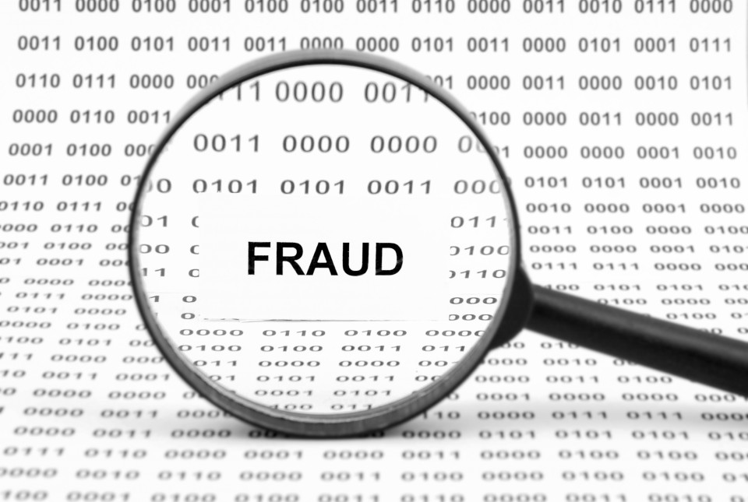

Problem Intuition
What is Credit Card Fraud ?
Fraud
Fraud Detection

Slide 5
Related Works
Study | dataset | Methods | Accuracy | Limitation
Awoyemi et al[1] | Kaggle dataset | Naïve bayes | 97.92%, | Most feature engineering is needed, Face memory insufficiency with huge amount of data
 |  | K- nearest neighbours | 97.69%
 |  | Logistic regression | 54.86%
Pumsirirat et al [2] | European dataset | Auto encoder | AUC- 0.9603 | May work poorly on history database
 |  | Restricted Boltzmann Machine | AUC- 0.9505
Carneiro et al [3] | Private dataset | RF | AUC-.935 | Ease of implementation and fast computation
 |  | SVM | AUC-.906
 |  | LR | AUC-.907
Dal Pozzolo et al [4] | Private dataset | Rule based model | .2% accounts for fraud | Will fail to classify unseen records
Patil et al [5] | 10 instances | DT | .4% accounts for Fraud | Not so effective

Slide 6
System Architecture
Data Corpus
Resampled Data
NB
KNN
SVM
Output

Slide 7
Methodologies
KNN
NB
SVM

Slide 8
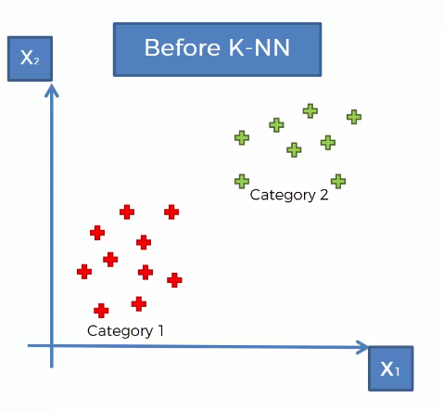
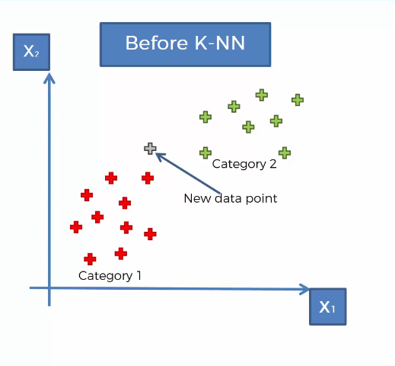
K-Nearest Neighbors

Slide 9
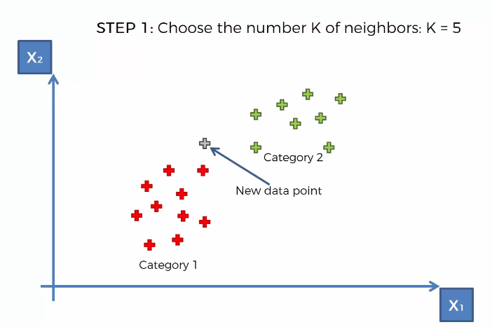
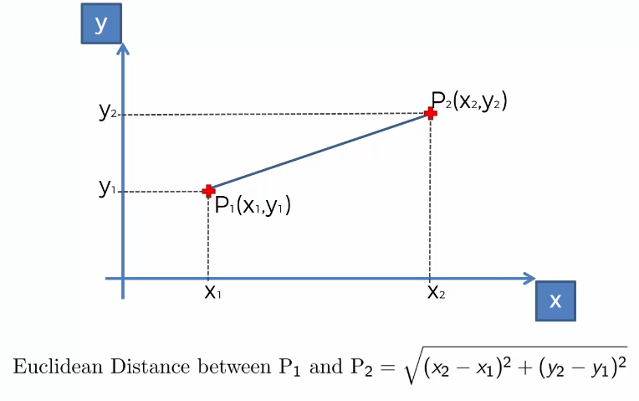
K-Nearest Neighbors (cont…)

Slide 10
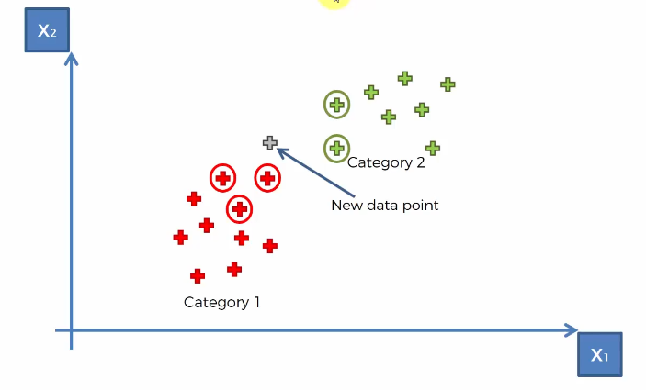
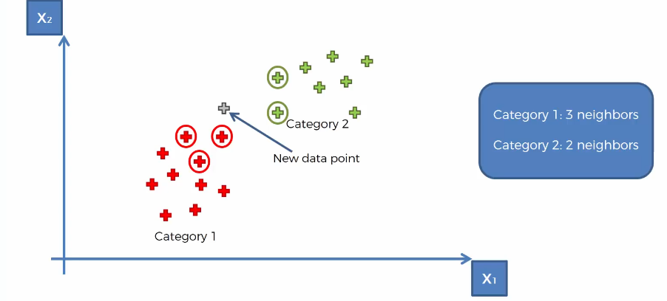
K-Nearest Neighbors (cont…)

Slide 11
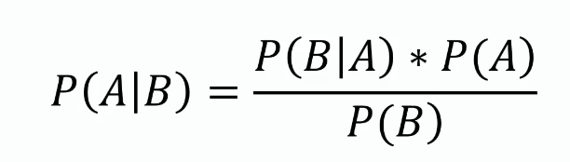
Naive Bayes

Slide 12
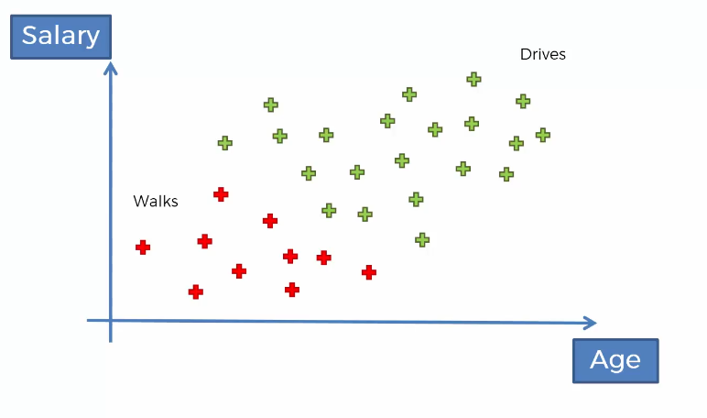
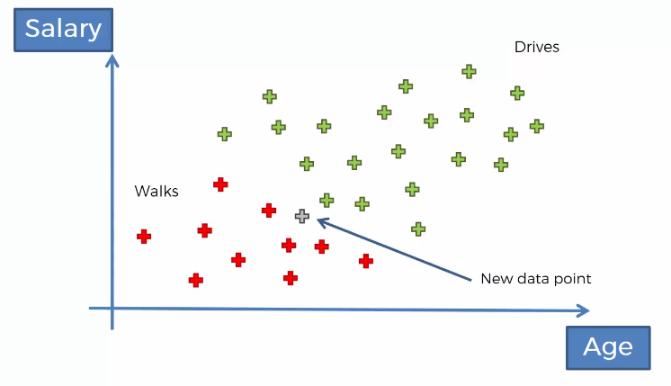
Naive Bayes (cont…)

Slide 13
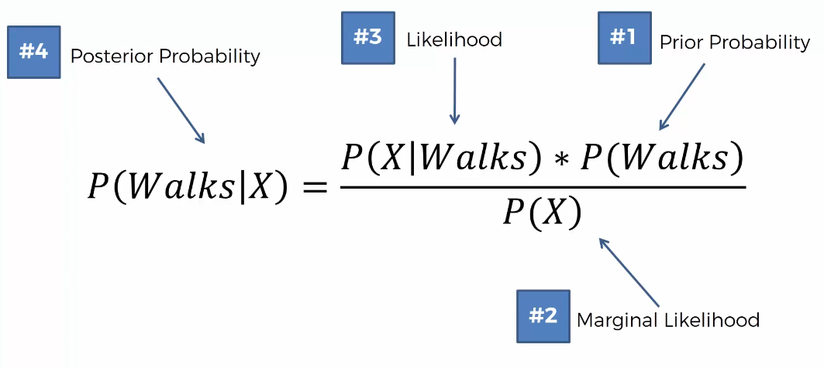
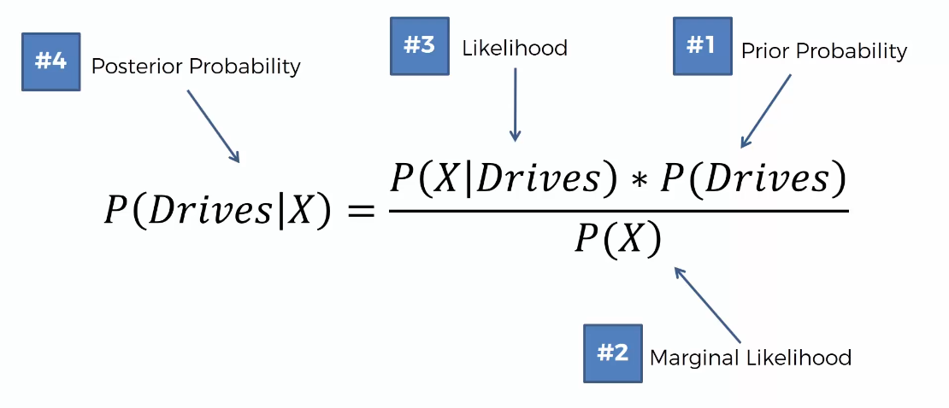
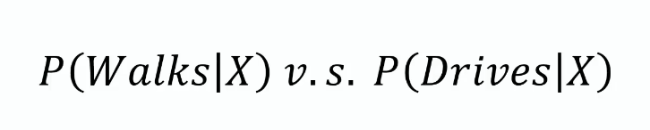
Naive Bayes (cont…)

Slide 14
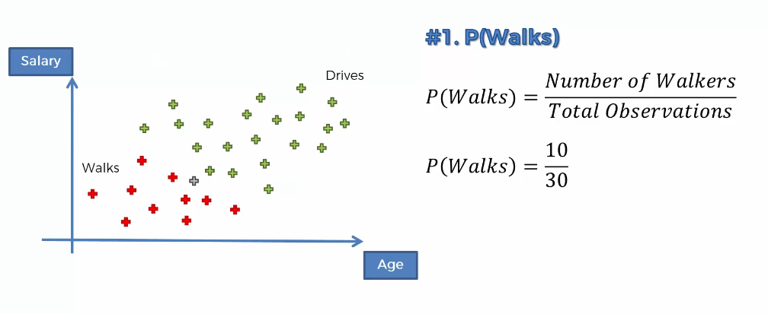
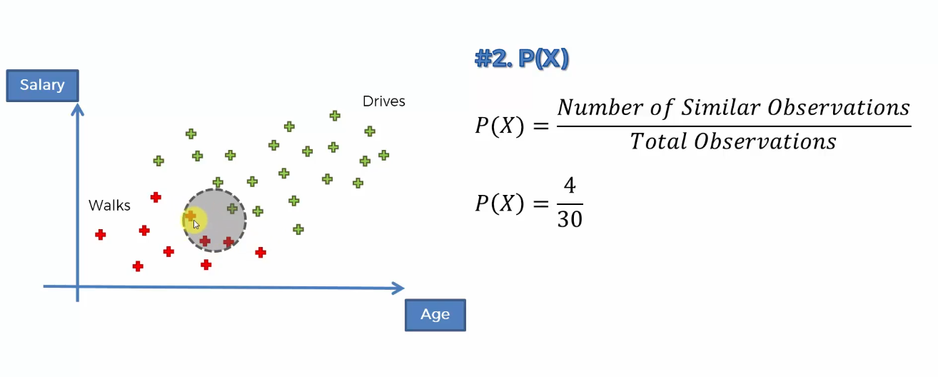
Naive Bayes (cont…)

Slide 15
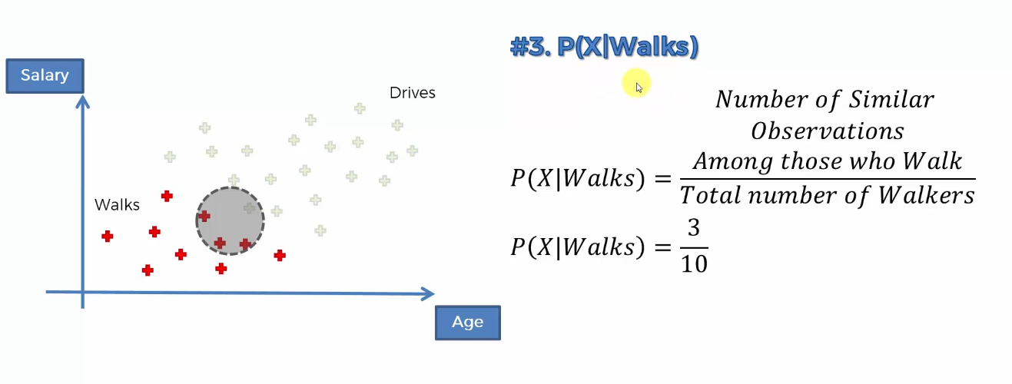
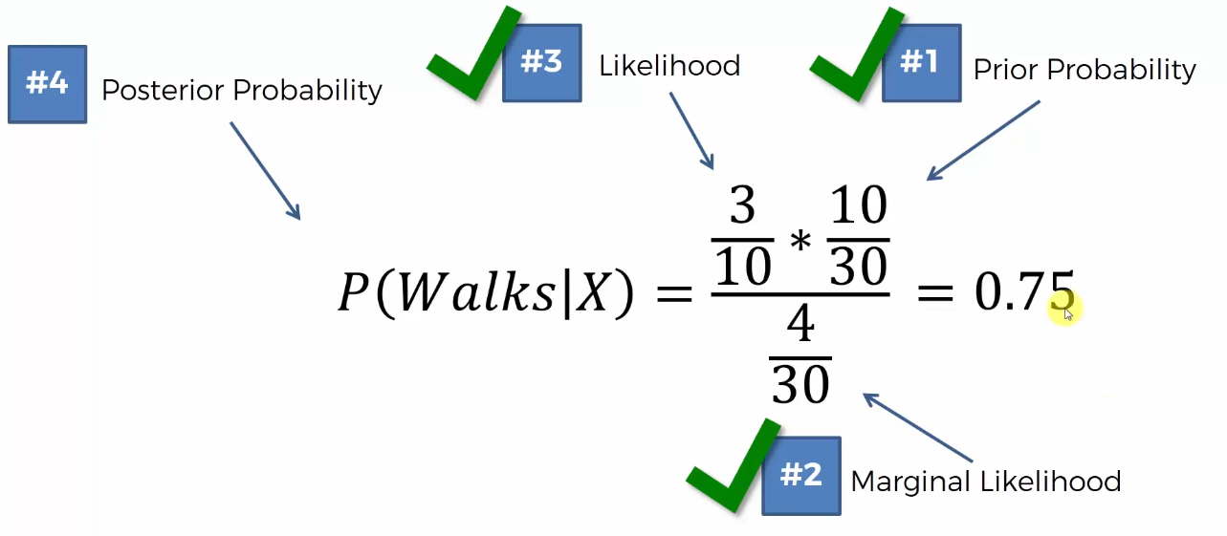
Naive Bayes (cont…)

Slide 16
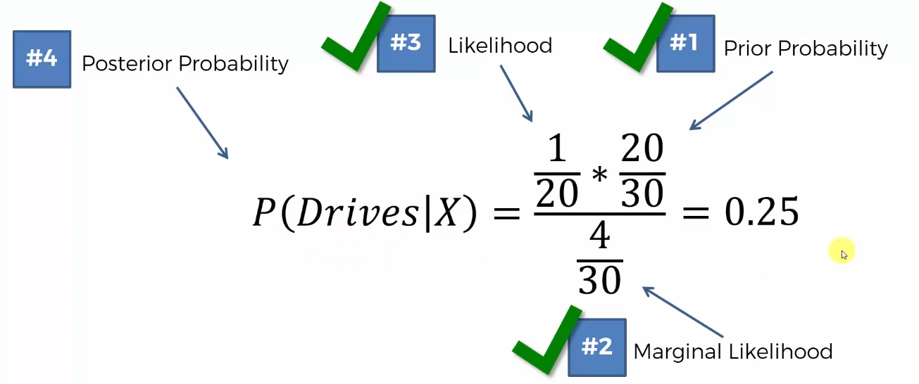
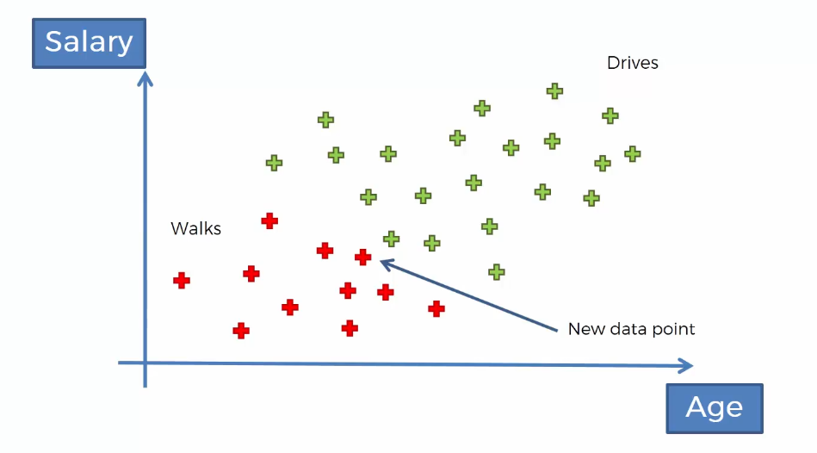
Naive Bayes (cont…)

Slide 17
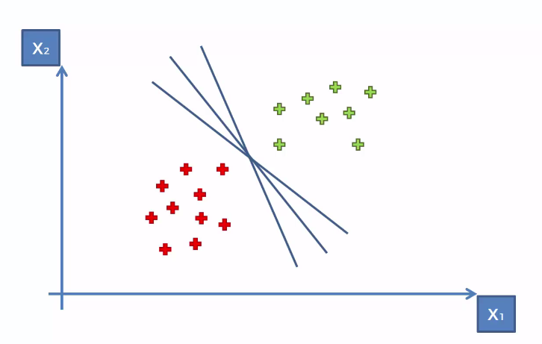
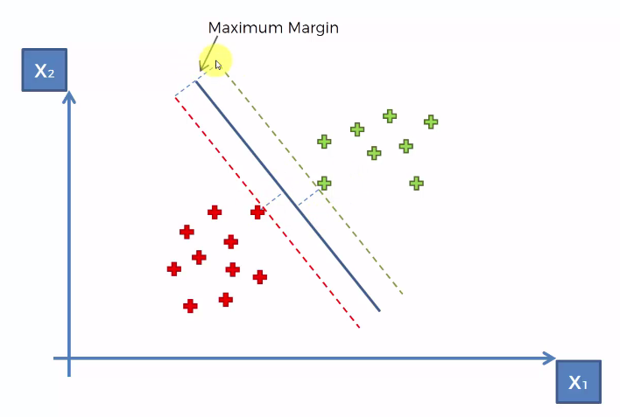
Support Vector Machine (cont…)

Slide 18
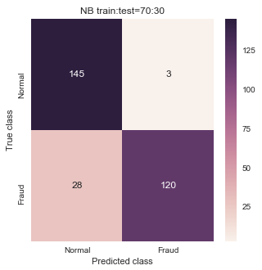
Output
Train:Test | Model | Precision | Recall | F1
70:30 | Naïve Bayes | .97 | .81 | .88
 | KNN | 0.99 | 0.83 | 0.90
 | SVM | 0.97 | 0.90 | 0.93

Slide 19
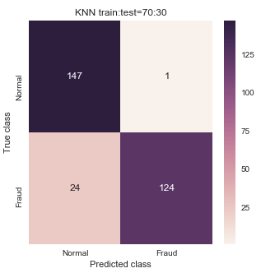

Output (cont…)

Slide 20
References
Awoyemi, John O., Adebayo O. Adetunmbi, and Samuel A. Oluwadare. "Credit card fraud detection using machine learning techniques: A comparative analysis." Computing Networking and Informatics (ICCNI), 2017 International Conference on. IEEE, 2017.
Pumsirirat, Apapan, and Liu Yan. "Credit Card Fraud Detection using Deep Learning based on Auto-Encoder and Restricted Boltzmann Machine." INTERNATIONAL JOURNAL OF ADVANCED COMPUTER SCIENCE AND APPLICATIONS 9.1 (2018): 18-25.
Carneiro, Nuno, Gonçalo Figueira, and Miguel Costa. "A data mining based system for credit-card fraud detection in e-tail." Decision Support Systems 95 (2017): 91-101.
Dal Pozzolo, Andrea, et al. "Credit card fraud detection: a realistic modeling and a novel learning strategy." IEEE transactions on neural networks and learning systems (2017).
1 Snehal Patil, 2Harshada Somavanshi et al “Credit Card Fraud Detection Using Decision Tree Induction Algorithm’’
www.Wikipedia.com

