Slide 1

D
INHERITANCE
INHERITANCE

Slide 2

D
ERROR
HANDLING

Slide 3

D
INTERFACE

Slide 4

D
GIT

Slide 5

D
LOGGER

Slide 6

D
POLYMORPHISM

Slide 8

CACHING

Slide 9

DATABASE

Slide 10

DATA
VALIDATION

Slide 11

FS ADAPTER

Slide 12
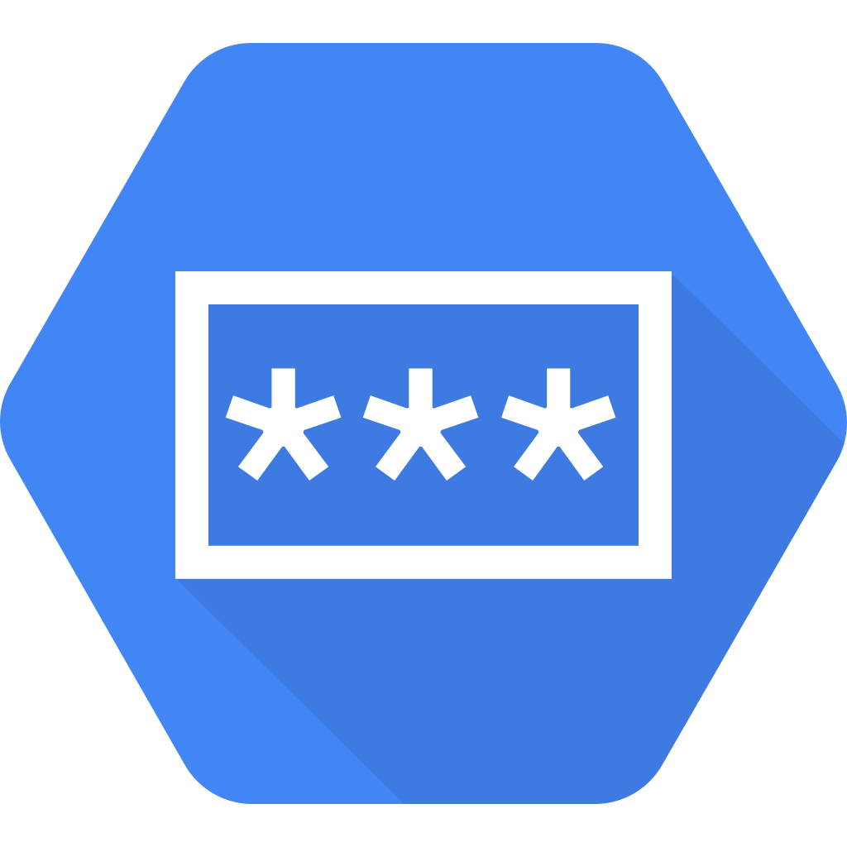
SECRETS
MANAGER

Slide 13

ORM

Slide 15

WEB

Slide 16

MOBILE

Slide 17

CLI

Slide 18

OUTPUT
VALIDATION

Slide 20

!

Slide 21

AUTHENTICATION

Slide 22

AUTHORIZATION

Slide 23

CSRF
PROTECTION

Slide 24

MIDDLEWARE

Slide 25

RATE LIMITING

Slide 26

ROUTING

Slide 28


A
DOS

Slide 29
A
CSRF

Slide 30

A
MALWARE

Slide 31

A
RANSOMWARE

Slide 32

A
SQL INJECTION

Slide 33

A
UNAUTH ACCESS

Slide 34
A
XSS

Slide 35

BUG

Slide 36

DISASTER

