Slide 1

Online Ticket Booking System

Slide 2
Group Members
Md. Abdul Ahad Rifat
ID: 2020-1-60-215
Md. Bayzid Hassan
ID: 2020-2-60-171
Sadia Alam Choity
ID: 2020-1-60-162
CSE325 – Operating Systems
Section: 01
Group: 09
Presented To: Dr. Md. Nawab Yousuf Ali
Professor
Department of Computer Science and Engineering
East-West University
Date : 3/1/2023

Slide 3
What is Online Ticket Booking System?
Online Ticket Booking means the sale of tickets to events via online. Where customer get chance to show the number of tickets are available as well as they are capable to purchase a ticket by their own. On the other hand it helps the seller to sell more tickets and it makes works more efficient as well as it provides various kinds of features, functionalities, promotion, marketing and advertising.

Slide 4
How we solve our problem?
Here we try to build a online ticket booking system for Star Cineplex. Star Cineplex is the first multiplex cinema theatre in Bangladesh. It also gives its viewers the facility to check available tickets and book shows via online ticket booking system. Here it create certain number of threads to sell all available tickets.
Here we are use some technique to solve our program
POSIX threads
Mutex locks
Semaphores

Slide 5
Discussion
Threads
A thread is a unit of execution on concurrent programming. Multithreading is a technique which allows a CPU to execute many tasks of one process at the same time. These threads can execute individually while sharing their resources.
Mutex Locks
Mutex lock in OS is essentially a variable that is binary nature that provides code wise functionality for mutual exclusion. At times, there maybe multiple threads that may be trying to access same resource like memory or I/O etc. To make sure that there is no overriding. Mutex provides a locking mechanism.
Semaphores
A semaphore is an integer variable, shared among multiple processes. The main aim of using a semaphore is process synchronization and access control for a common resource in a concurrent environment.

Slide 6
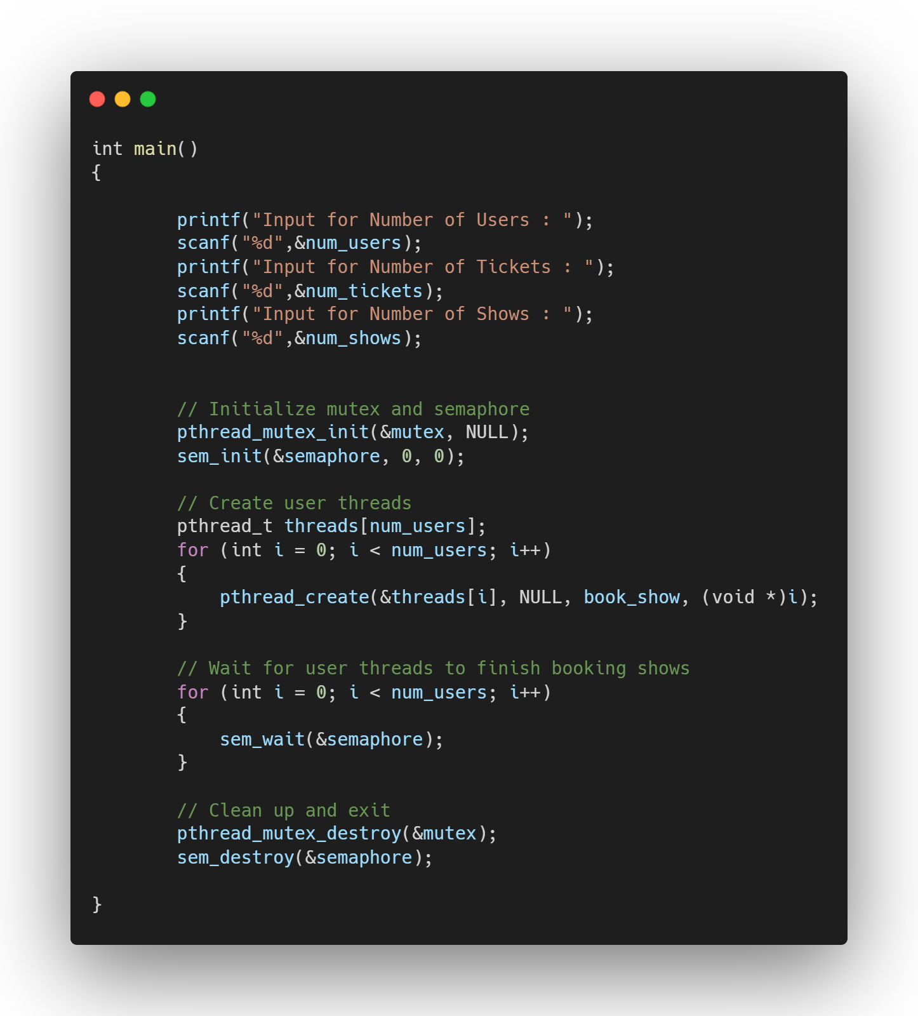
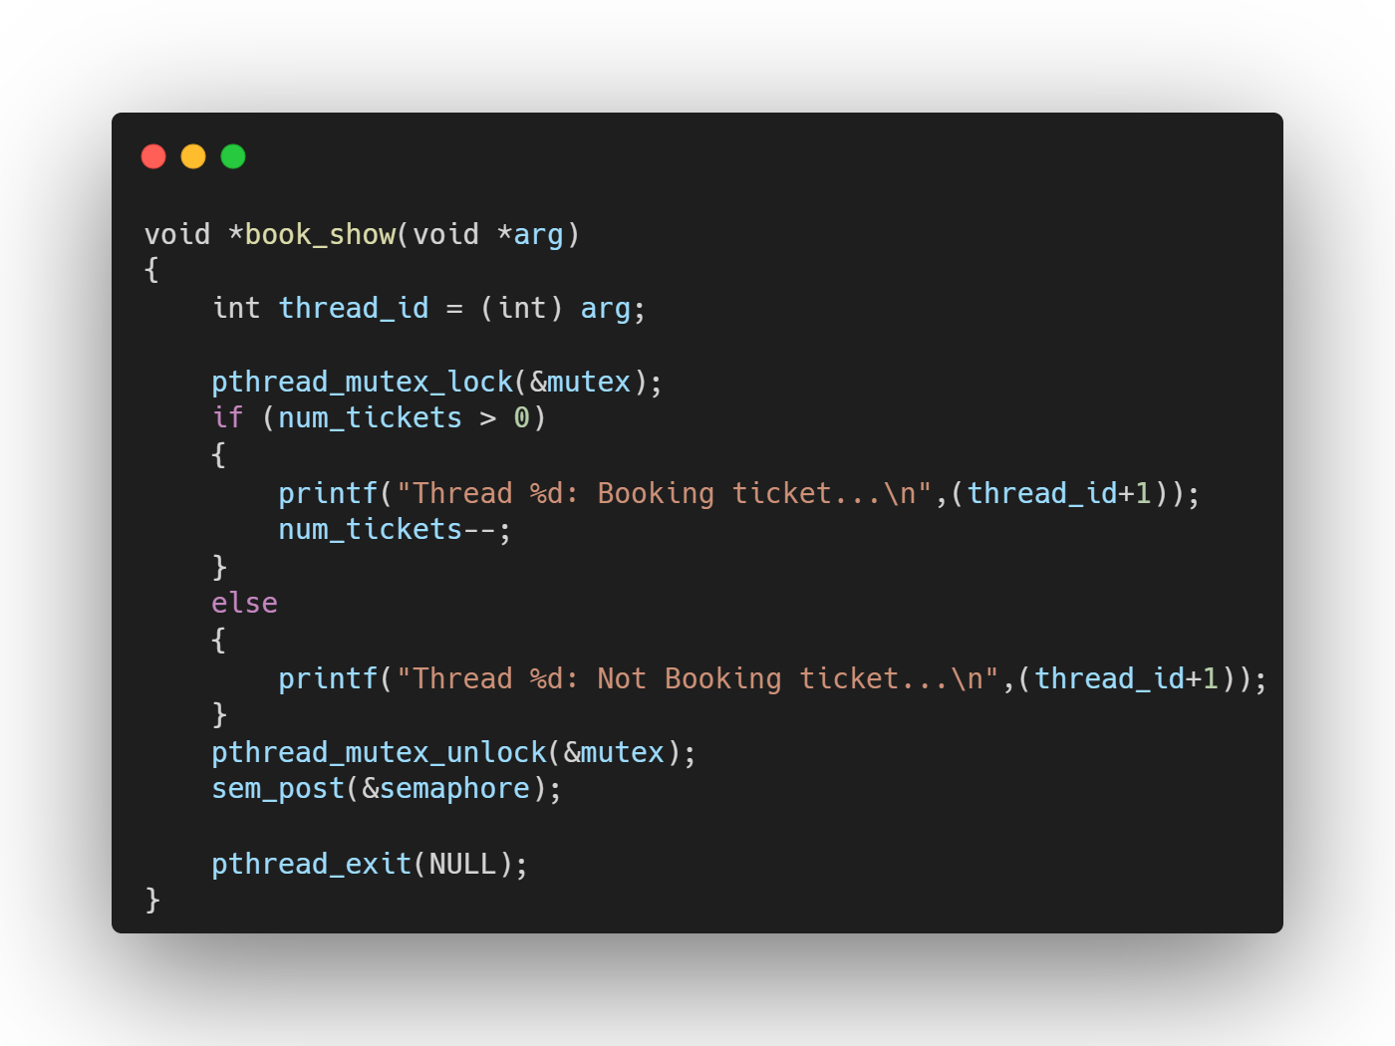
Pseudocode

Slide 7
Code Explanation
This C program creates multiple threads, each representing a user trying to book a ticket for a show. It uses a mutex lock to ensure that only one thread can modify the number of available tickets at a time, and a semaphore to synchronize the threads and ensure that they don't exit untilThe program first initializes the mutex and semaphore, then creates the user threads and waits for them to finish. Finally, it cleans up and exits.
The user threads execute the book_show function, which attempts to book a ticket by first acquiring the mutex lock and then checking if there are any tickets available. If there are, it books a ticket and decrements the number of available tickets. Otherwise, it prints a message saying that it was unable to book a ticket. The thread then releases the mutex lock and increments the semaphore before exiting.
The main thread waits for all of the user threads to finish by calling sem_wait for each thread. This ensures that all of the threads have completed their work before the main thread cleans up and exits all of them have finished booking tickets.
.

Slide 8
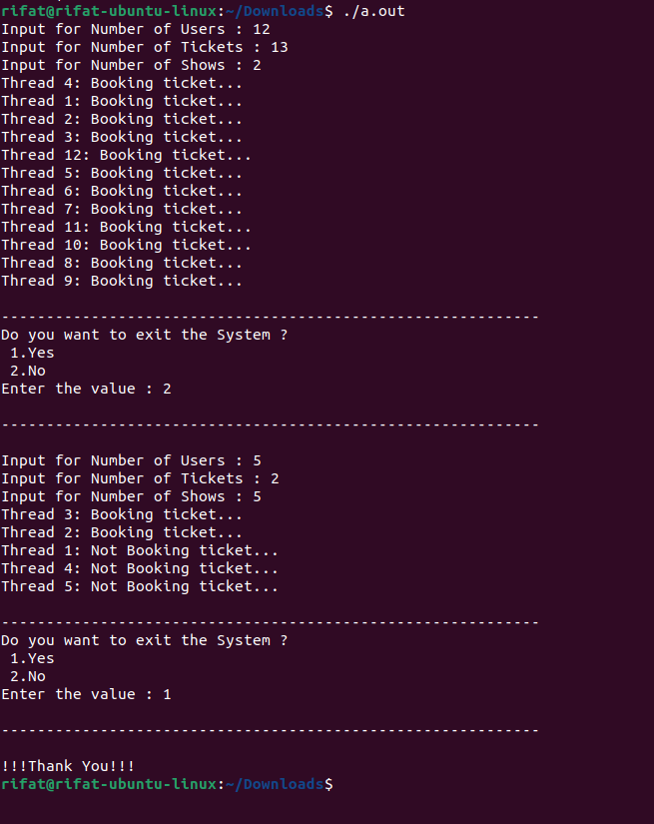
Output

Slide 9
Thank You

