Slide 1
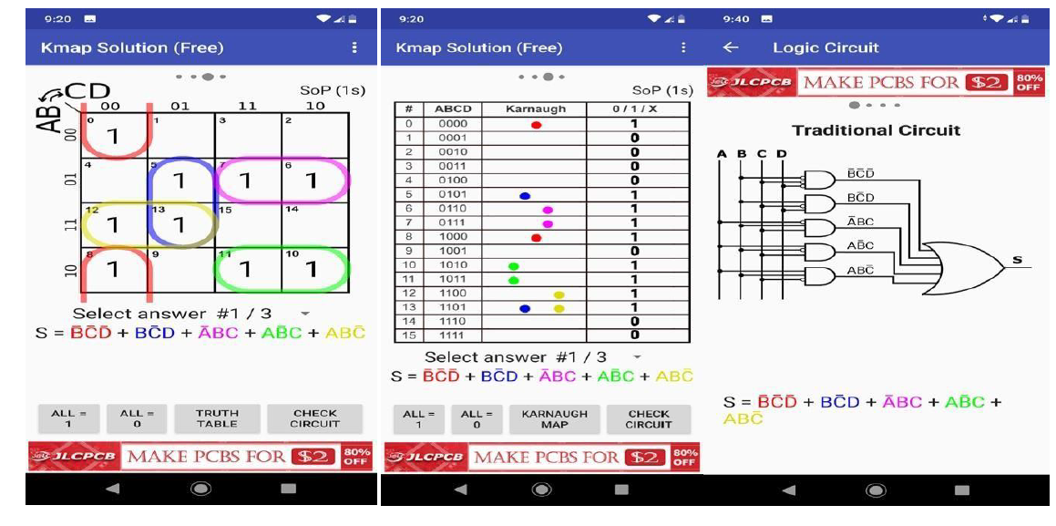
How to solve for logic expression ?

Slide 2
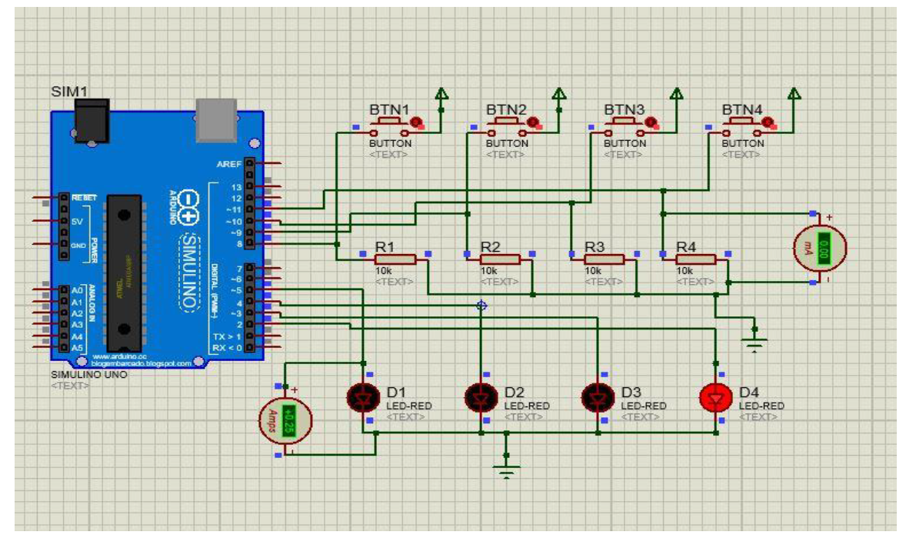
Example input-output interfacing to arduino board in proteus

Slide 3
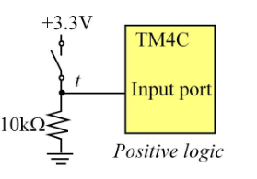
Input power consumption calculation
VCC is sometimes known as VDD
Case- Input high : 1
Current flow I through external resistor: VCC /R
Battery power consumption : VCC*I
Case-Input low: 0
Microcontroller port input leakage current I =20 micro ampere
Battery power consumption : VCC*I
VCC
R
https://electronics.stackexchange.com/questions/393863/problems-with-input-leakage-current-in-a-microcontroller

Slide 4
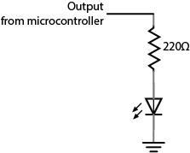
Output power consumption calculation
VCC is sometimes known as VDD
VCC
Case- Output high : 1
Current flow I through external resistor: VCC /R
Battery power consumption : VCC*I
Case-Input low: 0
Current flow I through external resistor I =0 micro ampere
Battery power consumption : VCC*I
R
LED

Slide 5
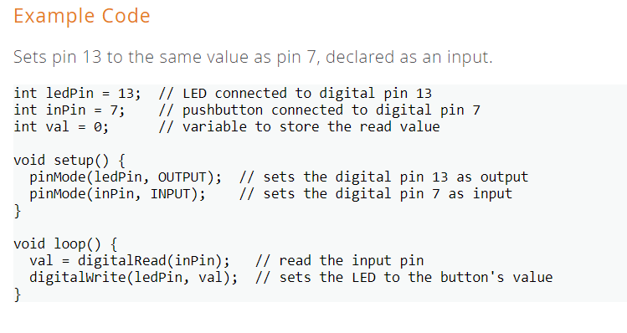
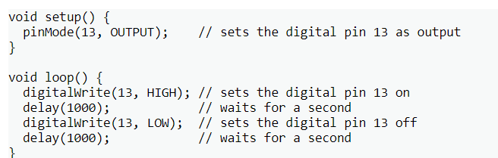
Arduino hints for pin assignment and pin read
https://www.arduino.cc/reference/en/language/functions/digital-io/digitalread/
https://www.arduino.cc/reference/en/language/functions/digital-io/digitalwrite/

Slide 6
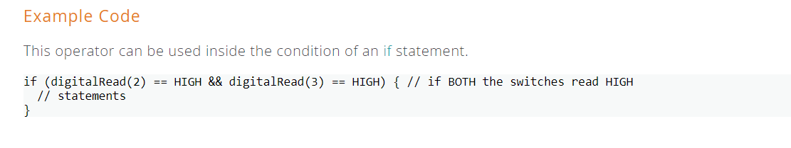
Arduino hints for pin read
https://www.arduino.cc/reference/en/language/structure/boolean-operators/logicaland/

Slide 7
Loading Hex file into arduino in proteus
1.
Adding arduino library
https://maker.pro/arduino/projects/how-to-simulate-arduino-projects-using-proteus
2.
Loading hex file in proteus environment
https://www.instructables.com/How-to-Simulate-Arduino-in-Proteus/

Slide 8
Trace maximum power consumption condition : Input + Output
Input |  |  |  | Output
I3 | I2 | I1 | I0 | O3 | O2 | O2 | O1
0 | 0 | 0 | 0 | 1 | 1 | 0 | 0
1 | 0 | 0 | 0 | 1 | 1 | 0 | 1
0 | 1 | 0 | 0 | 0 | 1 | 1 | 0
1 | 1 | 0 | 0 | 1 | 1 | 0 | 0
0 | 0 | 1 | 0 | 1 | 0 | 1 | 1
1 | 0 | 1 | 0 | 1 | 0 | 1 | 0
0 | 1 | 1 | 0 | 1 | 0 | 1 | 1
1 | 1 | 1 | 0 | 0 | 0 | 0 | 0
0 | 0 | 0 | 1 | 0 | 0 | 0 | 1
1 | 0 | 0 | 1 | 0 | 0 | 1 | 1
0 | 1 | 0 | 1 | 1 | 0 | 1 | 0
1 | 1 | 0 | 1 | 1 | 1 | 1 | 0
0 | 0 | 1 | 1 | 0 | 1 | 0 | 0
1 | 0 | 1 | 1 | 1 | 1 | 0 | 0
0 | 1 | 1 | 1 | 1 | 1 | 1 | 0
1 | 1 | 1 | 1 | 1 | 1 | 0 | 0

Slide 9
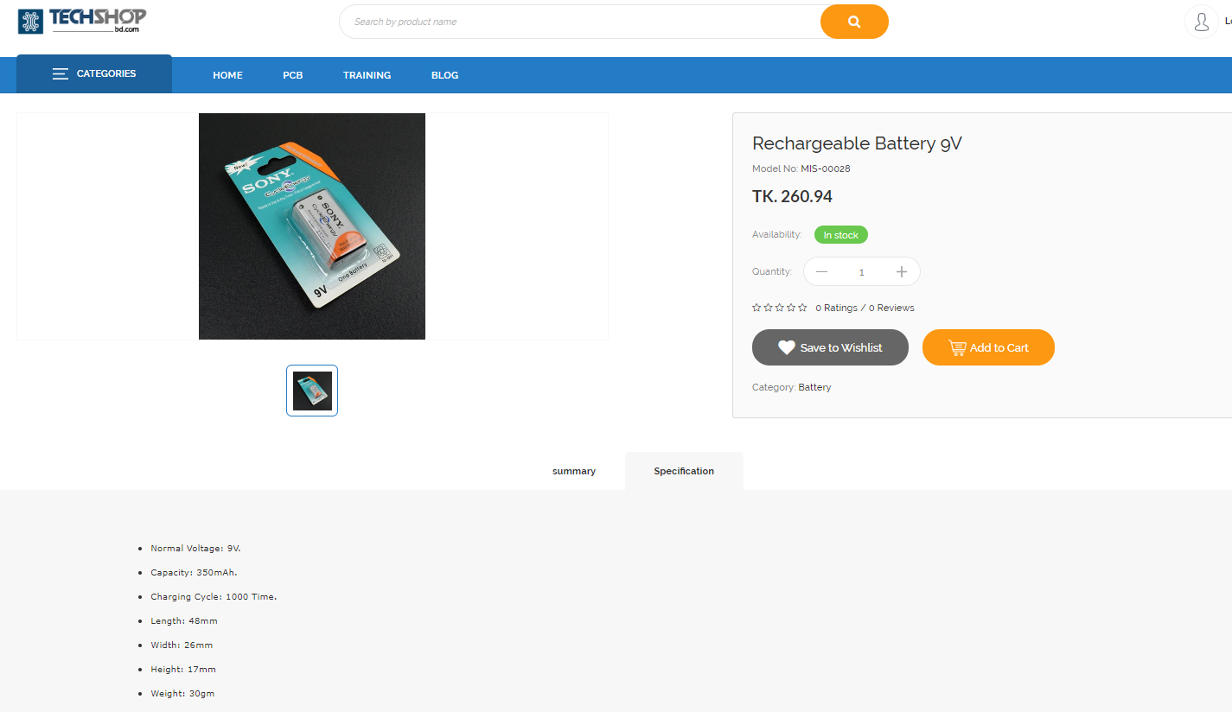
Rechargeable battery

Slide 10
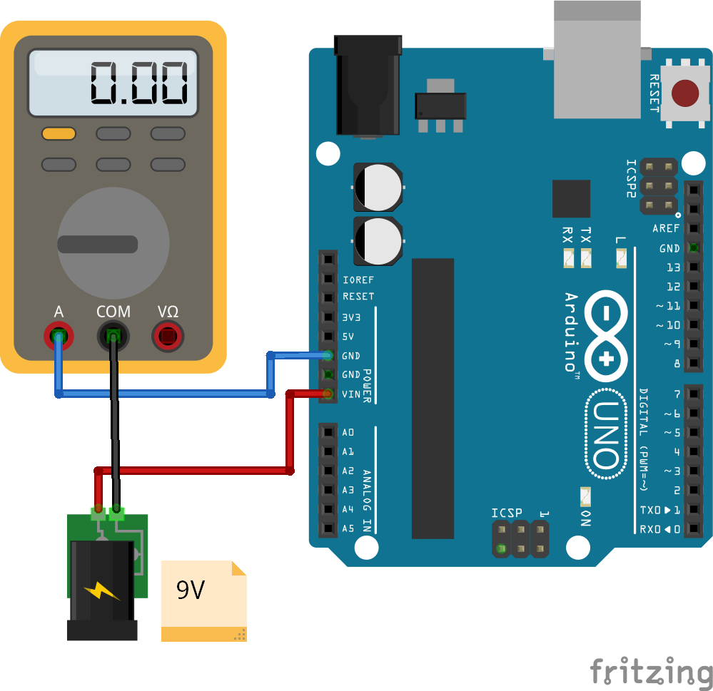
Power consumption measurement

Slide 11
Power consumption measurement
3.3V regulated output
5V regulated output
2 GND pins
Vin pin: this pin can be used in 2 different ways:
either as a voltage supply input (instead of using the power plug or the USB); the input voltage should be in 7-12V range and will be regulated internally (by the board circuits) to 5V
or an output supply voltage (if you plugged voltage supply through the power plug or the USB plug) that is a "copy" of the voltage input through the power plug or USB plug

Slide 12
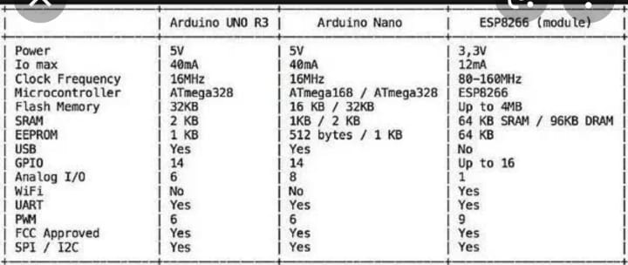
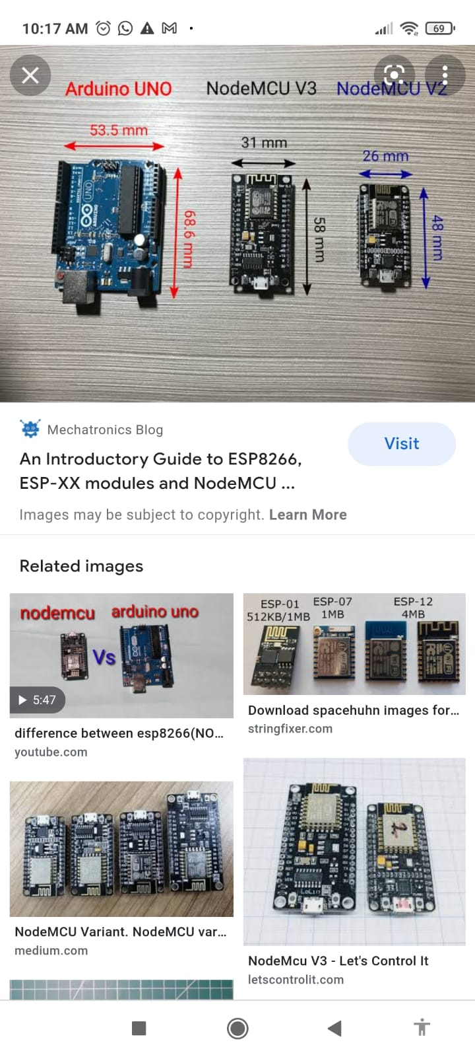
Comparison among boards

Slide 13
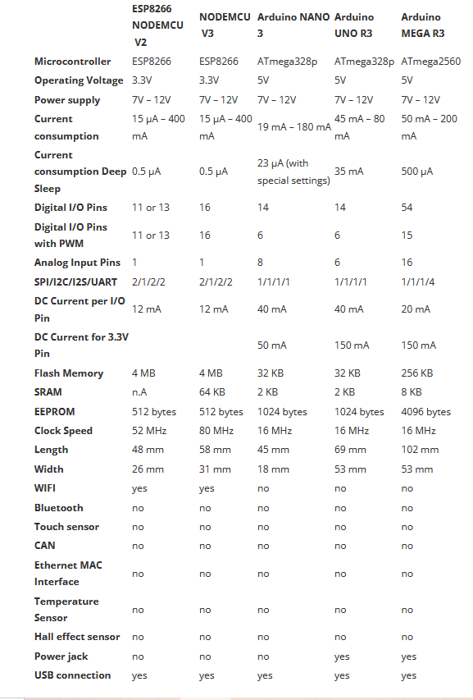
Detailed Comparison among boards

Slide 14
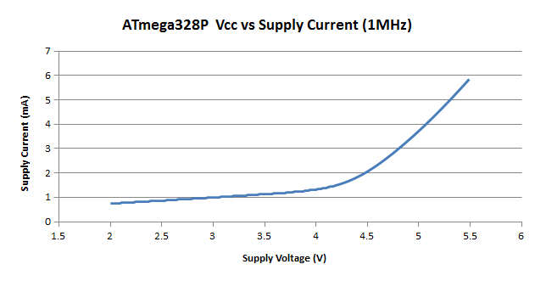
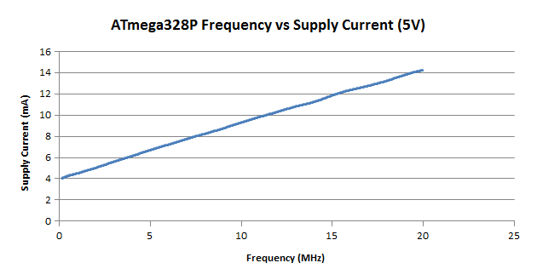
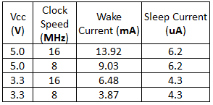
CPU draws is a function of voltage (v), frequency (f), and capacitance (c )
P = v² x f x c
The capacitance, or the amount of stored electrical charge, that is switched per each clock transition is a relatively fixed value depending on the design.

Slide 15
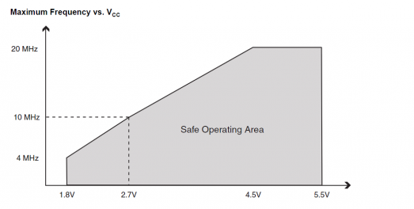
Higher voltages makes faster transistors (stronger electric fields for moving electrons).
Voltage is the main determinant of power usage and heating. The voltage required for stable operation is determined by the frequency at which the circuit is clocked, and can be reduced if the frequency is also reduced. Dynamic power alone does not account for the total power of the chip, however, as there is also static power, which is primarily because of various leakage currents

Slide 16
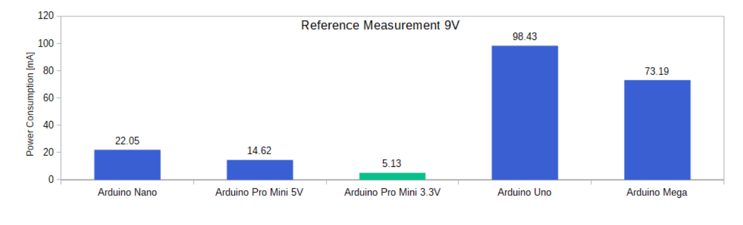
Example demonstration of power consumption variation across boards

Slide 17
Tasks to be covered
1. Group formation link
https://docs.google.com/spreadsheets/d/1nj99CnDQLup6d4v8O4bDrUrwrjq2Ycl4BxUiTrU12bE/edit?usp=sharing
A group can have maximum 4-6 students.
2. Repeat from group 1 , if all groups are occupied
3. The submission will contain a single pdf with cover page filled up with all details and google drive link to video showing the operation (at least 5 cases) in proteus and hardware (if available). Unnecessarily materials submitted can cause rejection of the submission.

Slide 18
Tasks to be covered
4. Final report should answer the following questions specifically: (mandatory) for each board
-what is the clock frequency of the microcontroller used ?
- what is the data bus width of the microcontroller used ?
- what is the size of your hex file generated ? Attach the hex codes in your report.
-Can the project be implemented by using interrupt ?
-Is the main routine required to be an infinite loop ? provide explanation in favor of your answer
- Is there any difference between level triggered and edge triggered operation for the given project ?
-Is the project referring encryption or decryption from input to output ?
5. The project will focus on comparison of at least two different boards in terms of power consumption at a fixed bias voltage of 9 V . Following has to be covered (mandatory)
Maximum and minimum power consumption sequence for a specific bit sequence for a specific board. In case of multiple cases, report all. exclusively comment on the input-output pair that will draw the maximum power assuming a single power supply is used for the system (compulsory)
Discussion on variation of power consumption based on the technical parameters provided in slide/page 14-15
Special bonus:
Comparison of sleep mode power consumption for the application with and without using a hardware interrupt in specific board (any one will suffice)
https://create.arduino.cc/projecthub/rafitc/interrupts-basics-f475d5

Slide 19
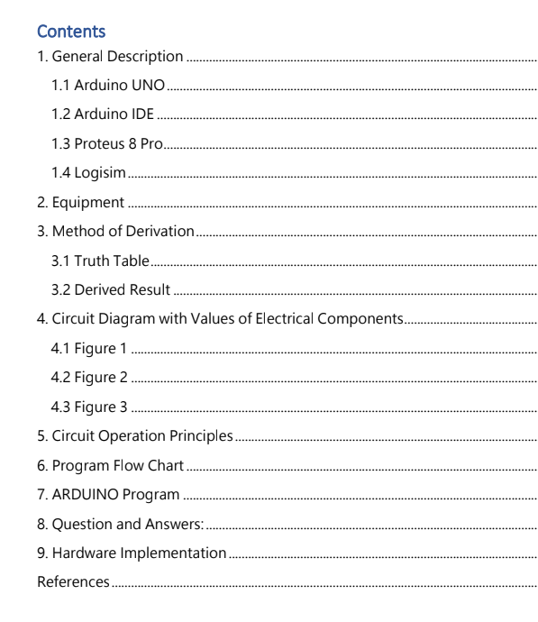
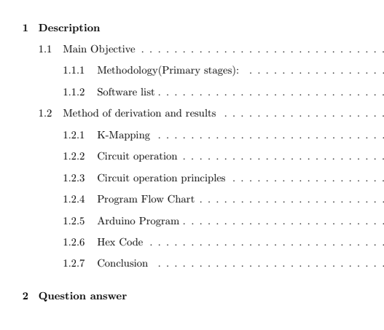
Tentative Sections to be covered in report

