Slide 1
A Chatbot for Psychiatric Counseling in Mental Healthcare Service Based on Emotional Dialogue Analysis and Sentence Generation
Kyo-Joong Oh, DongKun Lee, ByungSoo Ko, Ho-Jin Choi
School of Computing, Korea Advanced Institute of Science and Technology (KAIST), Daejeon, Republic of Korea

Slide 2
Presented By ( Group Number : 5 )
SL
NAME
ID
01
Mehrin Afroz
21241078
02
Tahseen Anzum Baptee
22141041
03
Rifat Sarker Aoyon
22341043
04
Yamin Ara
19301187

Slide 3
Introduction
Large amount of emotional-labeled data is used to train various emotion classification models.
Emotion identification techniques are still being used in only a few applications.
Self-diagnosis and basic consultation services must be encouraged in order to motivate specialist medical institutions to treat patients.
One-on-one interactions can help individuals with mental illnesses feel less isolated.
When an unintentional mental condition occurs, the service alerts the person.
The chat bot cannot adapt to long-term mental disease, because there is no continuous observation.
Most significant aspect of psychoanalytic treatment is linguistic engagement.
The conversational service causes the patient's self-awareness, personality, and conduct to alter in a healthy way.

Slide 4
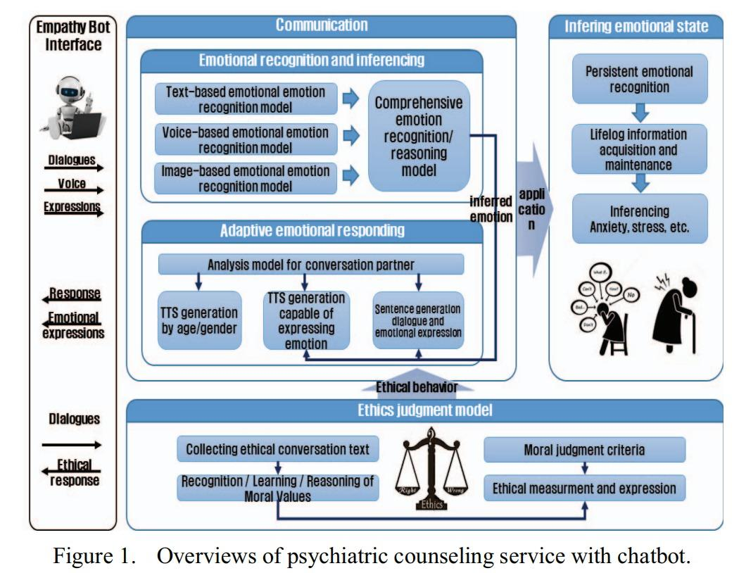
Introduction
We use the chat assistant platform to quickly obtain counseling services.
chat bot recognizes the user's current emotions and communicates the results to the conversational service.
the service will provide important information to boost mental health as well as goods to help you feel better.

Slide 5
Background
Necessity of developing multi-modal method that can obtains considering the strength of each modality, and various information at the same time.
The soft attention mechanism was used to temporally align and fuse the audio and visual streams at the feature level.
Analyzing a speaker's sentiment in online videos containing movie reviews automatically.
A framework based on deep CNN committee machines and its application to robust FER
One kind of intelligent assistant called MoSHCA

Slide 6
Steps for making a chatbot for Psychiatric Counseling
NATURAL LANGUAGE UNDERSTANDING
EMOTIONAL DIALOGUE ANALYSIS
SENTENCE GENERATION FOR PSYCHIATRIC COUNSELING
1
2
3

Slide 7
NATURAL LANGUAGE UNDERSTANDING
Understanding Sentence Entailment
1
Classification of Sentence Domain and Utterance Intention
2
Spatial-Temporal Context Analysis
3

Slide 8
EMOTIONAL DIALOGUE ANALYSIS
Defining Emotional Expression Model to Categorize
Emotion Recognition and Inference
Step 1
Step 3
Step 2
Step 4
Collecting Training Data for Emotion Recognition
Continuous Emotional Monitoring

Slide 9
SENTENCE GENERATION FOR PSYCHIATRIC COUNSELING
Emotional expression and communications
Psychiatric intervention
Response generation
Ethical response and behavior

Slide 10
Future Aspirations

Slide 11


