Slide 1




IOT Weather Sensor
Submitted by – Group B2.7
Ataher Sams
1606105
Rifat Bin Rashid
1606117
Md. Tanvir Raihan
1606118
Sabit MD Abdal
1606119

Slide 2
Outline
Summary
Background
Methods
Simulation (Arduino & STMCUBE)
PCB layout and 3d rendering
Photo Gallery
Future Outlook

Slide 3
Summary
The implemented system consists of a Arduino/Microprocessor as a main processing unit for the entire system and all the sensor (temperature, humidity and Pressure) and devices can be connected with the microcontroller. The sensors can be operated by the microcontroller to retrieve the data from them.
This processes the analysis with the sensor data and updates it to the internet through using Wi-fi through blynk server.

Slide 4
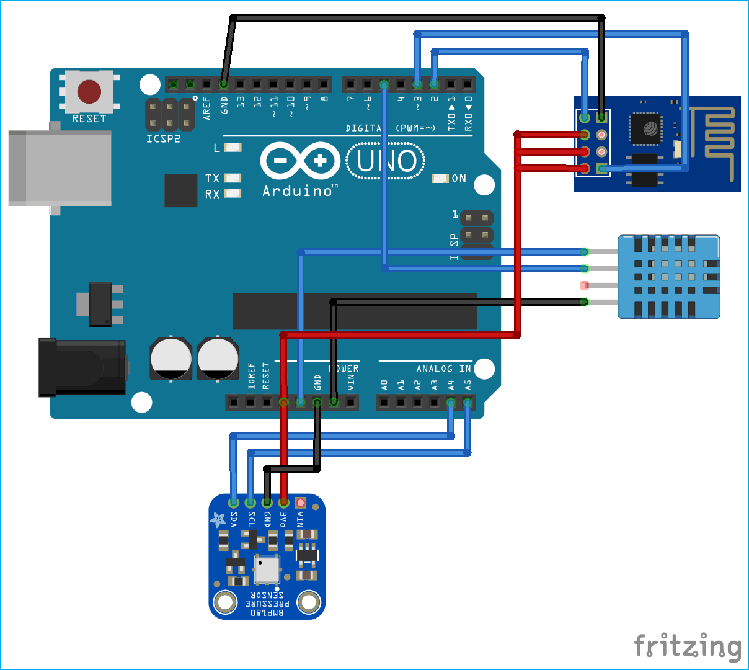
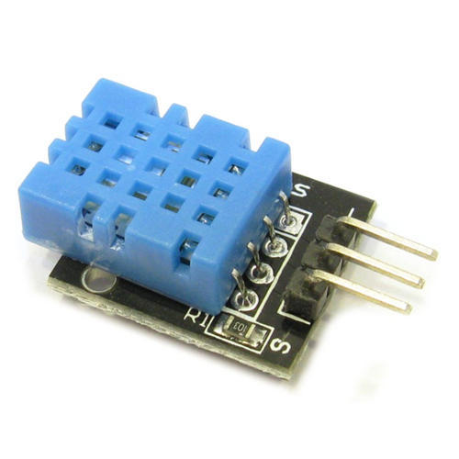
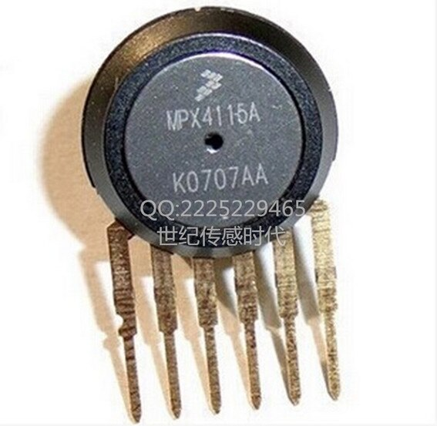
Background
The main goal of this project is to design and build an effective monitoring system in which the required parameters are monitored remotely over the internet, the data collected from the sensors is stored in the cloud, and the estimated trend is projected on a mobile device. This project proposes a solution for monitoring temperature, humidity, rain, LDR and pressure in the environment, as well as any parameter value crossing its threshold value ranges, utilizing a wireless embedded computing system. In addition, the solution offers sophisticated remote monitoring for a specific area of interest.

Slide 5
Used Components
Arduino Uno | Arduino Uno is a microcontroller board based on the ATmega328P. It has 14 digital input/output pins (of which 6 can be used as PWM outputs), 6 analog inputs, a 16 MHz quartz crystal, a USB connection, a power jack, an ICSP header and a reset button.
STM32F103C6 | STM32F103C6 is an ARM 32-bit Cortex-M3 Microcontroller
DHT11 | DHT11 is a low-cost digital sensor for sensing temperature and humidity. This sensor can be easily interfaced with any micro-controller such as Arduino, Raspberry Pi etc to measure humidity and temperature instantaneously.
MPX4115 | The MPX4115 series is designed to sense absolute air pressure in an altimeter or barometer (BAP) applications.
Blynk library | Blynk Library is an extension that runs on your hardware. It handles connectivity, device authentication in the cloud, and commands processing between Blynk app, Cloud, and hardware.
Virtual Serial Port Emulator | Used for connecting to internet.
COMPIN | COMPIM is used to model physical COM interfaces in Proteus. It works by capturing and buffering serial signals which it then presents to the electrical circuit.
Rain Sensor (HL83) | The rain sensor is used to detect water.
LDR sensor | LDRs (light-dependent resistors) are used to detect light levels, for example, in automatic security lights.

Slide 6
Methods
Method 1:
ARDUINO
Method 2:
STMCUBE32

Slide 7
Methods
Algorithms
Reading temperature and humidity value through DHT sensor
Initializing Blynk Module
Reading pressure value from MPX4115 & Rain sensor value
Sending the values to the server through virtual serial port emulator every 1000 ms interval

Slide 8
Reference
https://www.instructables.com/Esay-IoT-Weather-Station-With-Multiple-Sensors/
https://www.theengineeringprojects.com/2018/07/rain-sensor-library-for-proteus.html?fbclid=IwAR2edI7tgtulZPBXtBUD5DgVVg0YkzwnXzOCDkp3H2i2BOplUq6G7m501Lo
https://www.mouser.com/datasheet/2/758/DHT11-Technical-Data-Sheet-Translated-Version-1143054.pdf
https://www.arduino.cc/reference/en/libraries/blynk/
https://www.st.com/en/microcontrollers-microprocessors/stm32f103c6.html
https://www.youtube.com/watch?v=-lcrrRrKdFg&list=PLfIJKC1ud8gga7xeUUJ-bRUbeChfTOOBd

Slide 9
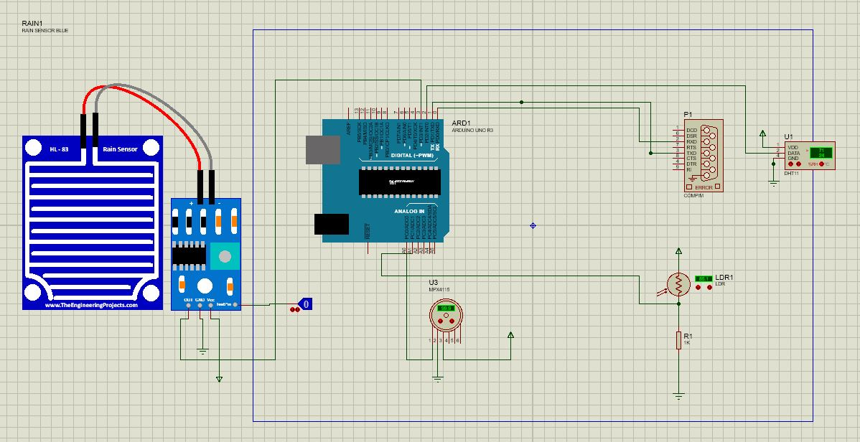
Simulation (Arduino) - Circuit
DHT11
ARDUINO
COMPIN
Rain
Sensor
LDR
MPX4115

Slide 10
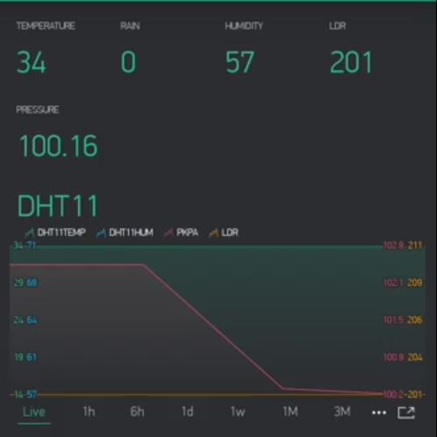
Simulation (Arduino) - Blynk App
LDR
Temperature
Rain
Humidity
Pressure
Realtime Plot

Slide 11
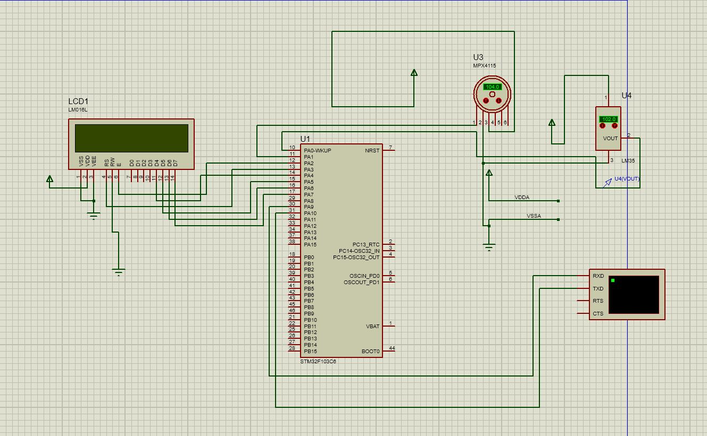
Simulation (STMcube32)

Slide 12
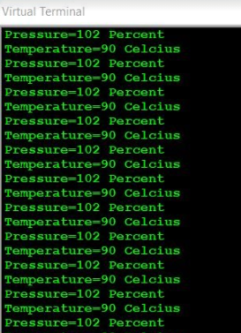
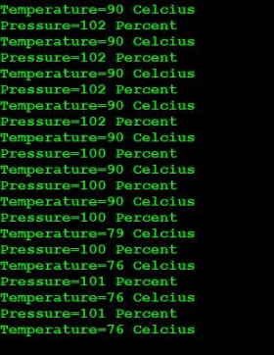
Output (STMcube32)

Slide 13
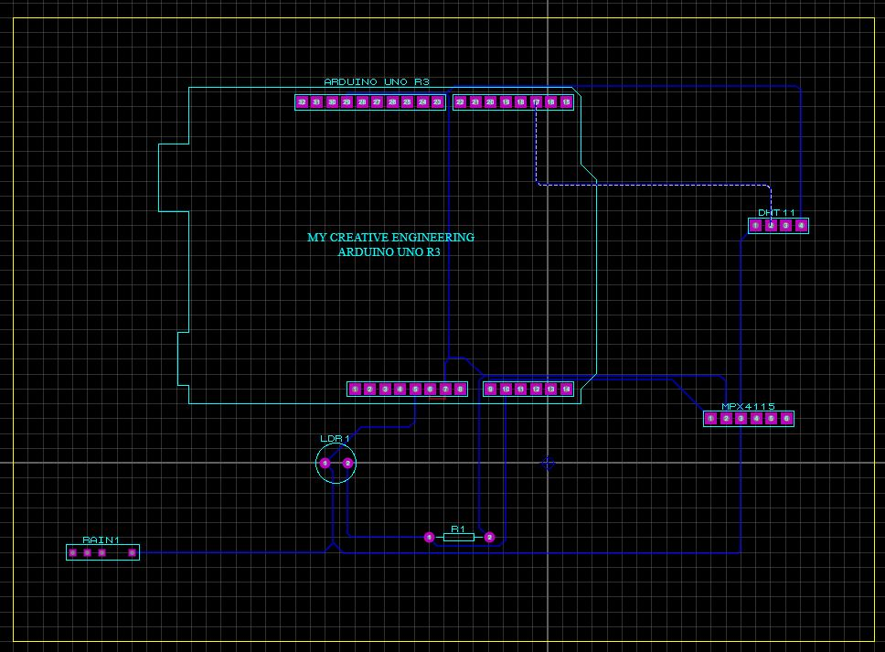
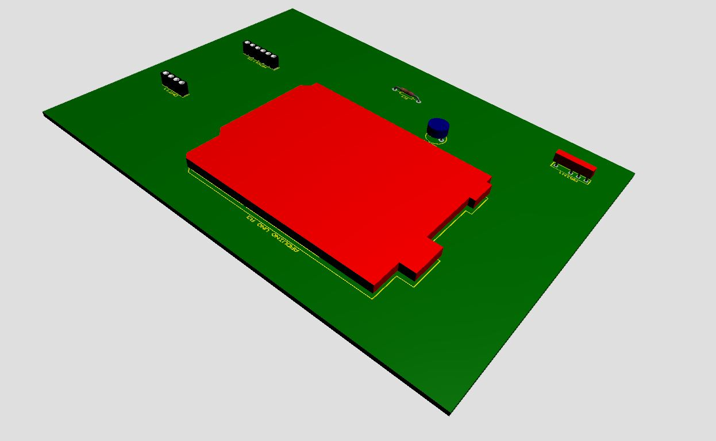
PCB Layout
PCB Layout
3D Visualization of PCB Layout

Slide 14
Future Outlook
We can do a hardware implementation of this project with GSM that can be used in household settings.
An alarm can be added to the circuit to notify the user in case of excess smoke conditions i.e. Smoke alarm.
More sensors like dew point temperature, altitude, light intensity can be added with the device according to necessity to further improve the utility of the system.

Slide 15
ADDITIONAL SLIDES
Slides after this must be present in the PPT file, however, you don’t need to show them in the video

Slide 16
References
https://www.instructables.com/Esay-IoT-Weather-Station-With-Multiple-Sensors/
https://www.theengineeringprojects.com/2018/07/rain-sensor-library-for-proteus.html?fbclid=IwAR2edI7tgtulZPBXtBUD5DgVVg0YkzwnXzOCDkp3H2i2BOplUq6G7m501Lo
https://www.mouser.com/datasheet/2/758/DHT11-Technical-Data-Sheet-Translated-Version-1143054.pdf
https://www.arduino.cc/reference/en/libraries/blynk/
https://www.st.com/en/microcontrollers-microprocessors/stm32f103c6.html
https://www.youtube.com/watch?v=-lcrrRrKdFg&list=PLfIJKC1ud8gga7xeUUJ-bRUbeChfTOOBd

Slide 17
Bill of Materials
Arduino Uno
DHT11
MPX4115
Blynk library
Virtual Serial Port Emulator
COMPIN

Slide 18
Software Used
Proteus 8.12
Arduino IDE
STMCUBE32 IDE
BLYNK APP

Slide 19
Source Codes
1
2
#include<Wire.h>
#include <BlynkSimpleStream.h>
#include <DHT.h>
#define kpa2atm 0.00986923267
BlynkTimer timer;
char auth[]="BmvLmGz6n9ttWSyOYk12pvKhUS8u6NAx";
DHT dht1(2,DHT11);
// pin defs
int pressurePin = 0;
int rainPin=3;
int ldrPin=1;
// variables
int val;
float pkPa; // pressure in kPa
float pAtm; // pressure in Atm
int ldr;
float light;
void sendToBlynk(){
int t4=dht1.readTemperature();
int h4=dht1.readHumidity();
int hic4=dht1.computeHeatIndex(t4,h4,false);
val = analogRead(pressurePin);
pkPa = ((float)val/(float)1023+0.095)/0.009;
pAtm = kpa2atm*pkPa;
int rain=digitalRead(rainPin);
ldr = analogRead(ldrPin);
Blynk.virtualWrite(V1,t4);
Blynk.virtualWrite(V2,h4);
Blynk.virtualWrite(V3,pkPa);
Blynk.virtualWrite(V4,rain);
Blynk.virtualWrite(V5,ldr);
delay(500);
}
void setup() {
// put your setup code here, to run once:
Serial.begin(9600);
Blynk.begin(Serial,auth);
dht1.begin();
pinMode(rainPin,OUTPUT);
timer.setInterval(1000L, sendToBlynk);
}
void loop() {
// put your main code here, to run repeatedly:
Blynk.run();
timer.run();
delay(1000);
}

Slide 20
Difficulties
Due to current covid situation, we could not implement the project in hardware. As the group members live in different parts of the country, we could not meet in person to build the project using hardware materials.
We tried to implement our whole setup in Stm32cube ide, but failed to do so because of some incompatibility with proteus.The STM32F103C6 failed to cope up with the sensor’s frequency range .
We tried to generate stm32cube.exe file in arduino, but the arduino ide cannot generate the hex file for stm32. The generated .bin and .elf file was not working properly in proteus as they are based on different bootlogs.

