Slide 1
Week 12 Recitation
Op-Amp & Review
Rifat Bin Rashid
Teaching Assistant
Dept. of ECE, Rutgers University

Slide 2
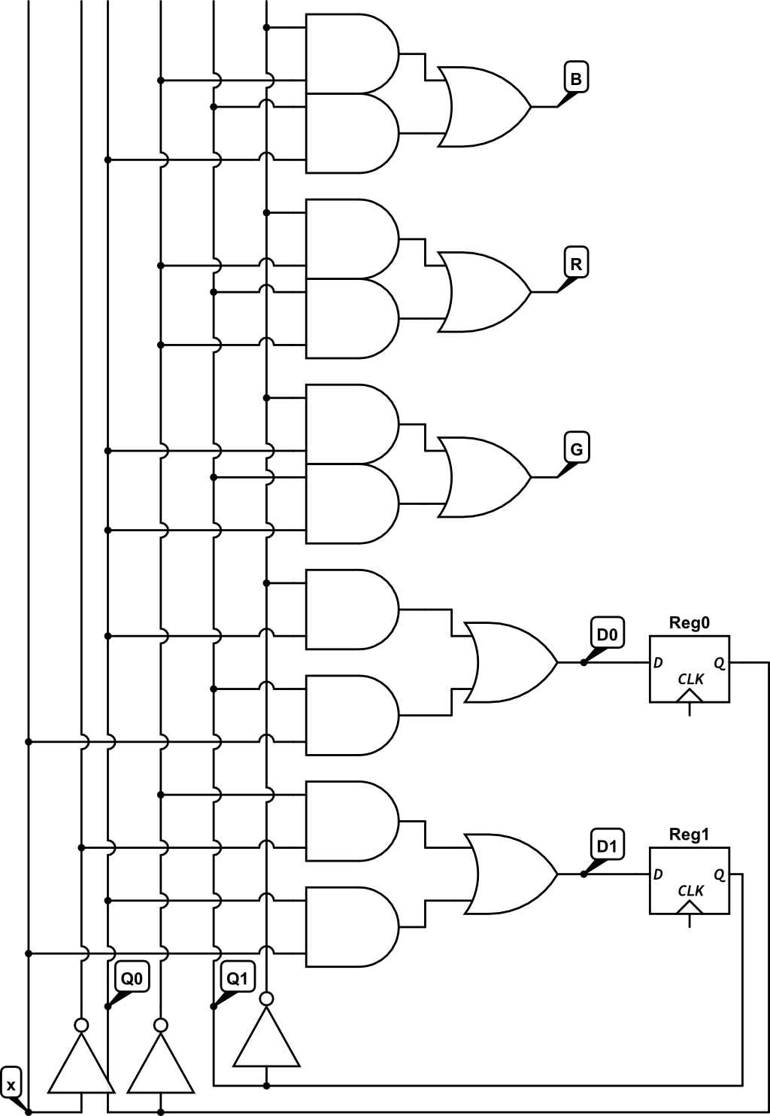
(20 points) Examine the following schematic. Label each AND gate with the term it computes
(ex. Q1’Q0X’) Then fill in the equation of each variable. Then complete the truth table
D1 = ___________________________
D0 = ___________________________
R = ____________________________
G = ____________________________
B = ____________________________
 | Q₁ | Q₀ | X | D₁ | D₀ | R | G | B
 | 0 | 0 | 0
 | 0 | 0 | 1
 | 0 | 1 | 0
 | 0 | 1 | 1
 | 1 | 1 | 0
 | 1 | 1 | 1
 | 1 | 0 | 0
 | 1 | 0 | 1

Slide 3
(20 points) Examine the following schematic. Label each AND gate with the term it computes
(ex. Q1’Q0X’) Then fill in the equation of each variable. Then complete the truth table
D1 = ___________________________
D0 = ___________________________
R = ____________________________
G = ____________________________
B = ____________________________
 | Q₁ | Q₀ | X | D₁ | D₀ | R | G | B
 | 0 | 0 | 0
 | 0 | 0 | 1
 | 0 | 1 | 0
 | 0 | 1 | 1
 | 1 | 1 | 0
 | 1 | 1 | 1
 | 1 | 0 | 0
 | 1 | 0 | 1

Slide 4
X (Input) | Q1 (Current State) | Q0 (Current State) | D1 (Next Q1) | D0 (Next Q0)
0 | 0 | 0 | 1 | 0
0 | 0 | 1 | 0 | 1
0 | 1 | 0 | 1 | 0
0 | 1 | 1 | 0 | 0
1 | 0 | 0 | 0 | 0
1 | 0 | 1 | 1 | 1
1 | 1 | 0 | 0 | 1
1 | 1 | 1 | 1 | 1

Slide 5
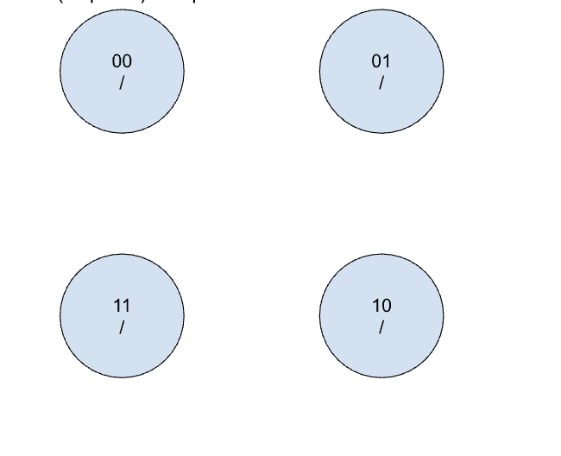
(10 points) Complete the state machine based on the truth table above.

Slide 6
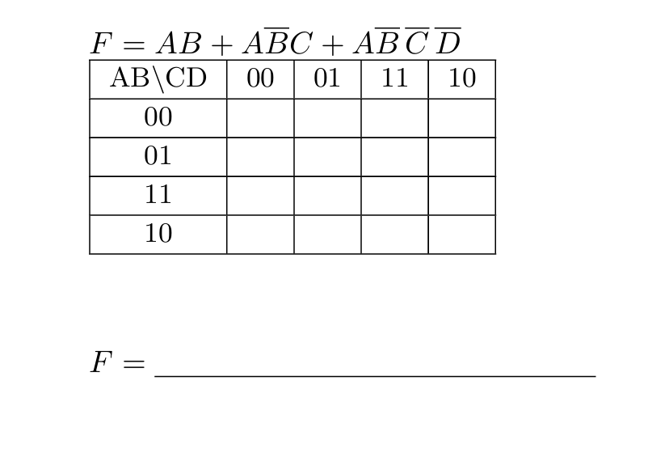
Timing Hazard
Adjacent 1’s should belong to the same group/chain.
AB \ CD | 00 | 01 | 11 | 10
00 | 0 | 0 | 0 | 0
01 | 0 | 0 | 0 | 0
11 | 1 | 1 | 1 | 1
10 | 1 | 0 | 1 | 1
AC + CD + B’C

Slide 7
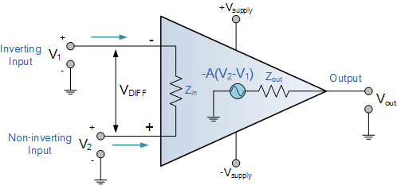
Operational Amplifiers

Slide 8
Operational Amplifiers
Key Characteristics:
Differential Inputs: Two inputs, one non-inverting (+) and one inverting (-).
High Gain: Amplifies the voltage difference between inputs by a huge factor (e.g., 10,000+).
High Input Impedance: Draws very little current from the input signals.
Low Output Impedance: Can supply current to the output with minimal voltage loss.
Single-Ended Output: Produces one output voltage.

Slide 9
Operational Amplifiers
How It Works:
The output voltage V_{out} is approximately the gain (A) times the voltage difference between the inputs V_{in+} and V_{in-}
              V_{out}=A (V_{in+}-V_{in-})
In negative feedback (most common), the op-amp adjusts its output to try and make the voltage at the inverting input equal to the non-inverting input, simplifying analysis.
Common Applications:
Amplifiers: Inverting, non-inverting, differential.
Comparators: Comparing two voltages.
Filters: Active filters for frequency selection.
Signal Conditioning: Amplifying sensor signals, noise reduction.
Mathematical Functions: Summing, subtracting, integrating, differentiating.

Slide 10
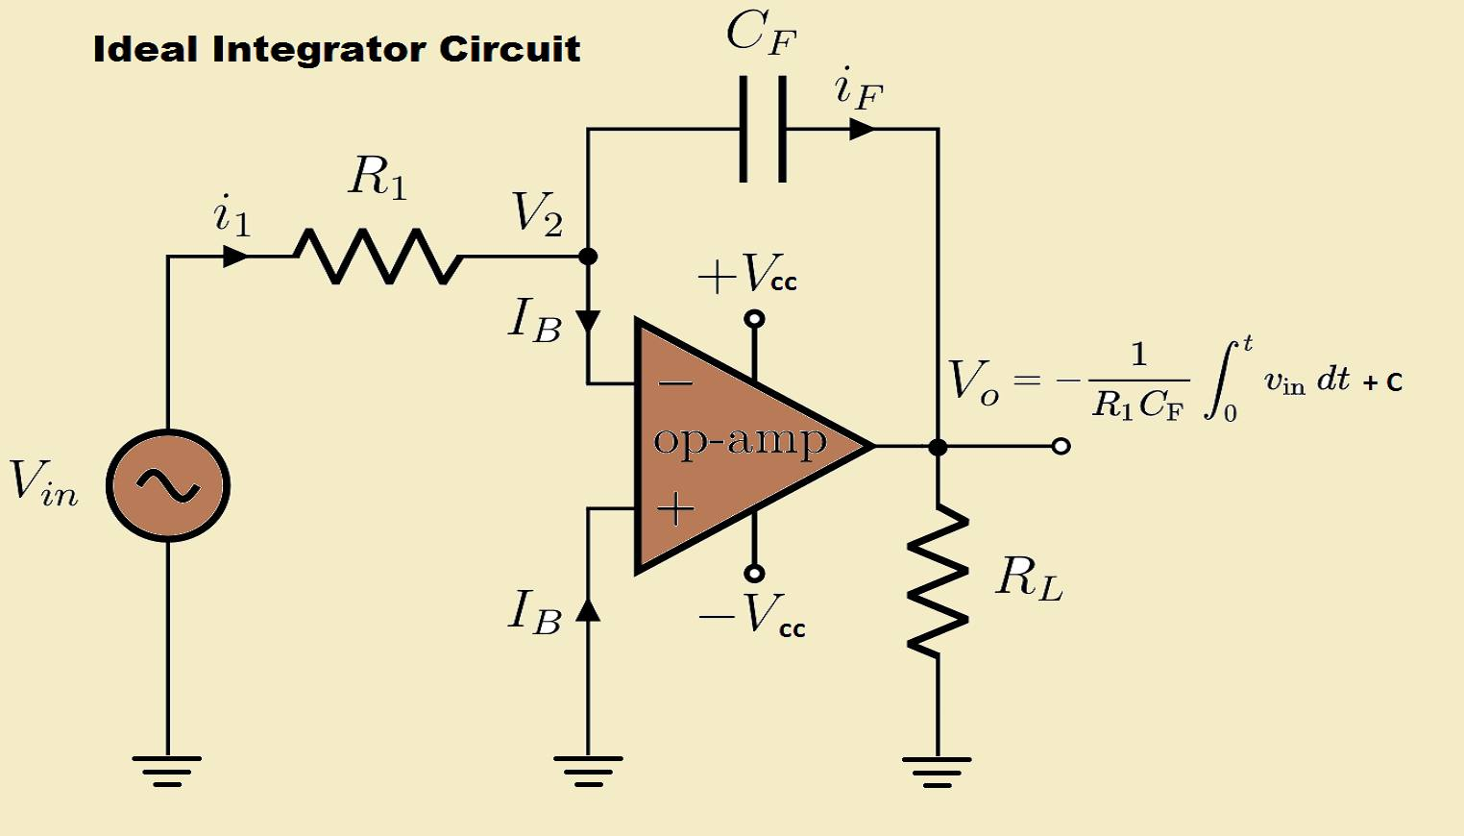
Operational Amplifiers

