Slide 1
Week 11 Recitation
Sequential Circuit
Rifat Bin Rashid
Teaching Assistant
Dept. of ECE, Rutgers University

Slide 2
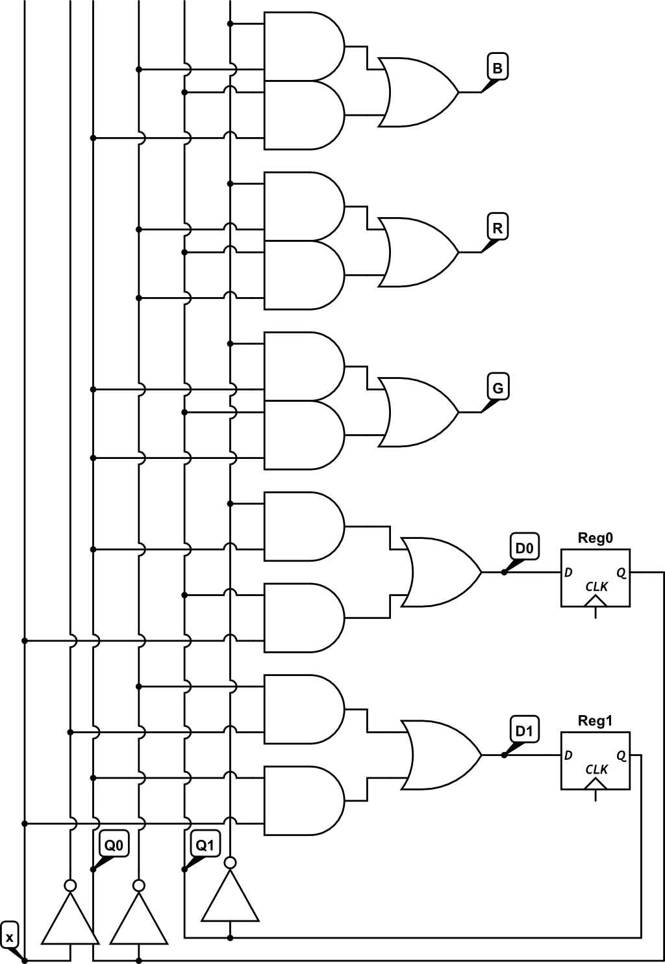
(20 points) Examine the following schematic. Label each AND gate with the term it computes
(ex. Q1’Q0X’) Then fill in the equation of each variable. Then complete the truth table
D1 = ___________________________
D0 = ___________________________
R = ____________________________
G = ____________________________
B = ____________________________
 | Q₁ | Q₀ | X | D₁ | D₀ | R | G | B
 | 0 | 0 | 0
 | 0 | 0 | 1
 | 0 | 1 | 0
 | 0 | 1 | 1
 | 1 | 1 | 0
 | 1 | 1 | 1
 | 1 | 0 | 0
 | 1 | 0 | 1

Slide 3
(20 points) Examine the following schematic. Label each AND gate with the term it computes
(ex. Q1’Q0X’) Then fill in the equation of each variable. Then complete the truth table
D1 = ___________________________
D0 = ___________________________
R = ____________________________
G = ____________________________
B = ____________________________
 | Q₁ | Q₀ | X | D₁ | D₀ | R | G | B
 | 0 | 0 | 0
 | 0 | 0 | 1
 | 0 | 1 | 0
 | 0 | 1 | 1
 | 1 | 1 | 0
 | 1 | 1 | 1
 | 1 | 0 | 0
 | 1 | 0 | 1

Slide 4
X (Input) | Q1 (Current State) | Q0 (Current State) | D1 (Next Q1) | D0 (Next Q0)
0 | 0 | 0 | 1 | 0
0 | 0 | 1 | 0 | 1
0 | 1 | 0 | 1 | 0
0 | 1 | 1 | 0 | 0
1 | 0 | 0 | 0 | 0
1 | 0 | 1 | 1 | 1
1 | 1 | 0 | 0 | 1
1 | 1 | 1 | 1 | 1

Slide 5
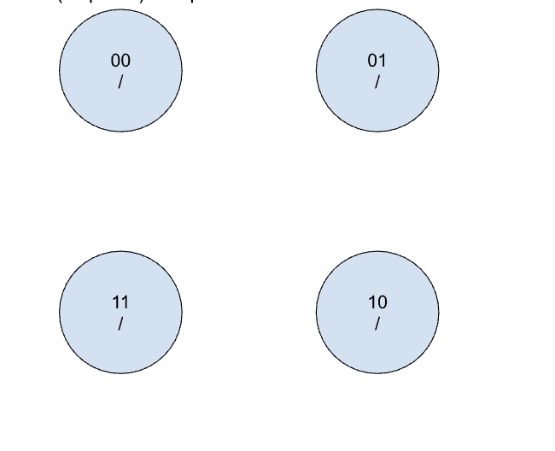
(10 points) Complete the state machine based on the truth table above.

Slide 6
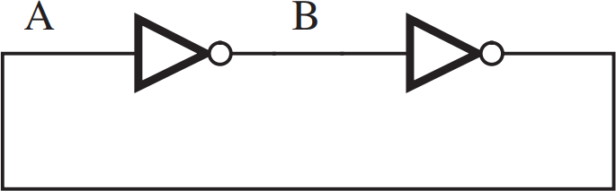
Simple Memory Element

Slide 7

Simple Memory Element

Slide 8
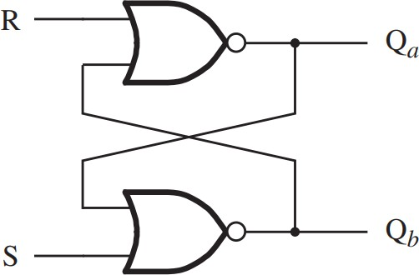
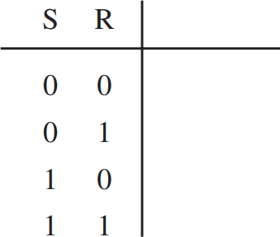
Basic Latch with NOR Gates

Slide 9
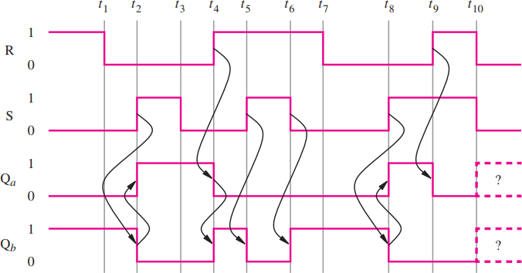
Basic Latch with NOR Gates

Slide 10
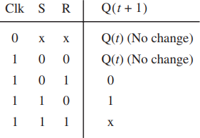
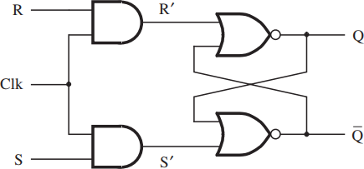
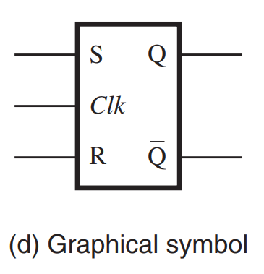
Gated SR Latch

Slide 11
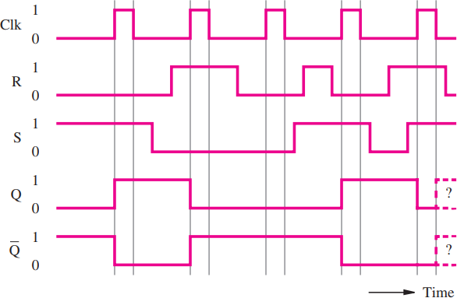
Gated SR Latch

Slide 12
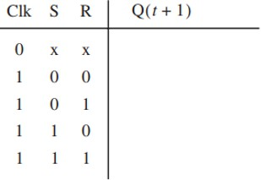
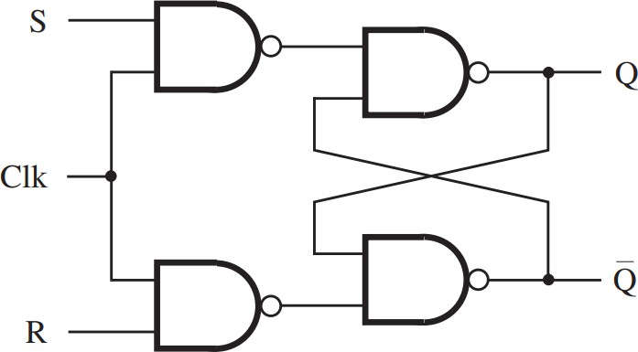




Gated SR Latch with NAND Gate

Slide 13
Comparison

Slide 14
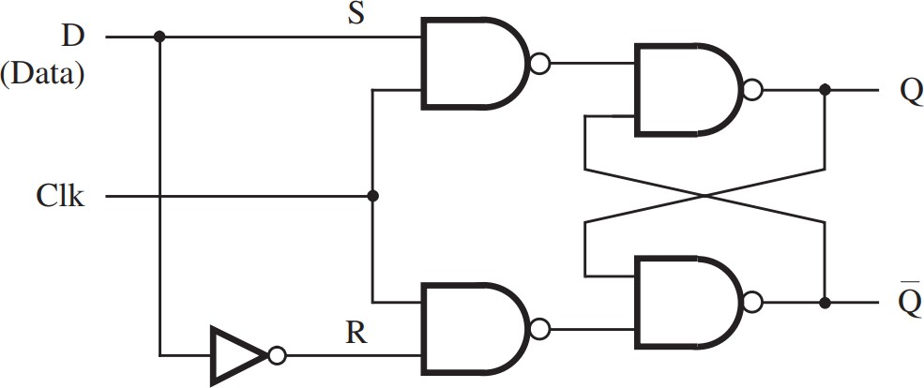
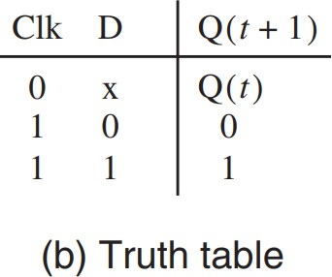
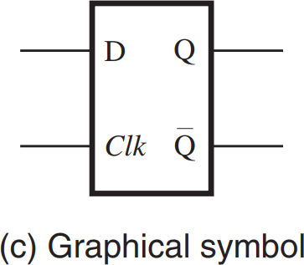
Gated D Latch

Slide 15
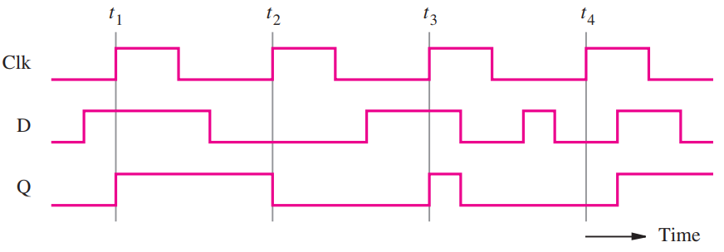
Gated D Latch

Slide 16
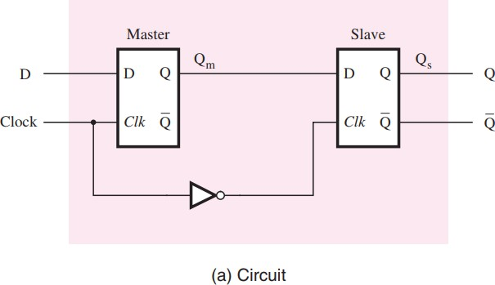
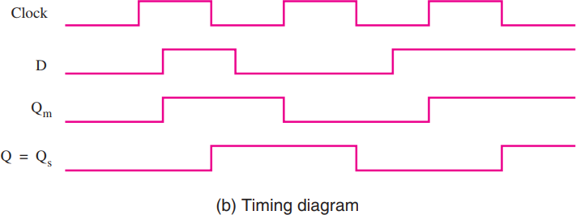
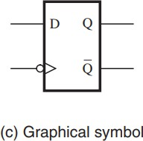
Master-Slave D Flip-Flop

Slide 17
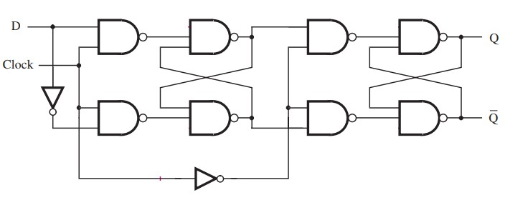
Negative-Edge Triggered D Flip-Flop

Slide 18
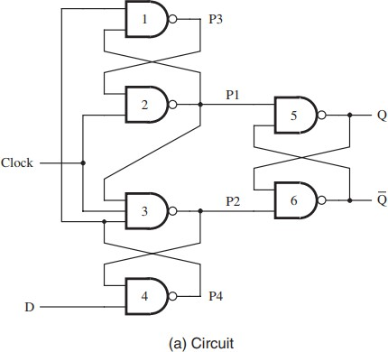
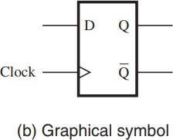
Positive-Edge Triggered D Flip-Flop

Slide 19
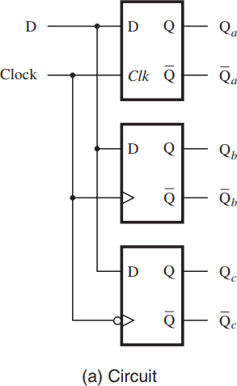
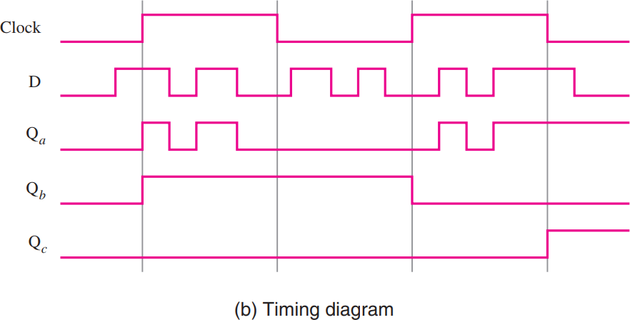
Comparison

Slide 20
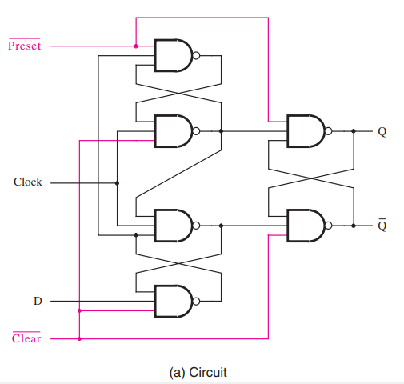
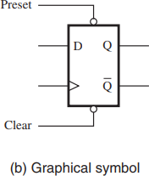
Positive-Edge Triggered D Flip-Flop with Clear and Preset

Slide 21
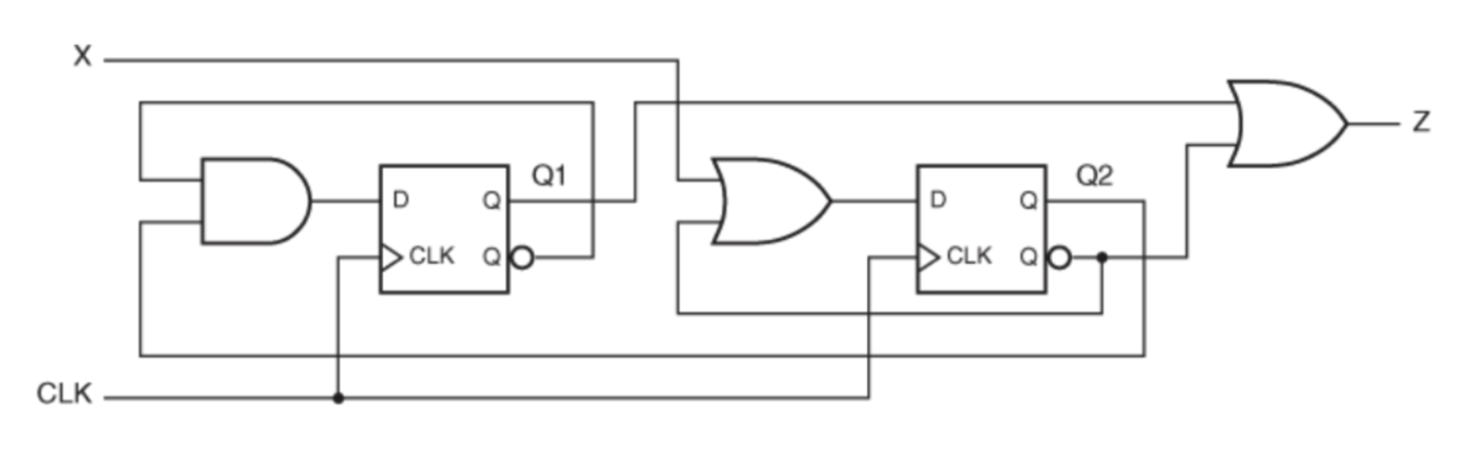
State Machine (Lab 5)
(

Slide 22
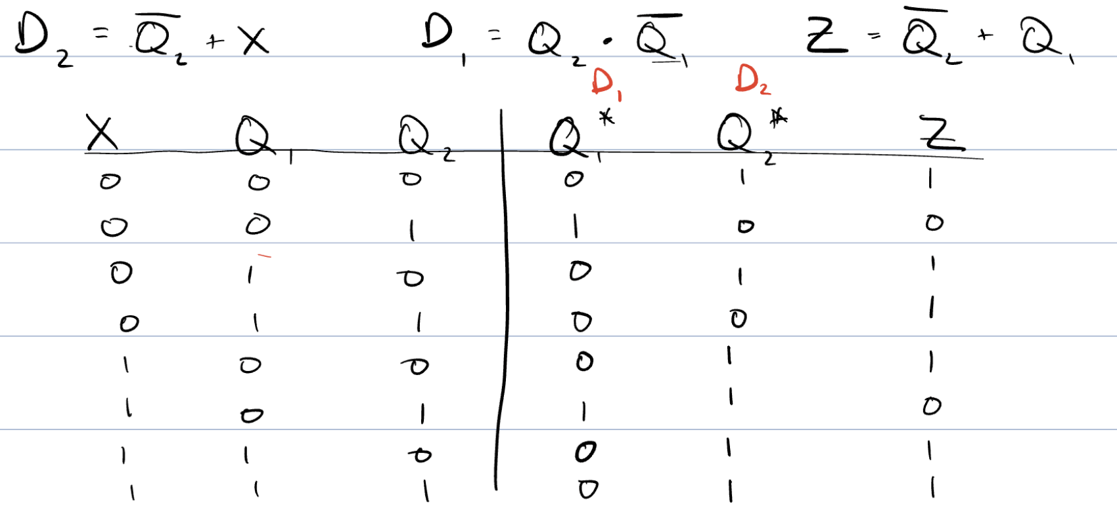
State Machine

Slide 23
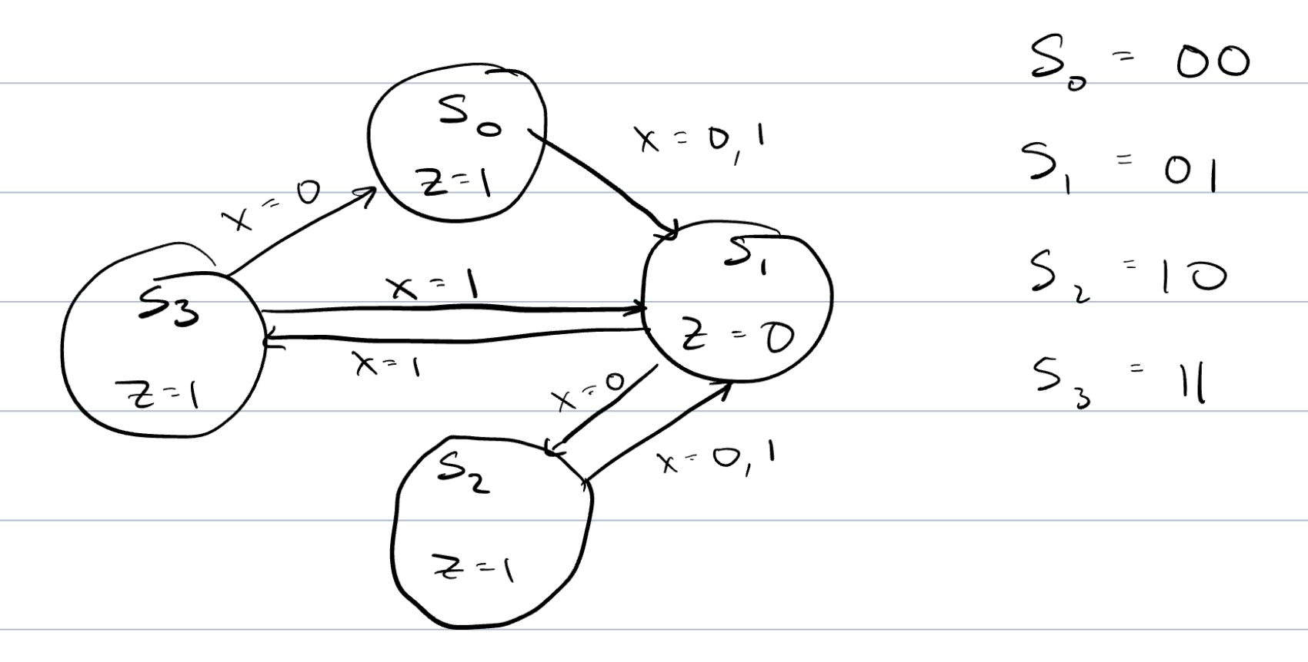
State Machine

