Slide 1
Week 10 Recitation
Transistors & Others
Rifat Bin Rashid
Teaching Assistant
Dept. of ECE, Rutgers University

Slide 2
BJT & MOSFET
Bipolar junction transistor (BJT) : current-controlled devices.
Control Signal : Base current
Field-Effect Transistors (FETs) : voltage-controlled devices.
Control Signal : Gate Voltage
In an FET, the gate is insulated, so no current flows into it.
The voltage applied to the gate controls the width of a channel between the source and drain,
which in turn controls the resistance and therefore the current flowing through the channel.

Slide 3
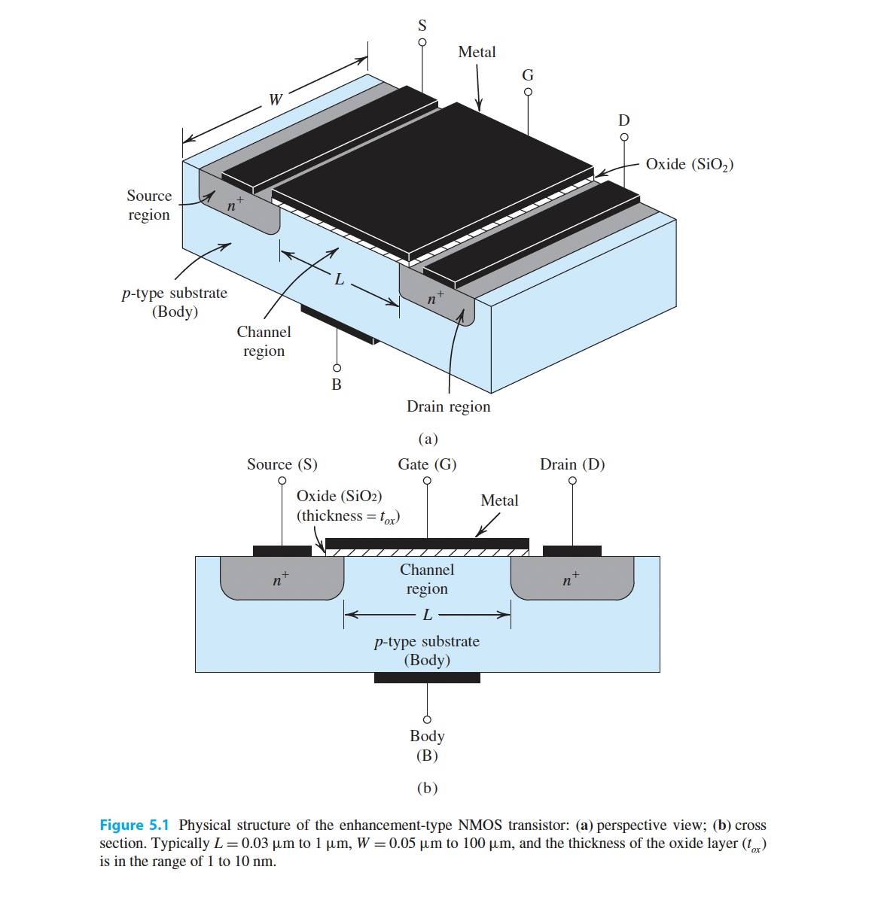
MOSFET (NMOS)
©: "Microelectronic Circuits" by Adel S. Sedra and Kenneth C. Smith

Slide 4
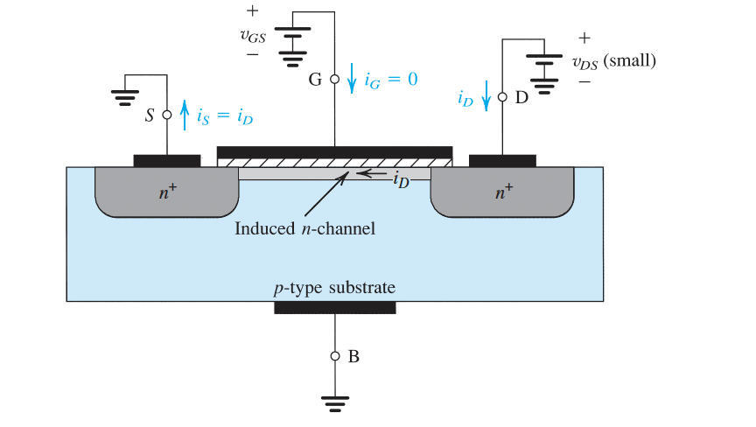
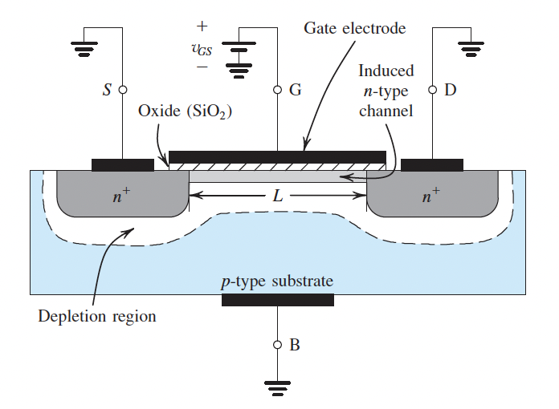
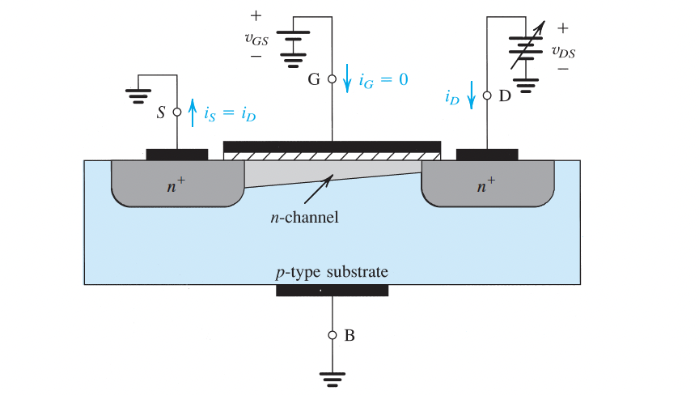
Channel Creation :
©: "Microelectronic Circuits" by Adel S. Sedra and Kenneth C. Smith

Slide 5

https://youtu.be/Bfvyj88Hs_o

Slide 6
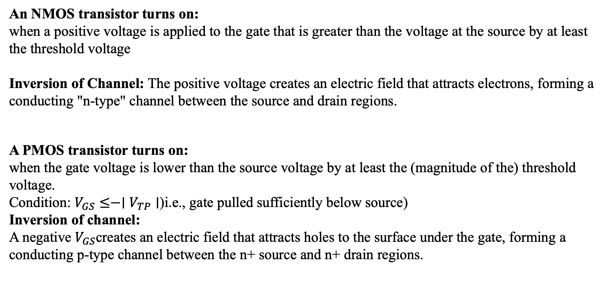
Summary :
An NMOS transistor turns on:
when a positive voltage is applied to the gate that is greater than the voltage at the source by at least the threshold voltage
Inversion of Channel: The positive voltage creates an electric field that attracts electrons, forming a conducting "n-type" channel between the source and drain regions.
A PMOS transistor turns on:
when the gate voltage is lower than the source voltage by at least the (magnitude of the) threshold voltage.
Condition: $V_{GS}≤−∣V_{TP}∣$(i.e., gate pulled sufficiently below source)
Inversion of channel:
A negative $V_{GS}$creates an electric field that attracts holes to the surface under the gate, forming a conducting p-type channel between the n+ source and n+ drain regions.

Slide 7
NMOS vs PMOS
Parameter | NMOS Transistor | PMOS Transistor
Type of channel formed | n-type | p-type
Major charge carriers | Electrons | Holes
Turns ON when: | Gate voltage > Source voltage + Threshold | Gate voltage < Source voltage – Threshold
Inversion condition | Positive gate voltage attracts electrons, forming a conducting n-channel | Negative gate voltage attracts holes, forming a conducting p-channel
Channel carriers | Electrons (high mobility → faster) | Holes (lower mobility → slower)
Current direction (conventional) | Drain → Source (for positive (V_{DS}​)) | Source → Drain (for negative ((V_{DS}​)))
Symbol polarity | Arrow points out of the source | Arrow points in to the source
Typical position in CMOS | Pull-down network (connects output to ground when ON) | Pull-up network (connects output to (V_{DD})when ON)
Logic activation | Activated by logic ‘1’ | Activated by logic ‘0’
Threshold voltage | ( V_{TN} > 0 ) | ( V_{TP} < 0 )

Slide 8
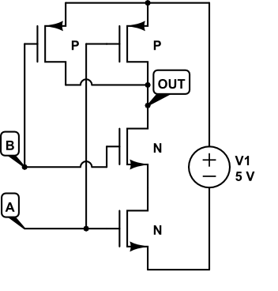
Q1. (10 points) All switches are shown open. Close any for which the transistor turns on:
A B OUT
0 0 _____
0 1 _____
1 0 _____
1 1 _____

Slide 9
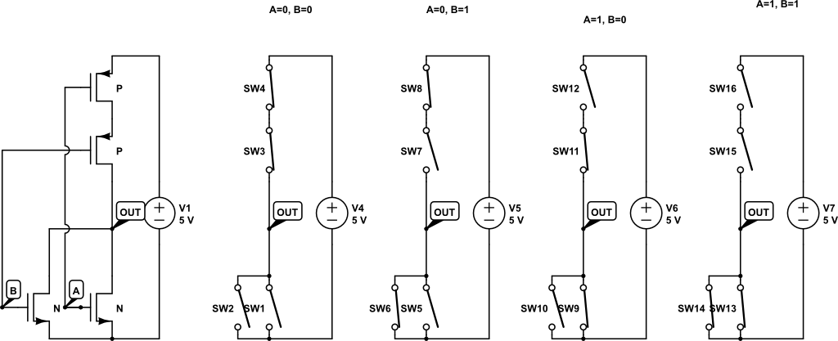
Q2. (10 points) All switches are shown open. Close any for which the transistor turns on:
A B OUT
0 0 _____
0 1 _____
1 0 _____
1 1 _____

Slide 10
Q2. (10 points) All switches are shown open. Close any for which the transistor turns on:
A B OUT
0 0 _____
0 1 _____
1 0 _____
1 1 _____

Slide 11
Q2. (10 points) All switches are shown open. Close any for which the transistor turns on:
A B OUT
0 0 __5V___
0 1 __0V__
1 0 __0V_
1 1 ___0V__
NOR Gate!

Slide 12
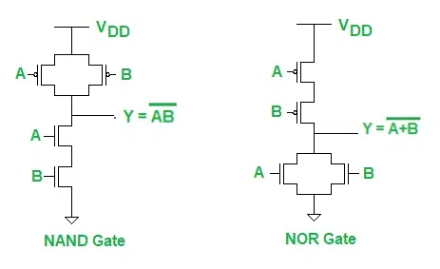

Slide 13
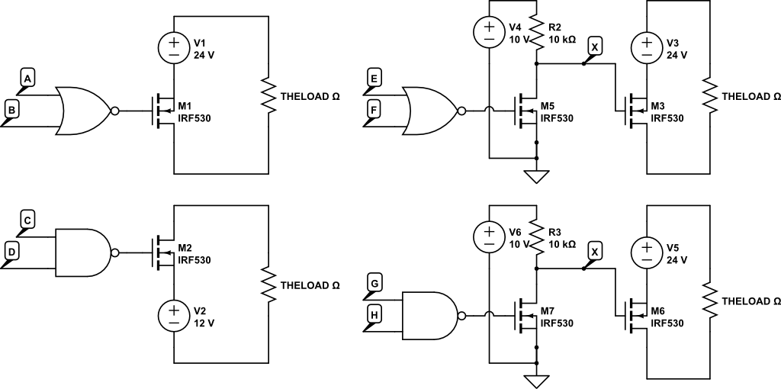
Q3. (20 points) Complete the truth table for the letters you are given. First indicate whether the output of the gate is 1 or 0.
For the problem on the right, show of the voltage of point X as a result. Last show whether the motor is ON or OFF as a result.
C D OUT Motor G H OUT X Motor
0 0 ____ _____ 0 0 _____ _____ ______
0 1 ____ _____ 0 1 _____ _____ ______
1 0 ____ _____ 1 0 _____ _____ ______
1 1 ____ _____ 1 1 _____ _____ ______

Slide 14
A | B | OUT | Motor
0 | 0 | 1 | ON
0 | 1 | 0 | OFF
1 | 0 | 0 | OFF
1 | 1 | 0 | OFF

Slide 15
C | D | OUT | Motor
0 | 0 | 1 | ON
0 | 1 | 1 | ON
1 | 0 | 1 | ON
1 | 1 | 0 | OFF

Slide 16
E | F | OUT | X (V) | Motor
0 | 0 | 1 | ≈ 0 V | Off
0 | 1 | 0 | ≈ 10 V | On
1 | 0 | 0 | ≈ 10 V | On
1 | 1 | 0 | ≈ 10 V | On

Slide 17
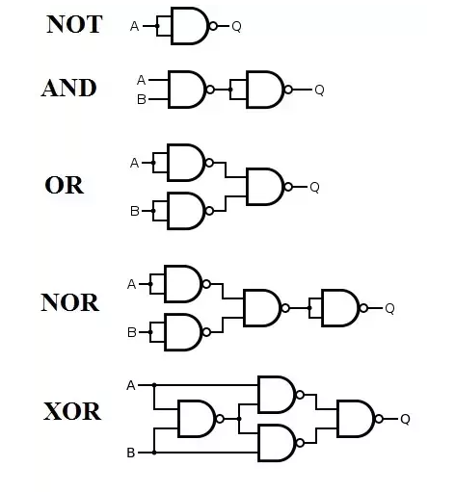
Nand/Nor – Universal gate

Slide 18
Nand/Nor – Universal gate

Slide 19
BUILD anything with NAND
BUILD anything with NOR

Slide 20
Verilog Procedural blocks
Two types.
initial block:
    This block executes only once at the beginning of a simulation (time 0) and is non-synthesizable, meaning it cannot be converted into actual hardware. It is typically used in testbenches for initial value setup.
            initial begin
            // statements
            end
always block:
    This block continuously executes statements based on a sensitivity list.
            always begin
            // statements
            end

Slide 21
Question 1:
`timescale 1ns/1ns
module my_tb;
logic [3:0] a = 4'b1001;
logic [3:0] b;
initial begin
logic [3:0] result = a & b; // a AND b
$display("%b", result);
result = a | b; // a OR b
$display("%b", result);
result = a ^ b; // a XOR b
$display("%b", result);
b = { ~a[3:2], a[1:0] }; // b = 01_01 when a=1001
result = ~(a & b); // a NAND b
$display("%b", result);
end
endmodule

Slide 22
Solution 1:
`timescale 1ns/1ns
module my_tb;
logic [3:0] a = 4'b1001;
logic [3:0] b; // b is not assigned , so b= xxxx
initial begin
logic [3:0] result = a & b; // a AND b
$display("%b", result);
result = a | b; // a OR b
$display("%b", result);
result = a ^ b; // a XOR b
$display("%b", result);
b = { ~a[3:2], a[1:0] }; // b = 01_01 when a=1001
result = ~(a & b); // a NAND b
$display("%b", result);
end
endmodule
Result:
x00x
1xx1
xxxx
1110

Slide 23
Timescale 1ns/1ns
timeunit 1ns;
timeprecision 1ns;

Slide 24
Question 2:
Complete the following system Verilog program. The timescale should be 2ns, splitting each delay in 100 parts to look for timing hazards.
`timescale ________________
_________ ALU_8bit_tb;
_____ [7:0] a;
_____ [7:0] b;
initial _______
a = 15;
b = 23;
reg[7:0] c = a & b; // c = __________
reg[7:0] d = a | b; // d = __________
reg[7:0] e = a ^ b; // e = __________
reg[7:0] f = a << 2; // f = _________
reg[7:0] g = b >> 1; // g = _________
reg[7:0] h = {a[0],a[7:1]};// h = _________
_____ // set a delay so this program ends after 1μs (1000ns)
$finish;
end
forever begin
________
clk = _________clk; // set timing so clock has period of 4ns
end
_________

Slide 25
Solution 2:
`timescale 2ns/20ps
module ALU_8bit_tb;
reg [7:0] a;
reg [7:0] b;
initial begin
a = 8'd15; // 0000_1111
b = 8'd23; // 0001_0111
reg [7:0] c = a & b; // c = 8'b00000111
reg [7:0] d = a | b; // d = 8'b00011111
reg [7:0] e = a ^ b; // e = 8'b00011000
reg [7:0] f = a << 2; // f = 8'b00111100
reg [7:0] g = b >> 1; // g = 8'b00001011
reg [7:0] h = {a[0], a[7:1]};// h = 8'b10000111
#500; // stop after 1 μs (1000 ns)
$finish;
end
// Clock with 4 ns period (2 ns high + 2 ns low)
forever begin
#1;
clk = ~clk; // toggle every 2 ns (timescale unit)
end
endmodule

Slide 26
Test 2
Next Wednesday – Nov 19
Time: 12:10 Pm -1:30 Pm
Place: SEC-209
For Recitation section 02

