Slide 1
Week 9 Recitation
Number System & Data (Continued), ALU, Multiplexer
Rifat Bin Rashid
Teaching Assistant
Dept. of ECE, Rutgers University

Slide 2
Multiplexer- Combinational Circuits
Multiplexer- Combinational Circuits : Output is dependent on the combination of inputs
Multiplexer circuit has a number of data inputs, one or more select inputs, and one output.
It passes the signal value on one of the data inputs to the output.
The data input is selected by the values of the select inputs.
n-to-1 multiplexer

Slide 3
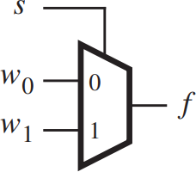
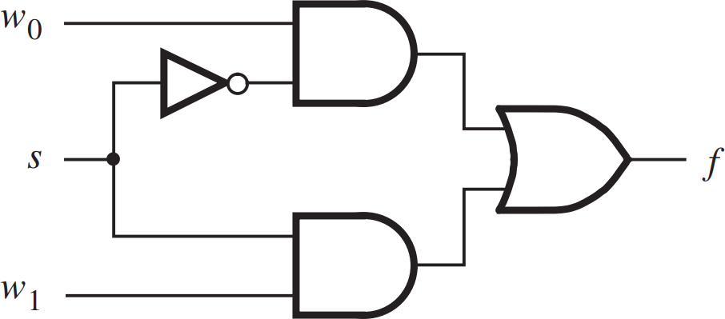
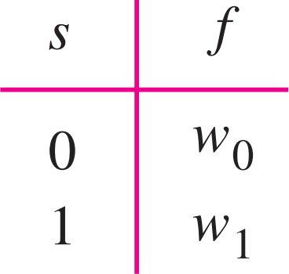
2-to-1 Multiplexer

Slide 4
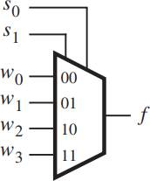
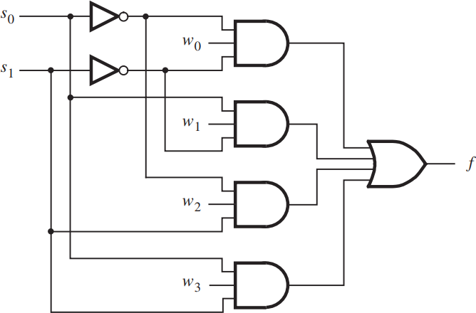
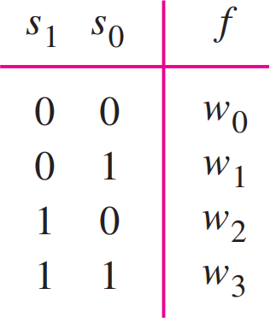
4-to-1 Multiplexer

Slide 5
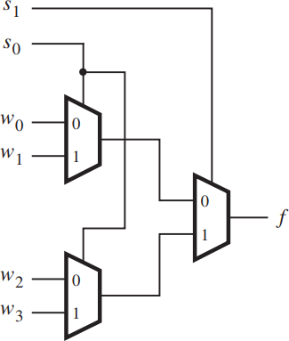
4-to-1 Mux using 2-to-1 Mux

Slide 6
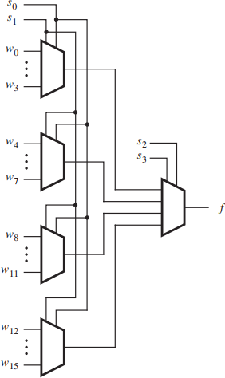
16-to-1 Mux using 4-to-1 Mux

Slide 7
Conditional Operator ?:

Slide 8
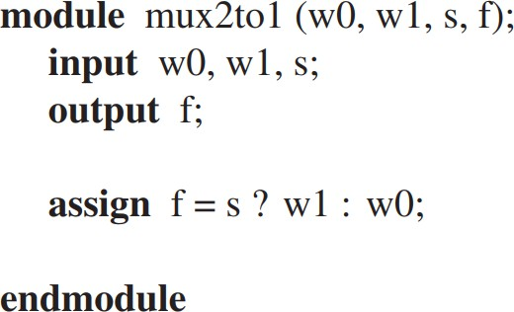
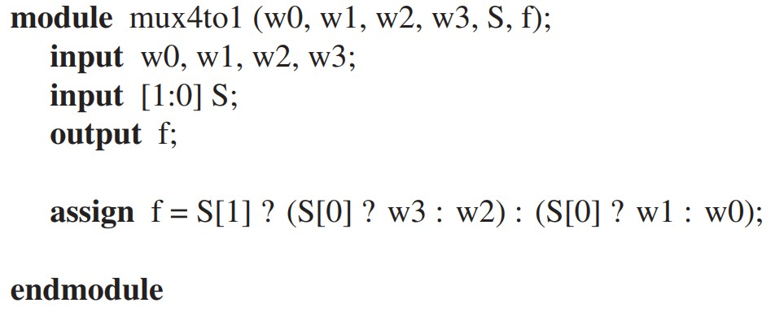
Mux Using Conditional Operator

Slide 9
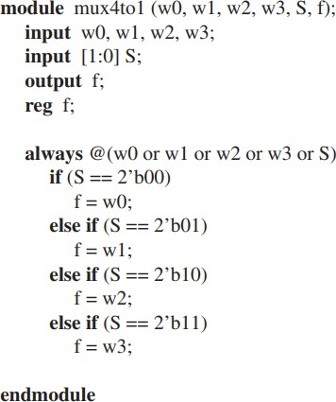
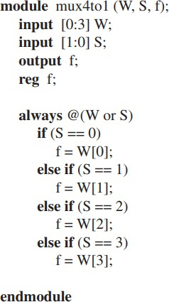
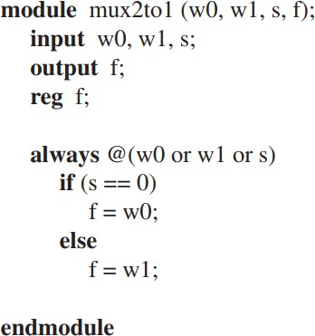
Mux Using if-else

Slide 10
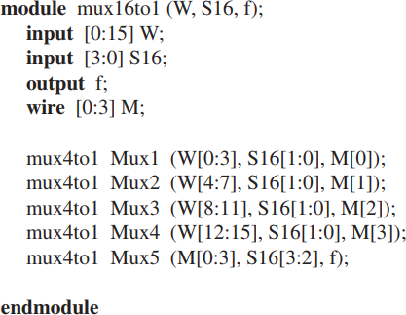
16-to-1 Mux using 4-to-1 Mux

Slide 11
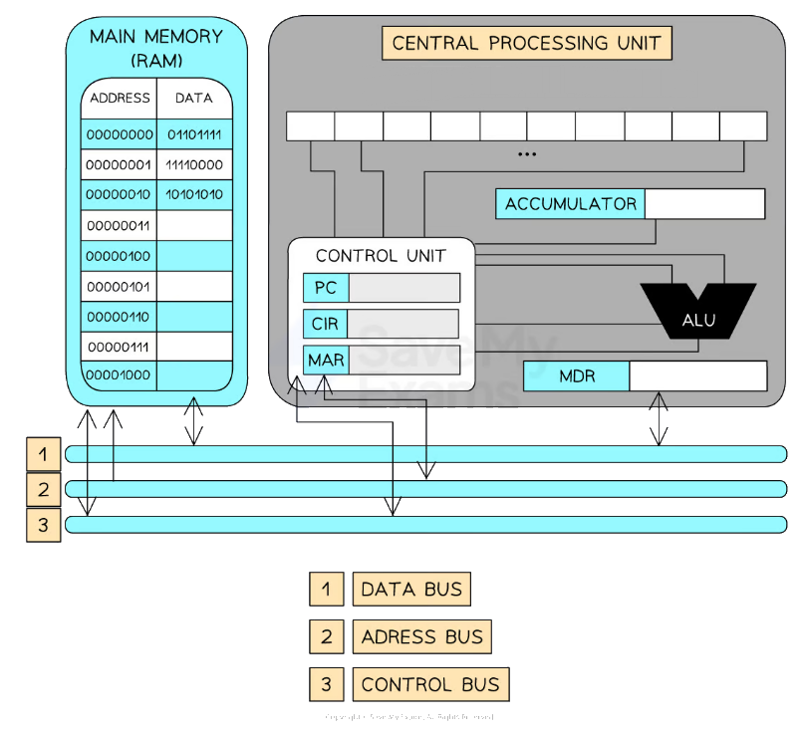

Slide 12
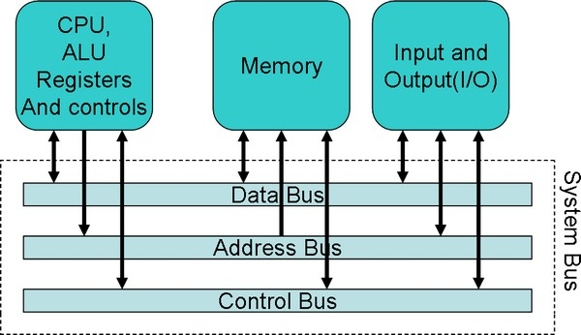

Slide 13
