Slide 1
Week 4 Recitation
K Map
Rifat Bin Rashid
Teaching Assistant
Dept. of ECE, Rutgers University

Slide 2
K MAP
❖ A systematic way of producing a minimum-cost logic expression
K-map provides the minimized SOP or POS version (not the most minimized form)

Slide 3
K-Map: Main Idea
If a bit changes, it does not matter. If it stays the same, it matters
A | B | f
0 | 0 | 0
0 | 1 | 0
1 | 0 | 1
1 | 1 | 1
B
B
 | 0 | 1
0 | m0 | m1
1 | m2 | m3
 | 0 | 1
0 | 0 | 0
1 | 1 | 1
A
A
SOP: f = AB’ + AB
= A( B’+B)
=A
POS: f = (A+B)(A+B’)
= A+ AB’ + AB+ BB’
=A

Slide 4
K-Map: Main Idea
❖1s for SOP, 0s for POS
❖Terms- minterm format for SOP, maxterm format for POS
A | B | f
0 | 0 | 1
0 | 1 | 1
1 | 0 | 0
1 | 1 | 1
B
B
 | 0 | 1
0 | m0 | m1
1 | m2 | m3
 | 0 | 1
0 | 1 | 1
1 | 0 | 1
A
A
SOP: f = A’ + B
POS: f = A’ + B

Slide 5
Two steps
Create the K map
(from truth table / Boolean function/ Given)
2. Minimize using the k map
(Minimized SOP / POS)

Slide 6
K Map Minimization Rules:
K-map provides the minimized SOP or POS version (not the most minimized form)
If a bit changes, it does not matter. If it stays the same, it matters
Include all 1’s for SOP and all 0’s for POS. Minterm format for SOP, maxterm format for POS

Slide 7
K Map Minimization Rules:
Select the largest chain (lateral or vertical) or rectangle with size 2^{𝑛} where
n=0,1,2,3,… (even if some part of the largest is already selected)
Number of variables in a term = Total number of variables – n
Chains may partially overlap (but full overlap is redundant)
Grey coding is cyclic. So, the ends are connected
Practice! Practice!! Practice!!!

Slide 8
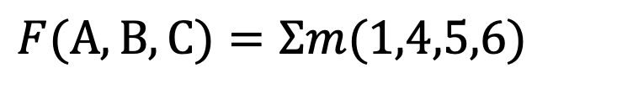
Three Variable
$$F(A,B,C)=Σm(1,4,5,6)$$
 | 00 | 01 | 11 | 10
0 | m0 | m1 | m3 | m2
1 | m4 | m5 | m7 | m6
BC
A

Slide 9
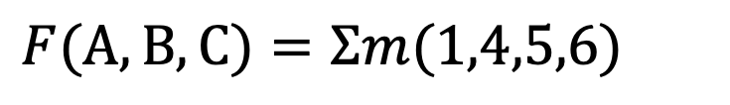
Three Variable
$$F(A,B,C)=Σm(1,4,5,6)$$
A | B | C | f
0 | 0 | 0 | 0
0 | 0 | 1 | 1
0 | 1 | 0 | 0
0 | 1 | 1 | 0
1 | 0 | 0 | 1
1 | 0 | 1 | 1
1 | 1 | 0 | 1
1 | 1 | 1 | 0
BC
 | 00 | 01 | 11 | 10
0 | 0 | 1 | 0 | 0
1 | 1 | 1 | 0 | 1
A

Slide 10
Three Variable
$$F(A,B,C)=Σm(1,4,5,6)$$
A | B | C | f
0 | 0 | 0 | 0
0 | 0 | 1 | 1
0 | 1 | 0 | 0
0 | 1 | 1 | 0
1 | 0 | 0 | 1
1 | 0 | 1 | 1
1 | 1 | 0 | 1
1 | 1 | 1 | 0
BC
 | 00 | 01 | 11 | 10
0 | 0 | 1 | 0 | 0
1 | 1 | 1 | 0 | 1
A
AC'+B'C

Slide 11
Four Variable
CD
 | 00 | 01 | 11 | 10
00 | m0 | m1 | m3 | m2
01 | m4 | m5 | m7 | m6
11 | m12 | m13 | m15 | m14
10 | m8 | m9 | m11 | m10
AB

Slide 12
Four Variable Example 1
CD
 | 00 | 01 | 11 | 10
00 | 0 | 0 | 0 | 0
01 | 0 | 0 | 1 | 1
11 | 1 | 0 | 0 | 1
10 | 1 | 0 | 0 | 1
AB

Slide 13
Four Variable Example 1 (continued)
CD
 | 00 | 01 | 11 | 10
00 | 0 | 0 | 0 | 0
01 | 0 | 0 | 1 | 1
11 | 1 | 0 | 0 | 1
10 | 1 | 0 | 0 | 1
AB
A'BC+AD'

Slide 14
Four Variable Example 2
CD
 | 00 | 01 | 11 | 10
00 | 0 | 0 | 0 | 0
01 | 0 | 0 | 1 | 1
11 | 1 | 1 | 1 | 1
10 | 1 | 1 | 1 | 1
AB

Slide 15
Four Variable Example 2 (continued)
CD
 | 00 | 01 | 11 | 10
00 | 0 | 0 | 0 | 0
01 | 0 | 0 | 1 | 1
11 | 1 | 1 | 1 | 1
10 | 1 | 1 | 1 | 1
AB
A+BC

Slide 16
Four Variable Example 3
CD
 | 00 | 01 | 11 | 10
00 | 1 | 1 | 1 | 0
01 | 1 | 1 | 1 | 0
11 | 0 | 0 | 1 | 1
10 | 0 | 0 | 1 | 1
AB

Slide 17
Four Variable Example 4
CD
 | 00 | 01 | 11 | 10
00 | 0 | 0 | 0 | 0
01 | 0 | 1 | 1 | 0
11 | 1 | 1 | 0 | 1
10 | 1 | 1 | 1 | 1
AB

Slide 18
Four Variable Example 5
CD
 | 00 | 01 | 11 | 10
00 | 0 | 0 | 0 | 0
01 | 1 | 1 | 1 | 0
11 | 1 | 1 | 1 | 0
10 | 0 | 1 | 0 | 0
AB

Slide 19
Four Variable Example 6
 | 00 | 01 | 11 | 10
00
01 |  | 1 | 1
11 | 1 | 1 |  | 1
10 | 1 | 1 | 1 | 1
CD
AB

Slide 20
Four Variable Example 6 (continued)
 | 00 | 01 | 11 | 10
00
01 |  | 1 | 1
11 | 1 | 1 |  | 1
10 | 1 | 1 | 1 | 1
CD
AB
A'BD+AB'+AD’ + AC’

Slide 21
Four Variable Example 7
CD
 | 00 | 01 | 11 | 10
00 | 1 | 1
01 |  | 1 | 1
11 |  |  | 1 | 1
10 | 1 |  |  | 1
AB

Slide 22
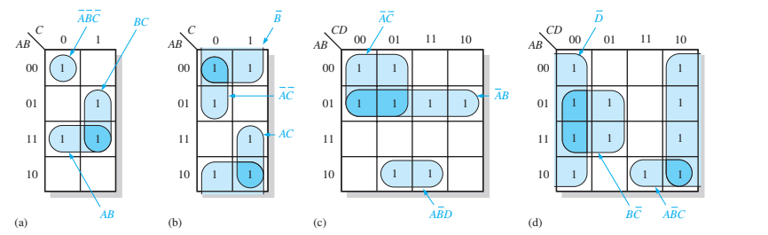
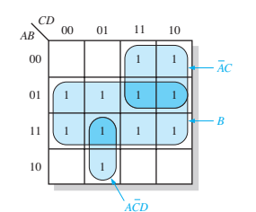
If a bit changes, it does not matter. If it stays the same, it matters.

