Slide 1
Wireless Channel
• Types
• Multipath analysis
• Frequency Response
• Null Formation
Rifat Bin Rashid

Slide 2


Channel
Transmitter
Receiver

Slide 3
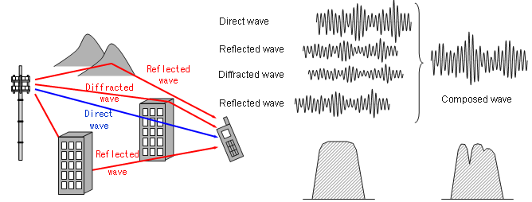
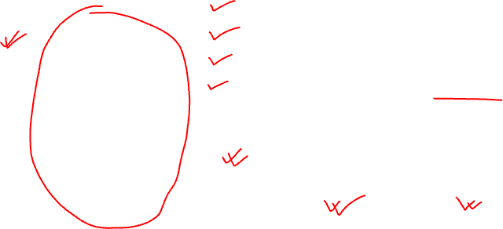
Wireless Communication Channel
© : https://www.sharetechnote.com/html/Handbook_LTE_Fading.html

Slide 4

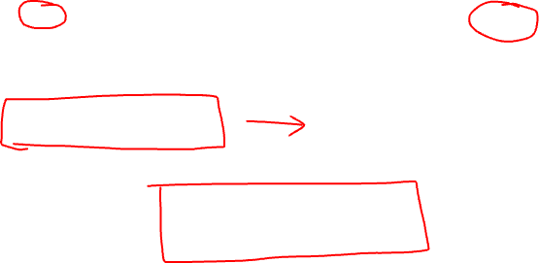
Noise
n(t)
Tx Signal
x(t)
Channel
h(t)
Rx Signal
y(t)
y(t)=(x∗h)(t) + n(t)
y(t)=$∫\text{​}\text{x}\text{(}\text{τ}\text{)}\text{h}\text{(}\text{t}\text{−}\text{τ}\text{)}\text{d}\text{τ} \text{+} \text{n}\text{(}\text{t}\text{)}$
Y(f)=H(f)X(f) + N(f)

Slide 5
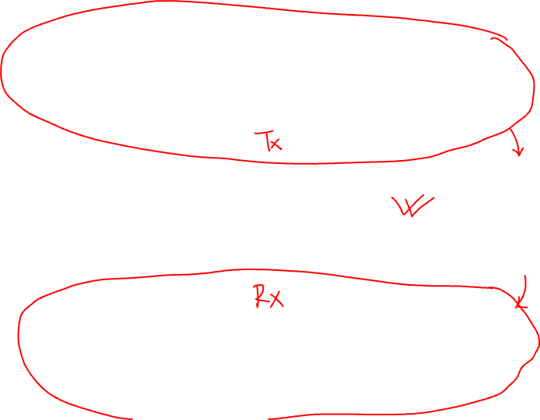
Information Source & Input Transducer
Source Encoder
Channel Encoder
Digital Modulator
Channel
Source Decoder & Output Transducer
Source Decoder
Channel Decoder
Digital Demodulator

Slide 6
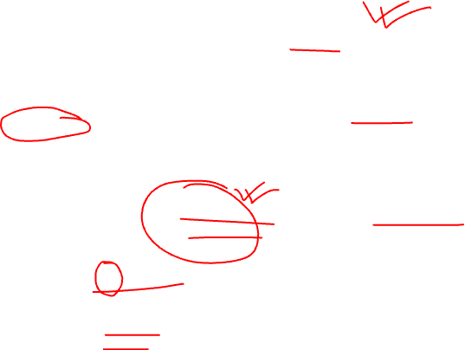
Channel Types
AWGN Channel
Fading Channels
Small Scale Fading
Large Scale Fading
Path loss
Multipath delay spread
Doppler Spread
Shadowing
Flat Fading
Slow Fading
Frequency Selective Fading
Fast Fading
Coherence Bandwidth
Coherence Time

Slide 7
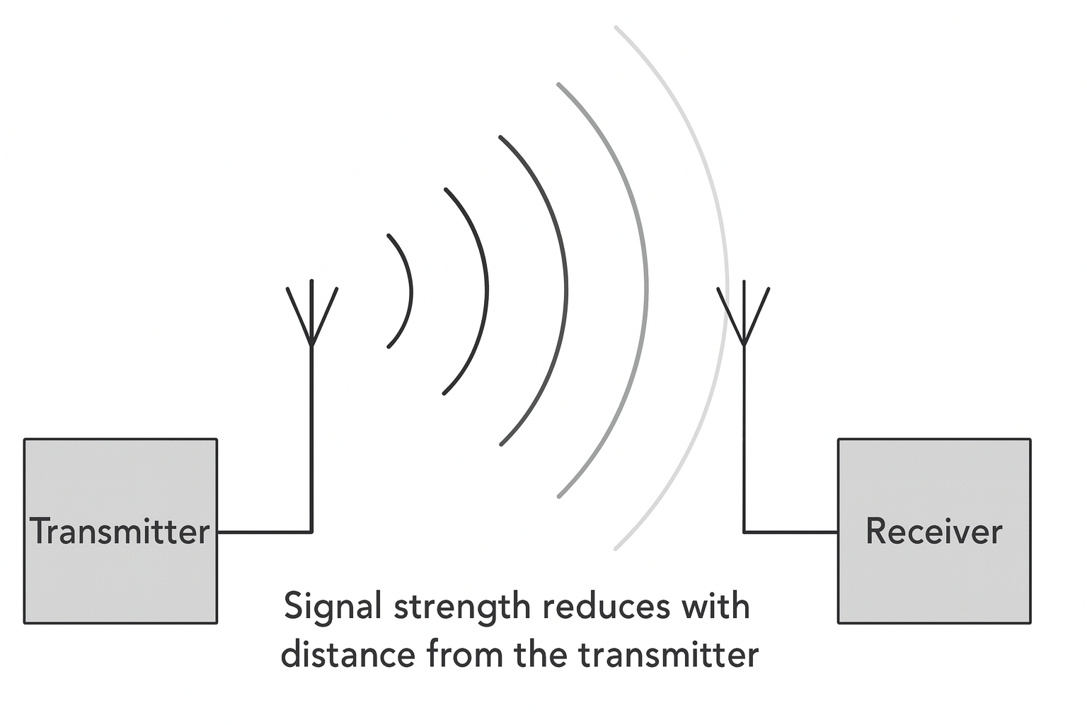
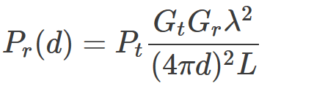
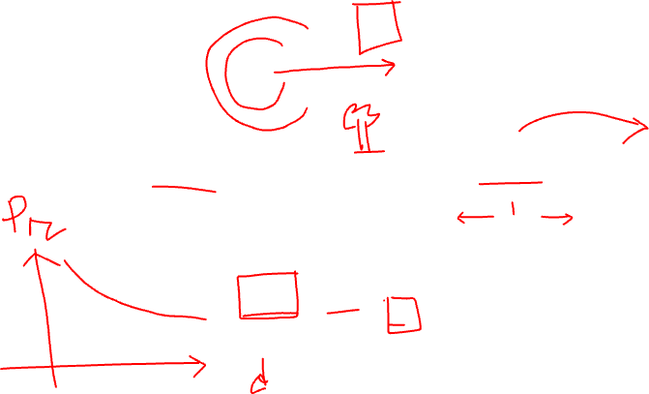
Large Scale Fading

Slide 8
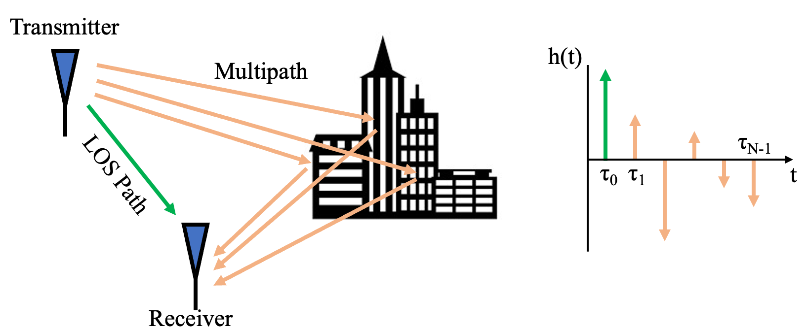

Multipath Fading
Impulse Response
©: https://pysdr.org/content/multipath_fading.html

Slide 9

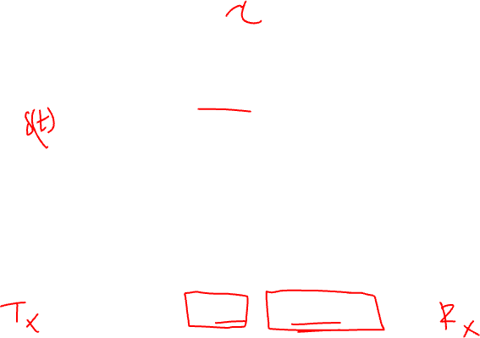
Two tap multipath
Impulse Response
h(t) = a₀·δ(t) + a₁·δ(t - τ)

Slide 10
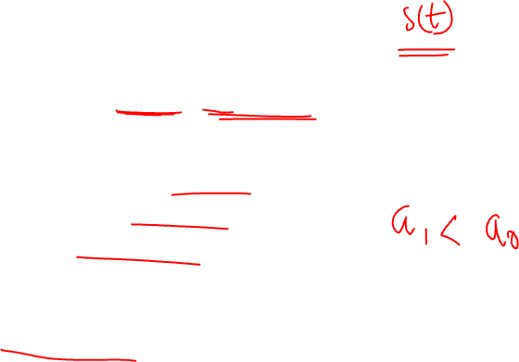
Channel Model Two tap multipath
Impulse Response
h(t) = a₀·δ(t) + a₁·δ(t - τ)
Parameters:
a₀ = Direct path amplitude (LOS)
a₁ = Reflected path amplitude
τ = Path delay time
δ(t) = Dirac delta function
Rician Fading

Slide 11

Frequency Domain
Impulse Response
h(t) = a₀·δ(t) + a₁·δ(t - τ)
Frequency Response
Fourier Transform:
H(f) = a₀ + a₁·e^(-j2πfτ)
Complex Form:
H(f) = [a₀ + a₁·cos(2πfτ)] - j[a₁·sin(2πfτ)]

Slide 12
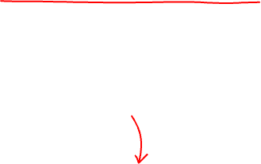
Magnitude Response
Complex Form:
H(f) = [a₀ + a₁·cos(2πfτ)] - j[a₁·sin(2πfτ)]
Channel Magnitude
|H(f)| = √[ (a₀ + a₁·cos(2πfτ))² + (a₁·sin(2πfτ))² ]
Simplified:
|H(f)| = √[ a₀² + a₁² + 2a₀a₁·cos(2πfτ) ]

Slide 13
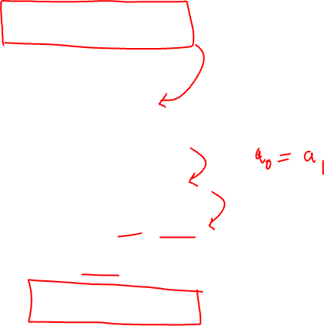
Null Formation
Fourier Transform:
H(f) = a₀ + a₁·e^(-j2πfτ)
Complete cancellation occurs when:
H(f) = 0
a₀ + a₁·e^(-j2πfτ) = 0
1 + e^(-j2πfτ) = 0
e^(-j2πfτ) = -1 = e^(-jπ)
2πfτ = π + 2πk (k = 0, 1, 2, ...)
f_null = (1 + 2k) / (2τ)

Slide 14
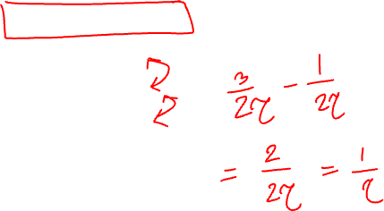
Null Characteristics
Null Properties
First Null (k=0): f₁ = 1/(2τ)
Second Null (k=1): f₂ = 3/(2τ)
Third Null (k=2): f₃ = 5/(2τ)
Null Spacing: Δf = 1/τ
Key Insight:
Null spacing depends ONLY on delay τ
Null depth depends on amplitude ratio a₁/a₀
f_null = (1 + 2k) / (2τ)

