Slide 1
Title:
Abstract:
Keywords:
1. Introduction: (size large with a literature review) (citation at least 10/12)

Slide 2
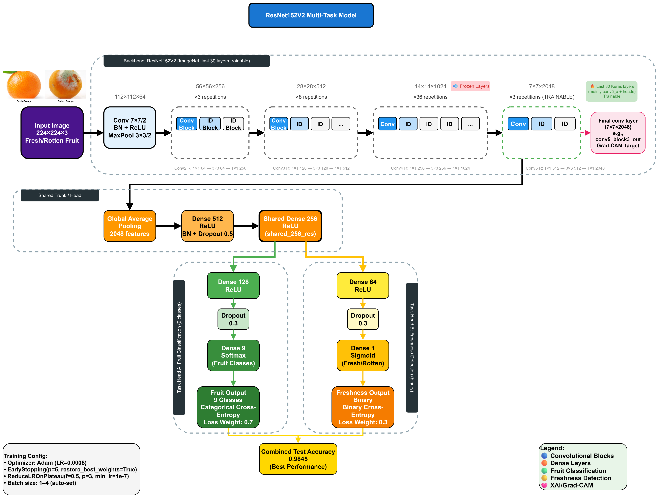
2. Methodology:
2.1 Dataset Description (size very short) (citation -1 )
2.2 Data preprocessing & augmentation (size short)
2.3 Proposed CNN model architecture (size medium + add suitable equations/formulas)
Fig 1: this image is the proposed cnn model architecture 2.3 section(only 1 image here for latex code)

Slide 3
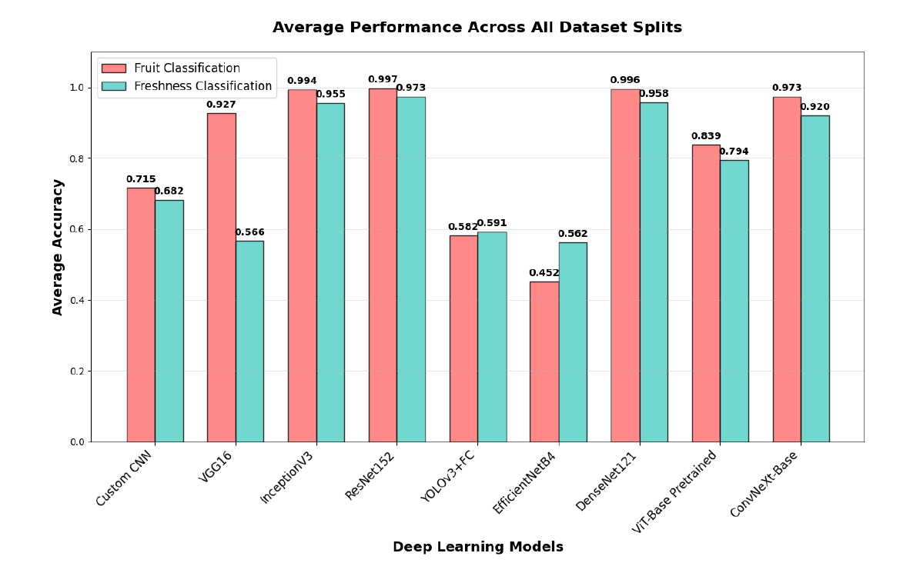
3. Deep Learning Model Comparison (size medium) (no citation)
(a)
(b)
(c)
(d)
Fig. 2. Performance of nine deep learning models on (a) average accuracy, (b) loss values, (c) fruit classification heatmap, and (d) fruit freshness classification heatmap across dataset splits for section 3. (here 4 sub image in 2*2 row col way in latex code)

Slide 4
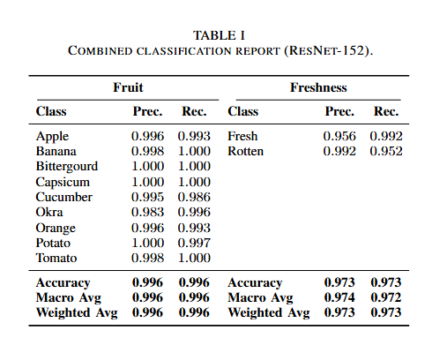
4. Performance Metrices of ResNet – 152 ( size Large) (no citation)
Table 1 this is for section 4 ( this table
Should be exact like this in latex code)
Fig. 3 this is for section 4 (this is only 1 image for latex code)

Slide 5
(a)
(b)
Fig. 4. this is for section 4 (a) fruit classify confusion matrix(b)freshness classify confusion matrix (here 2 sub image in 1*2 row col way for latex code)

Slide 6
Fig. 5 this is for section 4 (here only 1 image for latex code)

Slide 7
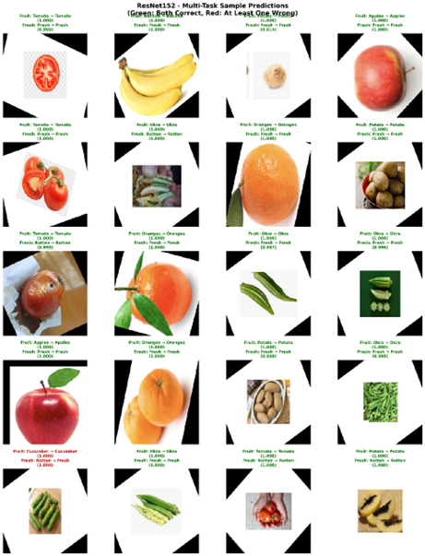
Fig. 6 this is for section 4 ( here only
1 image for latex code)

Slide 8
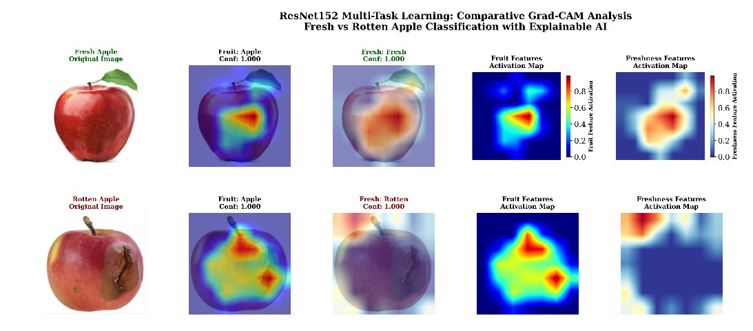
5. Grad – CAM Analysis: (size short)
Fig. 7 this is for section 5 (here only 1 image for latex code)

Slide 9
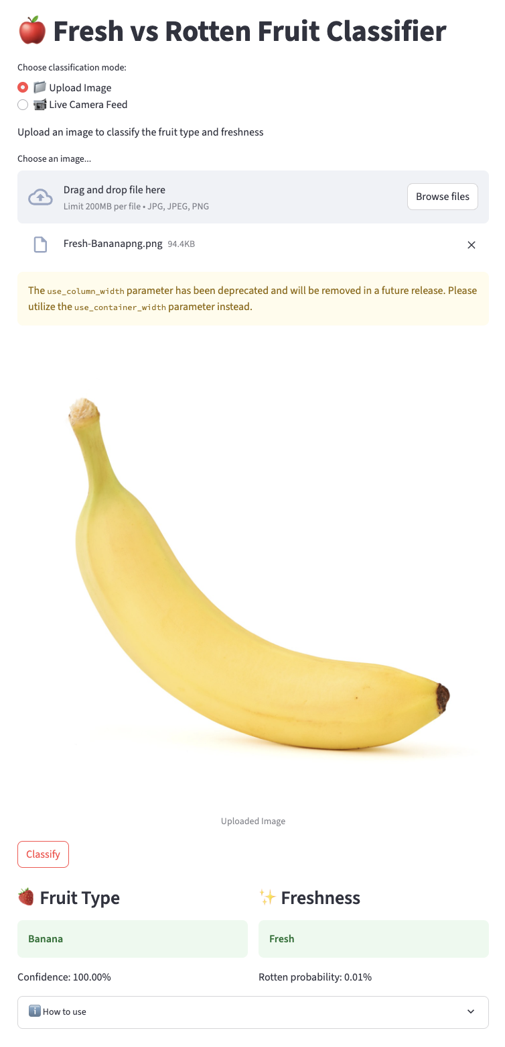
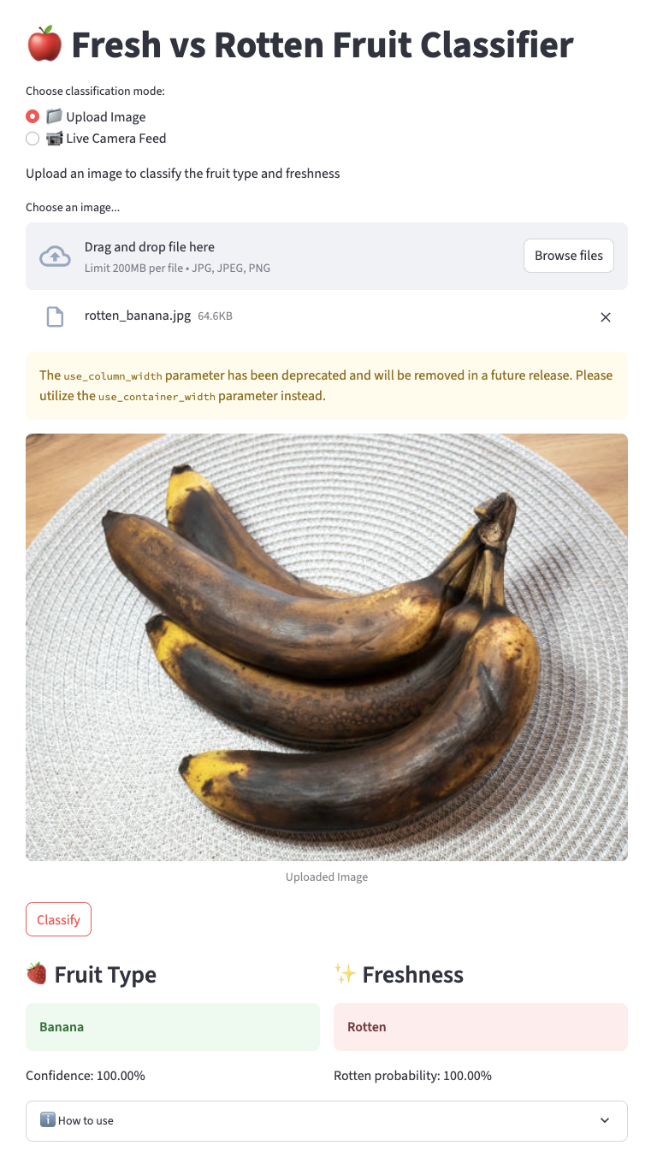
6. Real-World Deployment: (size very short) (live website link)
(a)
(b)
Fig. 8. this is for section 6 (a)for fresh banana check (b)for rotten banana check (here
2 sub image in 1*2 row col way for latex code)

Slide 10
7. Comparative Analysis: (just a table (with citation, cite relevant papers using the dataset that we have used here, comparable to our proposed work) with a short comparision writing)
8. Conclusion: (very short summary of the whole work, add a future direction in a single line)
References

