Slide 1
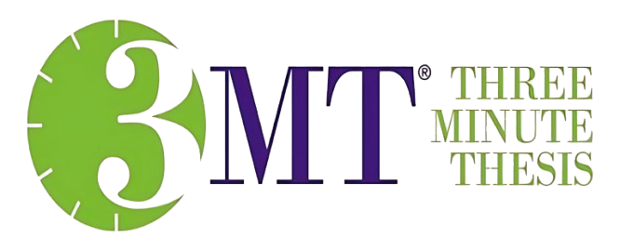


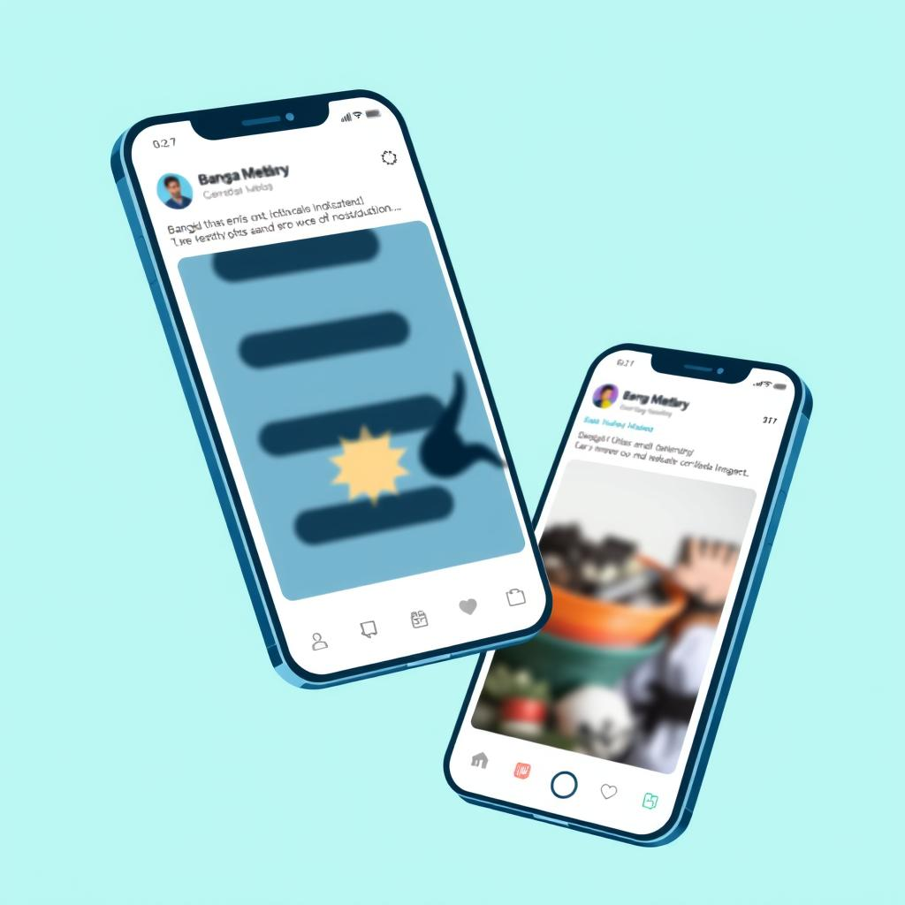
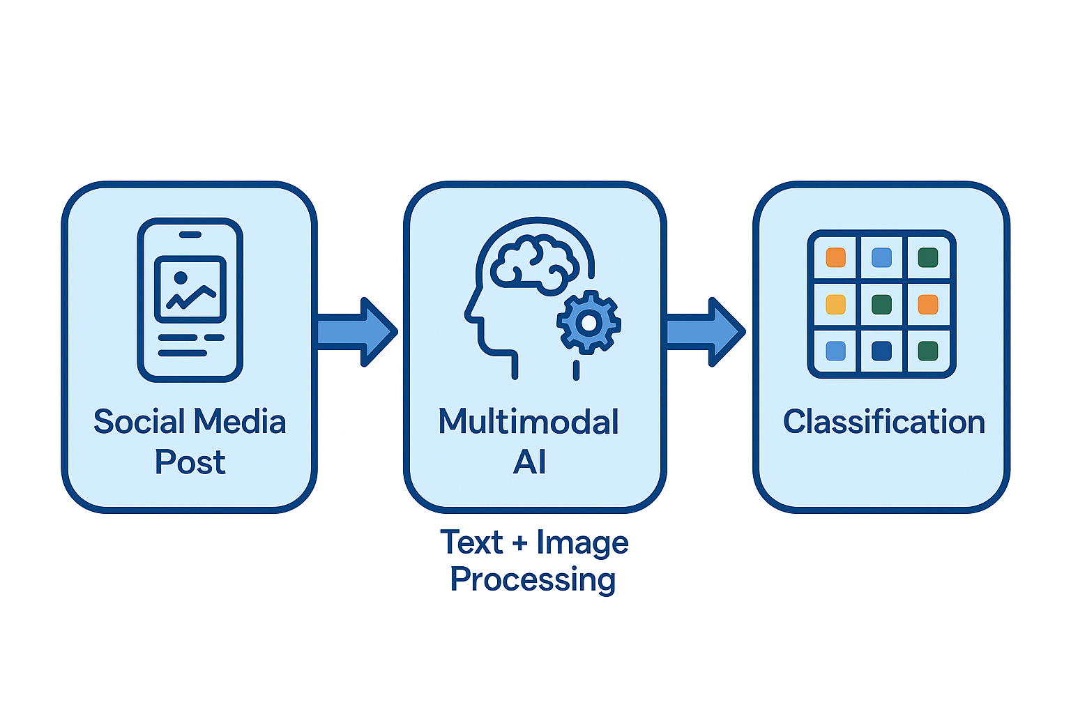
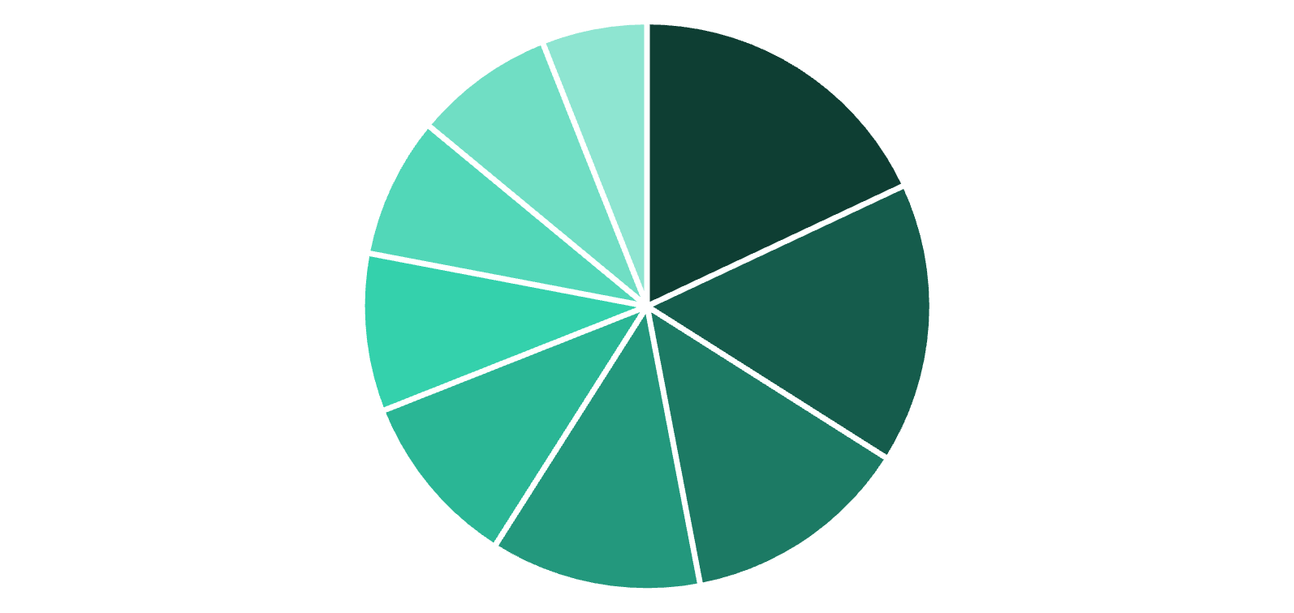
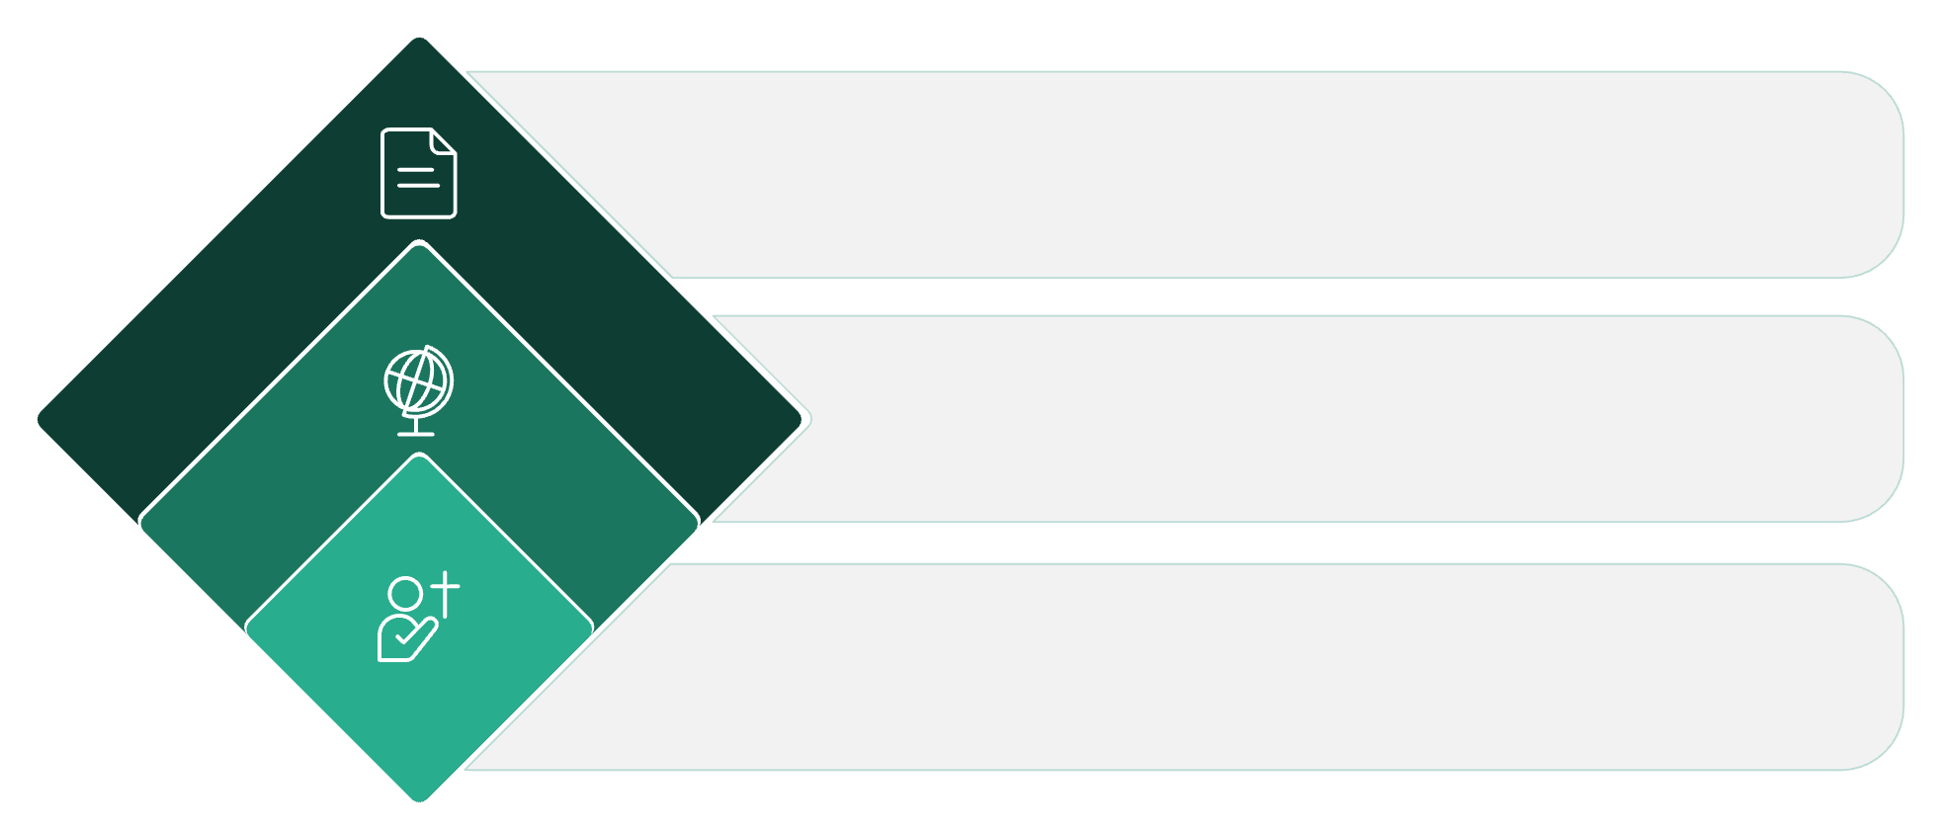
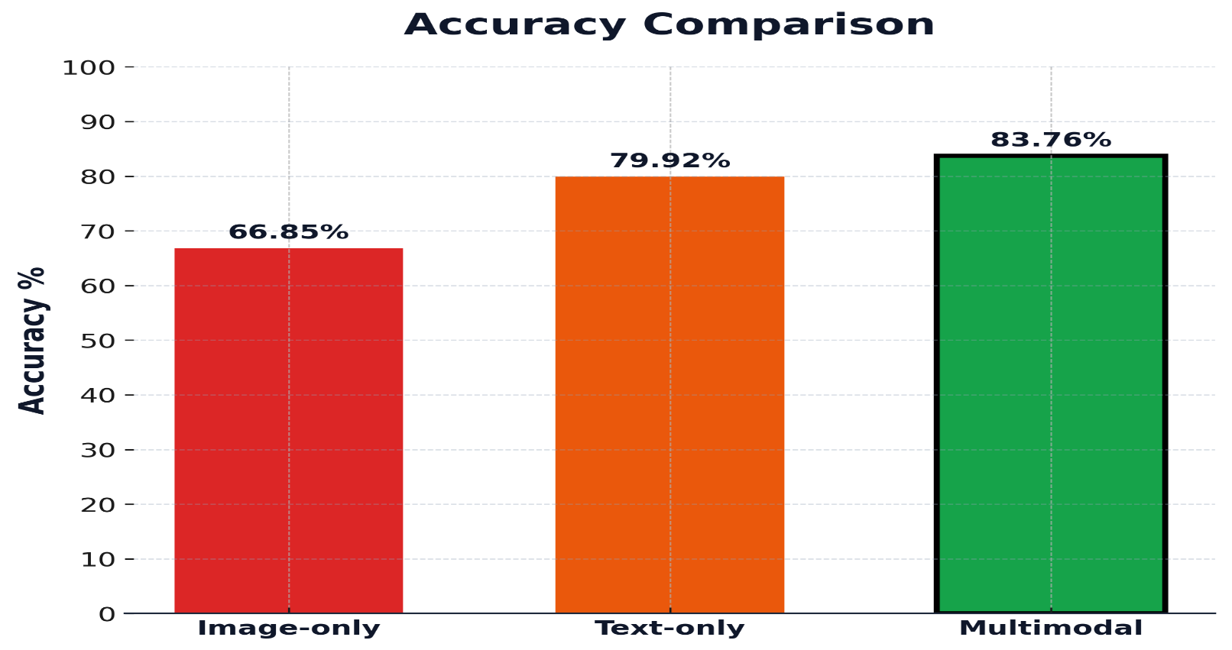






BanglaMM-Disaster: A Multimodal Transformer-Based Deep Learning Framework for Multiclass Disaster Classification in Bangla
Ariful Islam¹, Md Rifat Hossen²
1,2 Chittagong University of Engineering and Technology
🚨 THE CHALLENGE
🔬 OUR SOLUTION
Bangladesh faces frequent natural disasters
300M+ Bangla speakers lack automated monitoring
First comprehensive multimodal disaster AI for Bangla
Transformer‑CNN fusion architecture
Social media provides real-time disaster updates
No multimodal classification system exists for Bangla
Combines text analysis + visual understanding
Classifies 9 disaster categories automatically
📊 DATASET & APPROACH
🎯 RESULTS & IMPACT
Text Input
Real-time
Monitoring
8%
6%
18%
BanglaBERT, mBERT, XLM-RoBERTa
8%
Image Input
9%
16%
ResNet50, DenseNet169, MobileNetV2
Faster
Response
10%
12%
13%
Early Fusion
Agricultural Damage
Natural Landscape
Combined Features → Classification
300M+
People Served
Others
Economic
Loss
Non-Damage
Floods
Infrastructure
Landslides
Fires
5,037 annotated Bangla social media posts
Advanced transformer models for text processing
83.76% accuracy achieved (best performance)
+3.84% improvement over text‑only approach
9 disaster categories with balanced distribution
State‑of‑the‑art CNN architectures for images
+16.91% improvement over image‑only approach
Enables real‑time disaster response for millions

