Slide 1
BanglaSentNet: A Hybrid Deep Learning Framework for Multi-Aspect Sentiment Analysis in Bangla E-Commerce Reviews
Paper ID – 151, Technical Session – 23
Ariful Islam and Md Rifat Hossen
Chittagong University of Engineering and Technology
18 July 2025

Slide 2
Overview
Introduction & Problem Statement
Related Work & Background
Dataset & Preprocessing
BanglaSentNet Architecture
Training & Ensemble Strategy
Results & Performance Analysis
Conclusion & Future Work
References

Slide 3
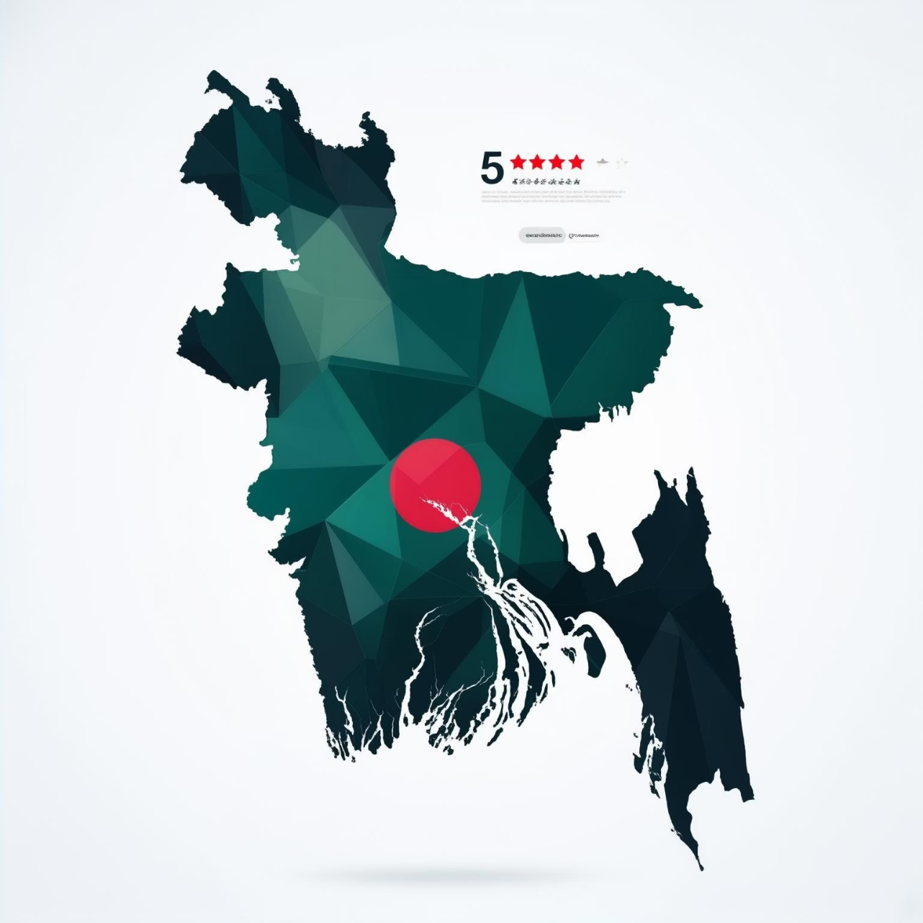
Introduction
Bangla (Bengali) is spoken by over 300 million people, yet it has scarce NLP resources.
E-commerce reviews in Bangla often contain multiple opinions on various aspects (quality, price, service).
Traditional sentiment analysis models miss these nuanced aspects, predicting only single polarity.
Challenges include limited benchmarked datasets and preprocessing tools for Bangla text [6].

Slide 4
Problem & Challenges
E-commerce reviews often contain mixed sentiments towards different aspects.
Mixed Sentiment Example
Goal: Perform multi-aspect sentiment classification in Bangla across categories: Quality, Service, Pricing, Decoration.
Original: “পণ্য মান খুব ভালা, কিন্তু দাম অনেক বেশি।”
Translation: “Product quality is very good, but price is too high.”
Challenges: Complex Bangla morphology, informal writing, spelling variations, and code-mixing [6].
Limited pre-trained models are fine-tuned specifically for Bangla [12].
Analysis: Quality (Positive), Price (Negative)

Slide 5




Key Contributions
Dataset Creation
Hybrid Deep Model
Large Bangla e-commerce review dataset labeled by aspect (Quality, Service, Price, Decoration).
Design integrating LSTM, BiLSTM, GRU, and BanglaBERT (transformer) for enhanced learning.
Ensemble Strategy
Data Preprocessing
Weighted ensemble strategy combining models to improve classification accuracy.
Feature engineering to handle Bangla-specific issues: class imbalance, misspellings, informal text.

Slide 6
Related Work - International & ABSA Foundations
International ABSA Foundations
Early Bangla NLP
Mandal et al. pioneered supervised learning for Bangla classification [5].
SemEval tasks established ABSA benchmarks [1,2].
Advanced techniques include Hierarchical GCNs for explicit and implicit sentiment [3].
Dhar et al. identified challenges like morphological complexity in ML classifiers [6].
Hybrid lexical-ML approaches are used in service industry ABSA [4].
Neural transition: Multi-label classification using Bengali word embeddings [7].

Slide 7
Related Work - Deep Learning & Modern Approaches
Deep Learning Advances
Transformer & Ensemble Methods
CNN, BiLSTM, GRU models compared for Bangla SA [8].
BERT and BanglaBERT applied to low-resource Bengali tasks [11,12].
Transfer learning with Multilingual BERT shown effective for Bengali SA [9].
Hybrid approaches combining Lexicon + BanglaBERT achieved record performance [13].
Specialized datasets like BanglaBook created for domain-specific research [10].

Slide 8
Dataset and Annotation
Data Collection: We collected 8,755 Bangla product reviews from prominent e-commerce platforms, including Daraz, Facebook Marketplace, Rokomari, and Shajgoj.
Manual Annotation: Trained Computer Science students manually labeled each review, with domain experts ensuring high-quality annotations for Quality, Service, Pricing, and Decoration (Positive, Negative, or Neutral).
Table 1: Reviews by Platform
Table 2: Sentiment Distribution by Aspect
Platform
Review Count
Aspect
Positive
Negative
Neutral
Daraz
6,521
Quality
2,400
1,200
400
Facebook
1,145
Service
600
300
100
Rokomari
494
Price
1500
900
100
Shajgoj
155
Decoration
750
400
105
Other
440
Total
8,755
Total
8,755

Slide 9

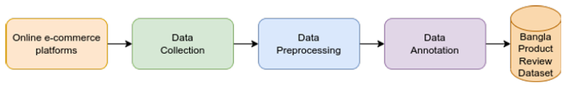

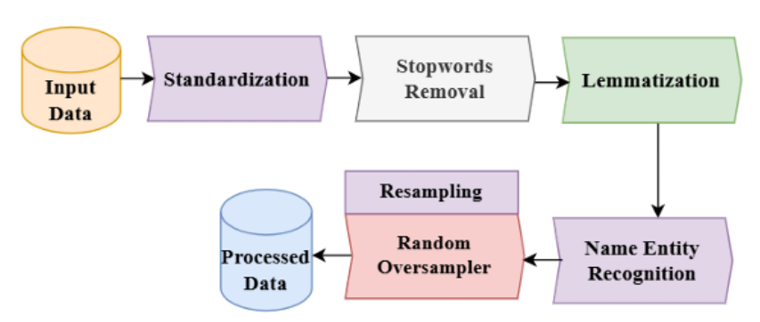

Preprocessing Pipeline
Automated Cleaning
Normalized text by removing noise, special characters, and non-Bangla scripts. Corrected common spelling variants using custom Bangla tokenizers.
Figure 1: Data collection pipeline from online platforms to final dataset.
Result
A linguistically consistent and high-quality dataset comprising 8,755 product reviews, ready for model training and evaluation.
Manual Review
Eliminated spam, emojis, and poorly structured reviews. Verified terminology using a comprehensive Bangla dictionary to ensure data integrity.
Figure 2: Data preprocessing pipeline from raw input to processed dataset

Slide 10
Vocabulary Overlap
Vocabulary is rich and varied across aspects.
Table 3: Jaccard Similarity Coefficients (Aspects)
Quality reviews possess the largest lexicon (more unique words).
Quality
Service
Pricing
Decoration
Semantic overlap between aspects quantified by Jaccard similarity.
Quality
1.00
0.38
0.52
0.45
Service
-
1.00
0.41
0.58
For example, Pricing and Quality aspects share a 0.52 Jaccard similarity.
Pricing
-
-
1.00
0.50
Decoration
-
-
-
1.00

Slide 11
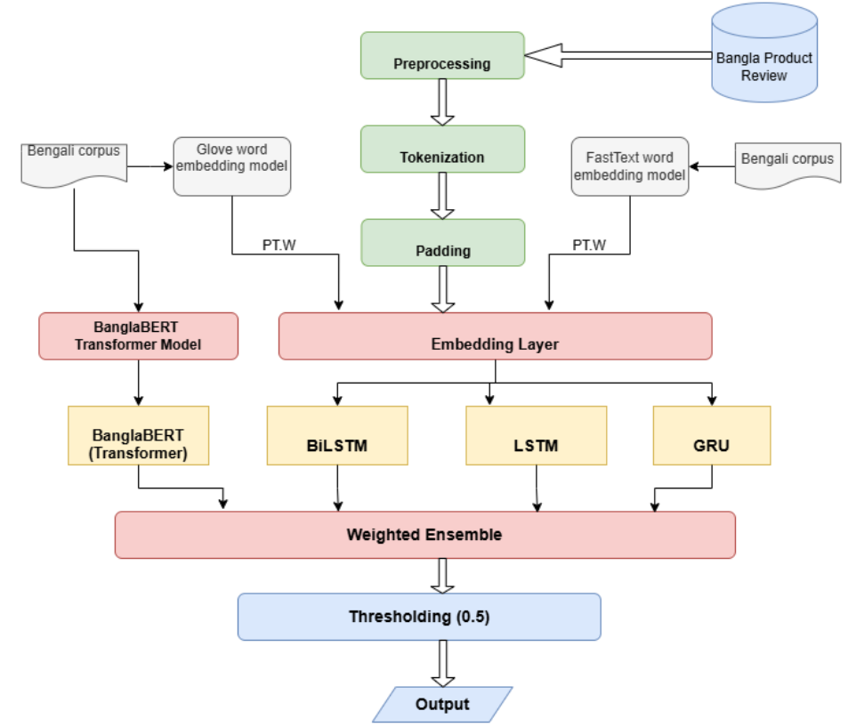
Proposed BanglaSentNet Model
Ensemble of four neural models:
BanglaBERT: 12-layer transformer (768-dim)
BiLSTM: 2 layers, 128x2 units (bidirectional context)
LSTM: 2 layers, 256 units (sequential dependencies)
GRU: 2 layers, 200 units (efficient gating)
Figure 3: Proposed Ensemble Framework for Bangla Sentiment Analysis

Slide 12


Embedding Layer
Static Word Embeddings
FastText Embeddings
GloVe (300-d) trained on 2.5B Bangla tokens for semantic content.
Captures subword information for morphological details.
Dual Embeddings
BanglaBERT Contextual Embeddings
Combines static word embeddings with FastText for comprehensive semantic capture.
capture dynamic meanings of words based on sentence context.

Slide 13
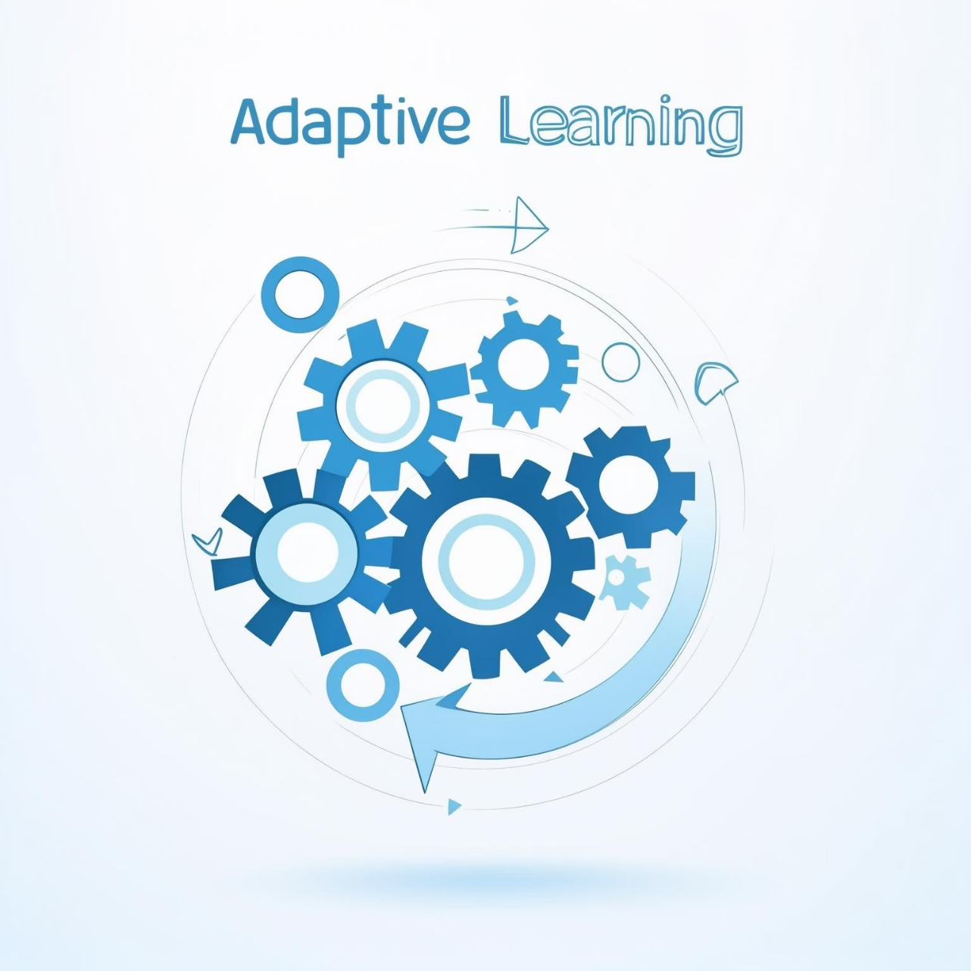
Training and Ensemble
Individual Training: BanglaBERT with AdamW (lr=2e-5), RNNs with Adam (lr=1e-3).
Adaptive Weighted Voting: Weights learned via gradient descent on validation data.
Dynamic Weight Tuning: Weights adapt based on review length and complexity.
Final Decision: Softmax for multiclass, calibrated threshold (0.5) for binary.

Slide 14
Experimental Setup
Dataset Split:
Evaluation Metrics:
Implementation:
- Training: 70% (6,128 reviews)
- Validation: 15% (1,313 reviews)
- Test: 15% (1,314 reviews)
- Accuracy, Precision, Recall, F1-Score
- Macro-average for balanced multi- label evaluation
- Python 3.8, TensorFlow 2.4
- Individual model training followed by ensemble optimization

Slide 15
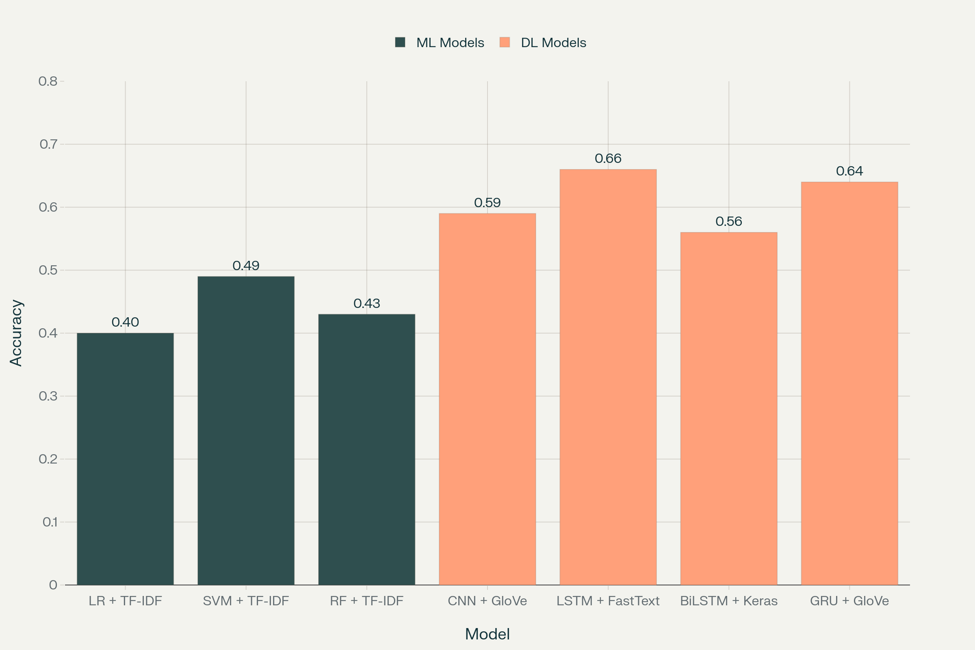
Baseline Model Performance
Figure 4: Performance Comparison of Baseline Models

Slide 16
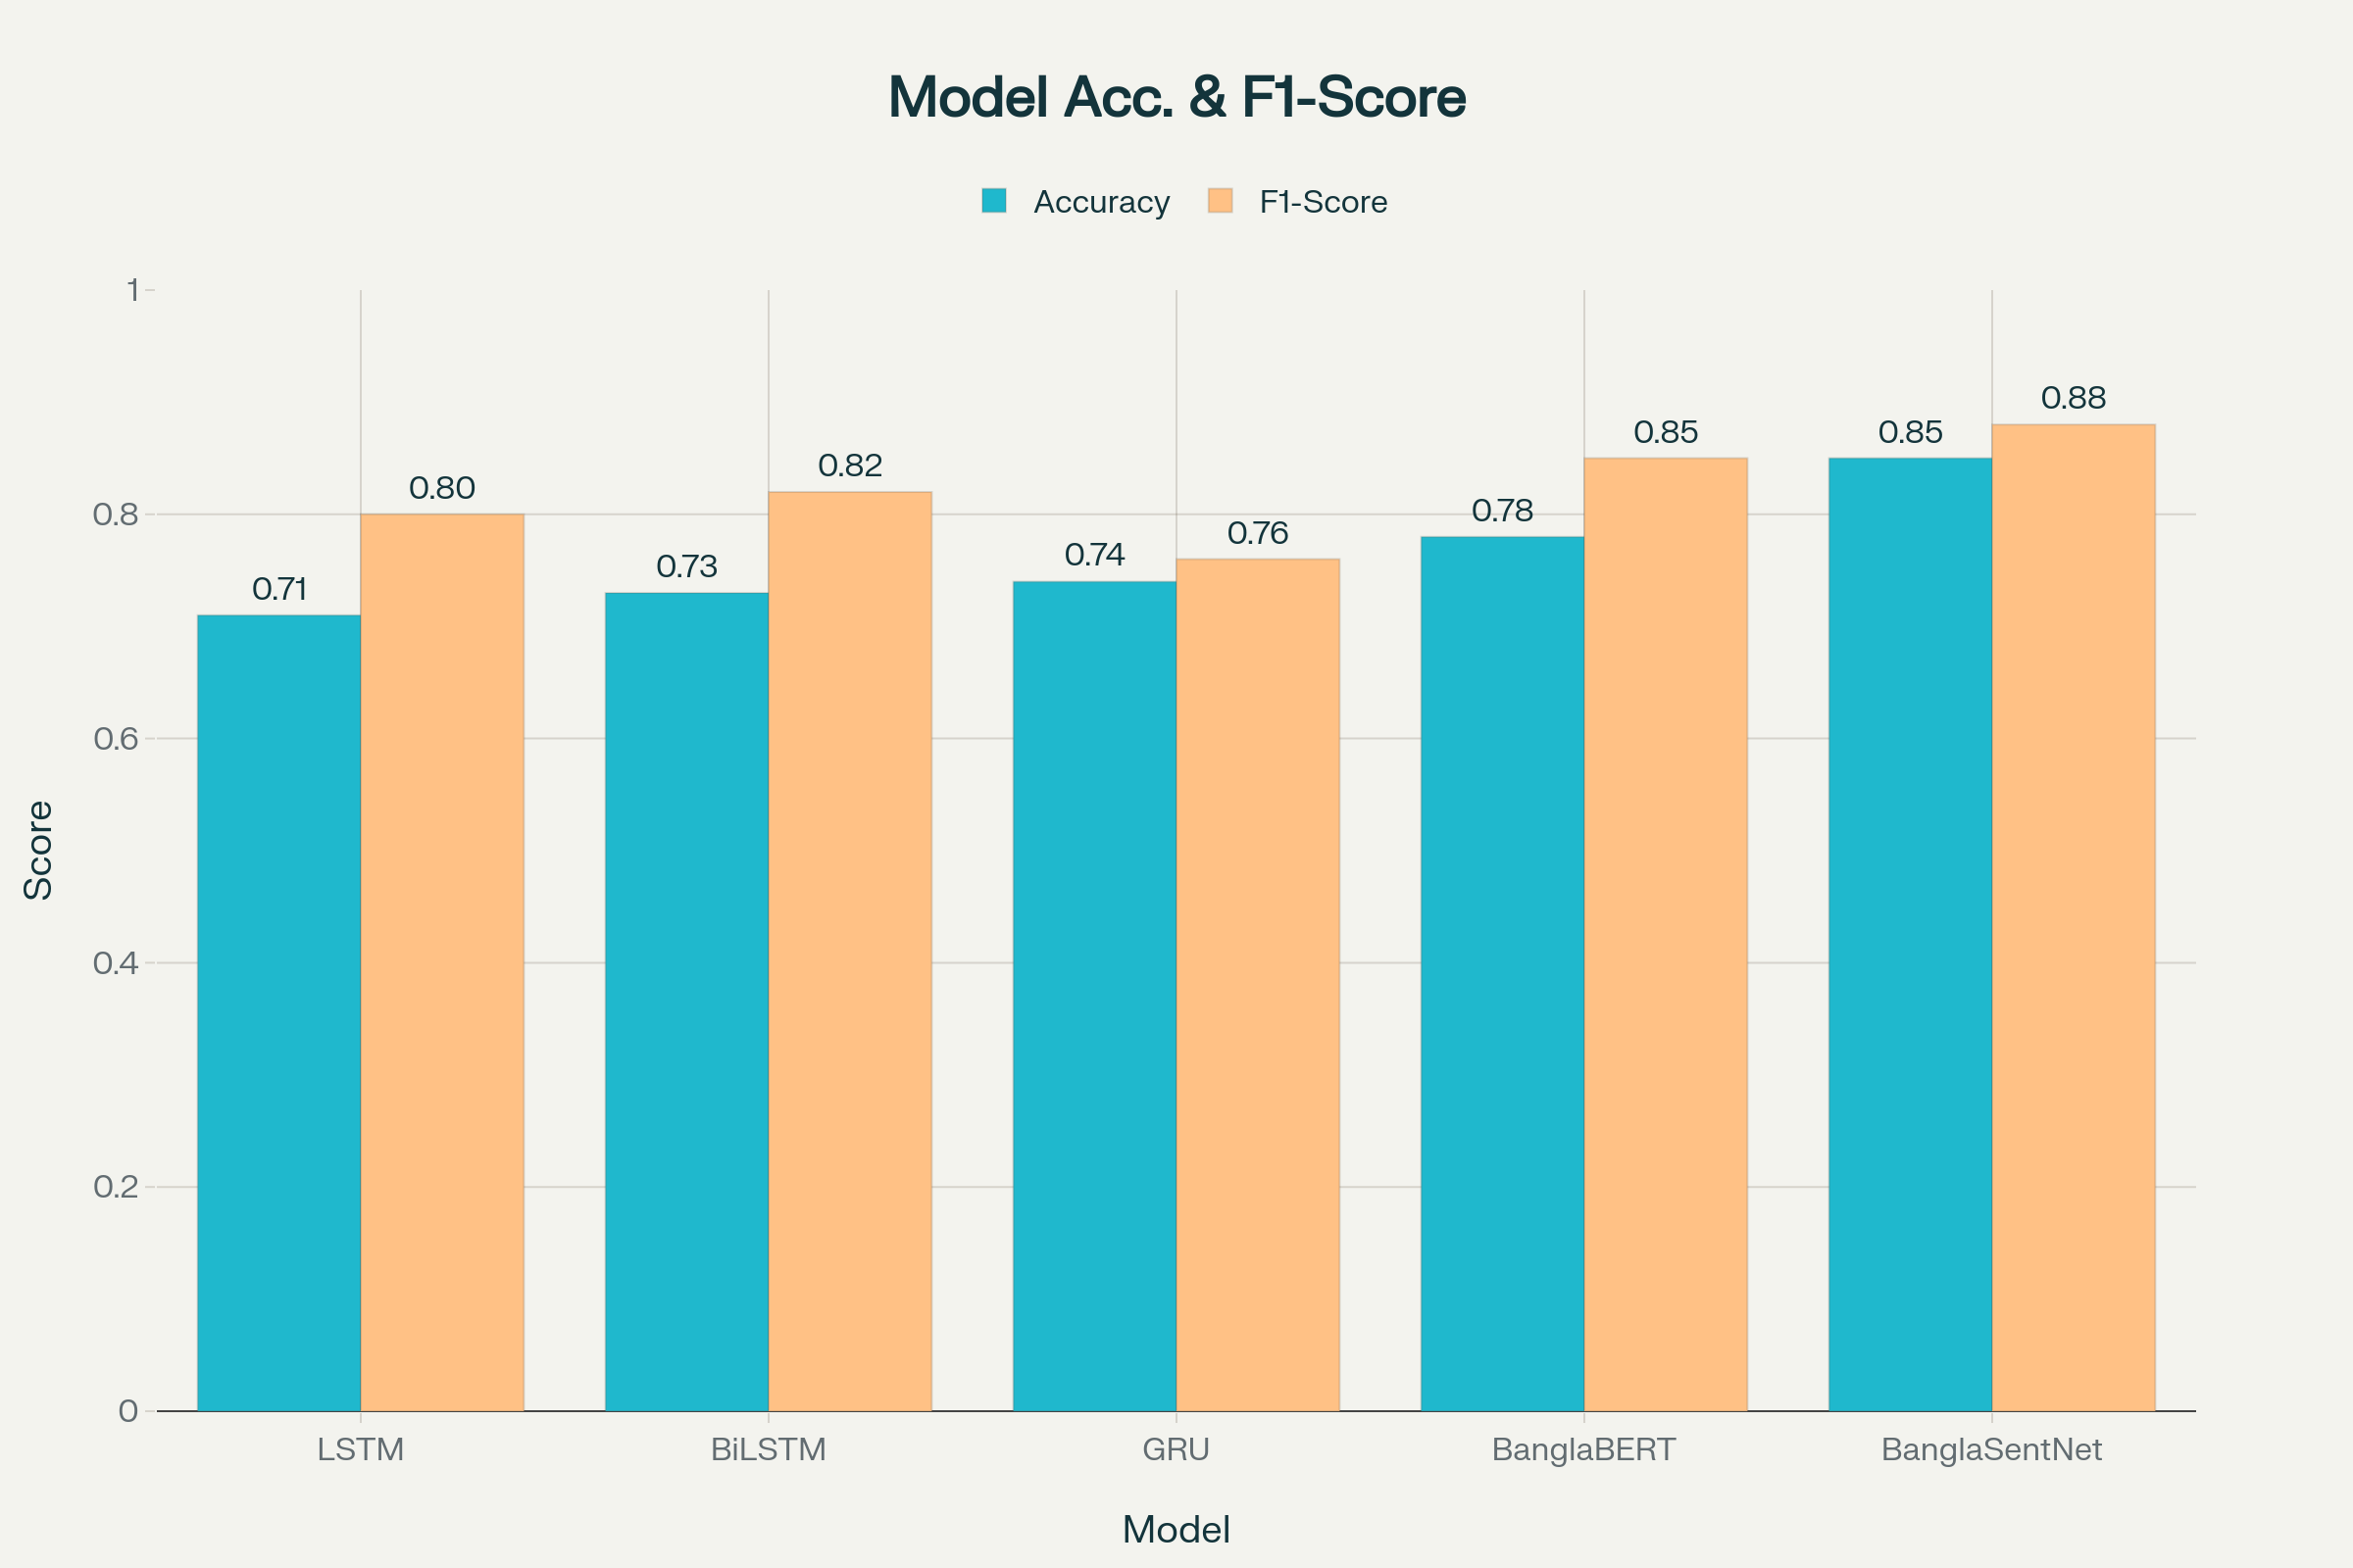
BanglaSentNet Performance
Figure 5: Performance Comparison of Final Models

Slide 17
Ablation Study
Full Ensemble
Without BanglaBERT
Without BiLSTM
F1: 0.88
F1 drops to 0.75
F1 drops to 0.79
Without LSTM
Without GRU
F1 drops to 0.81
F1 drops to 0.78
Removing any component degrades performance, highlighting the value of each model.

Slide 18
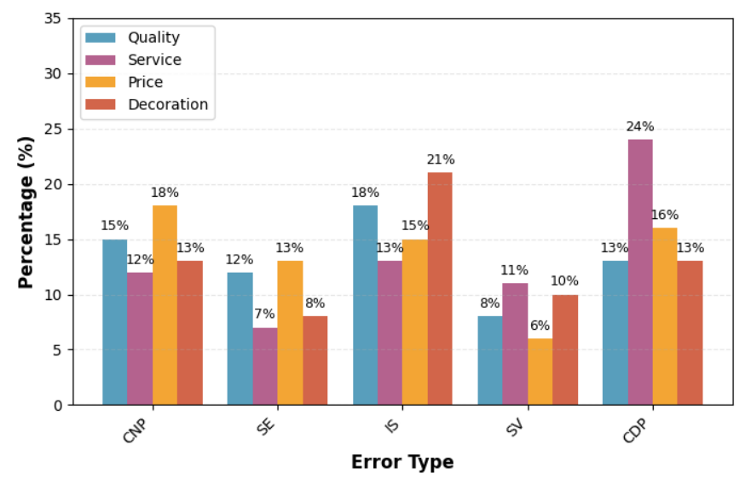
Error Analysis
Major Error Types: Complex negation, sarcasm, implicit sentiment, spelling variations, context-dependent polarity.
Most Frequent Error: Context-dependent polarity (same term, different sentiment).
Figure 6: Distribution of Error Types Across Product Categories

Slide 19
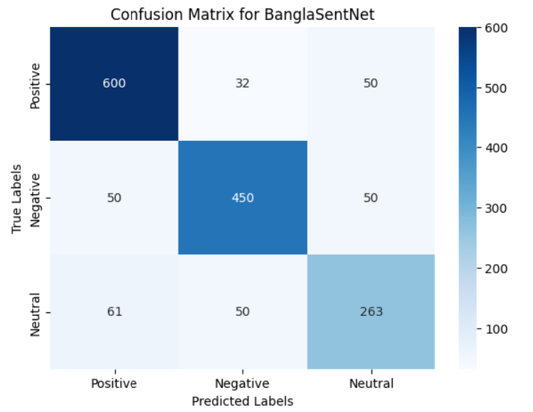
Confusion Matrix
Most positives (600) and negatives (450) correctly
detected.
Neutral sentiment is the hardest (263 correct), often confused as positive or negative.
Typical in sentiment tasks due to implicit tones.
Figure 7: Confusion Matrix for BanglaSentNet on Test Data

Slide 20



Real-World Case Study
E-commerce Data
Actionable Insights
Practical Value
Applied BanglaSentNet to live product feedback (Daraz).
Detected high positive sentiment on quality, but negative on pricing, leading to strategy change.
Improves consumer insight and decision-making.

Slide 21
Conclusion and Future Work
Conclusion:
Future Work:
BanglaSentNet improves multi-aspect sentiment analysis for Bangla reviews.
Optimize ensemble to reduce compute cost; explore few-shot/transfer learning.
Tested on a new dataset of 8,755 Bangla reviews.
Address limitations (informal text, slang) and extend to more domains.
Achieved 85% accuracy and 0.88 F1 on an 8,755-review dataset, outperforming baselines.
Sets new state-of-the-art for low-resource Bangla SA.

Slide 22
References
[1] Pontiki et al. (2015), SemEval-2015 Task 12: Aspect based sentiment analysis
[2] Pontiki et al. (2016), SemEval-2016 Task 5: Aspect based sentiment analysis
[3] Cai et al. (2020), Aspect-category based sentiment analysis with hierarchical graph convolutional network
[4] Maroof et al. (2024), IEEE Access: Aspect-based sentiment analysis for service industry
[5] Mandal et al. (2014), Supervised learning methods for bangla web document categorization
[6] Dhar et al. (2018), Performance of classifiers in bangla text categorization
[7] Hasan et al. (2017), Multi-label sentence classification using bengali word embedding model
[8] Hoq et al. (2021), Sentiment analysis of bangla language using deep learning approaches
[9] Islam et al. (2020), Sentiment analysis in bengali via transfer learning using multi-lingual bert
[10] Kabir et al. (2023), BanglaBook: A large-scale bangla dataset for sentiment analysis
[11] Hoque et al. (2024), Exploring transformer models in sentiment analysis for Bengali language
[12] Chakma et al. (2023), Low-resource sentiment analysis leveraging BanglaBERT
[13] Mahmud et al. (2024), Enhancing sentiment analysis in bengali texts: A hybrid approach

Slide 23


Thank You!
Questions?
Presenter: Md Rifat Hossen
Chittagong University of Engineering and Technology
Email: rifat8851@gmail.com

