Slide 1
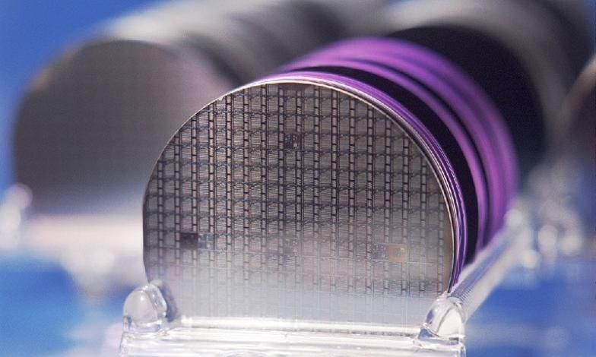
2025 International Conference on Electrical, Computer and Communication Engineering (ECCE)
Advancing Semiconductor Fabrication: A
CNN-Based Wafer Defect Detection with XAI
Insights
Paper Id: 821
Md Rifat Hossen, CSE, CUET; Md Nahian Abdullah, EEE, CUET

Slide 2
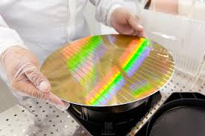
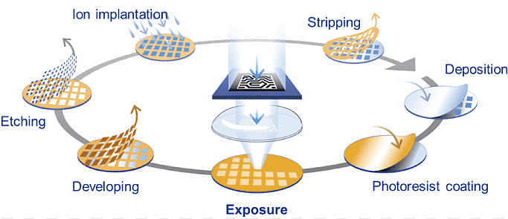
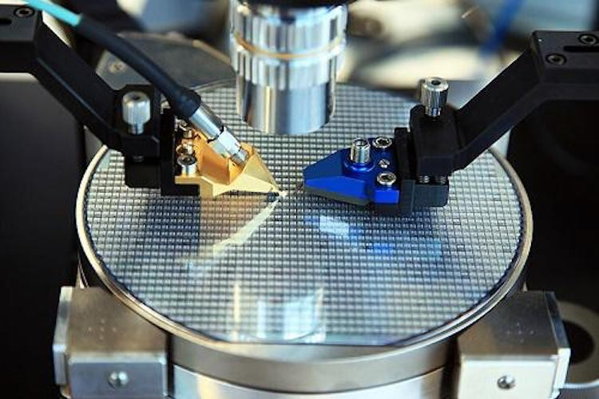
Chip manufacturing is complex
Several opportunities for a defect to occur
> 1000
Processing steps to finish a chip
> 10
Weeks of processing time
Start
End
> 100
Equipment used in manufacturing
> 40000
wafers started every month

Slide 3
Yield maximization is critical for cost reduction
91% yield
120 dies, 109 good
58% yield
26 dies, 15 good
Good Die
Defective Die
Defects = Yield = $ Cost

Slide 4
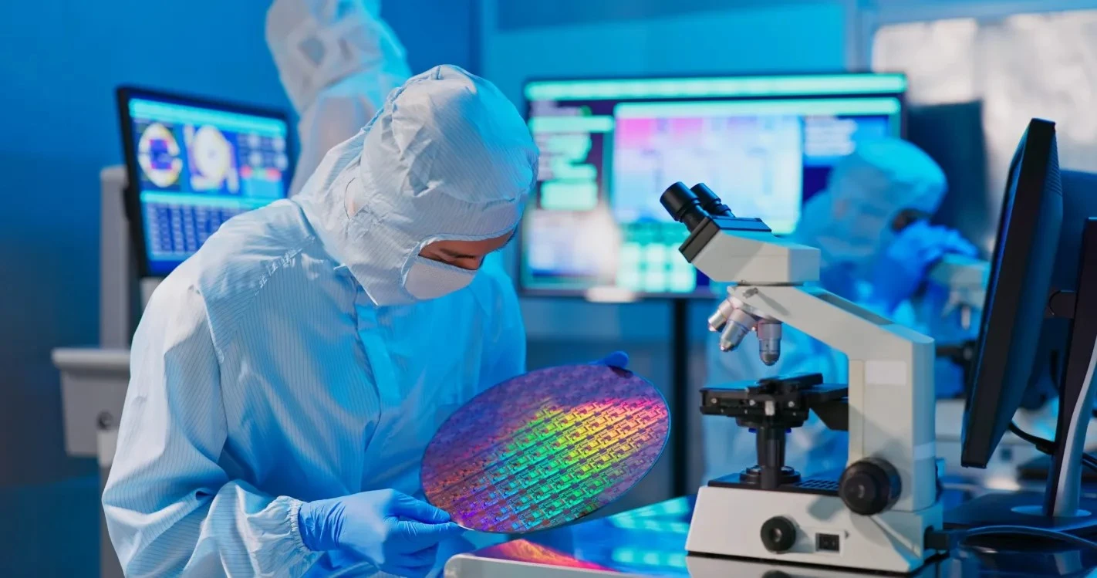
Wafer defect analysis is mainly performed manually by expert engineers, attaining accuracy rates below 45% [1].
Challenges
Time-consuming
Varying expertise
Strict IP policies
Notes:
Challenges (first two from Intel paper):
Limited human-hour resources prevent engineers from reviewing and documenting every issue in every wafer in every lot
Detection accuracy depends on an engineer’s experience level. It takes many years for yield analysis engineers to gain experience in manufacturing process technologies to perform GFA (gross failure areas) detection accurately. This task tends to be a balance between art and science; engineers need many years of experience to learn how to distinguish accurately between random statistical “noise” and real GFAs/patterns/signatures.
Manufacturers are hesitant to share data, which results in limited data available for developing AI models.

Slide 5

Problem Statement
Automated Semiconductor Wafer Defect Classifier
Use a neural network to identify wafers with single defect patterns and classify them into different defect groups with >90% accuracy

Slide 6
Literature review
Approach | Details | Limitations
Manual Inspection | Inefficient, time-intensive, prone to human errors and accuracy rates below 45% [1]. | Ineffective for high-volume manufacturing processes. Prone to subjective errors due to manual assessment. Limited scalability
Machine Learning | Cheon et al. (2019): CNN with k-NN for unknown defects [2]. Zheng et al. (2021): DCNN for wafer patterns. - Outperformed traditional methods, Achieved 93.75% accuracy [3]. | Cheon: Poor generalization in noisy environments. Zheng: Difficulty with detecting localized failure patterns ("Loc").
Deep Learning | Saqlain et al. (2020): Deep-layered CNN for imbalanced datasets. - Focused on WM-811K dataset [4]. Kyeong & Kim (2018): CNN for mixed-type defects. - Addressed mixed-class issues [5]. | Saqlain: Significant performance gaps for rare defect categories. Kyeong & Kim: Limited accuracy for overlapping defect categories.

Slide 7
Limitations in Existing Research
Data Challenges
Severe class imbalance: “None” class dominates most datasets
Inconsistent image dimensions and quality: Complicates preprocessing steps
Model Performance
Difficulty achieving high accuracy for multiple wafer defect classes
Overfitting risks: Insufficient regularization leading to performance drops
Lack of comprehensive methods to interpret and justify model decisions
Explainability

Slide 8
Notable Contribution of This Work
ResNet50 achieved superior performance (~99% accuracy) across multiple wafer defect classes in the WM-811k dataset, including Donut, Edge-Ring, Near-full, and Random
Addressed class imbalance through advanced data augmentation
In addition to ResNet-50, a custom CNN, Inception V3, and SVM classifiers were developed and evaluated for wafer defect detection
XAI-Grad-CAM visualizations validated model focus on critical defect areas and improved transparency in model decision-making processes.

Slide 9

Where does our data come from?
WM-811K is one of the largest open source dataset from real production process, comprising 811,457 real-world wafer maps [6].
Wafer Bin Map
Defective
Wafer
Probing
Fabrication
Assembly
Final
Test
Blank Wafer
Fabricated Die
Die bank
Package
End Product
Front End Operations
Back End Operations
Notes:
Main points:
Using WM-811K dataset, largest open source dataset from real production process
Data = pass/fail wafer bin maps from electrical probing after manufacturing
Can be treated as a grayscale image classification problem

Slide 10
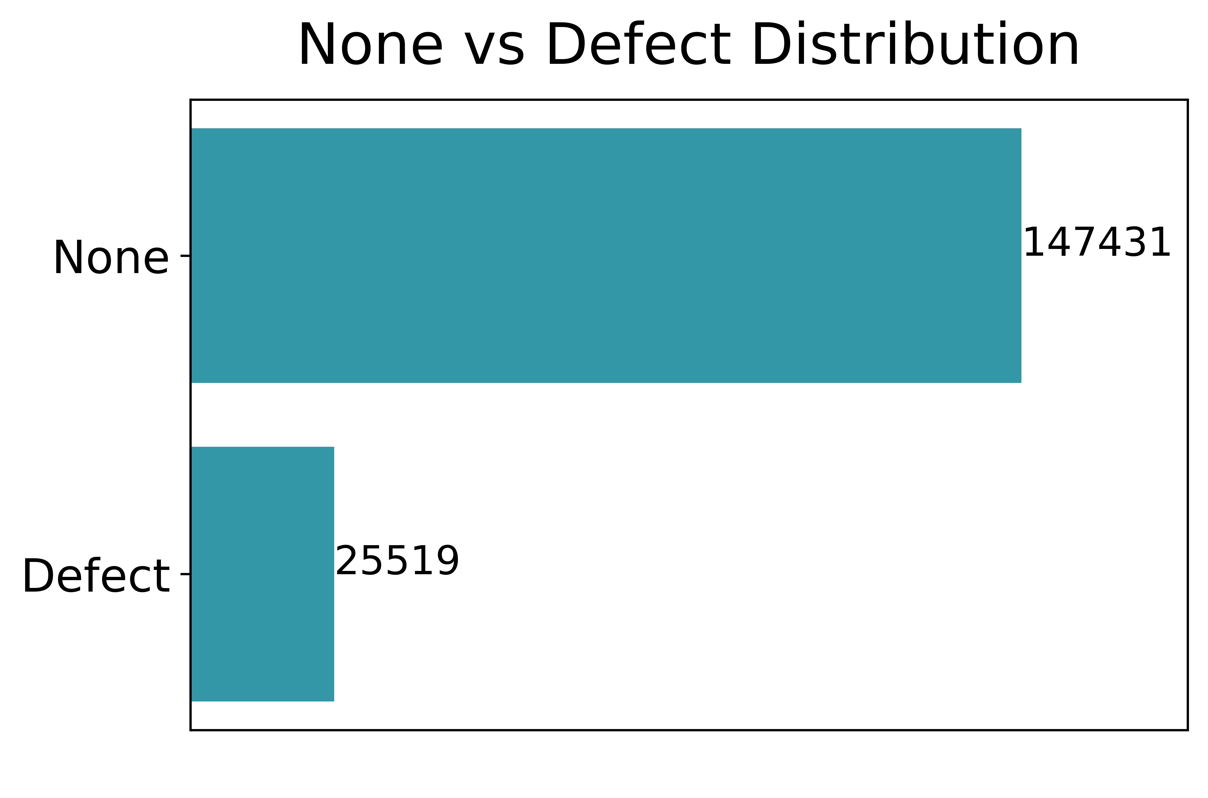
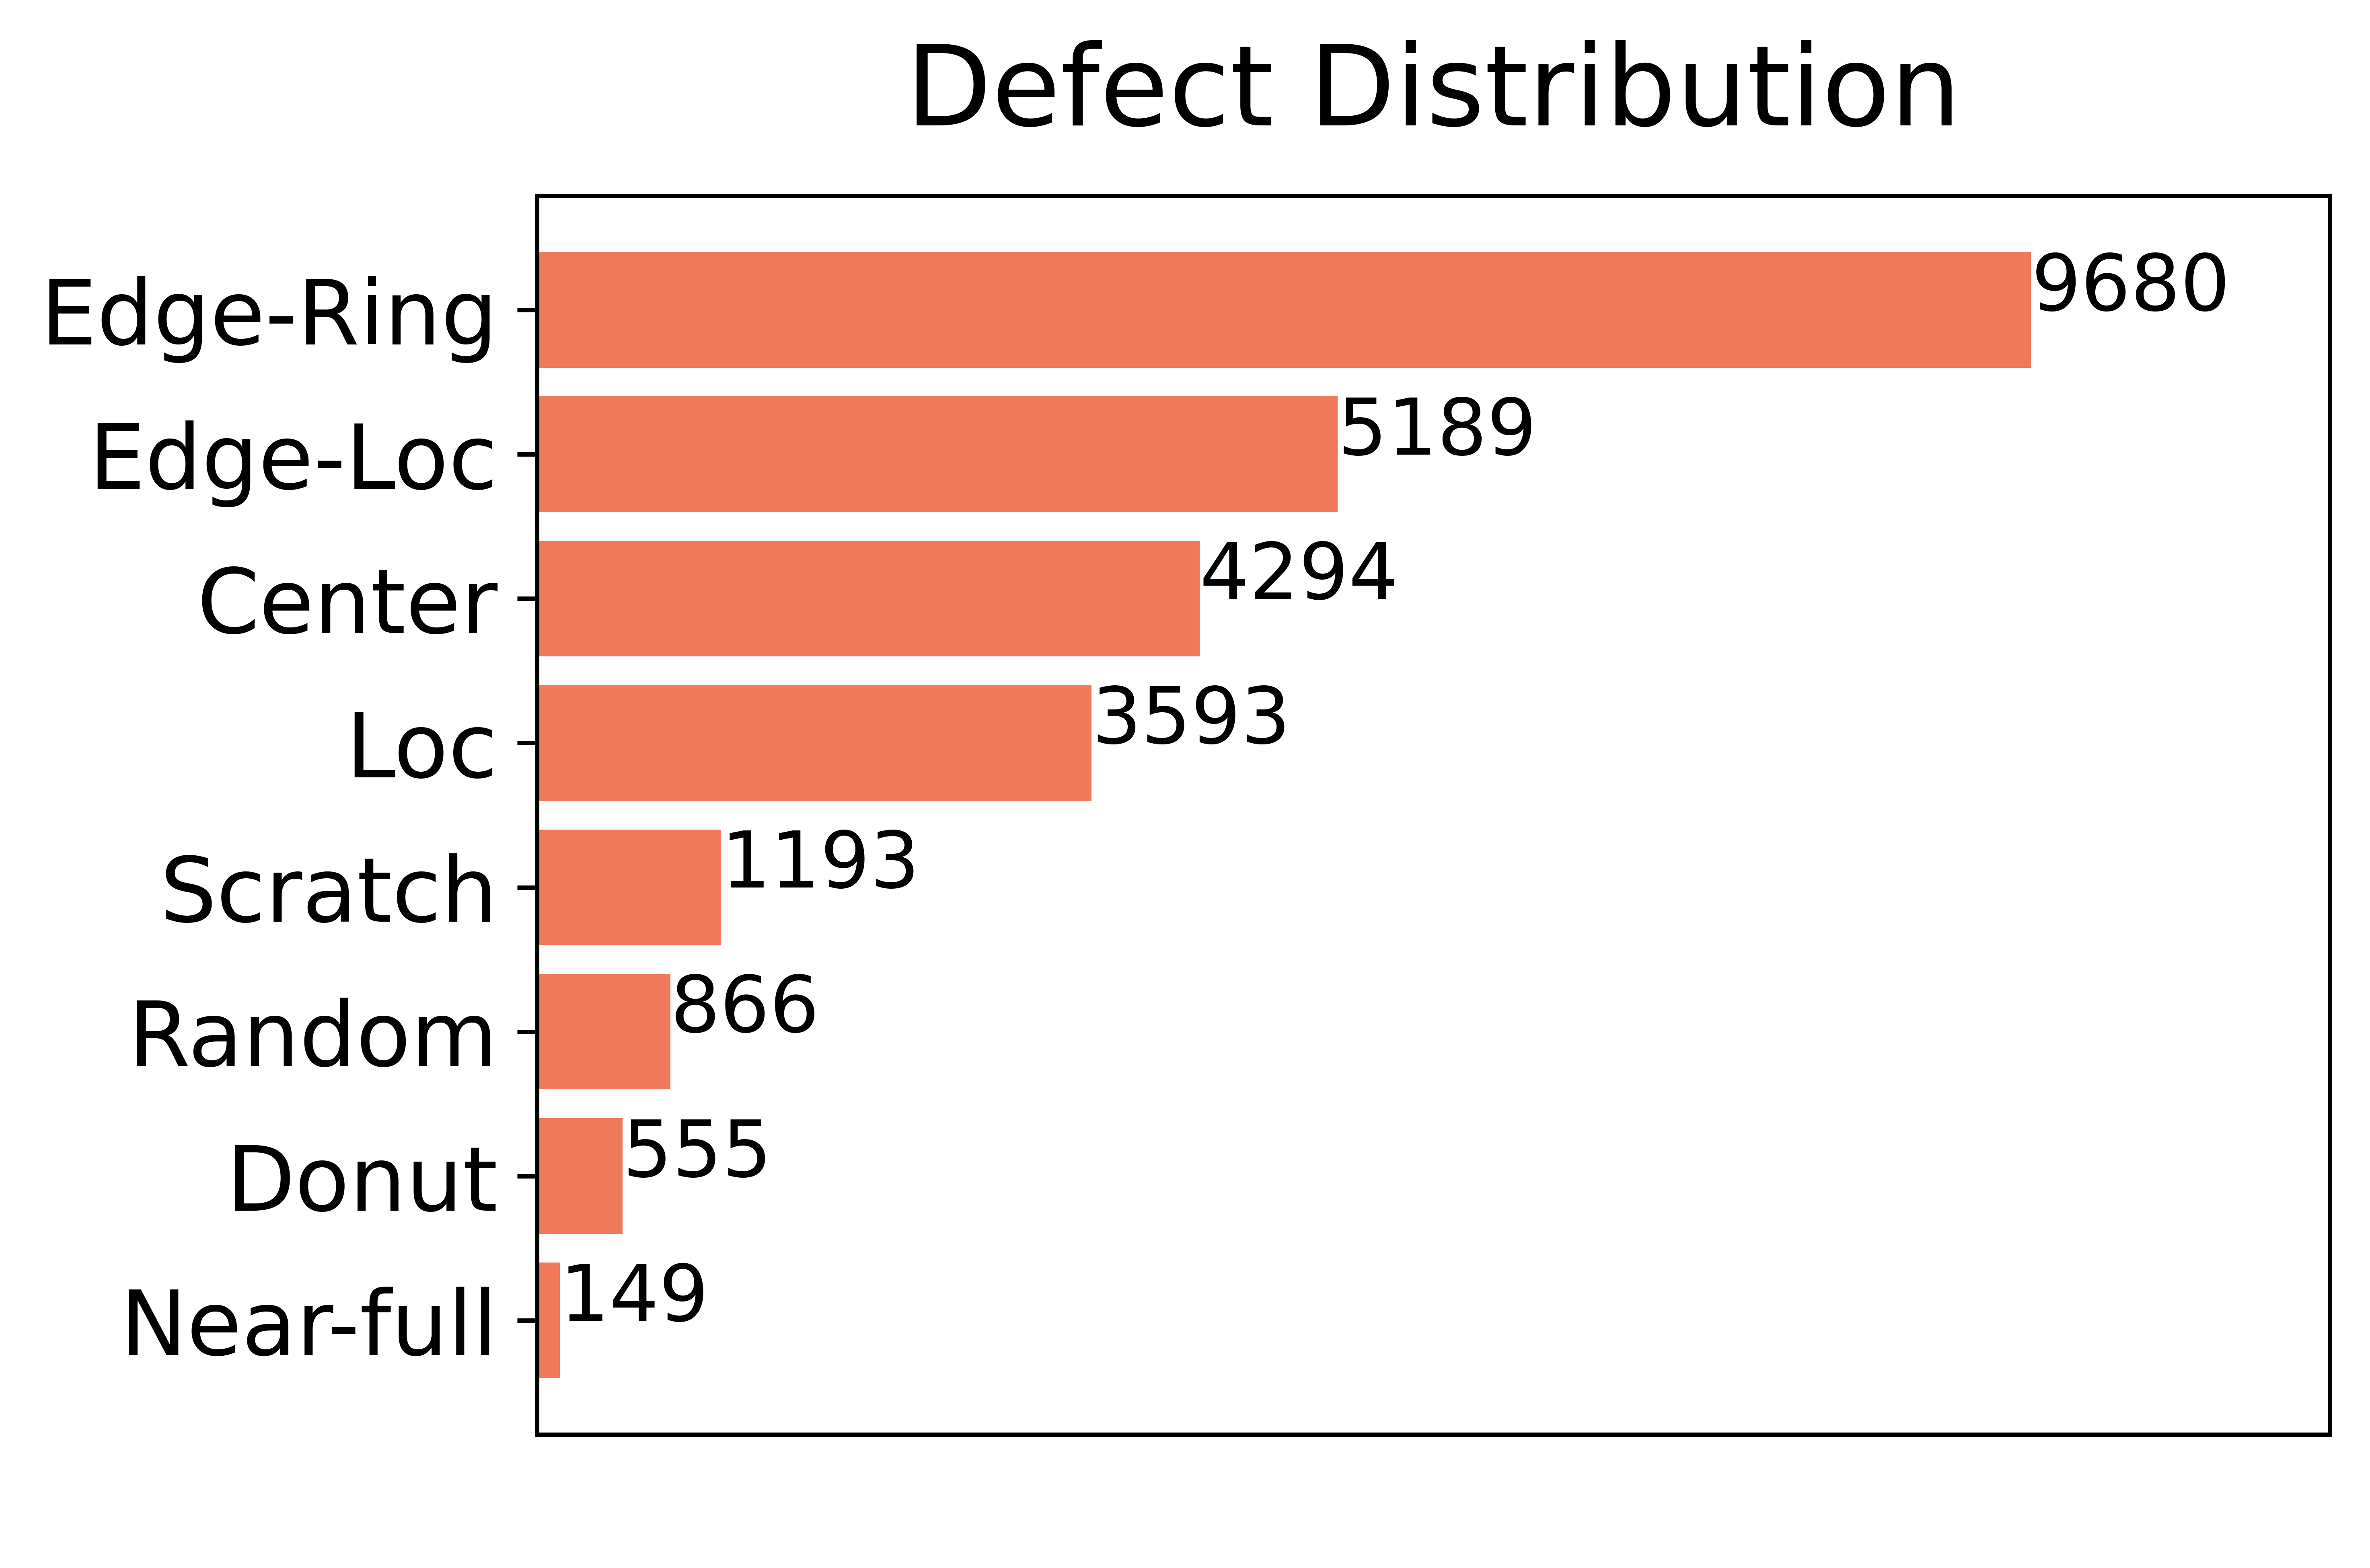
What does our data look like?
Highly Imbalanced
Undersampling, data augmentation
Single-defect multi-class
9 classes total, including none
Variable quality and resolution
Resizing and pre-processing
Notes:
Main points:
Labeled data consist of single-defect wafers with 9 classes total (including none)
Click to show gray box
As in real-world, nones are most prevalent (~85%)
Data is doubly imbalanced because defect types are imbalanced as well
Click to show orange box
As in real-world, wafer map resolution varies (manufacturing plant can produce wafers for different applications with different die sizes)
In addition to variable resolution, the dataset also contains varying wafer quality (different amounts of “noise”)

Slide 11
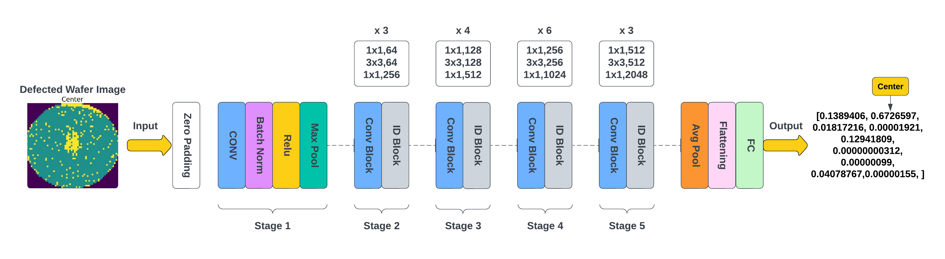
Proposed ResNet-50 CNN model architecture
Notes:
Here is an overview of our model framework. First, we resize all the pass/fail wafermaps to 224x224. We then apply morphological thinning. For model training, we undersample the none type and introduce random flips and rotations to augment the defect types. Finally, we use a convolutional neural network to achieve the wafer classification.

Slide 12
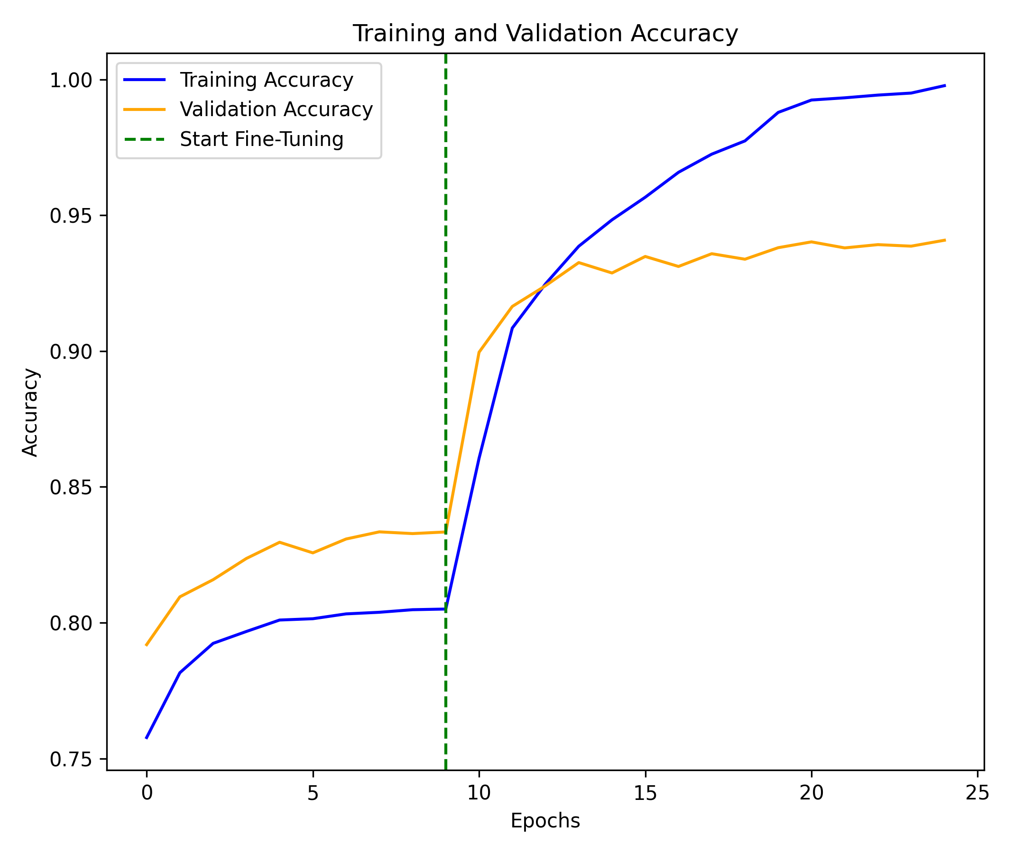
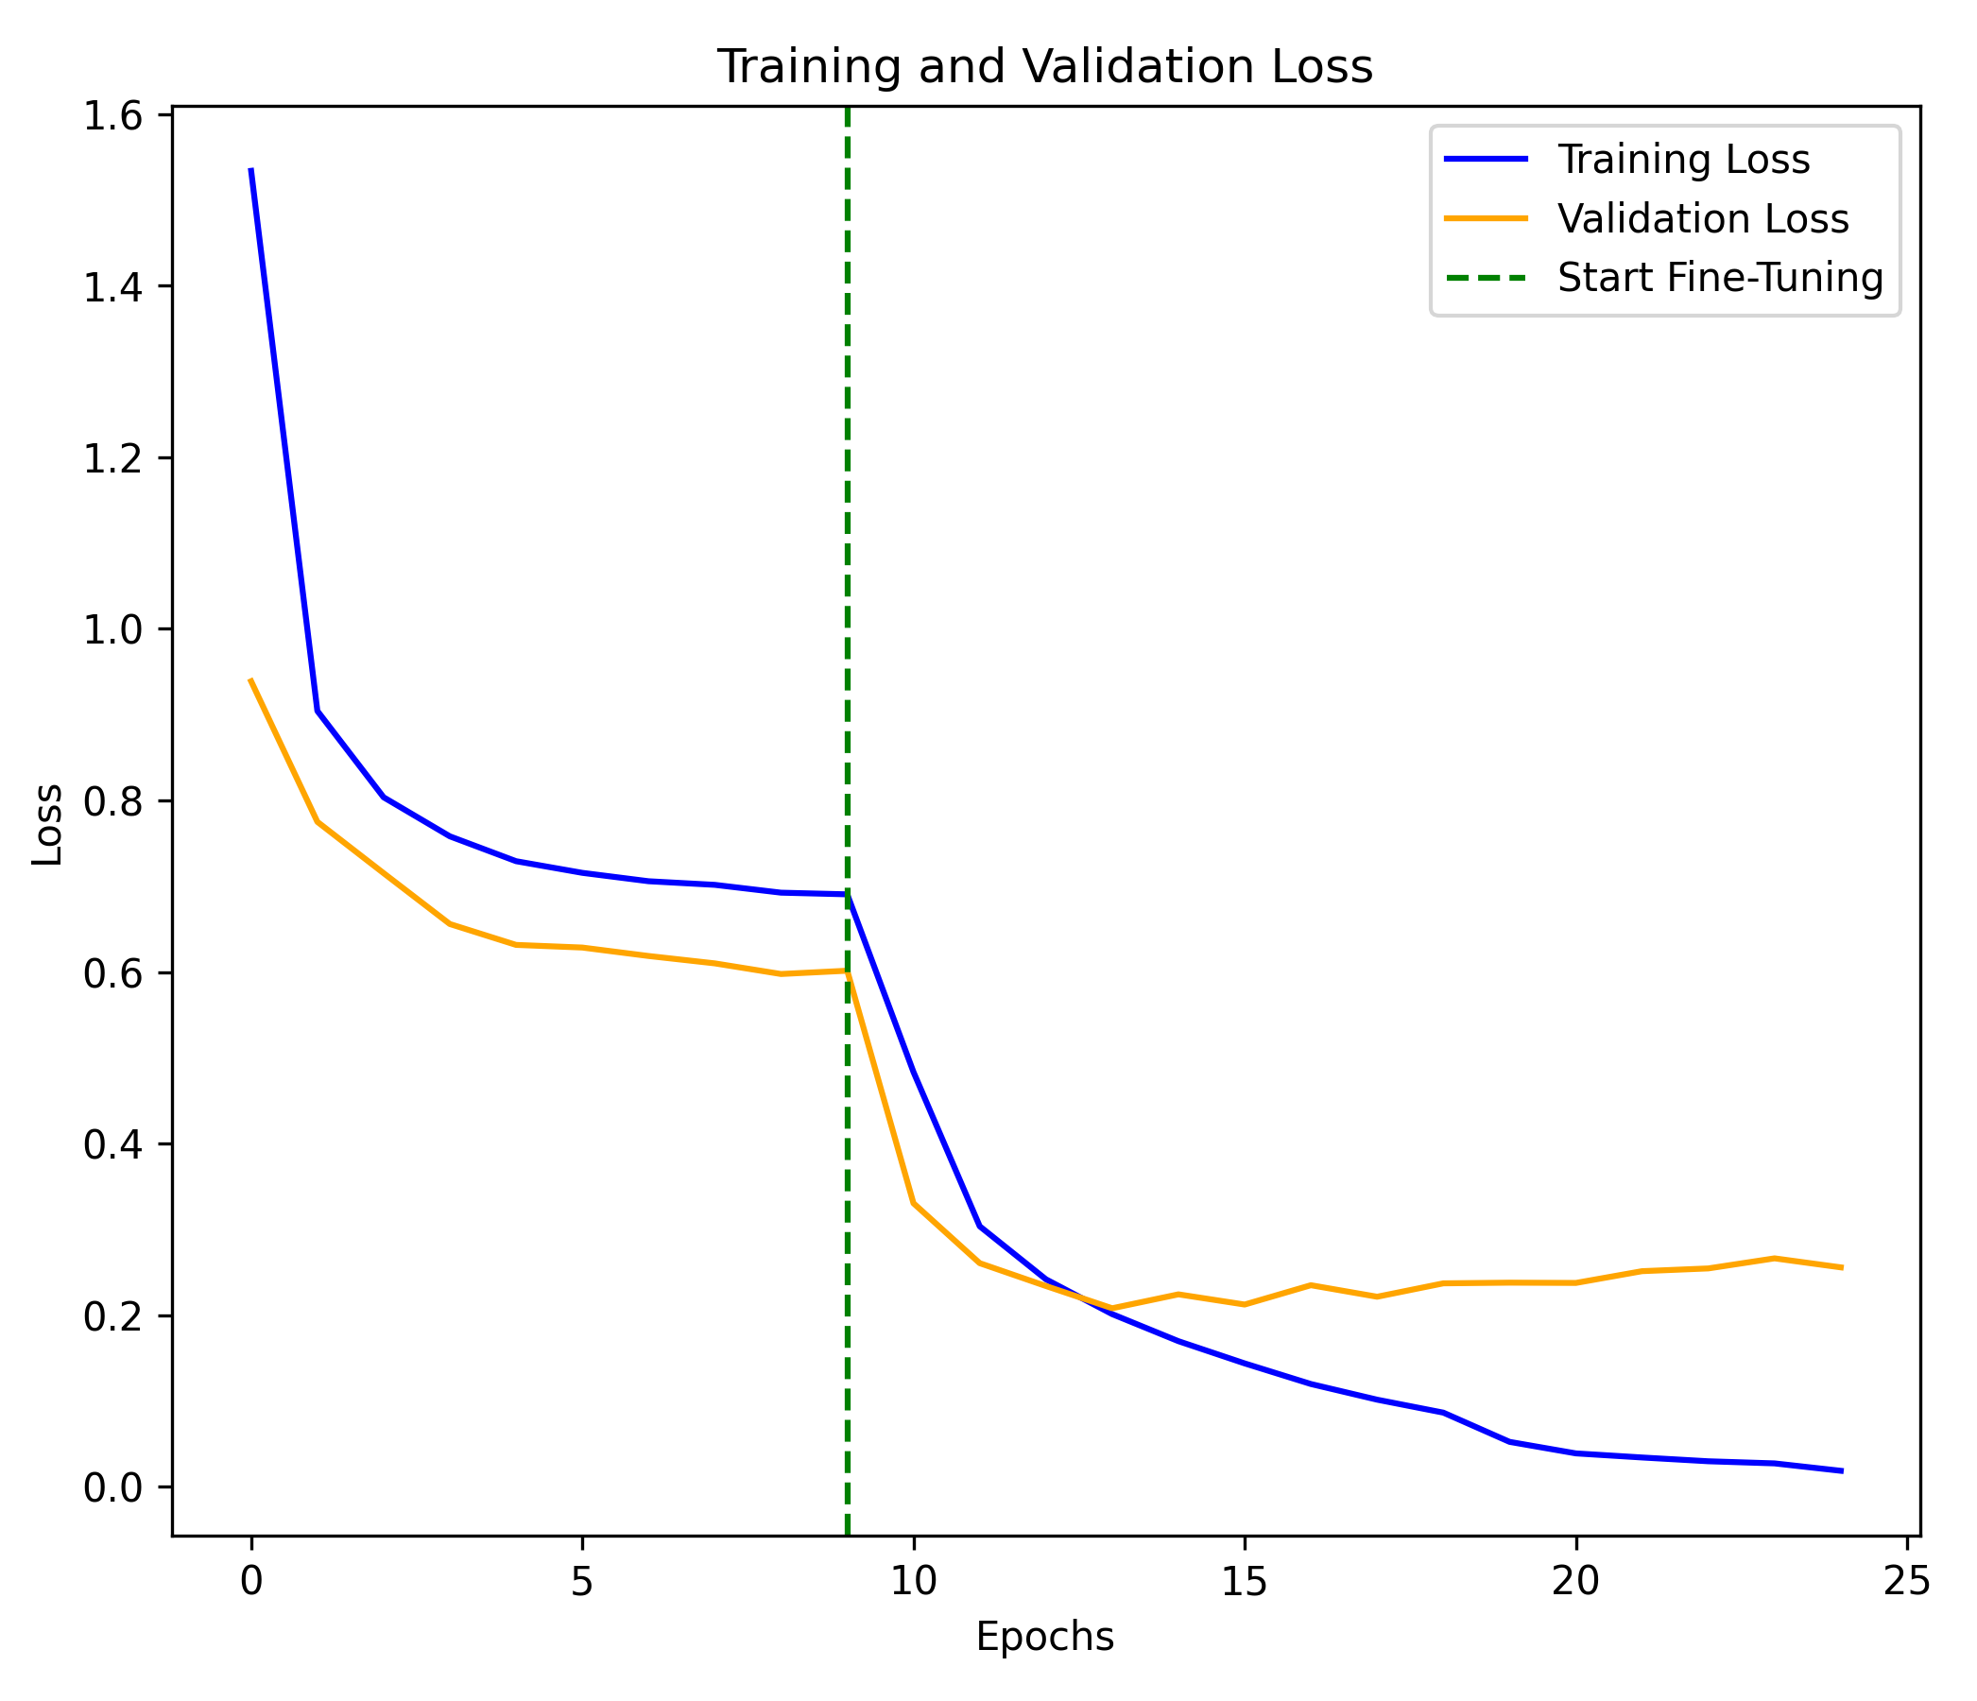
Model architecture exploration

Slide 13
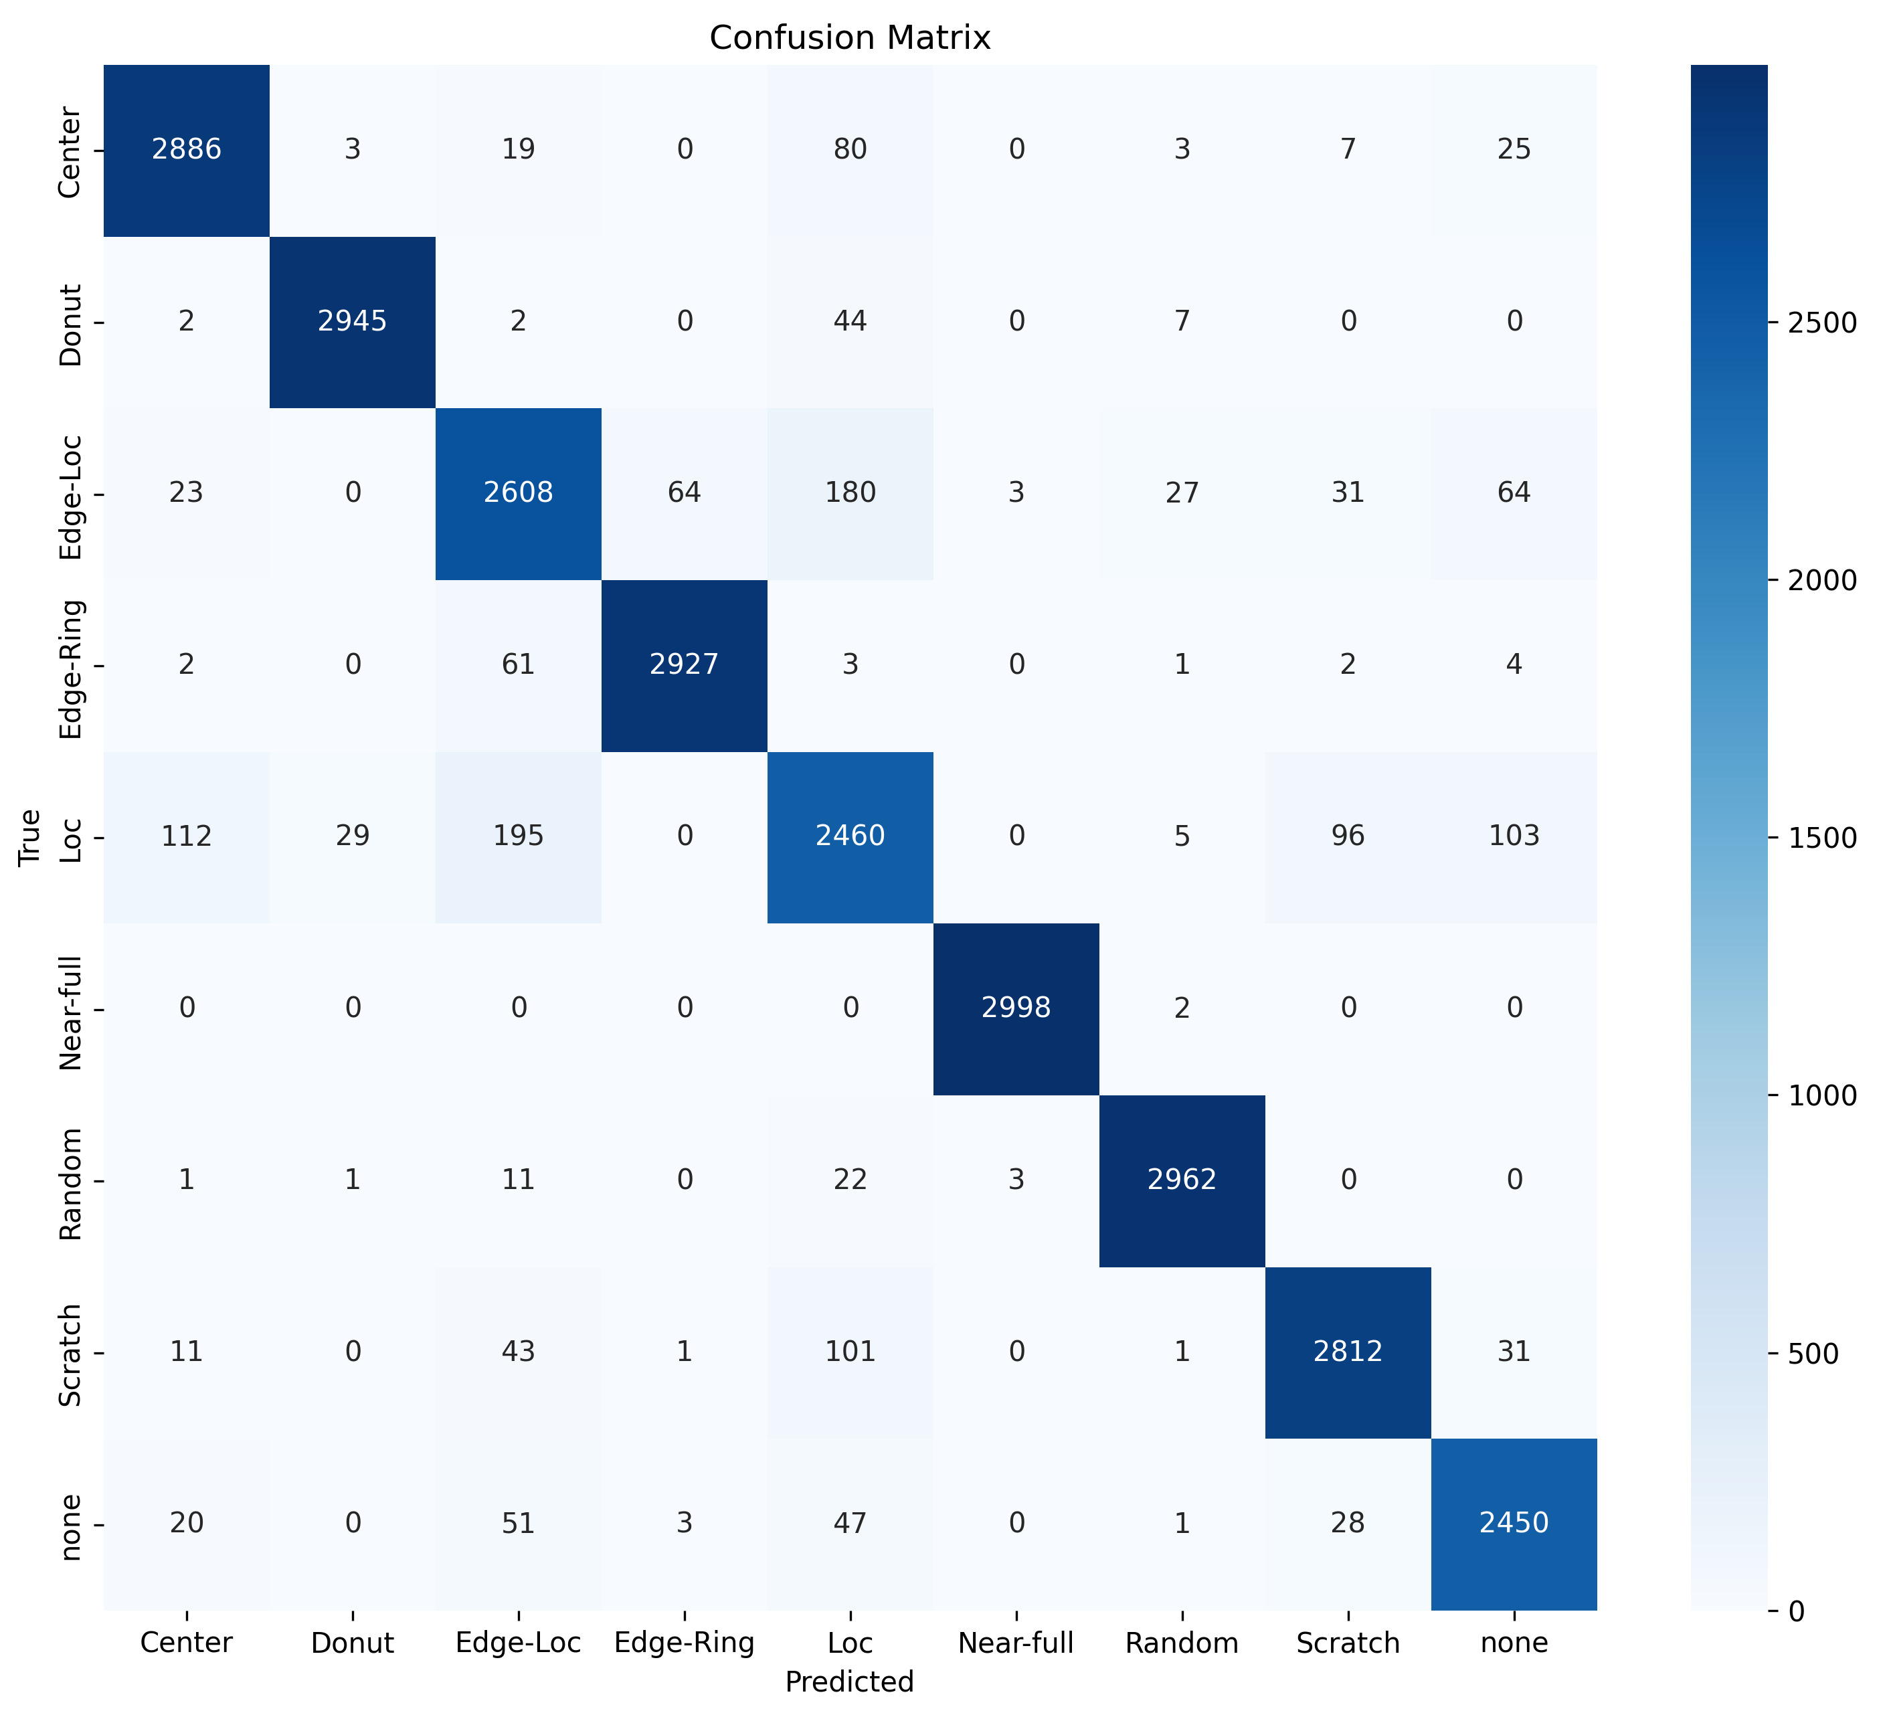
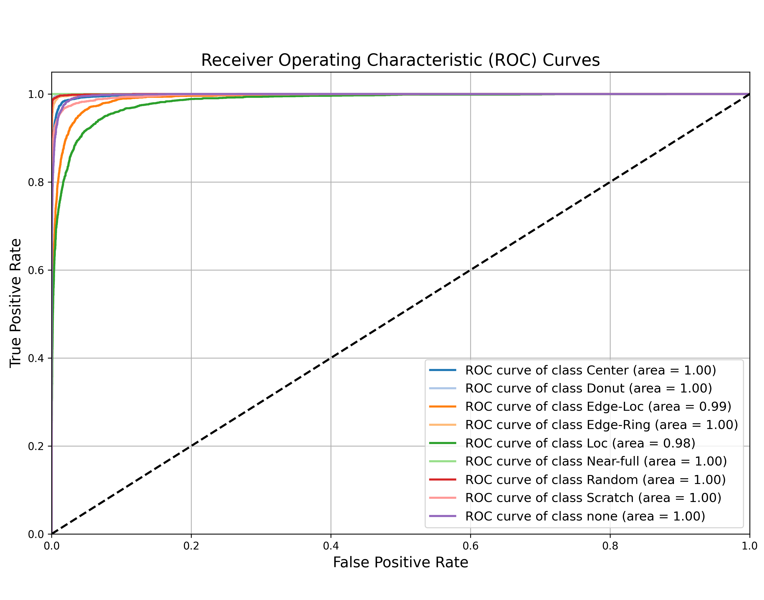
Model architecture exploration

Slide 14
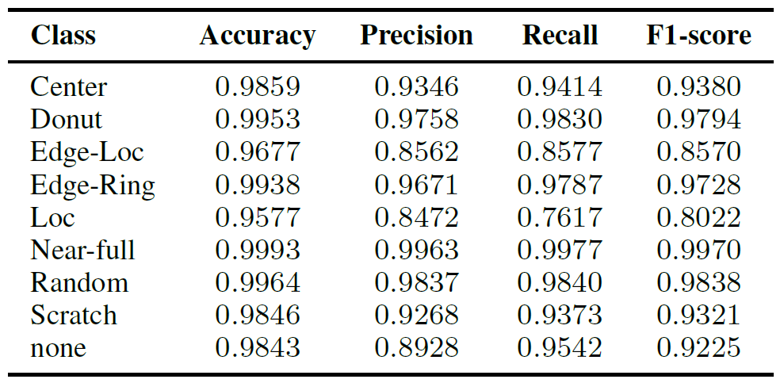
Per-class Performance Metrics of the ResNet-50 CNN model

Slide 15
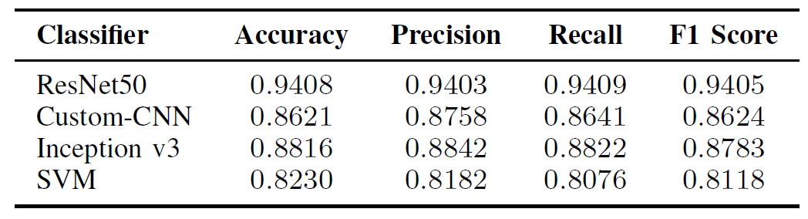
Comparative Analysis of Our Other Proposed Models

Slide 16
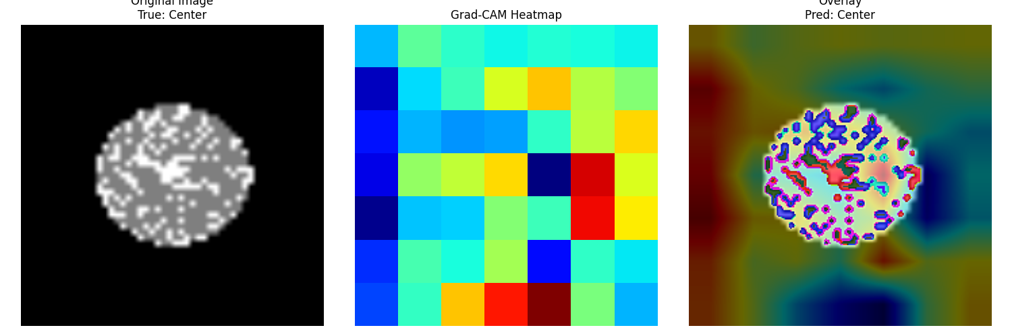
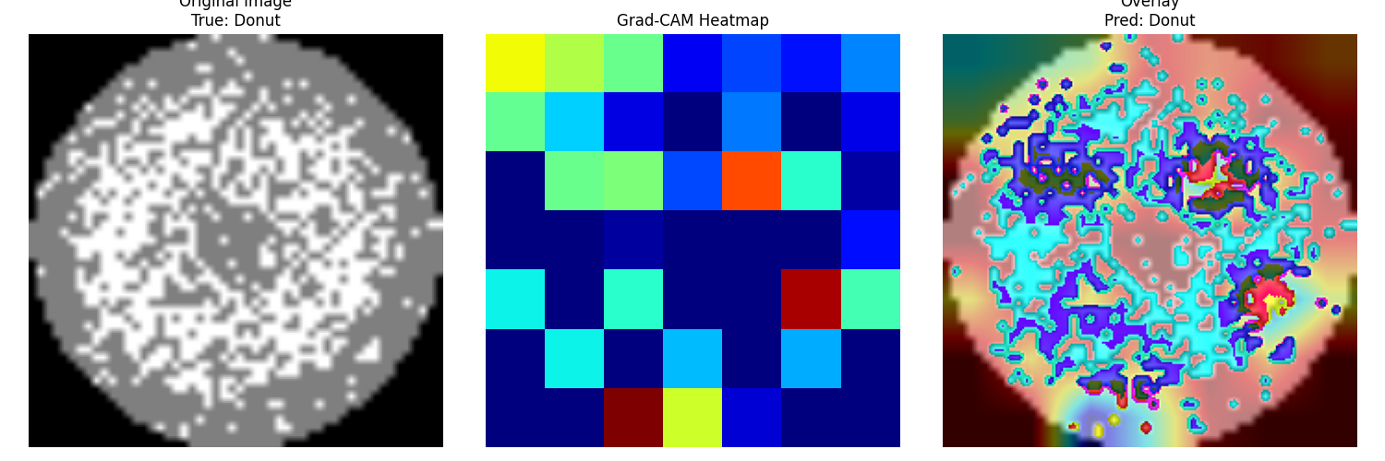
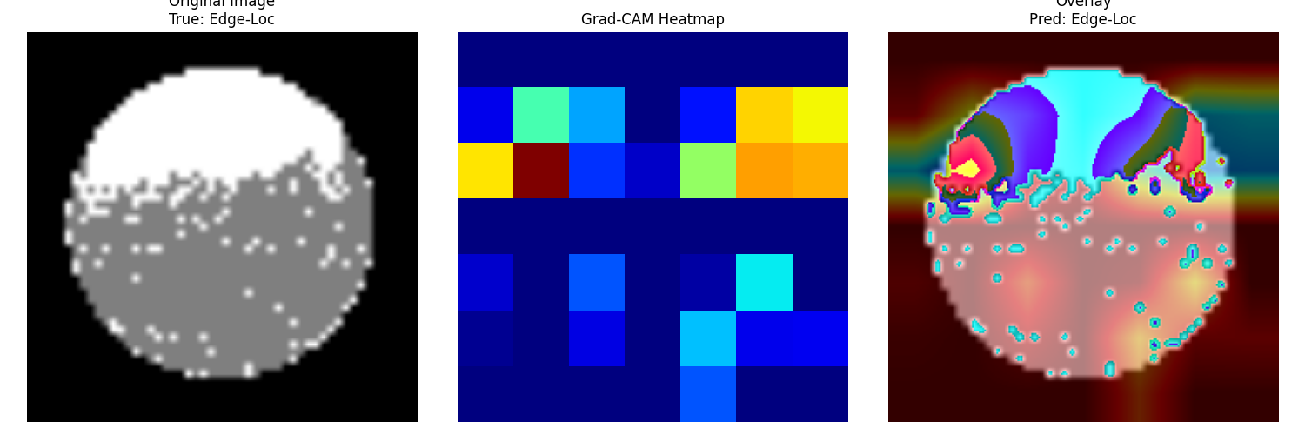
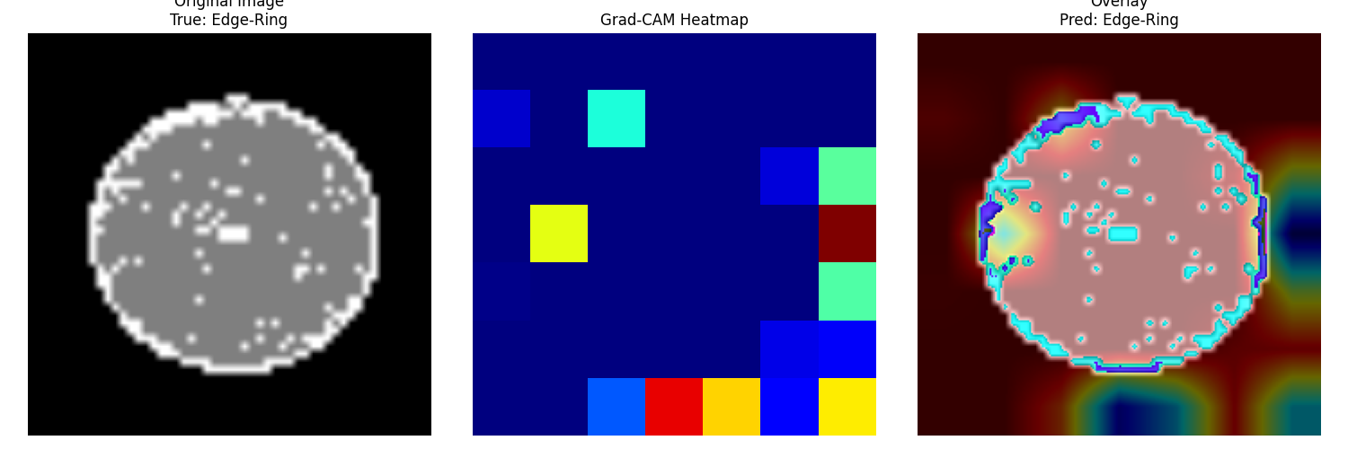
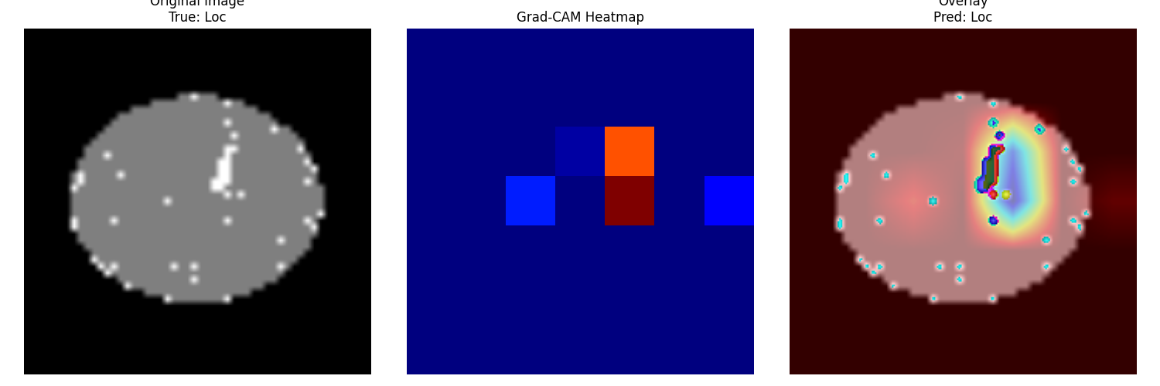
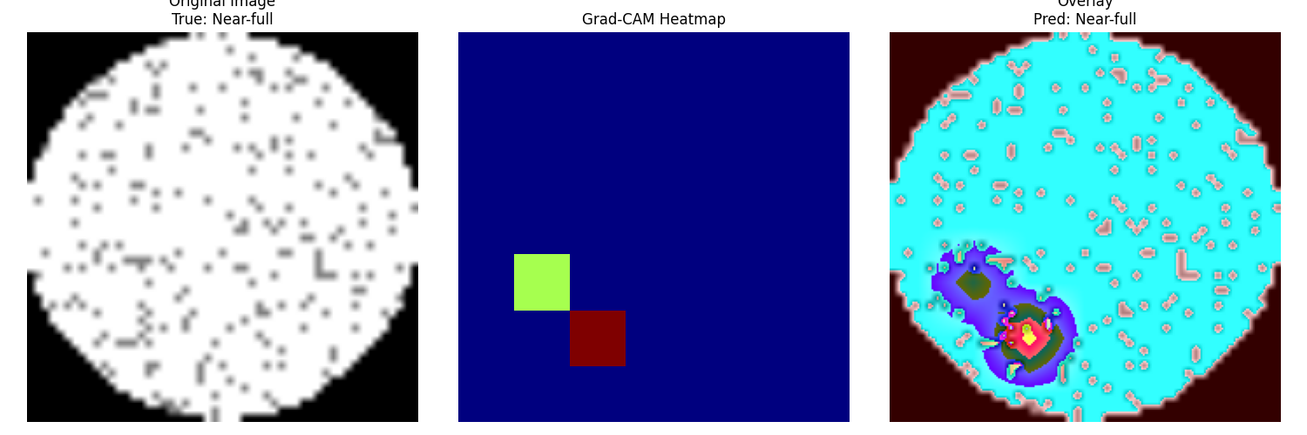
What does our model see?
XAI-Grad-CAM: Visualizes the class activation maps for the different defect classification types
Notes:
Neural networks are often thought of as a "black box" but it doesn't have to be that way.
To understand what our model is seeing, we visualized the last convolutional layer before classification. Here we got confirmation that our model is working properly. It seems to be able to identify the defect patterns clearly.
Now that we know that our model is working as we expected, we want to understand why our model is making mistakes.

Slide 17
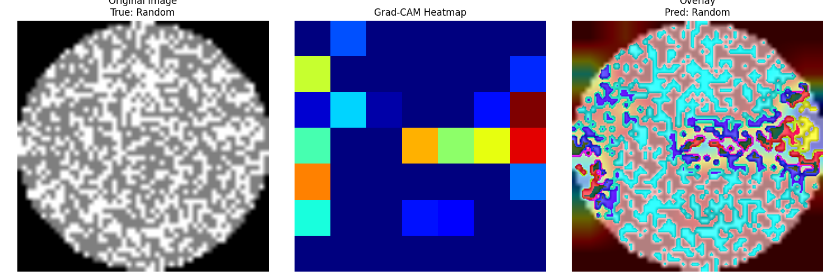
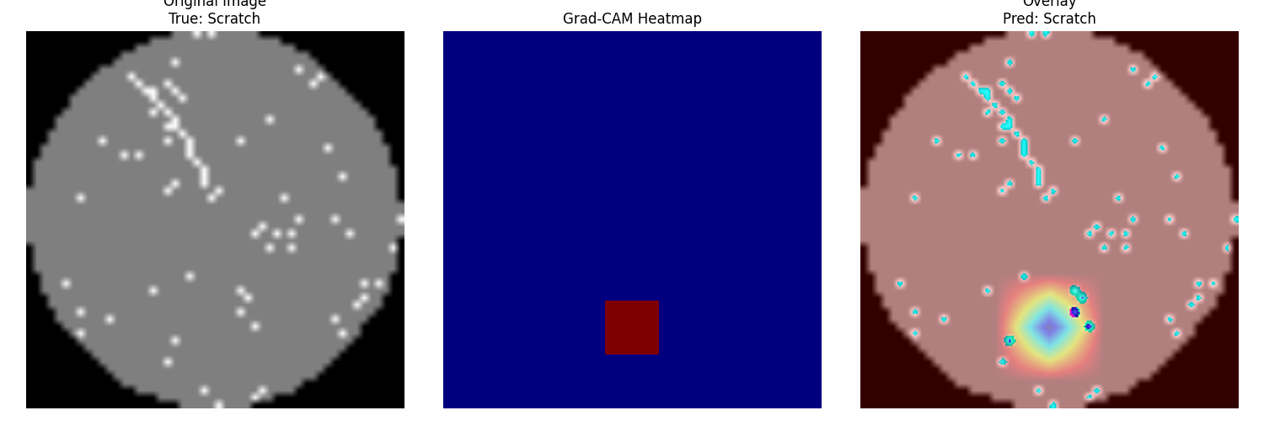
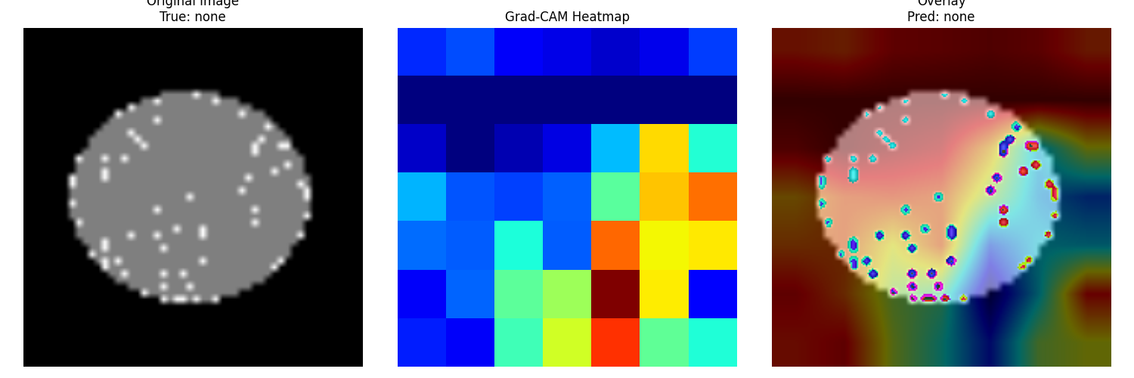
What does our model see?

Slide 18

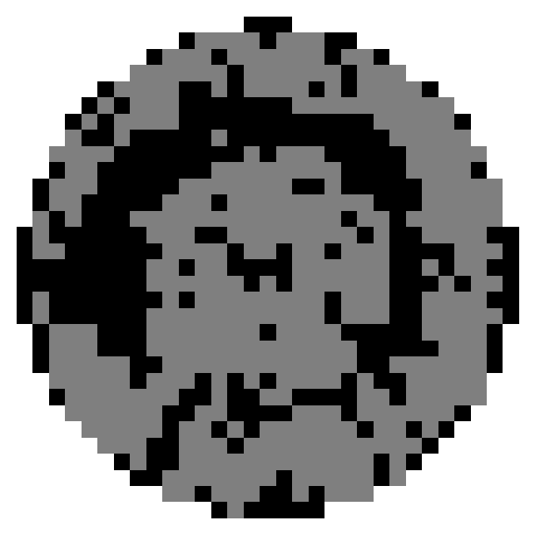



Production model pipeline
Customized data pipeline to meet the business need with real time inference
Data Collection
Data Acquisition
Data Pre-processing
Prediction
Presentation
Notes:
This is our production model data pipeline. It is completely customizable for the needs of the semiconductor manufacturer.
First, pass/fail data for all die (think of them as chips still in silicon form) on a wafer is collected on a fleet of tester and output into the ingestion pipeline. From here, our algorithm is able to quickly do the pre-processing steps of resizing and thinning. Next these wafermaps are sent to our model for predictions and those predictions are displayed in our web based solution. From here yield engineers can quickly identify yield issues. If there are any new defect types or incorrect classifications, those can be fed back to the model as additional training data for model improvement over time.

Slide 19

Wafer Map Classifier for Early and Fast Defect Detection and Defect Source Identification
Consistent
Time Efficient
Customizable
Model can be tuned for custom Defect Patterns for fast defect sourcing
Cost Effective
Notes:
In summary, our Wafer Defect Classifier can aid in defect source identification and lead to improvements in yield for semiconductor manufactures. This leads to improved revenue and reduces cost. The model can be tuned and trained for any custom defect patterns that semiconductor manufacturers have. It is an efficient solution with consistent and accurate results.

Slide 20
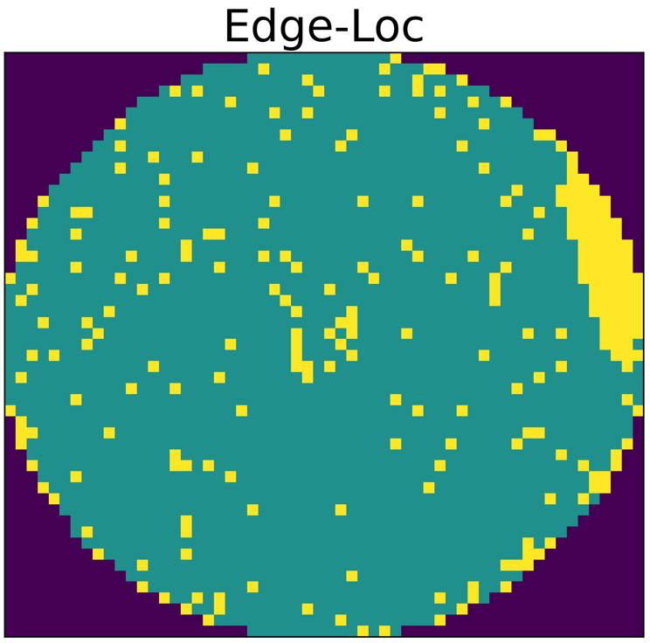
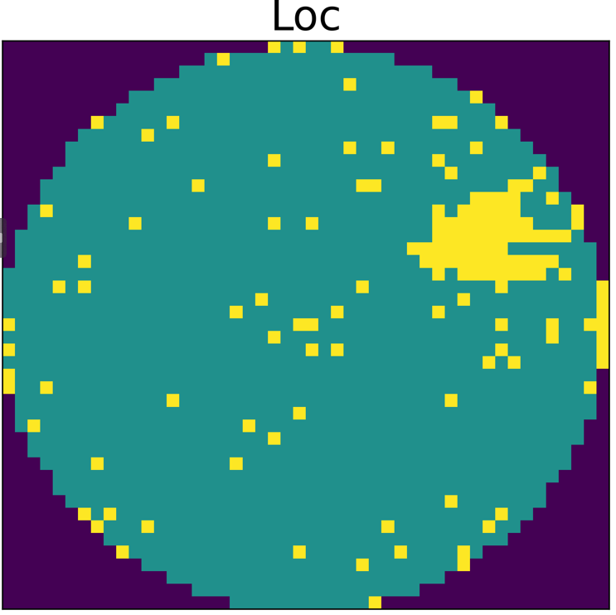
Future Research Direction
Future research could explore alternative model architectures, implement targeted training strategies, or employ advanced data augmentation techniques to better the detection of the Edge-Loc and Loc defect class on wafers.

Slide 21
References
[1] A. Drozda-Freeman, M. McIntyre, M. Retersdorf, C. Wooten, X. Song,and A. Hesse, “The application and use of an automated spatial pattern recognition (spr) system in the identification and solving of yield issues in semiconductor manufacturing,” in Proceedings of the 2007 IEEE/SEMI Advanced Semiconductor Manufacturing Conference, Stresa, Italy, Jun. 2007, pp. 302–305. [Online]. Available: https://doi.org/10.1109/ASMC.2007.4391932
[2] S. Cheon, H. Lee, C. O. Kim, and S.-H. Lee, “Convolutional neural network for wafer surface defect classification and the detection of unknown defect
class,” IEEE Transactions on Semiconductor Manufacturing, vol. 32, no. 2, pp. 163–170, May 2019. [Online]. Available: https://doi.org/10.1109/TSM.2019.2902657
[3] H. Zheng, S. W. A. Sherazi, S. H. Son, and J. Y. Lee, “A deep convolutional neural network-based multi-class image classification for automatic wafer map failure recognition in semiconductor manufacturing,” Applied Sciences, vol. 11, no. 20, p. 11209769, Oct. 2021. [Online]. Available: https://doi.org/10.3390/app11209769
[4] M. Saqlain, Q. Abbas, and J. Y. Lee, “A deep convolutional neural network for wafer defect identification on an imbalanced dataset in semiconductor manufacturing processes,” IEEE Transactions on Semiconductor Manufacturing, vol. 33, no. 4, pp. 436–444, 2020. [Online]. Available: https://doi.org/10.1109/TSM.2020.2984490
[5] K. Kyeong and H. Kim, “Classification of mixed-type defect patterns in wafer bin maps using convolutional neural networks,” IEEE Transactions
on Semiconductor Manufacturing, vol. 31, no. 3, pp. 395–402, Aug. 2018. [Online]. Available: https://doi.org/10.1109/TSM.2018.2841416
[6] M. -J. Wu, J. -S. R. Jang and J. -L. Chen, "Wafer Map Failure Pattern Recognition and Similarity Ranking for Large-Scale Data Sets," in IEEE Transactions on Semiconductor Manufacturing, vol. 28, no. 1, pp. 1-12, Feb. 2015, doi: 10.1109/TSM.2014.2364237

Slide 22
Thanks for Watching
Any Questions?
Notes:
Thanks for listening and we welcome questions

