Slide 1

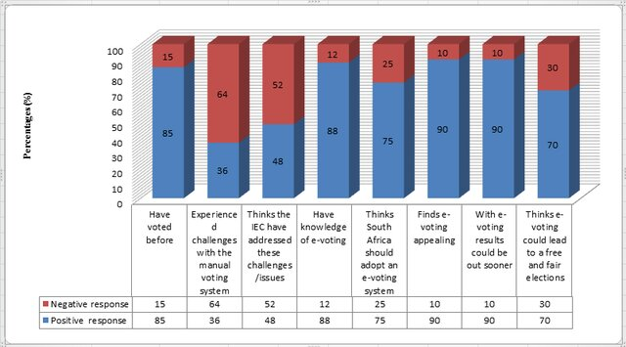
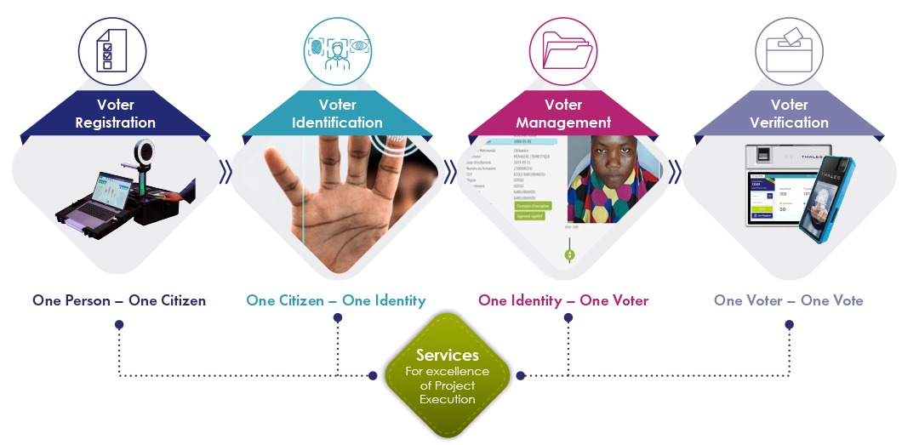
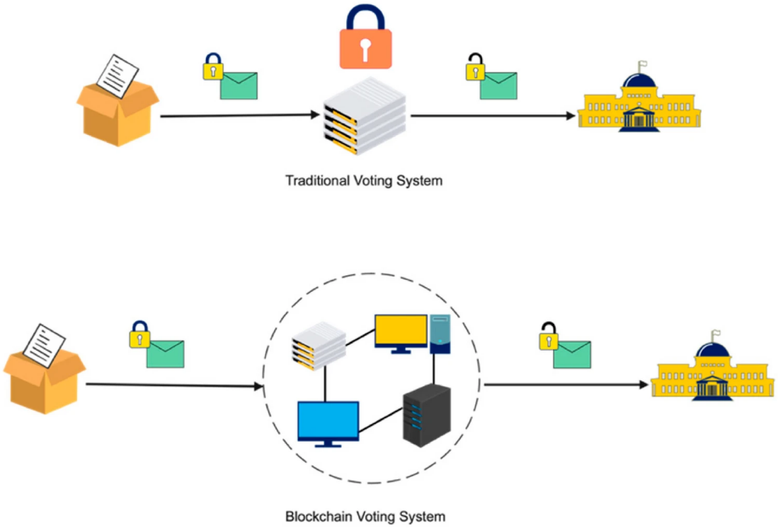

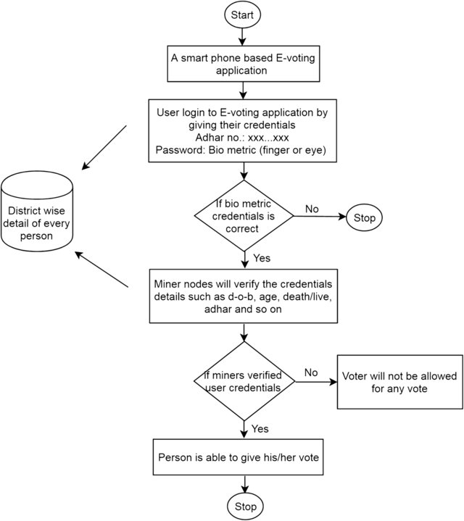
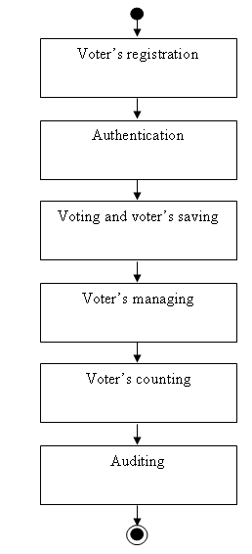
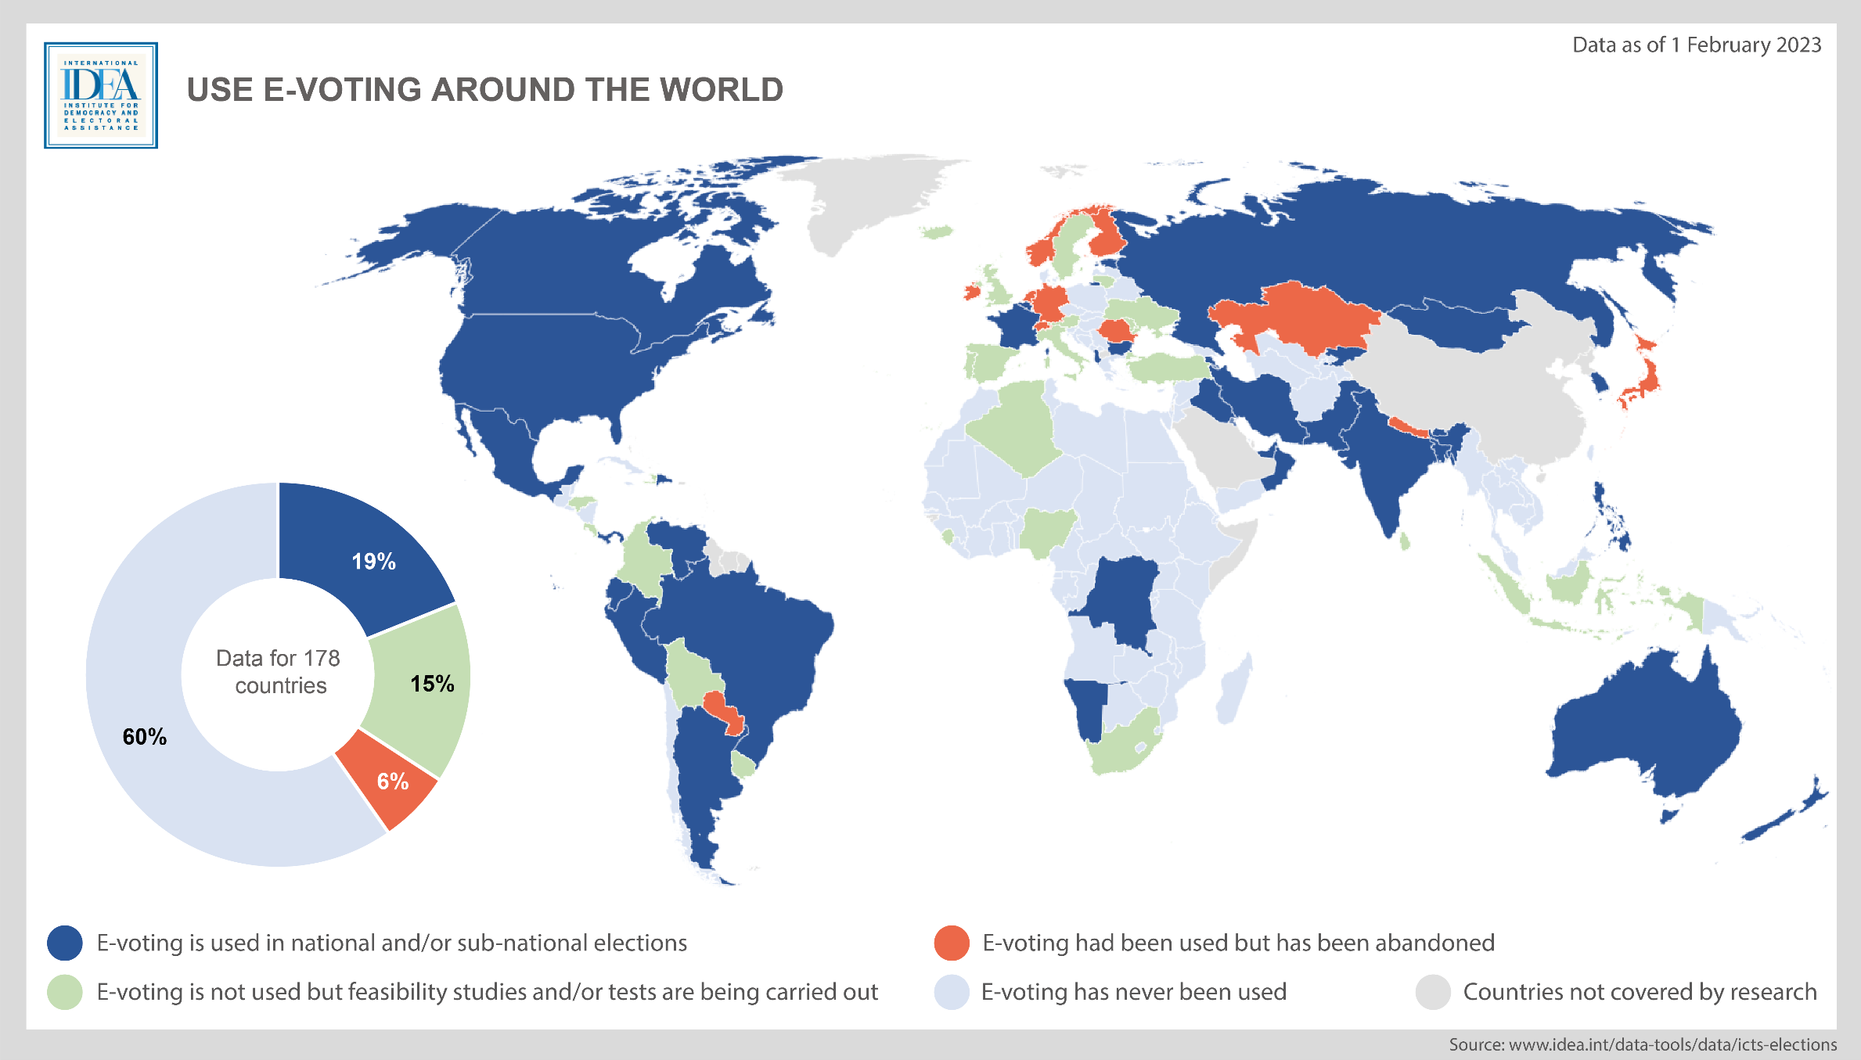
E‑Voting Systems: The Future of Secure and Transparent Elections
Empowering democracy with secure, efficient, and trusted digital voting platforms.
Md. Rifat Hossain
ID: 2004129
Department of Computer Science and Engineering, CUET
Chattogram-4349, Bangladesh
Introduction
Technology
Definition
E‑Voting (Electronic Voting) refers to the use of electronic systems and digital technologies to cast and/or count votes. It encompasses various methods, from voting on dedicated machines in polling stations to online voting via secure web portals.
Importance
Efficiency: Speeds up vote counting and reduces manual errors.
Accessibility: Allows people with disabilities or remote voters (e.g., overseas citizens) to participate more easily.
Transparency: Potential for verifiable voting records and audit trails.
Cost Reduction: Decreases the need for extensive physical infrastructure (paper ballots, large venues, etc.).
Challenges
Security & Privacy: Ensuring votes cannot be tampered with or traced back to the voter.
Technological Barriers: Internet reliability, device compatibility, and digital literacy.
Blockchain‑Based Systems: Provide decentralized, tamper‑evident ledgers for secure vote recording.
End‑to‑End Encryption: Protects the confidentiality of votes during transmission and storage.
Biometric Verification: Ensures only eligible voters can cast ballots (e.g., fingerprint, facial recognition).
Secure Hardware: Specialized voting machines with built‑in security modules to prevent hacking.
Cryptographic Protocols (e.g., Homomorphic Encryption): Enables counting votes without revealing individual selections.
Public Trust: Overcoming skepticism about the integrity of electronic systems.
Regulatory and Legal Hurdles: Aligning with election laws, data protection, and privacy requirements across jurisdictions.
Potential Application Areas
National and Local Government Elections: Streamline large‑scale voting processes.
University / Student Elections: Encourage higher participation, especially for remote or busy students.
Corporate Governance: Shareholder voting, board elections, and company decisions.
Professional Associations and Unions: Faster, more accessible ways to collect and tally votes.
Additional Information
Benefits of E-Voting:
-Reduces logistical challenges like printing and transporting ballots.
-Environmentally friendly (less paper use).
-Promotes voter inclusivity (e.g., for overseas voters).
Risks and Mitigation:
Risk: Cyberattacks. Solution: Advanced firewalls and penetration testing.
Risk: Digital divide. Solution: Parallel traditional voting options.
Pilot Programs: Numerous countries test e‑voting to gauge reliability and user satisfaction.
Future Trends: Potential integration with AI for anomaly detection in voting patterns.
Conclusion
Vision: E‑voting systems promise more accessible, faster, and verifiable elections.
Evolution: As technology matures and public trust grows, e‑voting could become a standard practice worldwide.
Keyword
-Cryptography
-Blockchain
-Transparency
-Cybersecurity
-Democracy
Secure, transparent, and inclusive e‑voting systems are a critical step toward strengthening modern democracy.
URL, Emails, and Others
Reference links: e-votingresearch.org
My Email: rifat8851@gmail.com

