Slide 1
CSE465
Project: Flame and Smoke Detection
Rifat Islam
Group-20

Slide 2
Problem
Dataset
Required data was collected form Kaggle
The dataset contains 3000 images
90% of them were used to train the model and the rest 10% were used to test and validate the model
The image data was divided into smaller batches and batch normalization was used as a dataset augmentation technique
A classification problem to classify images containing flame and smoke from the image dataset

Slide 3
Solution
Different Approaches
Primarily approached the problem with custom CNN architecture.
Then applied various pre-trained models of different architectures to find the best solution with maximum accuracy.
Custom CNN
ALEXNET
RESTNET
VGG16
ZFNET
GOOGLENET

Slide 4
Custom CNN
Specifications
Custom CNN
Input (224x224x3)
Conv1 ( 3x3 filter, stride 1, 6 out channels)
Max-Pool (2x2)
Conv2 ( 3x3 filter, stride 1, 16 out channels)
Max-Pool (2x2)
Conv3 ( 3x3 filter, stride 1, 26 out channels)
Max-Pool (2x2)
Conv4 ( 3x3 filter, stride 1, 36 out channels)
Max-Pool (2x2)
Conv5 ( 3x3 filter, stride 1, 48 out channels)
Max-Pool (2x2)
FC1 (1200, 512)
FC2 (512, 256)
FC3 (256, 80)
FC4 (80, 3)
5 Convolutional layers
4 Fully Connected Layers
More than 0.8 million parameters
Used Adam as the optimizer
Used ‘Cross Entropy Loss` function

Slide 5
Not Pre-trained (not available in pytorch)
Implement the pytorch version of the model from the paper (repository)
58 Million Paramerters
12.5 Million Parameters
Used Adam Optimizer
122 Million Parameters
Used SGD Optimizer
ALEXNET
RESNET
VGG16
GOOGLENET
ZFNET
11.17 Million Parameters
Used SGD Optimizer with Exponential Learning Rate
6.6 Million Parameters
Used SGD Optimizer

Slide 6
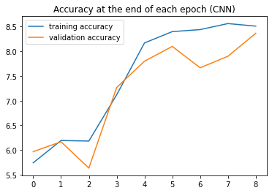
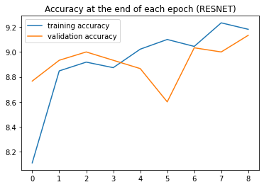
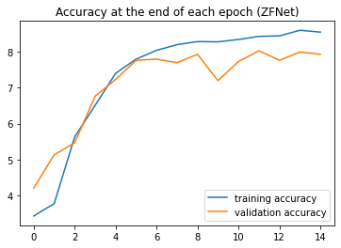
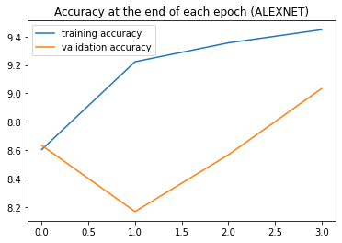
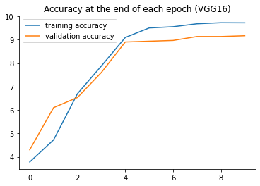
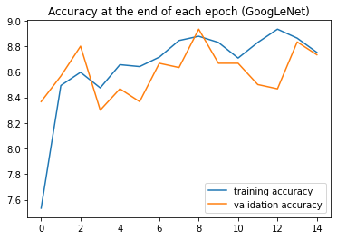
Accuracy After Each Epoch

Slide 7
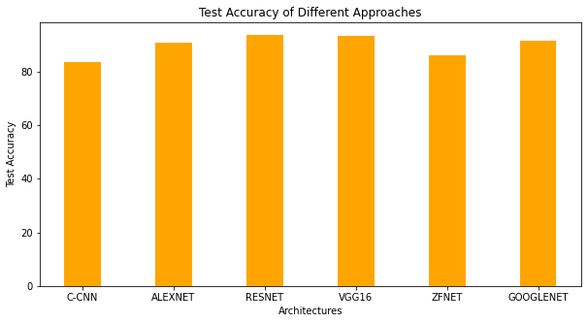
Recall and Precison
Accuracy
 |  | CNN | ALEXNET | RESNET | VGG16 | ZFNET | GoogLeNet
Recall | Class A | 0.94 | 0.90 | 0.91 | 0.95 | 0.88 | 0.90
 | Class B | 0.73 | 0.87 | 0.93 | 0.92 | 0.76 | 0.92
 | Class C | 0.81 | 0.95 | 0.97 | 0.93 | 0.94 | 0.92
Precision | Class A | 0.85 | 0.90 | 0.96 | 0.93 | 0.93 | 0.89
 | Class B | 0.82 | 0.94 | 0.96 | 0.94 | 0.85 | 0.95
 | Class C | 0.84 | 0.88 | 0.90 | 0.93 | 0.80 | 0.88
Accuracy (%) |  | 83.67 | 90.67 | 93.67 | 93.33 | 86.00 | 91.33

Slide 8
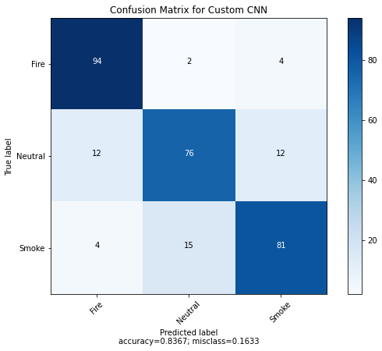
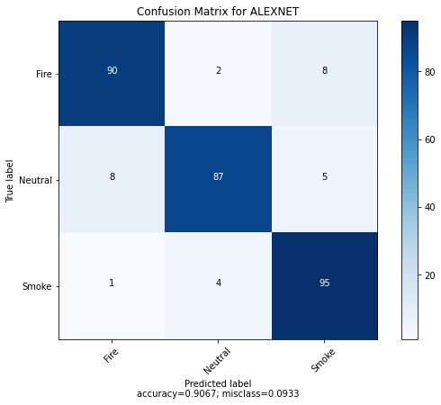
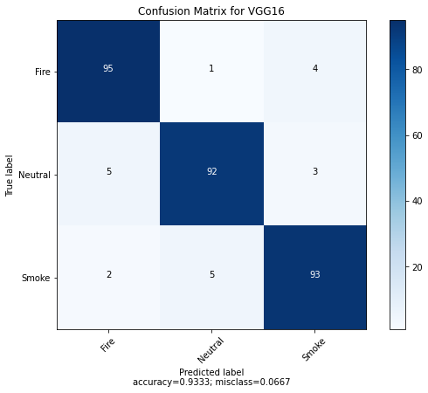
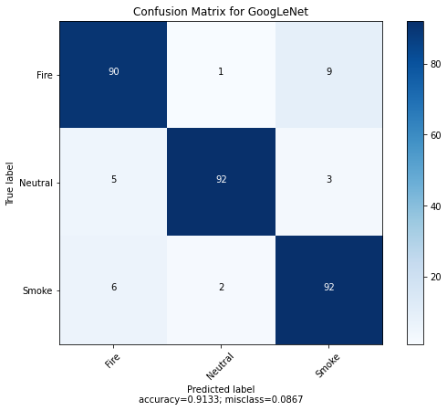

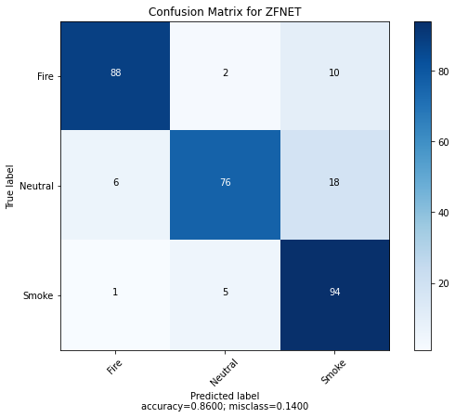
Confusion Matrix

Slide 9
Thank You

