Slide 1

CSE299: Junior Design Project
App-based E-Commerce System for android
KinteChai
Presented By:
Md. Rifat Hasan 171 2162 642
Md. Oahiduzzaman Mondol 171 1855 642
Syed Md. Zishan Ali 171 2587 642

Slide 2
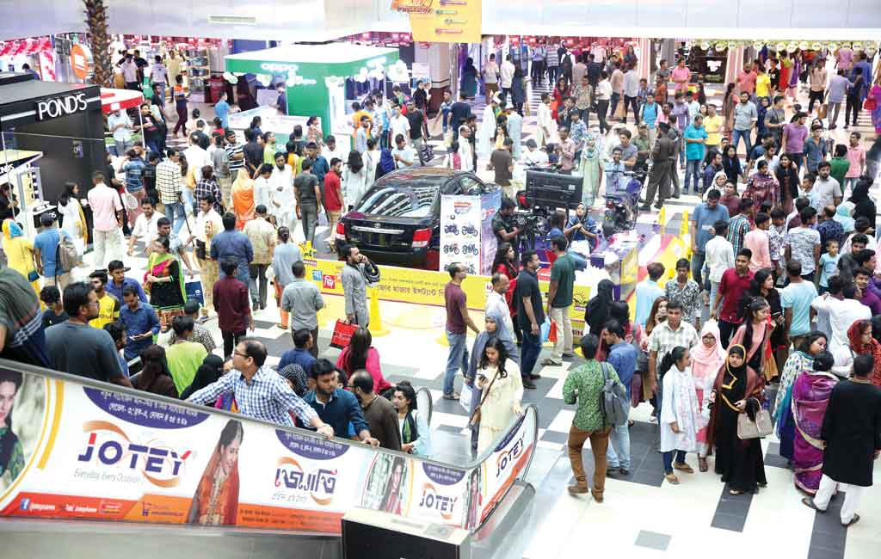
Problem
Bangladesh has a large population with great chances of big economy.
Customer Satisfaction.
Misrepresentation of features.
Availability of required products.
Shopping becomes hazardous.
Wastes time and money

Slide 3
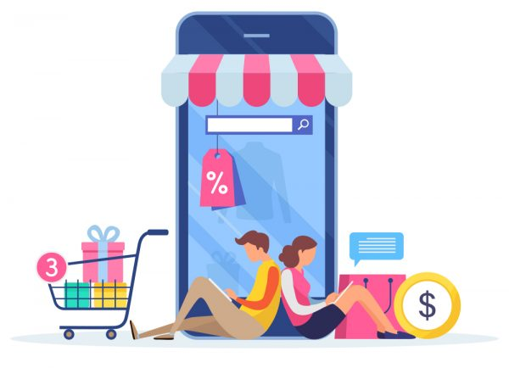
E-Commerce
E-commerce (electronic commerce) is a platform of business which is buying and selling products or providing services over an electronic network.
The ability to made transaction for personal or professional use over the internet is known as electronic commerce or e-commerce.
Currently, there are 4 types of E-commerce popular in Bangladesh:
Business-to-Business(B2B)
Business-to-Consumers(B2C)
Consumer-to-Consumer(C2C)
Business-to-Employees(B2E)

Slide 4
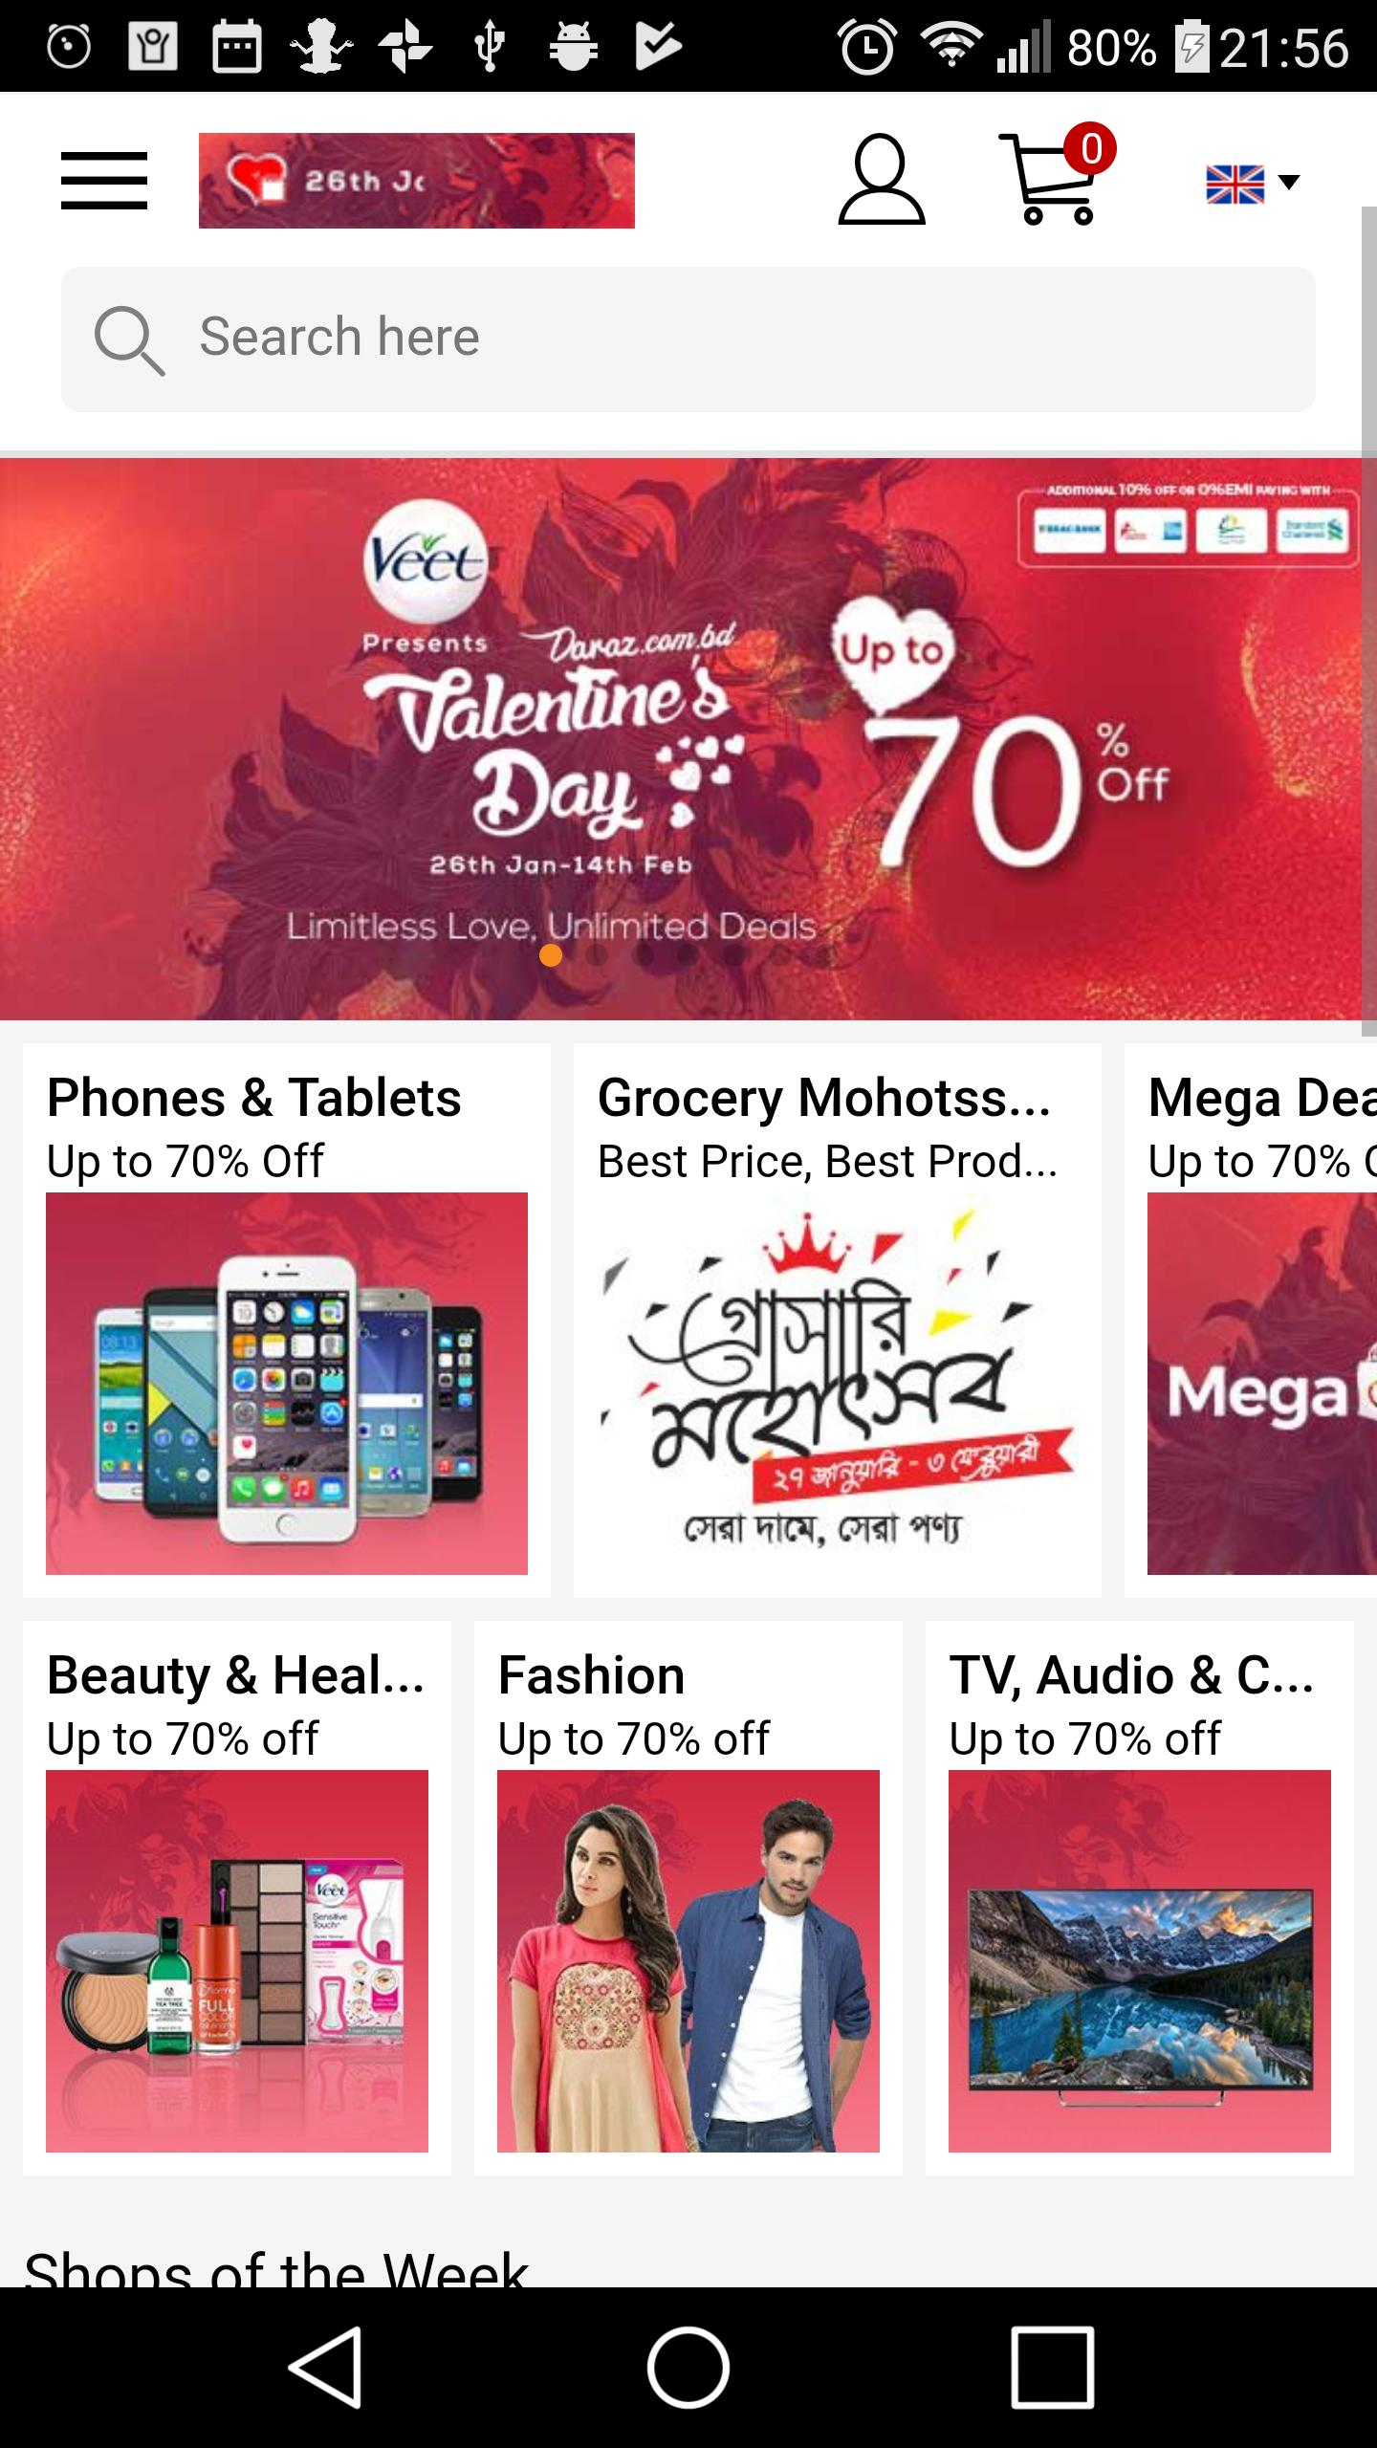
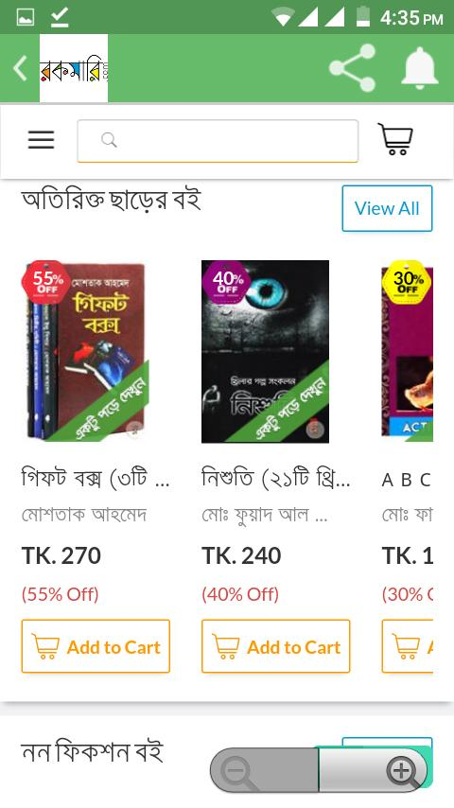
Scenario
700 eCommerce sites
8,000 eCommerce pages on Facebook
Although there are great applications like these, there are still a great deal of options for further improvement.

Slide 5

Solution
Nowadays, almost everyone has a mobile phone and easy access to internet.
Reduce our urge to go out for shopping
The product quality and reasonable cost
Help customers narrow down their broad ideas and enable them to finalize the products they want to purchase.
An app can do all of these.

Slide 6
Features
The application should have responsive interface
Users should be able to register for an account
Users can login and logout.
Business users can upload the information of their goods.
Users can search any product.
A cart system for general user to have products and checkout through specific ID
General users will have multiple options for payment.
General user give review of their used products.
Use Augmented Reality to let customer to take a trial of the goods.
Implement a chatbot for better user experience.
Review options as well as videos from youtube.
Admin can handle the site to avoid unnecessary and inappropriate things.
Offer or discount for particular product for a limited time.
Frequently Asked Question (FAQ) to the support for any information about the site.

Slide 7
Technical Requirement
Front-end development: XML, Android Programming
Back-end development: PHP, Core Java, Firebase
Environment: Android Studio

Slide 8

Chatbot
A 24/7 chatbot for the customer assistance.
Customer can track orders.
Best reviews.
FAQ
Appoint for admin panel directly.
API can be used for implementation.

Slide 9
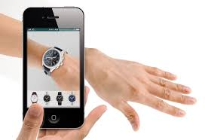
Augmented Reality
Customer always wants to have a trial before the purchase.
Insecure for women to have a trial in a trial room of a random shop or a renowned one.
Augmented reality can provide a taste of the goods.
Also, let customers decide more accurately for keeping up the trend.

Slide 10
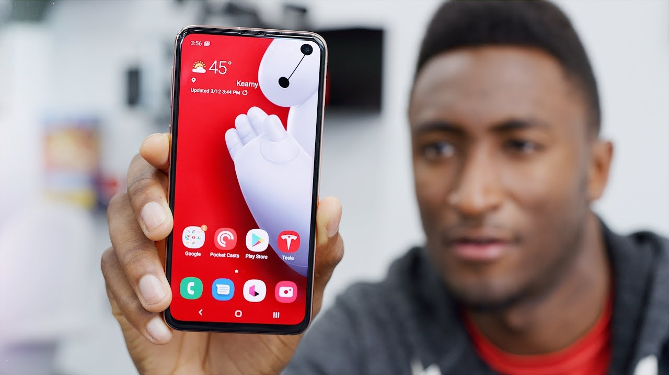
Interactive Review
Written review is not enough.
Customer wants some real life scenario.
Hands-on review from most watched and trusted reviewers from youtube.
ATC, MKBHD and so on.

Slide 11
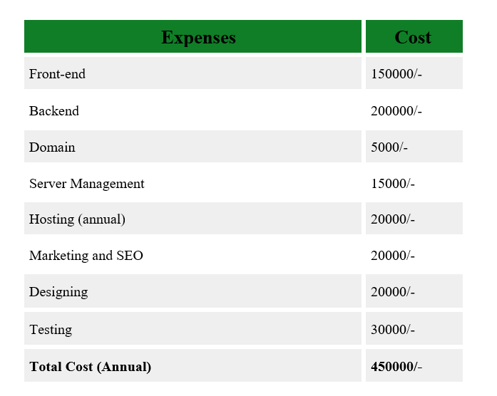
Budget

Slide 12
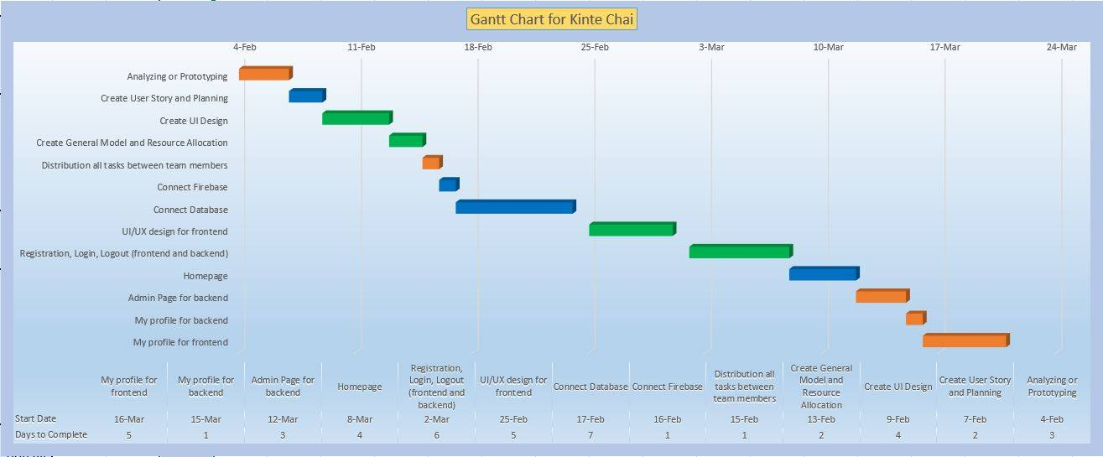

Slide 13
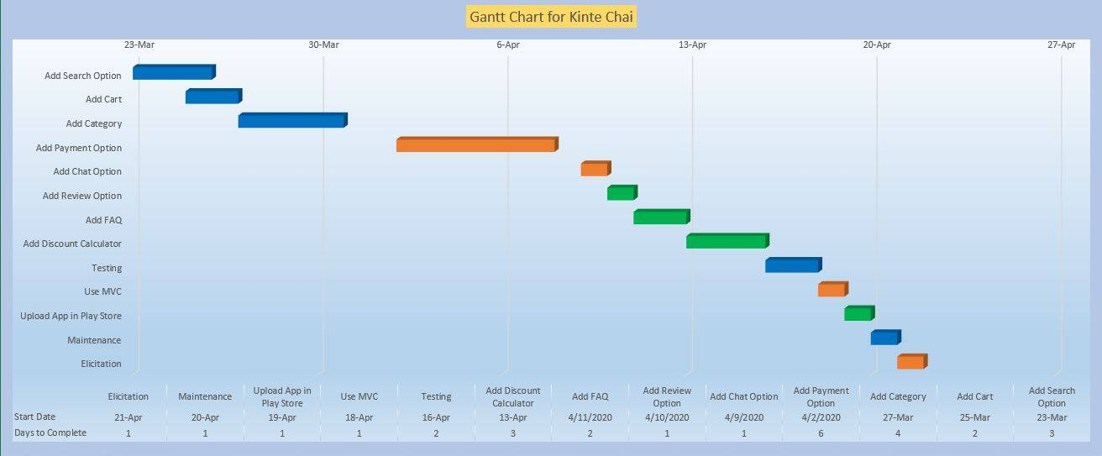

Slide 14

Conclusion
There’s always the necessity of better user experience.
Can be used in different purpose like book shop, pharmacy etc.
Make an E-commerce app specially for NSU students.
Can be used to purchase food item also.

Slide 15
THANK YOU

