Slide 1

CSE299: Junior Design Project
App-based E-Commerce System for android
KinteChai
Presented By:
Md. Rifat Hasan 171 2162 642
Md. Oahiduzzaman Mondol 171 1855 642
Syed Md. Zishan Ali 171 2587 642

Slide 2
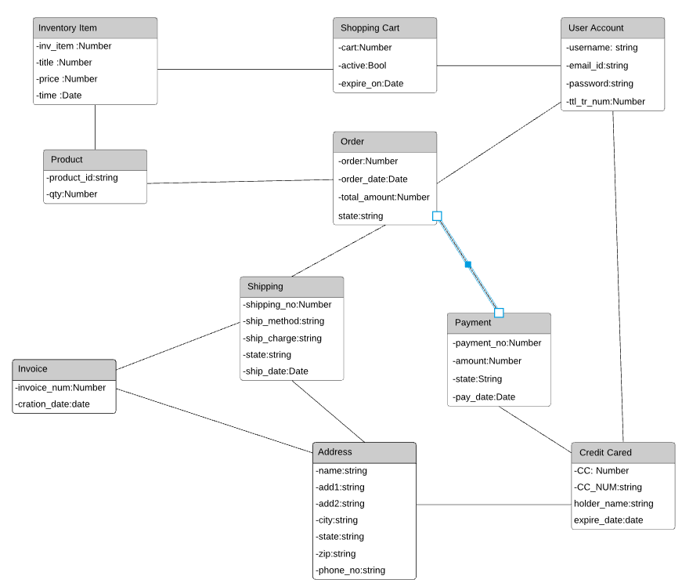
ER DIagram

Slide 3
User Story
As a user, I can sign up and sign out.
As a provider, I can upload product.
As a customer, I can view product.
As a customer, I can buy product.
As a customer, I can give a review of the product.
As an admin, I can select which products will be uploaded.
As a user, I can pay in cash-on-delivery, online and credit card.
As a user, I can view the youtube review.
As a customer, I can chat in chatbox.

Slide 4
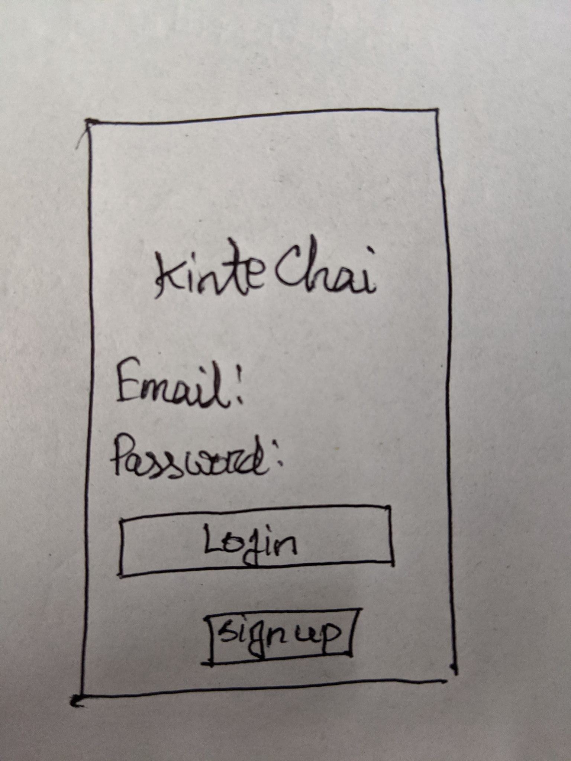
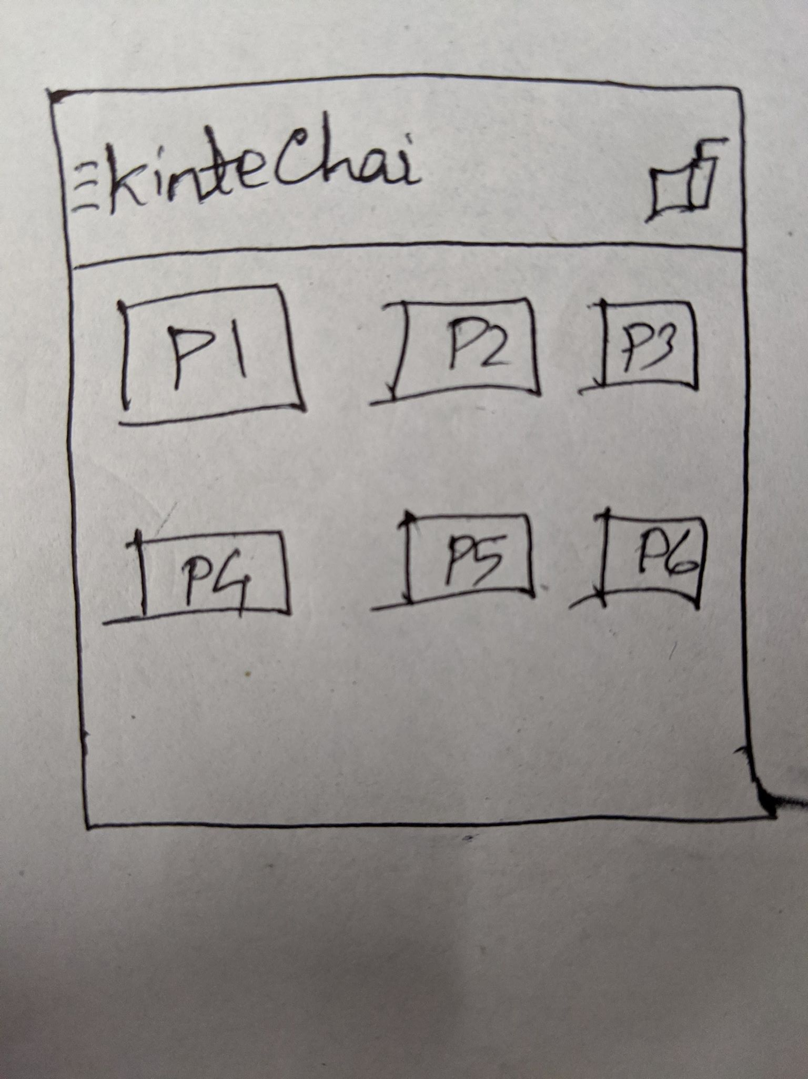
UI Design

Slide 5
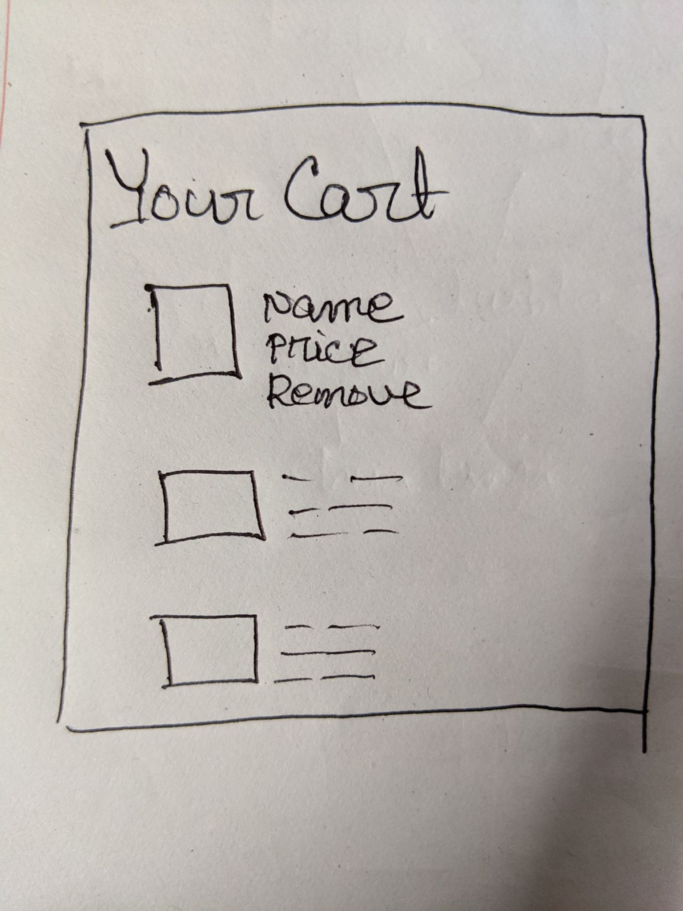
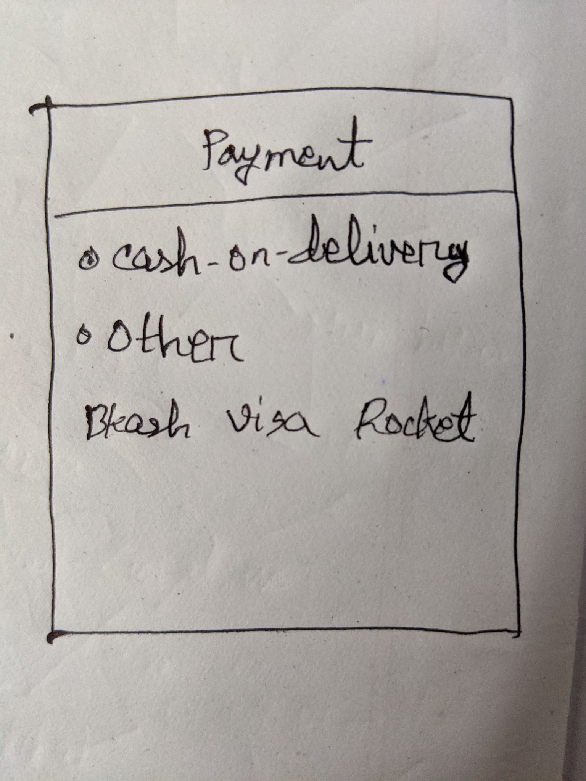
UI Design

