Slide 1
Blood_Bank and Food Nutrition
Anything You Can Do, Artificial Intelligence Can Do Better

Slide 2

Presented by
Md. Ataur Rahman Bhuiyan ID: 2014-1-60-101
Md. Rifat Ullah ID: 2014-1-60-102

Slide 3



We need emergency blood for your patient, Arrange it as soon as possible..
How can I arrange blood within short time..!

Slide 4

Let’s find out a Problem….!
Incase of a medical emergency sometimes we need urgent blood as soon as possible.
Every two seconds somewhere around the globe need blood.
At present time, It is very much difficult to query blood in blood bank.
Sometimes it’s too late to query blood in every blood bank in a medical emergency for a patient.
We also face same problem in hospital.
Is there a way to minimize time in case ‘need of emergency blood’?

Slide 5


Let’s Make a solution for This
Think of technology of our time.
Processing power increased and cheap.
Can we use processing power of our technology for solve this kind of problem?

Slide 6

Can we build a smart system that can help us with this?

Slide 7
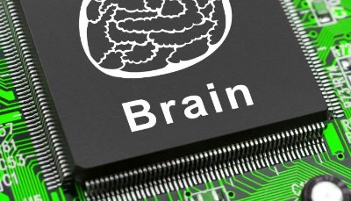
A smart System
We tried to build an intelligent system which can help us to find blood bank faster with the nearest location.
We can also Query blood bank data for every region.

Slide 8


Done, Doctor.
I just got blood.
How did you?
Well , I just used a smart system.

Slide 9

Search for Blood Bank
Blood Bank Location in Dhaka City:
Dhanmondi
Mohammadpur
Gulshan2
Maghbazer
Panthapath
Mirpur14
Shahbagh
Shantinagar
Kakrail
Chamelibag

Slide 10
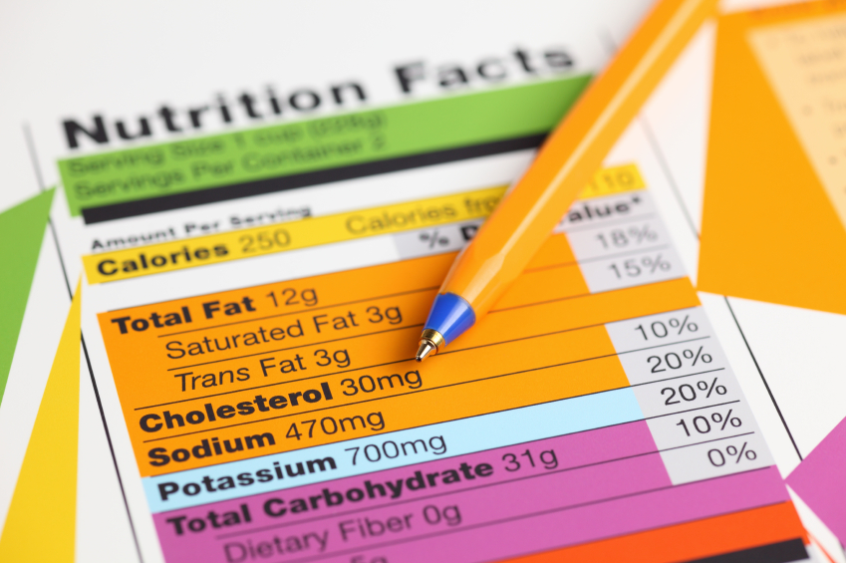
Food Nutrition Facts….

Slide 11
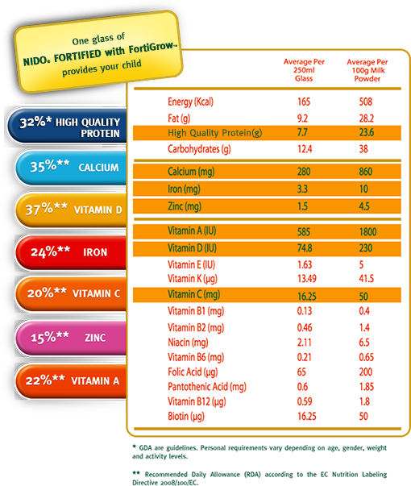
Motivation of Nutrition Fact…!
Eating smart will not only make you smart, it’s the smart thing to do. You will be at a much lower risk of needing to rely on doctors and medicines to maintain your health.
Diet is just as important, if not more, then exercise. Don’t waste your time and sweat in the gym by not fueling your body with good food. It only makes sense.
Life is more than just eating. View food as a way to fuel your body so that you can feel good, look good, and live your life to the fullest.

Slide 12
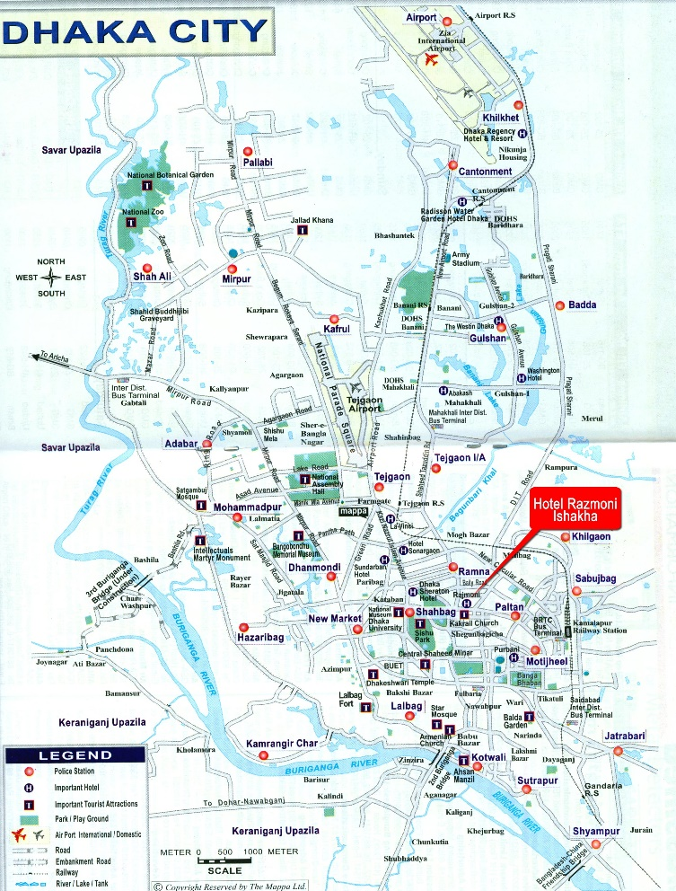
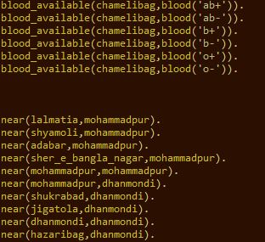
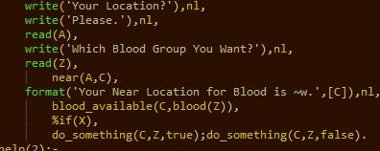
How do we do that…?

Slide 13
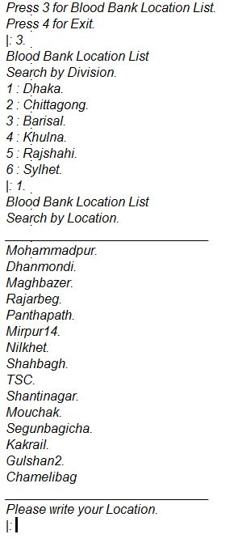
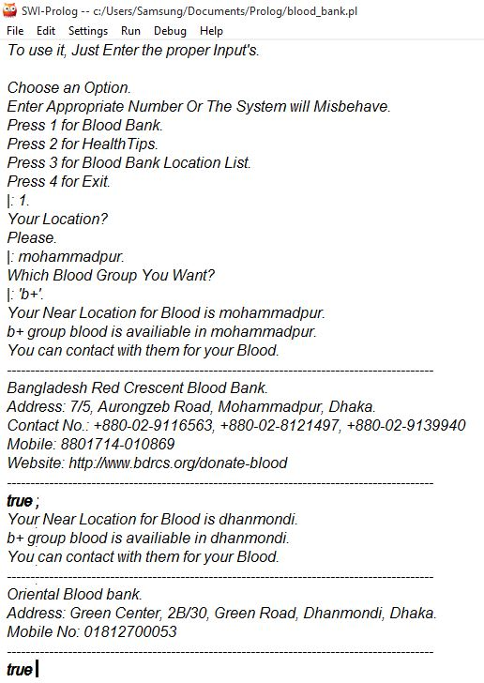
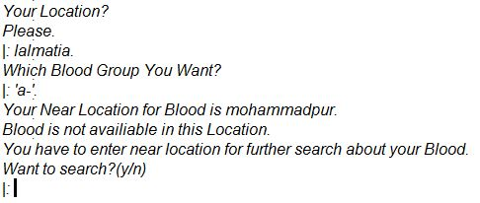
Sample Output

Slide 14

Any Question..?

Slide 15
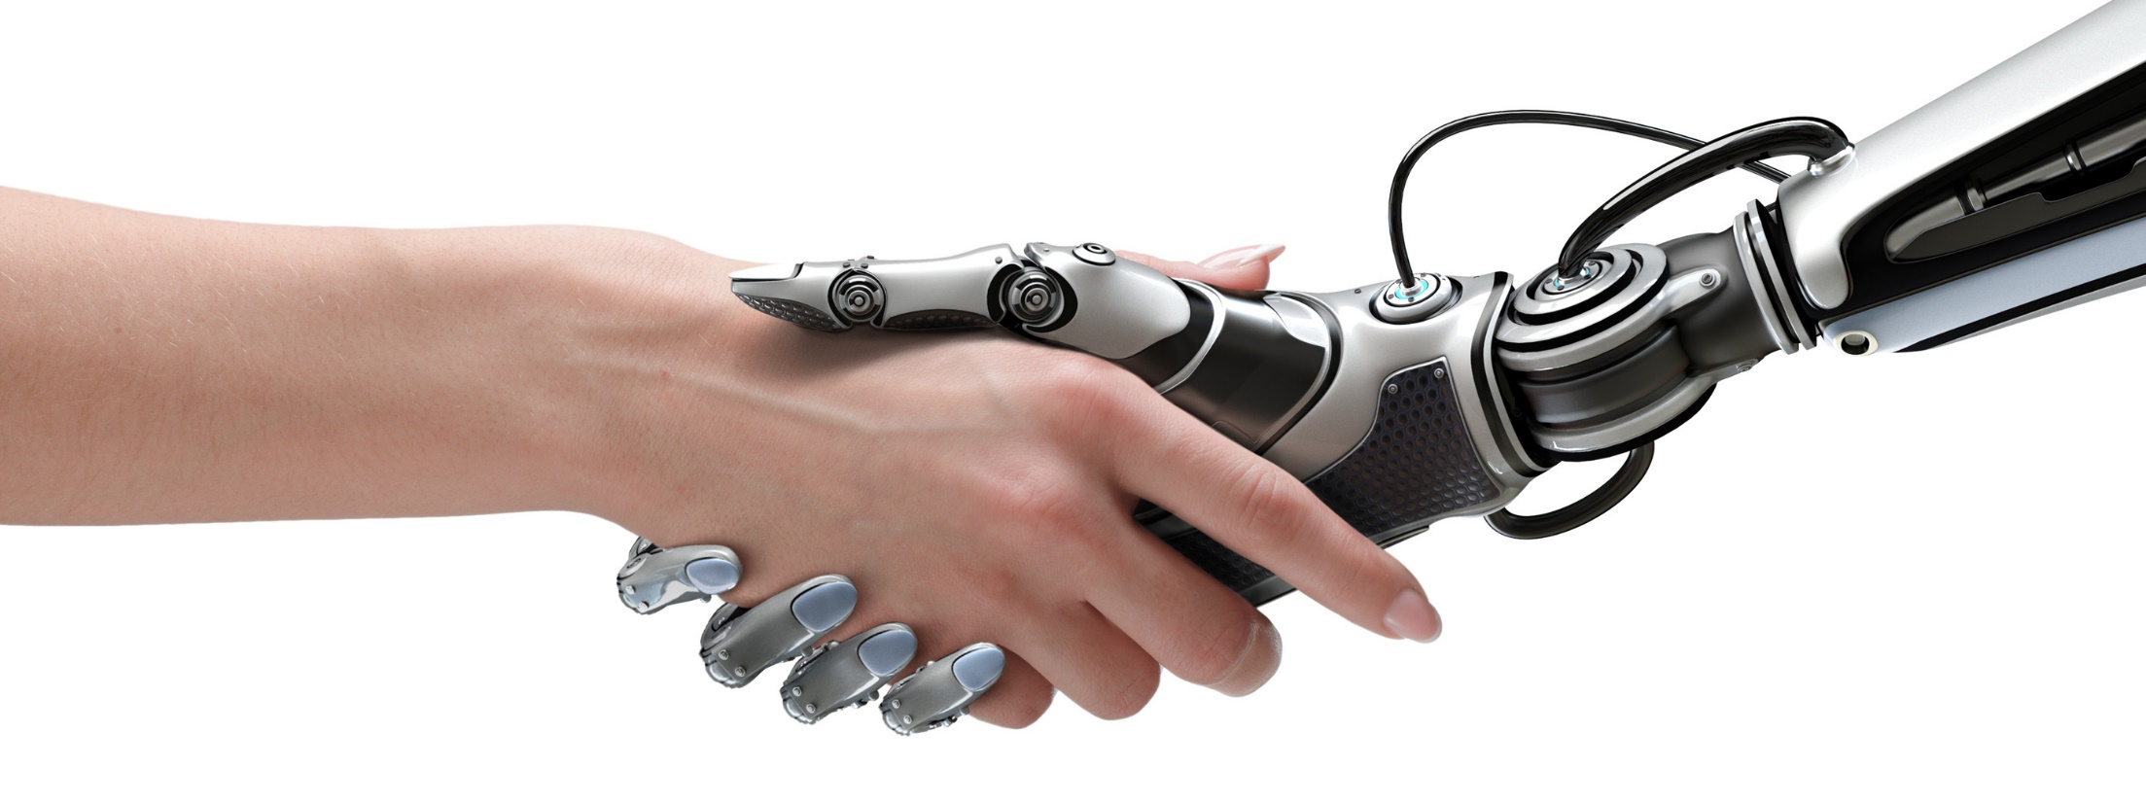
Thank You

