Slide 1
MALIGNANT COMMENT CLASSIFICATION

Slide 2
Business Problem
There has been a remarkable increase in the cases of cyberbullying and trolls on various social media platforms. Many celebrities and influences are facing backlashes from people and have to come across hateful and offensive comments. This can take a toll on anyone and affect them mentally leading to depression, mental illness, self-hatred and suicidal thoughts.
Internet comments are bastions of hatred and vitriol. While online anonymity has provided a new outlet for aggression and hate speech, machine learning can be used to fight it. The problem we sought to solve was the tagging of internet comments that are aggressive towards other users. This means that insults to third parties such as celebrities will be tagged as unoffensive, but “u are an idiot” is clearly offensive.
Our goal is to build a prototype of online hate and abuse comment classifier which can used to classify hate and offensive comments so that it can be controlled and restricted from spreading hatred and cyberbullying.

Slide 3
MOTIVATION FOR THE PROJECT
Motivations for malicious comments identified in the study involved targeting people's mistakes. Conversely, most benevolent comments involved encouragement and compliments to help people in difficult or risky situations, showing malicious comments is a primary reason for degradation of online social networks. Moreover, the abolition of anonymity and intensification of punishment in social media can be effective in reducing malicious comments and rumors. However, potential violation of freedom of expression also risks trivializing the online social network itself. Because anonymous forms of freedom of expression have always been controversial in theoretical and normative spheres of social research. Careful consideration of any limiting of comments is necessary before a ban might be contemplated.
Requiring true identities would cause them to be more careful and responsible. Our results also suggest providers of social media services can apply text filters to their systems. Because certain texts are used repeatedly in cyberbullying or malicious comments, providers should be persuaded to develop a system to detect certain texts and alert them as to when to possibly take action against the people posting them. Such a filtering function could reduce the number of all kinds of malicious comments. Conversely, social media service providers should consider posting lists that rank users most active in posting benevolent comments on their sites. Because people generally enjoy self-expression, these rankings could motivate more people to post positive comments as a way to develop a new social norm in which malicious comments are unwelcome and the people posting them are scorned.

Slide 4
ANALYTICAL PROBLEM FRAMING
While analyzing the data, we can use variety of methods.
For the given project, we need to analyze the comments based on different metrics.
The data has been provided in a comma separated values(.excel) format in two different files namely train and test.
This data set has around 1lakh 50 thousand rows and 7 columns.

Slide 5
EXPLORATORY DATA ANALYSIS
Data preprocessing is a technique of converting raw data into useful format.
Data cleaning is a part of pre-processing technique where missing values will be dealt.
For the given dataset there are no null values and much of pre processing involved with the comments.

Slide 6
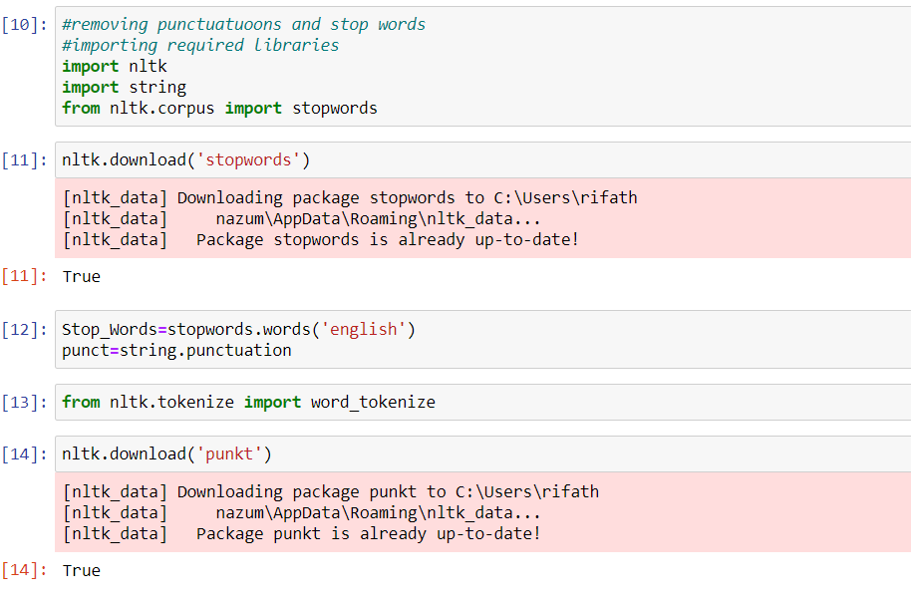

Slide 7
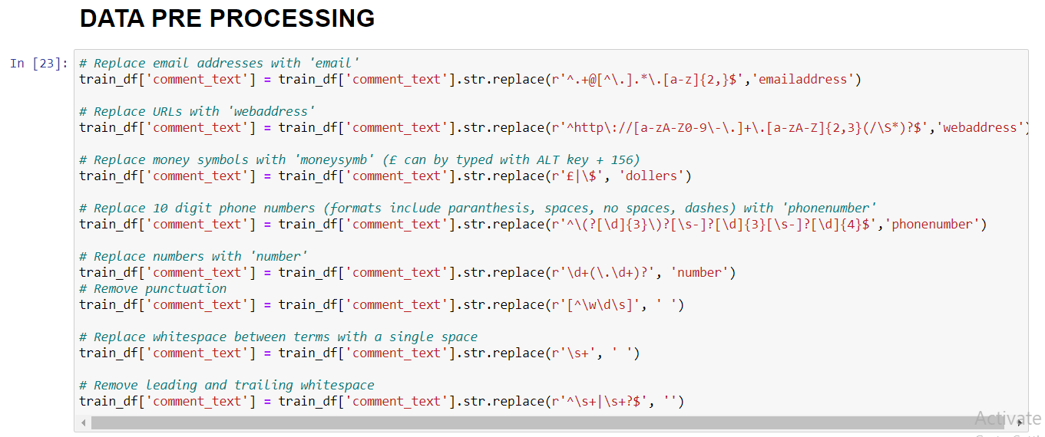

Slide 8
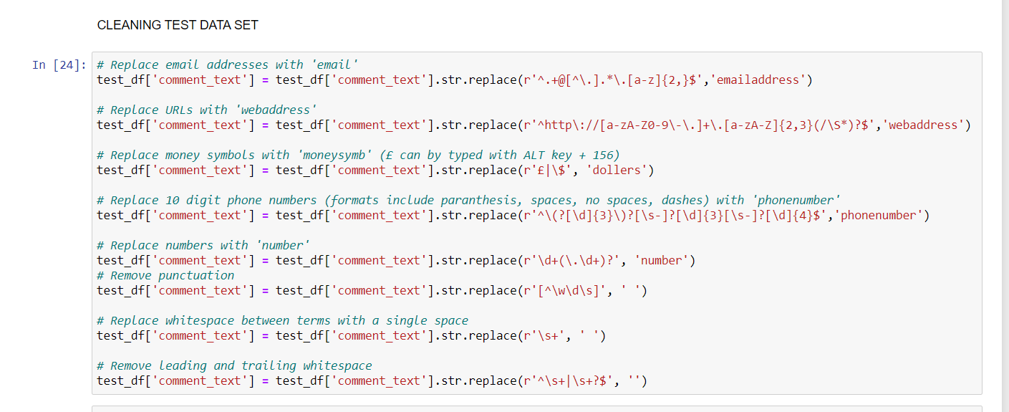

Slide 9
