Slide 1

AI PROOF OF CONCEPT
AI-Powered
Release Notes Workflow
From YouTrack Data to Publication-Ready Documentation
Proof of Concept | Documentation Automation

Slide 2



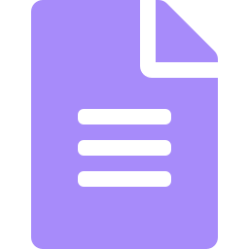

01 CONTEXT
Business Challenge
Fragmented Sources
Manual & Time-Consuming
Release information is scattered across YouTrack tickets and implementation notes.
Repetitive release-note authoring drains writer bandwidth every cycle.
Heavy Review Loops
Publication Overhead
Multiple review passes multiply the documentation effort per release.
Extra manual formatting is needed to make notes publication-ready.
OBJECTIVE Automate the end-to-end release-note workflow while preserving quality, consistency, and publication standards.
02

Slide 3






02 APPROACH
AI-Powered Solution
YouTrack +
Impl. Notes
Release Data
Extractor
Release Note
Generator
Publication-Ready
Release Notes
Release Note
Publisher
Release Note
Reviewer
AI SKILLS
Release Data Extractor
Release Note Generator
Release Note Reviewer
Release Note Publisher
Human Review and Approval
03

Slide 4

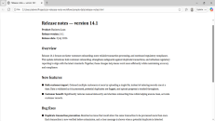


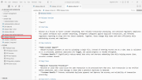
03 DEMONSTRATION
End-to-End Workflow
01
02
03
Extract Release Data
Generate Release Notes
Review Release Notes
04
Review and Publish Release Notes
Human Validation -> Approval -> Publication
04

Slide 5
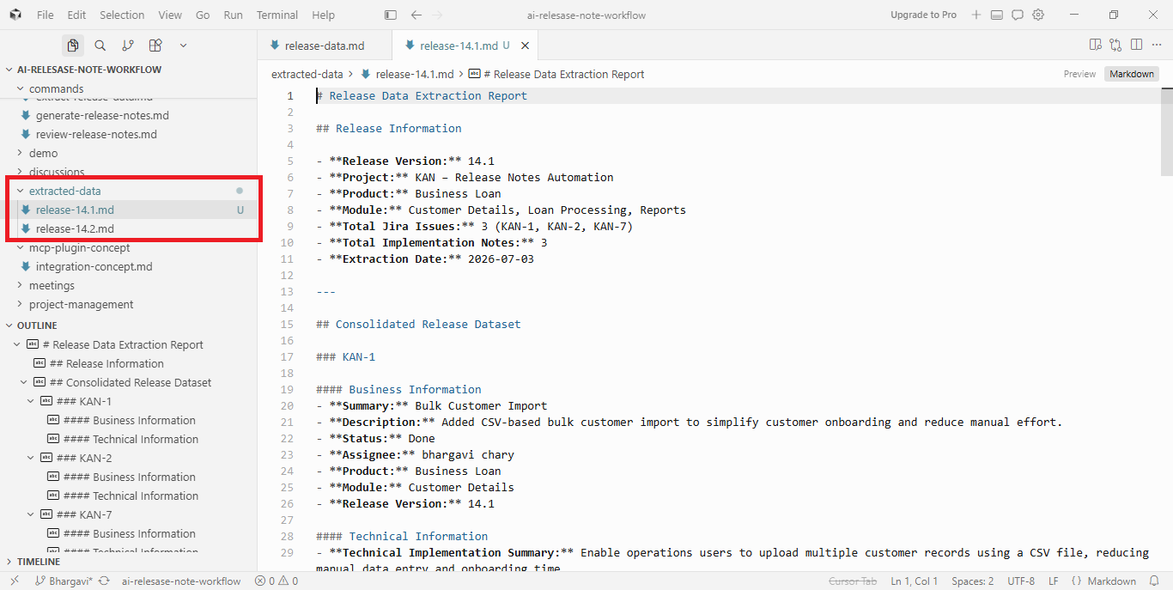

Slide 6
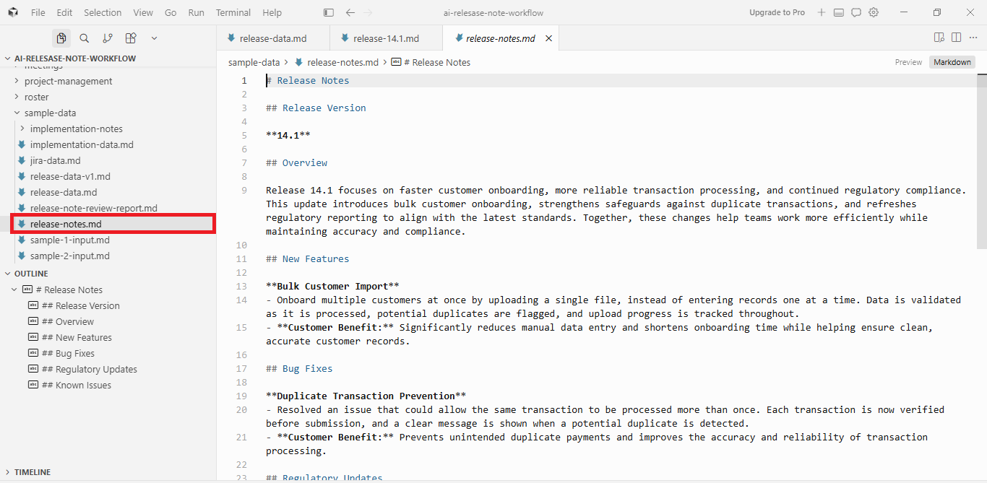

Slide 7
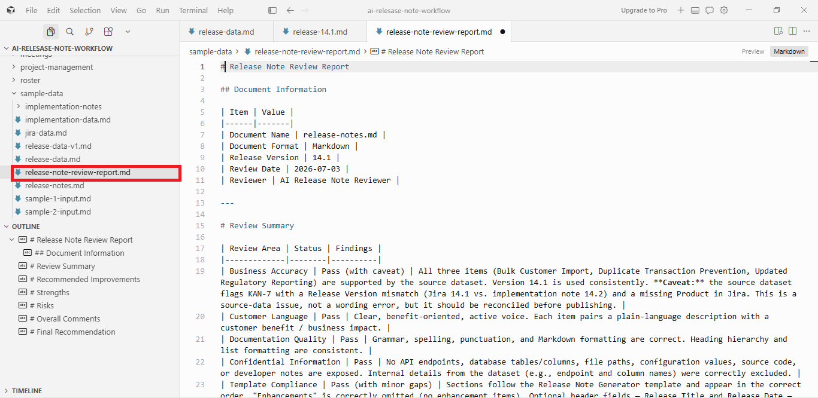

Slide 8
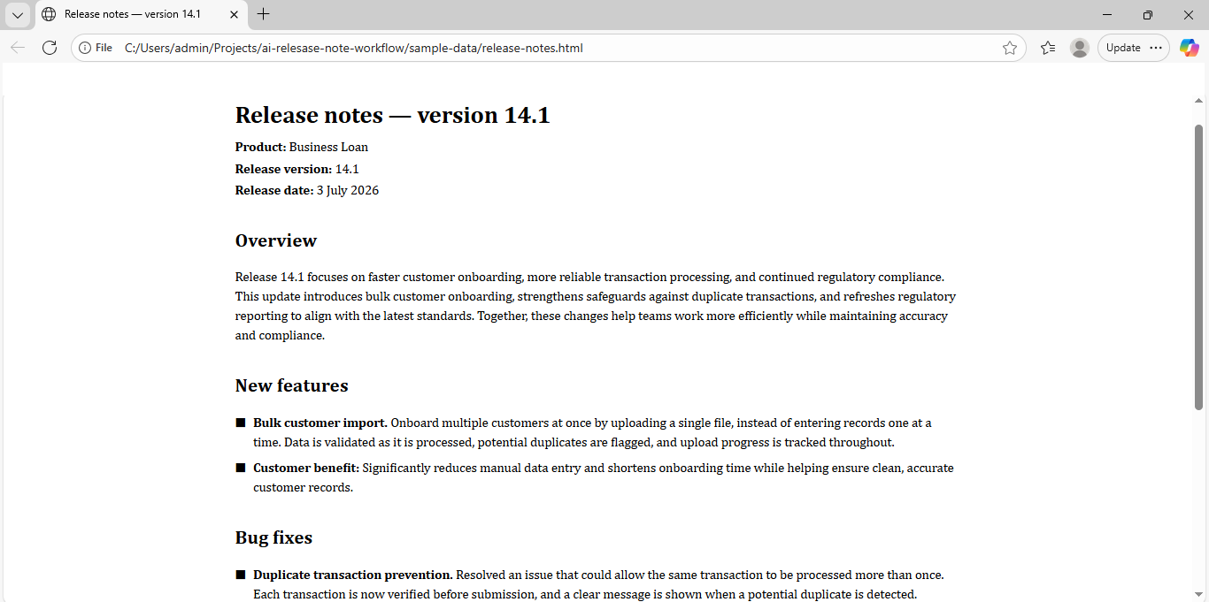

Slide 9





04 IMPACT
Business Value
Benefits
Reduced manual documentation effort in release note creation
Consistent and standardized release note generation
Faster documentation turnaround
Publication-ready outputs
Improved content quality through AI review
05

Slide 10
Thank you

