Slide 1
Pig Latin Converter
Computer Methodology Project - Fall 2017
Rina Lazaroff, Rivky Grossberg, Reena Klein

Slide 2
How it works
Our program accepts a String from the user, it is then split up into sentences. Then each sentence was sent to a method that converted to pig latin
We allowed users to enter a word in pig latin which then converted it into English.

Slide 3
How it works (cont.)

Slide 4
How it works (cont.)

Slide 5
Why we chose this project
It’s relatable – we felt that it would be something that everyone in the class can understand and relate to.
It’s possible – as a programmer, we felt that it was a challenge, being that we’ve never done something like this before, but it was also possible to accomplish.
It’s expandable - we began with a simple English to Pig Latin converter and were able to expand it to include a Pig Latin to English converter and a short ‘test-yourself’ game. (with more room to expand if necessary)

Slide 6
Difficulties encountered
Group Work– Although it did make the workload easier working as a team, one also had to train oneself to understand another’s code and to listen to another’s ideas…
Figuring out how much to leave in the user’s hands – Of course we had to have some data validation. However, how much was up to us. We had to decide if the user should be allowed to enter invalid entries and then receive incorrect results, or should we force the user to only enter exactly what we think would make sense…

Slide 7
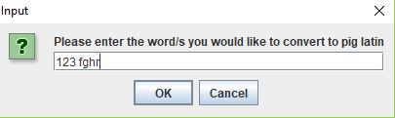
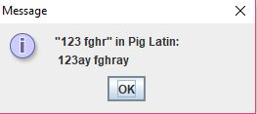
Difficulties encountered (cont.)
Here’s what we came up with…
Suppose one decided to use the English to Pig Latin converter and entered this:
The converter would return…
We assume that whoever uses our converter, is well-versed in the English language and if one chooses to enter words that are not in the dictionary, he is aware of it, and he therefore will get back those words in Pig Latin.

Slide 8
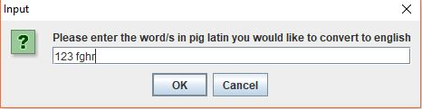
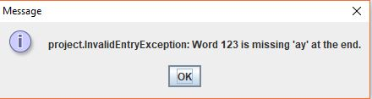
Difficulties Encountered (cont.)
In contrast, when using the Pig Latin to English converter, we are not very certain that one is well-versed in Pig Latin, and so, if one enters the same thing in the Pig Latin to English converter:
It would return:
This exception would help the user understand what he did wrong and how to write proper Pig Latin.

Slide 9
What we’ve learned
Team Work – It definitely taught us how to work as a team, how to pitch in, to coordinate…
Agile – It gave us a real feel to agile programming when we had ‘clients’ and feedback. Also, that we had to show a real demo with working software…
We can really create something! Sitting in class, doing assignments, and taking tests, is one thing. But actually coming up with your own idea and creating a program that really works, is something else entirely! It was a true learning experience (and perhaps an ego booster too)!

