Slide 1
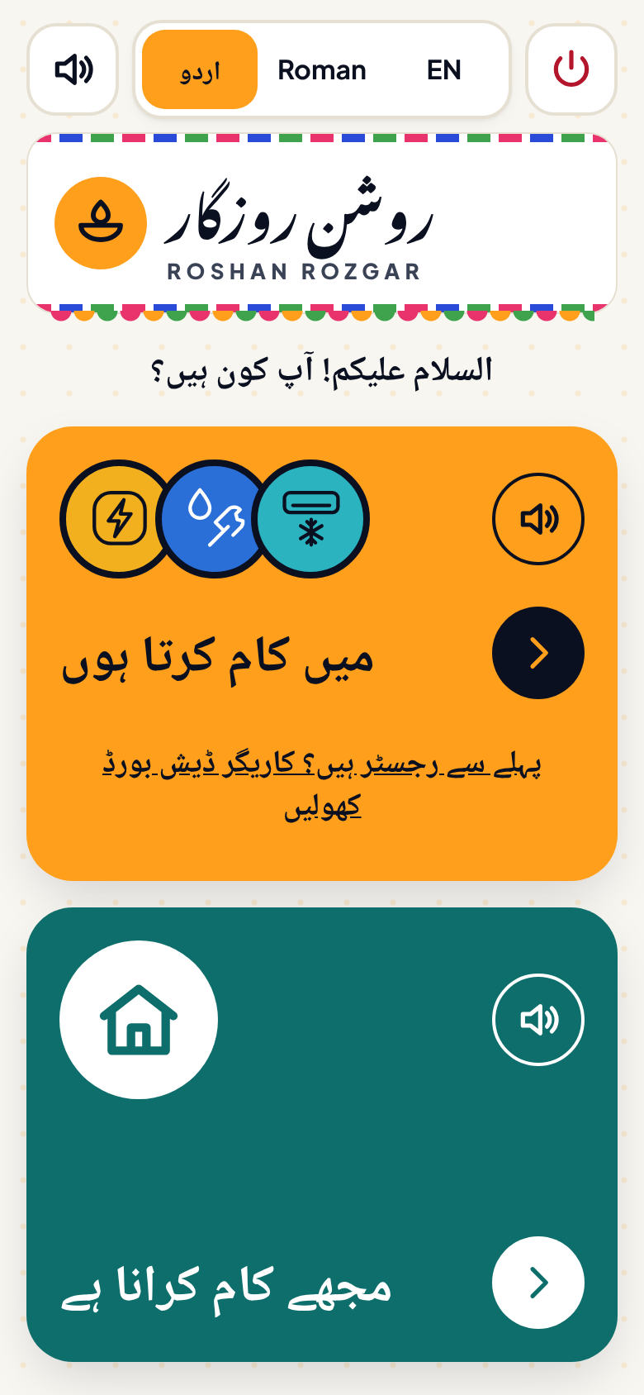
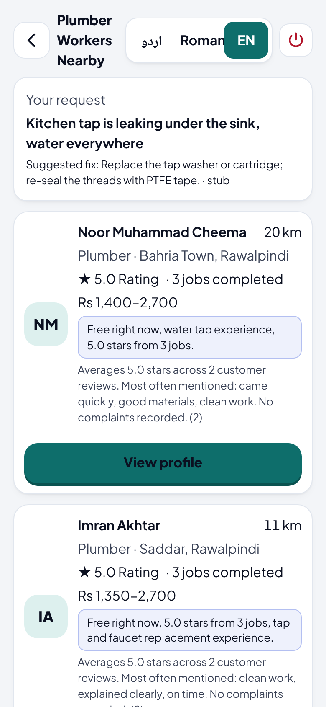
CUI TECH FEST · AI WEB FORGE HACKATHON
Roshan Rozgar
روشن روزگار
The job platform that doesn’t ask a worker to read.
A voice-first, Urdu-first marketplace that connects households with nearby, available, trusted skilled trade workers — electricians, plumbers, AC technicians, carpenters and more.
Team Compiler Society
COMSATS University Islamabad · Full-Stack Web Development & Applied AI track
Notes:
Assalam-o-Alaikum. We are Compiler Society, and this is Roshan Rozgar.
In one sentence: it is the job platform that doesn't ask a worker to read.
On the left of the phones you see the worker's world — Urdu-first and spoken. On the right, the customer's world — fast results for a household that needs help now. Both run on the same system, and in the next few minutes we'll show you every step working.

Slide 2


Skilled workers are invisible online
THE PROBLEM
72.1%
The worker
The household
Every job portal assumes he reads, types into forms and has a CV
Years of skill, no written proof of it
Waits at the adda for work that may not come
Something breaks — who is nearby and free right now?
Is he competent for this specific job?
Is he safe to let into my home?
of Pakistan’s non-agricultural employment is informal
Electricians, plumbers, AC technicians and carpenters are a large share of it. They find work at a street-corner adda, through contractors, or by word of mouth.
The real barrier is literacy, not language. A form translated into Urdu still needs reading and typing.
Source: Pakistan Bureau of Statistics, Labour Force Survey
Notes:
72 percent of Pakistan's non-agricultural work is informal. A plumber with 15 years of experience still finds work by standing at an adda, because every job portal ever built asks him to fill in a form and upload a CV.
On the other side, a household with a leaking geyser has four questions: who is nearby, who is free right now, who can actually do this job, and who is safe to let in.
Our key insight: the barrier is literacy, not language. Translating a form into Urdu doesn't help someone who doesn't read comfortably.

Slide 3







Two skins over one system
OUR SOLUTION
Worker skin
Customer skin
One backend
Urdu-first · voice-first
Fast · dense · trilingual
one database
one booking engine
one AI layer
Builds a profile by speaking — no keyboard needed
Large tap targets, icons + colour for every trade
Every screen can be read aloud
Describe the problem by text, voice or photo
Ranked nearby workers, each with its reason
Book, agree a price, track live, review
Speak
Describe
Match
Agree
Book
Review
Worker profile
AI finds the trade
Nearby & free now
Price, both confirm
Worker locked: busy
Trust for the next
Notes:
Our design idea is "two skins over one system".
The worker skin is Urdu-first and voice-first: he speaks, the app listens, and it reads everything back to him.
The customer skin is faster and denser: describe the problem in your own words, by voice or with a photo, and get ranked workers nearby.
Underneath is a single backend: one database, one booking engine, one AI layer — which is why the two sides always agree on who is free.
The strip at the bottom is the full journey: speak, describe, match, agree, book, review.

Slide 4

Five outcomes, both roles, one flow
PROJECT OVERVIEW
1. Onboarding
A complete profile from a spoken interview — no form, no typing
Worker
2. Discovery
Describe the problem → nearby, available workers, ranked with reasons
Customer
3. Communication
Price offer and two-sided price agreement; chat stores Urdu + English
Both
4. Booking
A state machine; the database refuses a second active job
Both
The first screen: “I do work” (amber) or “I need work done” (teal) — chosen by icon and colour, with a speaker button to hear it.
5. Trust
Stars, tag chips, written or spoken review → AI trust summary
Customer
Every screen switches between اردو · Roman Urdu · English
Notes:
Here is the platform in one view. The brief asked for five outcomes working together as one flow, for both roles — and that's how we built it.
Onboarding is the worker side. Discovery is the customer side. Communication and booking involve both. Trust closes the loop for the next customer.
Everything opens from this one screen: an amber card for "I do work", a teal card for "I need work done". You pick by colour and icon, and the speaker button reads it out.

Slide 5


Eight features, each tied to a real barrier
WHAT WE BUILT
Voice-interview onboarding
Problem → trade, by AI
Explainable ranking
Trilingual + read-aloud
Speak name, trade, years, area and skills — AI turns it into a profile
Text, voice or photo is classified into trade, urgency and likely fix
Availability → distance → skill → rating, with the reason on every card
Urdu, Roman Urdu and English on every screen; text-to-speech
Price offer & agreement
No double-booking
Reviews → trust summary
Honest AI labels
Customer offers, worker proposes, both confirm a structured price
Transactional state machine + a partial unique index in Postgres
Stars, tag chips, review text; AI summary shows its source count
“AI” chip only when a real model answered; “demo data” otherwise
Notes:
These are the eight things we built. Each one exists because of a specific barrier in the brief.
Voice onboarding removes the literacy barrier. AI classification means the customer doesn't need to know the name of the trade. The ranking is explainable — every card says why it ranked there. The whole app is trilingual and can read itself aloud.
On the transaction side: a price offer and two-sided agreement, and booking that the database itself protects from double-booking. Then reviews feed an AI trust summary.
And one feature judges should notice: honest AI labels. If a real model answered, you see an "AI" chip. If the offline fallback answered, it says "demo data".

Slide 6
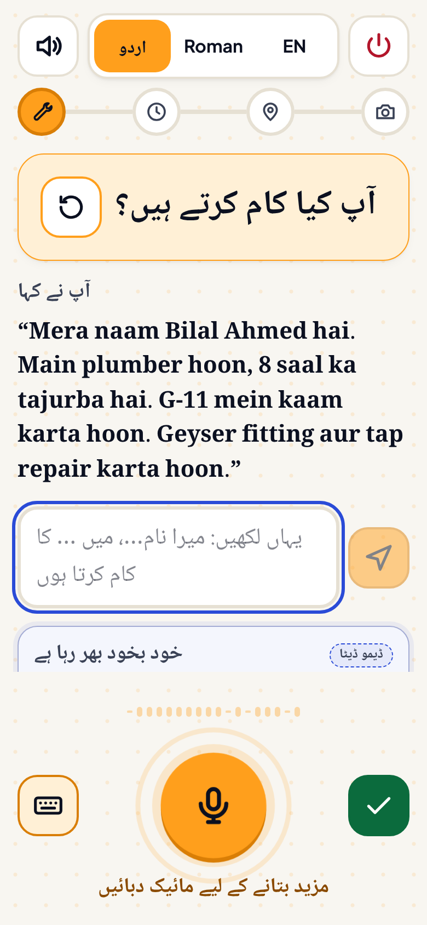
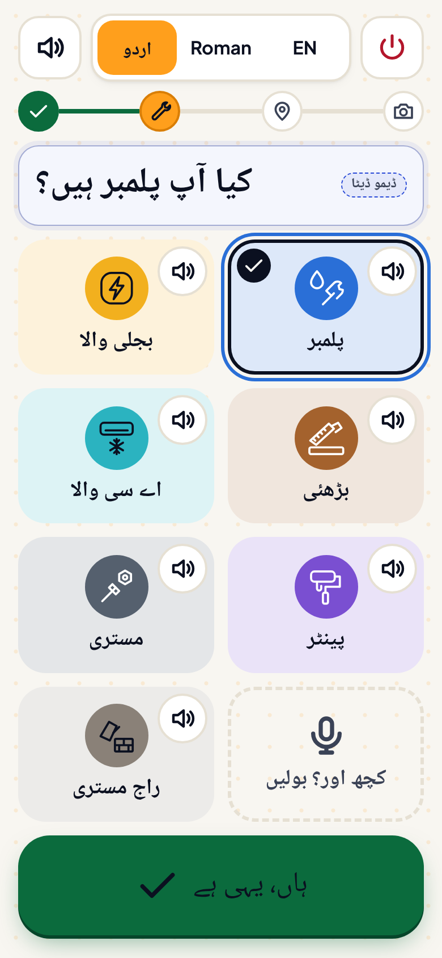
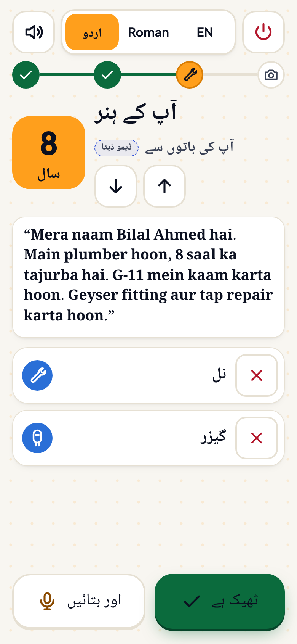
A complete profile, built by speaking
FEATURE 1 · ONBOARDING
1
2
3
A four-step voice interview replaces the sign-up form. The worker answers aloud in Urdu or Roman Urdu; AI extracts name, trade, years, area, skills and rate band.
1
He speaks
“Mera naam Bilal Ahmed hai, main plumber hoon, 8 saal…” → transcript appears, fields fill in
2
Trade is pre-selected
“Are you a plumber?” — confirm with one tap on an icon tile, or say another trade
3
Skills from his own words
8 years, tap and geyser skills quoted back; step 4 adds work photos, reads the profile aloud and publishes
Benefit: no keyboard, no CV — the only way this user gets on.
Notes:
Feature one: onboarding by voice. These are real screens from our app.
Screen one: the app asks, in Urdu, "What work do you do?" He answers aloud. The transcript appears and the AI pulls out name, trade, years, area and skills. Anything missing gets a spoken follow-up question.
Screen two: the trade is already selected — "Are you a plumber?" — he taps yes, or picks another icon.
Screen three: his years and skills, quoted from his own words. Step four adds work photos, reads the whole profile back to him, and publishes.
Honesty note: speech goes to ElevenLabs Scribe, with Whisper as fallback. For these screenshots we used the typed fallback, because the capture browser has no microphone.

Slide 7
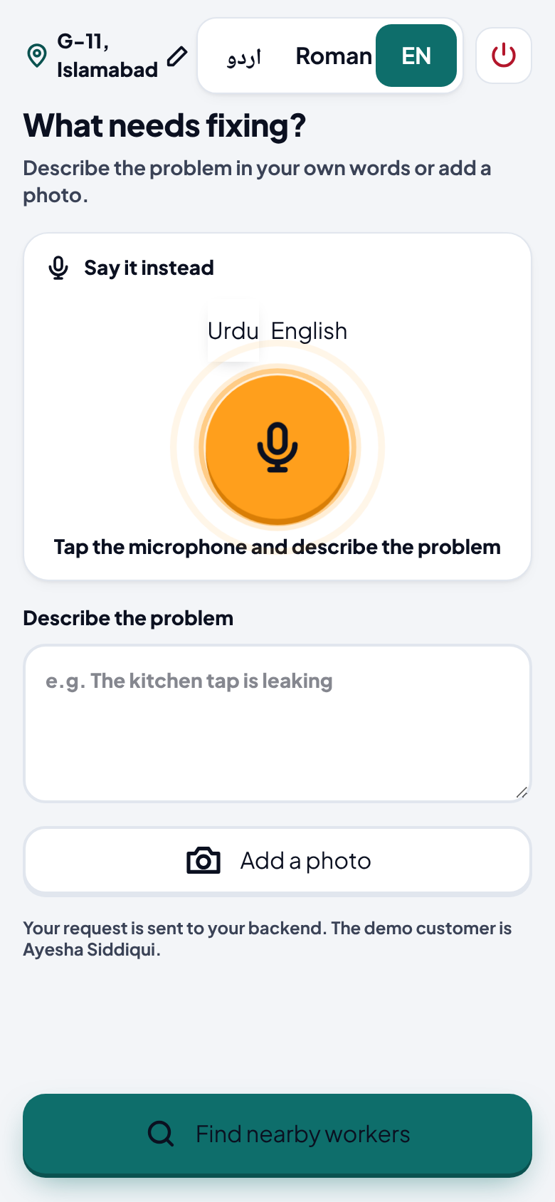
Say what’s broken — get who’s free, nearby, and why
FEATURE 2 · DISCOVERY
1
2
The reason, on every card
“Free right now, water tap experience, 5.0 stars from 3 jobs.”
How workers are ranked
40%
25%
20%
15%
Available now
Distance
Skill match
Rating
Input: text, voice or photo — AI returns trade, urgency, likely fix and keywords.
Benefit: she doesn’t need to know the trade’s name, and can see why each worker is shown.
Notes:
Feature two: discovery. The customer types, speaks, or photographs the problem. Here she typed "Kitchen tap is leaking under the sink".
The AI classifies it as plumbing, with a likely fix — replace the washer or cartridge — and searches for plumbers who are free right now.
Our ranking is a simple, explainable formula: 40 percent availability, 25 percent distance, 20 percent skill match, 15 percent rating. And every card shows its reason in plain words — "free right now, water tap experience, 5 stars from 3 jobs".
A visible reason builds more trust than a clever hidden algorithm.

Slide 8
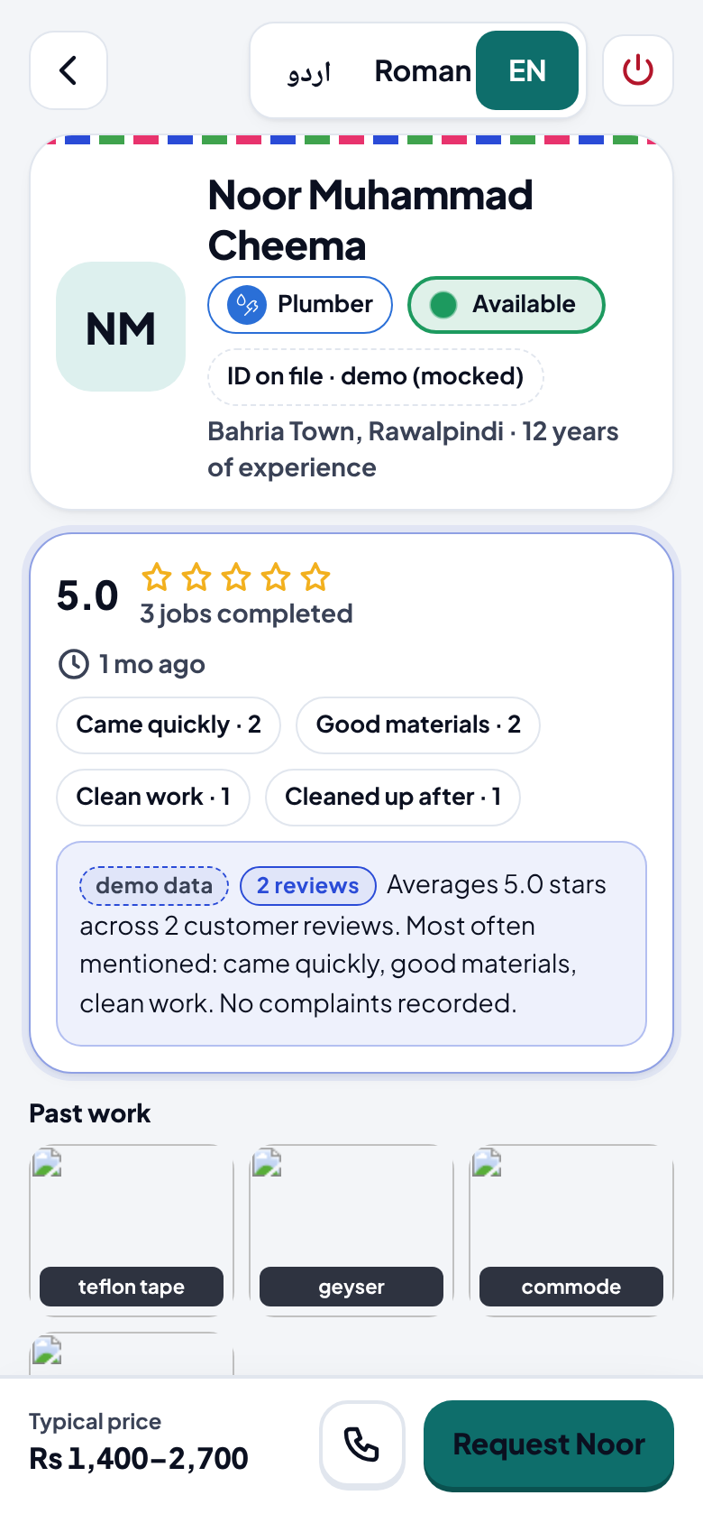
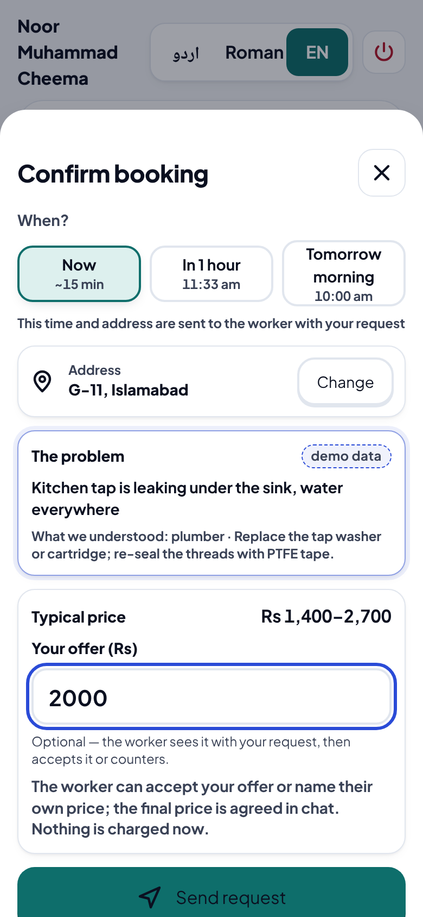
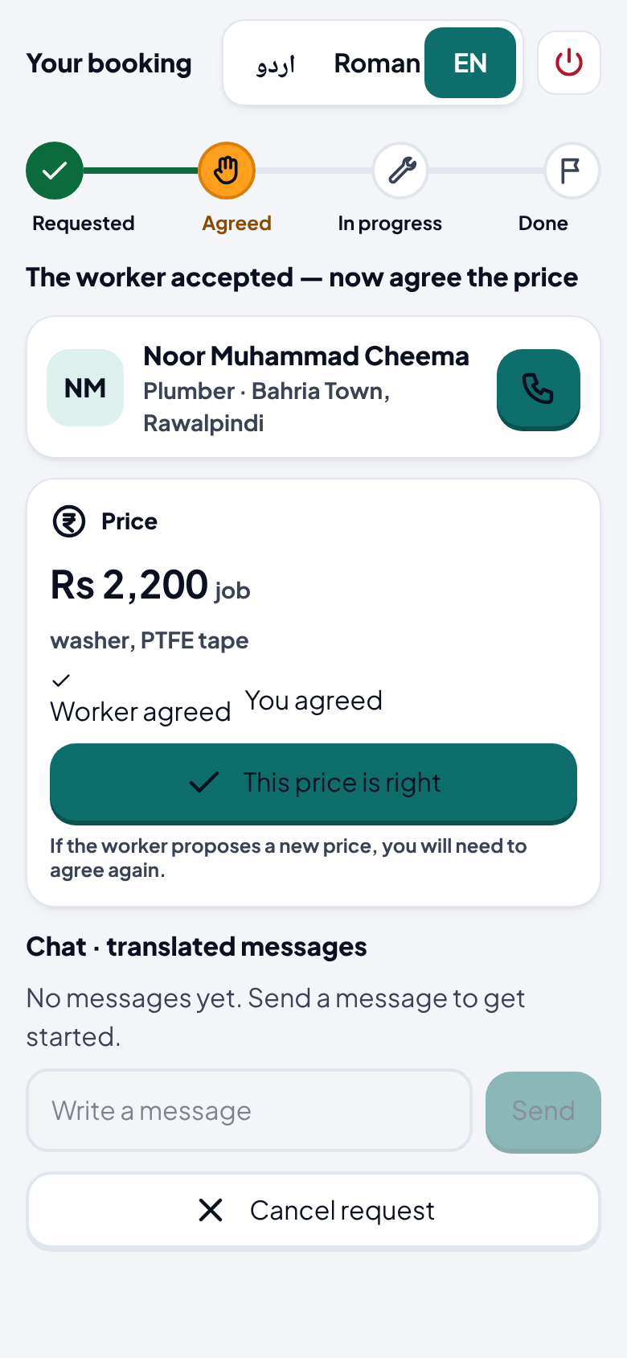
From profile to an agreed price in three taps
FEATURE 3 · COMMUNICATION & PRICE
1
2
3
1
Check the worker
Trade, area, years, “Available” badge, star rating, top tags and an AI trust summary with its review count
2
Request + optional offer
Choose Now / 1 hour / tomorrow, confirm the address, offer a price (here Rs 2,000)
3
Both sides agree
Worker proposes Rs 2,200 incl. washer and PTFE tape → customer taps “This price is right”
Benefit: a structured price both sides confirmed — a record instead of a roadside argument. Chat stores every message in Urdu and English.
Notes:
Feature three: from profile to price. These are screens from a real booking we made against our backend.
One: she checks the worker — rating, tags like "came quickly" and "good materials", and an AI trust summary that says how many reviews it is based on.
Two: she picks a time, confirms the address and can offer a price — here two thousand rupees.
Three: the worker accepted and proposed 2,200 including the washer and tape. She taps "This price is right" and the job moves to PRICE_AGREED.
Each chat message is stored in both Urdu and English. To be clear: today the chat is text-only, and the worker proposes his price from his home screen; a spoken price quote is on our next-steps list.

Slide 9
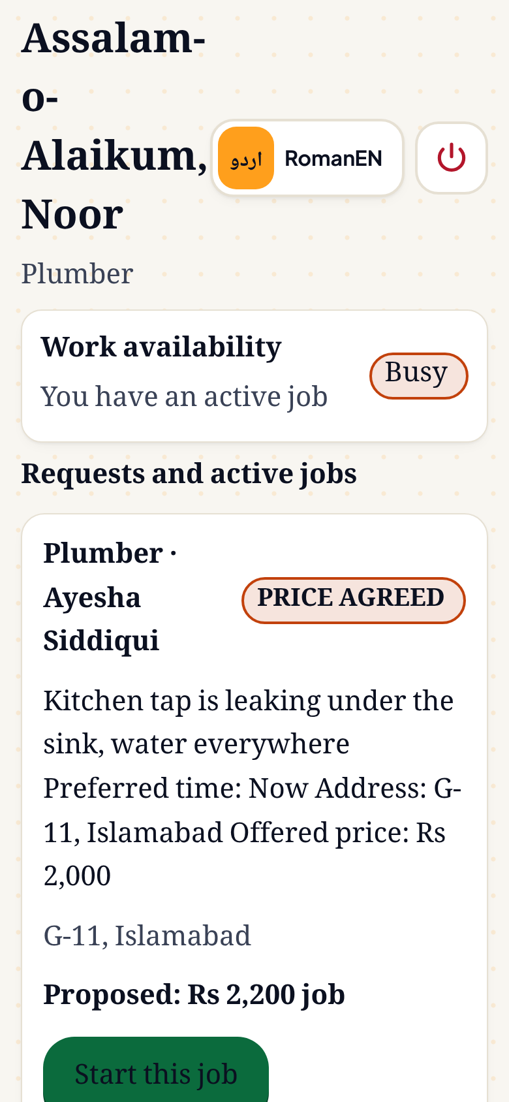
No double-booking — the database says no
FEATURE 4 · BOOKING
REQUESTED
ACCEPTED
PRICE_AGREED
IN_PROGRESS
COMPLETED
Side exits: DECLINED · CANCELLED
Active job → worker is BUSY and hidden from “available now”
db/migrations/0000_*.sql
11 / 11
CREATE UNIQUE INDEX one_active_job_per_worker
ON jobs (worker_id)
WHERE status IN ('ACCEPTED',
'PRICE_AGREED', 'IN_PROGRESS');
database invariant checks pass (npm run verify)
22 / 22
Accept = one transaction: job → ACCEPTED, worker → BUSY, the worker’s other pending requests auto-declined. Complete flips him back to FREE and recounts his jobs.
race-test checks pass, incl. double-accept (npm run race)
Worker home after price agreed: “Busy”
Notes:
Feature four is the one we are most proud of technically. Availability must be honest — if a worker accepts a job, he must disappear from "available now".
Every job moves through this state machine. Accepting is a single database transaction: the job becomes ACCEPTED, the worker becomes BUSY, and his other pending requests are declined.
And we don't trust the UI to prevent double-booking. This partial unique index means Postgres itself refuses a second active job for the same worker. A race condition becomes a clean error, not corrupt data.
We test it: 11 out of 11 invariant checks and 22 out of 22 race-test checks pass.
On the right, the worker's home screen after the price was agreed: status Busy.

Slide 10
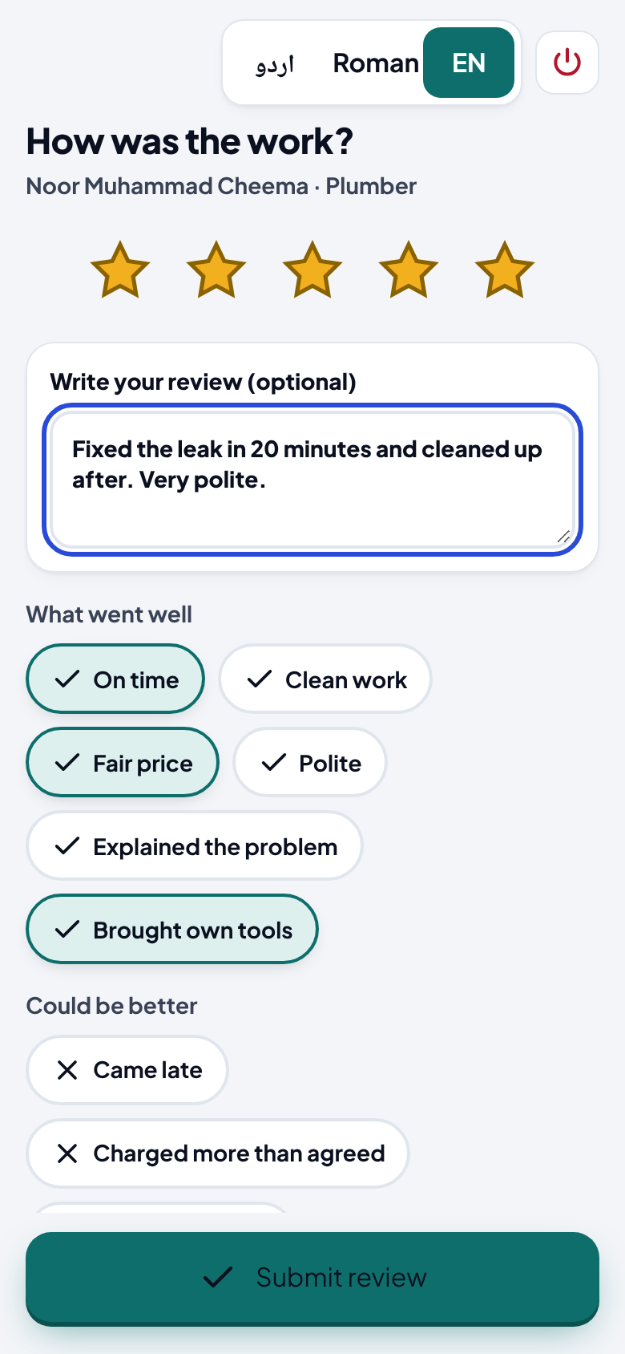
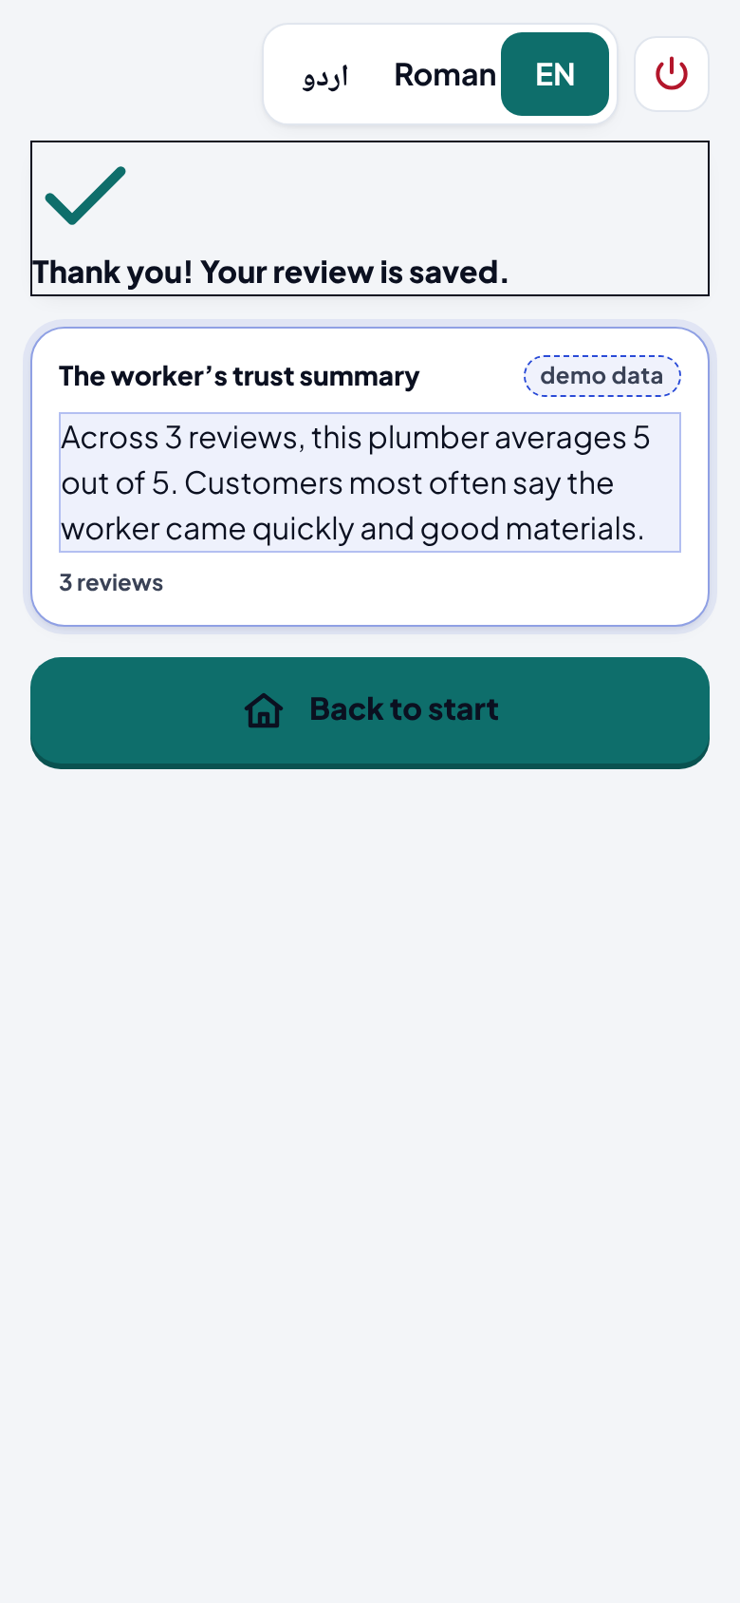
Every finished job makes the next choice easier
FEATURE 5 · TRUST
1
2
1
Rate in seconds
5 stars, tap chips like “On time”, “Fair price”, “Brought own tools”; optional written or spoken review
2
Trust summary regenerates
The worker’s summary is rebuilt from all his reviews and shows its source: 2 reviews → 3 reviews
3
Rating stays true
Rating is recomputed on every review; an invariant check confirms rating = real average
Benefit: the next customer gets a summary of real experiences instead of “ask a neighbour”.
Notes:
Feature five: trust. After the job is complete, the customer rates in seconds — stars, tap chips, and an optional review, which can be spoken.
Submitting regenerates the worker's trust summary. You can see it here: it now says "3 reviews" — before this review it said 2. We always show the source count, so the customer knows how much evidence is behind the summary.
In this run, no AI key was configured, so the summary is computed by our offline fallback from the real review rows — and the app labels it "demo data" instead of pretending. With a key, the same endpoint uses Claude or Gemini to write it.

Slide 11
From a spoken sentence to a finished, reviewed job
HOW IT WORKS
1 Join
2 Ask
3 Match
4 Agree & book
5 Finish & trust
Speaks his profile; AI extracts it; he confirms and publishes
Goes “available”
Sees the request; accepts with one tap → BUSY
Proposes a price; starts the job
Completes → FREE again; jobs count +1
Worker
One shared Job record in Postgres — both screens poll it every 4–5 s, so they always show the same state
Picks area or live location
Describes problem: text, voice or photo → AI finds trade
Gets free workers nearby, ranked, with reasons
Requests + offers a price; confirms worker’s price; tracks live
Rates, tags, reviews → trust summary updates
Customer
Notes:
Here is the full workflow in five stages, worker on top, customer below.
Join: the worker speaks his profile; the customer sets a location.
Ask: the customer describes the problem, and AI turns it into a trade.
Match: free workers nearby are ranked; the worker sees the request and accepts with one tap, which marks him busy.
Agree and book: price offered, proposed and confirmed; the job starts.
Finish and trust: completing frees the worker; the customer's review updates his trust summary.
In the middle, the key point: both sides read one shared job record, so they never disagree about what's happening.

Slide 12




Chosen for reliability over novelty
TECHNOLOGY STACK
Frontend
Backend
Data & storage
AI services
Next.js 16 · React 19
App Router; both skins in one app
Next.js Route Handlers
29 API routes, one deploy, no CORS
PostgreSQL (Supabase)
Partial unique index, jsonb, enums
Claude (Anthropic) · Gemini
Extract, classify, tag photos, translate, price, summarise
TypeScript (strict)
One type system, front to back
Zod 4
Validation at every boundary
PGlite fallback
Embedded Postgres — runs with no cloud
ElevenLabs Scribe · Whisper
Urdu speech-to-text
Browser speech + mic APIs
Recording and read-aloud fallback
Job state machine
Transactional transitions
Drizzle ORM · Supabase Storage
Migrations; audio & photo uploads
ElevenLabs eleven_v3
Urdu text-to-speech
Hosting: Vercel, plus a local instance as demo backup. Built with: Claude Code as AI coding assistant (disclosed in README).
Notes:
Our stack was chosen for reliability, because the brief says reliability is valued over feature count.
One Next.js 16 app holds both front ends and all 29 API routes — one deploy, no CORS, fewer things to break.
Data is Postgres on Supabase. If there's no cloud database, it falls back to PGlite — real Postgres compiled to WebAssembly — so the same constraints apply even offline.
For AI: Claude and Gemini handle extraction, classification, photo tagging, translation, price parsing and review summaries. ElevenLabs and Whisper handle Urdu speech-to-text, and ElevenLabs reads screens aloud.
We disclose that we used Claude Code as our coding assistant.

Slide 13
One app, one database, a fail-safe AI layer
SYSTEM ARCHITECTURE
CLIENTS (phone browser)
NEXT.JS APP — API ROUTE HANDLERS
PostgreSQL
Supabase · or embedded PGlite
unique index: 1 active job / worker
Worker skin
/worker/* · Urdu-first, voice
/api/ai/*
transcribe · extract · classify · tag · translate · price · summarise · speak
/api/workers
ranked search with reasons; profiles
Customer skin
/customer/* · trilingual
/api/jobs/*
accept · price · start · complete · cancel
/api/messages · reviews
bilingual rows; trust recompute
Supabase Storage
or local disk
AI provider chain
Claude → Gemini → OpenAI → offline stub · cached
/api/upload
audio + photos, 5 MB cap
AI APIs
Anthropic Claude · Google Gemini
Polls job + messages every 4–5 s
Every response: { ok, data, meta.provider }
Speech APIs
ElevenLabs Scribe + TTS · OpenAI Whisper
Notes:
This is the actual architecture in the repository.
Two front ends — the worker skin and the customer skin — run in the phone's browser and talk to one Next.js app through JSON API routes. Live status is kept in sync by polling every four to five seconds.
Inside the app: AI routes, ranked worker search, the job state machine, messages and reviews, and uploads.
The AI layer is a provider chain: Claude first, then Gemini, then OpenAI, and finally a deterministic offline stub — so a dead API key or bad venue wifi never breaks the demo. Real answers are cached, and every response says which provider answered.
On the right: Postgres with our unique index, Supabase Storage for audio and photos, and the external AI and speech APIs.

Slide 14
Why a worker — and a household — would choose this
INNOVATION & COMPETITIVE ADVANTAGE
 | Typical job portal / classifieds | Roshan Rozgar
Joining | Typed form, CV upload | A spoken interview in Urdu
Finding help | Pick the right category yourself | Describe it in your words, voice or photo
Ranking | Opaque order | A plain-language reason on every card
Availability | Stale listings | Free / busy enforced by the database
Trust | A star count | AI summary with its source count
Remove the AI and…
Speech-to-text
the worker cannot onboard at all
Profile extraction
raw audio is not a searchable profile
Problem classification
she must diagnose her own fault first
Translation
the two users cannot negotiate
Review synthesis
trust goes back to “ask a neighbour”
Also built for venue reality: runs with no keys and no cloud (PGlite + offline stub), and labels it honestly.
Notes:
What makes us different? Compare us with a typical job portal or classifieds site.
Joining: a form and a CV, versus a spoken interview. Finding help: picking the right category yourself, versus describing the problem in your own words. Ranking: opaque, versus a reason on every card. Availability: stale listings, versus free and busy enforced by the database. Trust: a star count, versus a summary that tells you how many reviews it's built on.
The judges asked: what stops working if the AI is removed? Our answer, per component, is on the right. Without speech-to-text, the worker cannot onboard at all. Without classification, the customer must diagnose her own fault. Without translation, the two users cannot negotiate. The AI isn't decoration — it's the access layer.

Slide 15



What works today, what’s next, and why it matters
STATUS, FUTURE SCOPE & IMPACT
Working today
Being finished
Future scope
Voice onboarding (4 steps) → published profile
Text / voice / photo problem description
Ranked search with reasons
Booking, price offer & agreement, live status
Reviews + trust summary
Text chat stored in Urdu + English
Worker “incoming request” & “job done” screens are design mock-ups
Spoken price quote → structured price
Voice notes inside chat (text today)
Real-mic test on the demo device
Login is a mocked phone + PIN
Offline-first job queue for 3G dead zones
Adda-level vouching: workers vouch for new workers
Real OTP and ID verification
Cash-free payments
More cities beyond Islamabad / Rawalpindi
Impact: brings skilled workers online without asking them to learn to read first — and gives households a faster, safer way to get things fixed.
Notes:
We want to be precise about what is real.
Working today: voice onboarding, problem description, ranked search, booking with price agreement and live status, reviews and trust summaries, and bilingual text chat.
Being finished: two worker screens — the incoming-request and job-done screens — are still design mock-ups; workers accept and complete from their home screen today. The spoken price quote and voice notes in chat are not wired yet, and login is a mocked phone and PIN. Seeded workers, jobs and reviews are demo data, as the brief allows.
Next: an offline-first job queue for weak networks, an adda-level vouching graph so existing workers can vouch for new ones, real OTP and ID verification, payments, and more cities.
The impact: we bring skilled workers online without asking them to change who they are.

Slide 16
THANK YOU · شکریہ
Five outcomes.
Both roles.
One flow.
Roshan Rozgar — the job platform that doesn’t ask a worker to read.
A worker speaks once and becomes discoverable. A household describes a problem and gets someone nearby, free and trusted. The database keeps both sides honest.
Team Compiler Society
Live demo next — worker on the left, customer on the right
Notes:
To close: five outcomes, both roles, one flow.
A worker speaks once and becomes discoverable. A household describes a problem and gets someone nearby, free, and trusted. And the database keeps both sides honest.
Remove the speech layer and the worker can't use the product. Remove the booking constraint and availability becomes a guess. That's why every piece is there.
Thank you — shukriya. We'd now like to show you the live demo, and we're happy to take your questions.

