Slide 2


Project Lambda: Functional Programming Constructs & Simpler Concurrency In Java SE 8
Simon Ritter
Head of Java Evangelism
Oracle Corporation
Twitter: @speakjava

Slide 3
The following is intended to outline our general product direction. It is intended for information purposes only, and may not be incorporated into any contract. It is not a commitment to deliver any material, code, or functionality, and should not be relied upon in making purchasing decisions. The development, release, and timing of any features or functionality described for Oracle’s products remains at the sole discretion of Oracle.

Slide 4

HTTP URL Permissions
Base64
Enhanced Verification Errors
Improve Contended Locking
DocTree API
Prepare for Modularization
Lambda (JSR 335)
Remove the Permanent Generation
Date/Time API (JSR 310)
Generalized Target-Type Inference
Java 8
Bulk Data Operations
Parallel Array Sorting
Limited doPrivileged
Repeating Annotations
Compact Profiles
Nashorn
Parameter Names
Unicode 6.2
Configurable Secure-Random Number Generation
TLS Server Name Indication
Type Annotations (JSR 308)
Lambda-Form Representation for Method Handles
Fence Intrinsics

Slide 5

Project Lambda:
Some Background

Slide 6
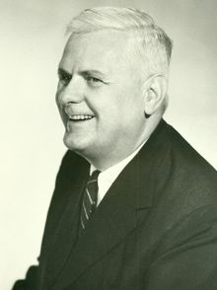
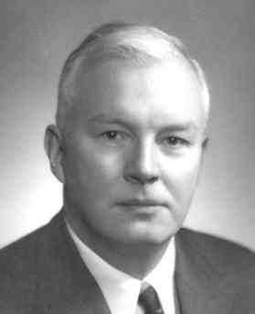
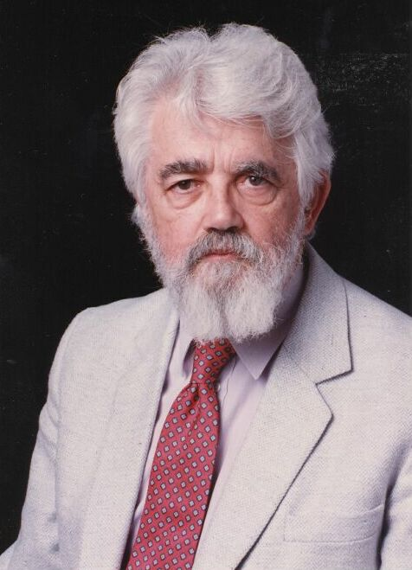


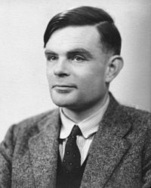
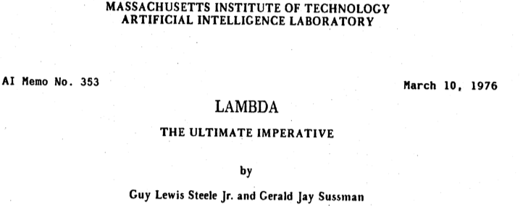
1930/40’s
1950/60’s
1970/80’s
Images – wikipedia / bio pages
Notes:
Alonso Church – Lambda Calculus – variable binding and substitution
Alan Turing – Supervised by Church
Haskell Curry – Combinatory Logic – Functional Programming
John McCarthy – Invented Lisp, timesharing, MIT 1961, Cloud
Gerald Sussman – Scheme Language like Lisp
Guy Steele – Java, Scheme, Fortress, Parallel algorithms

Slide 7


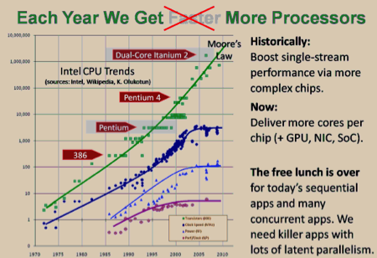
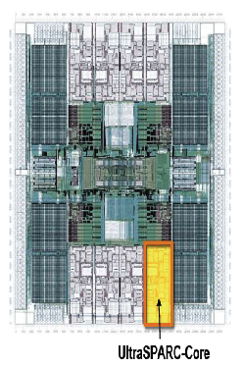
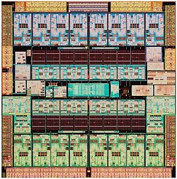
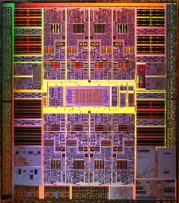

Computing Today
360 Cores
2.8 TB RAM 960 GB Flash
InfiniBand
…
Multicore is now the default
Moore’s law means more cores, not faster clockspeed
We need to make writing parallel code easier
All components of the Java SE platform are adapting
Language, libraries, VM
Herb Sutter
http://www.gotw.ca/publications/concurrency-ddj.htm
http://drdobbs.com/high-performance-computing/225402247
http://drdobbs.com/high-performance-computing/219200099

Slide 8

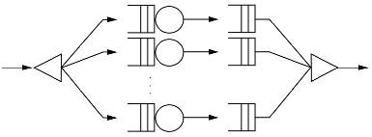

Concurrency in Java
Project Lambda
Fork/Join Framework (jsr166y)
java.util.concurrent (jsr166)
Phasers, etc (jsr166)
java.lang.Thread
1.4 5.0 6 7 8
2002 2003 2004 2005 2006 2007 2008 2009 2010 2011 2012 2013...

Slide 9
Goals For Better Parallelism In Java
Easy-to-use parallel libraries
Libraries can hide a host of complex concerns
task scheduling, thread management, load balancing, etc
Reduce conceptual and syntactic gap between serial and parallel expressions of the same computation
Currently serial code and parallel code for a given computation are very different
Fork-join is a good start, but not enough
Sometimes we need language changes to support better libraries
Lambda expressions

Slide 10
Bringing Lambdas To Java

Slide 11
The Problem: External Iteration
List<Student> students = ...
double highestScore = 0.0;
for (Student s : students) {
if (s.gradYear == 2011) {
if (s.score > highestScore) {
highestScore = s.score;
}
}
}
Client controls iteration
Inherently serial: iterate from beginning to end
Not thread-safe because business logic is stateful (mutable accumulator variable)

Slide 12
Internal Iteration With Inner Classes
More Functional, Fluent and Monad Like
Iteraction, filtering and accumulation are handled by the library
Not inherently serial – traversal may be done in parallel
Traversal may be done lazily – so one pass, rather than three
Thread safe – client logic is stateless
High barrier to use
Syntactically ugly
List<Student> students = ...
double highestScore =
students.filter(new Predicate<Student>() {
public boolean op(Student s) {
return s.getGradYear() == 2011;
}
}).map(new Mapper<Student,Double>() {
public Double extract(Student s) {
return s.getScore();
}
}).max();
Notes:
Fluent API
Monad

Slide 13
Internal Iteration With Lambdas
SomeList<Student> students = ...
double highestScore =
students.stream()
.filter(Student s -> s.getGradYear() == 2011)
.map(Student s -> s.getScore())
.max();
More readable
More abstract
Less error-prone
No reliance on mutable state
Easier to make parallel
Notes:
Question: how are we going to get there with real collections?

Slide 14
Lambda Expressions
Some Details
Lambda expressions represent anonymous functions
Like a method, has a typed argument list, a return type, a set of thrown exceptions, and a body
Not associated with a class
double highestScore =
students.stream()
.filter(Student s -> s.getGradYear() == 2011)
.map(Student s -> s.getScore())
.max();

Slide 15
Lambda Expression Types
Single-method interfaces used extensively to represent functions and callbacks
Definition: a functional interface is an interface with one method (SAM)
Functional interfaces are identified structurally
The type of a lambda expression will be a functional interface
This is very important
interface Comparator<T> { boolean compare(T x, T y); }
interface FileFilter { boolean accept(File x); }
interface Runnable { void run(); }
interface ActionListener { void actionPerformed(…); }
interface Callable<T> { T call(); }
Notes:
Erased function types are the worst of both worlds

Slide 16
Target Typing
A lambda expression is a way to create an instance of a functional interface
Which functional interface is inferred from the context
Works both in assignment and method invocation contexts
Comparator<String> c = new Comparator<String>() {
public int compare(String x, String y) {
return x.length() - y.length();
}
};
Comparator<String> c = (String x, String y) -> x.length() - y.length();

Slide 17
Local Variable Capture
Lambda expressions can refer to effectively final local variables from the enclosing scope
Effectively final means that the variable meets the requirements for final variables (e.g., assigned once), even if not explicitly declared final
This is a form of type inference
void expire(File root, long before) {
... root.listFiles(File p -> p.lastModified() <= before);
...
}

Slide 18
Lexical Scoping
The meaning of names are the same inside the lambda as outside
A ‘this’ reference – refers to the enclosing object, not the lambda itself
Think of ‘this’ as a final predefined local
Remember the type of a Lambda is a functional interface
class SessionManager {
long before = ...;
void expire(File root) {
...
// refers to ‘this.before’, just like outside the lambda
root.listFiles(File p -> checkExpiry(p.lastModified(), this.before));
}
boolean checkExpiry(long time, long expiry) { ... }
}

Slide 19
Type Inferrence
Compiler can often infer parameter types in lambda expression
Inferrence based on the target functional interface’s method signature
Fully statically typed (no dynamic typing sneaking in)
More typing with less typing
Collections.sort(ls, (String x, String y) -> x.length() - y.length());
Collections.sort(ls, (x, y) -> x.length() - y.length());

Slide 20
Method References
Method references let us reuse a method as a lambda expression
FileFilter x = new FileFilter() {
public boolean accept(File f) {
return f.canRead();
}
};
FileFilter x = (File f) -> f.canRead();
FileFilter x = File::canRead;

Slide 21
Constructor References
interface Factory<T> {
T make();
}
Factory<List<String>> f = ArrayList<String>::new;
Equivalent to
Factory<List<String>> f = () -> return new ArrayList<String>();
When f.make() is invoked it will return a new ArrayList<String>

Slide 22
Library Evolution

Slide 23
Library Evolution
The Real Challenge
Adding lambda expressions is a big language change
If Java had them from day one, the APIs would definitely look different
Most important APIs (Collections) are based on interfaces
How to extend an interface without breaking backwards compatability?
Adding lambda expressions to Java, but not upgrading the APIs to use them, would be silly
Therefore we also need better mechanisms for library evolution

Slide 24
Library Evolution Goal
Requirement: aggregate operations on collections
New methods required on Collections to facilitate this
forEach, stream, parallelStream
This is problematic
Can’t add new methods to interfaces without modifying all implementations
Can’t necessarily find or control all implementations
int heaviestBlueBlock = blocks.stream()
.filter(b -> b.getColor() == BLUE) .map(Block::getWeight) .reduce(0, Integer::max);
Notes:
Current fashion: imagine the libraries you want, then build the language features to suit
But, are we explicit enough that this is what we're doing?
This is hard because lead times on language work are longer than on libraries
So temptation is to front-load language work and let libraries slide
We should always be prepared to answer: why *these* language features?

Slide 25
Solution: Virtual Extension Methods
AKA Defender Methods
Specified in the interface
From the caller’s perspective, just an ordinary interface method
List class provides a default implementation
Default is only used when implementation classes do not provide a body for the extension method
Implementation classes can provide a better version, or not
interface Collection<E> { default Stream<E> stream() { return StreamSupport.stream(spliterator());
}
}
Notes:
Can also say “default none” to reabstract the method

Slide 26
Virtual Extension Methods
Stop right there!
Err, isn’t this implementing multiple inheritance for Java?
Yes, but Java already has multiple inheritance of types
This adds multiple inheritance of behavior too
But not state, which is where most of the trouble is
Though can still be a source of complexity due to separate compilation and dynamic linking
Notes:
Start talking about how this is a VM feature

Slide 27
Functional Interface Definitions
Single Abstract Method (SAM) type
A functional interface is an interface that has one abstract method
Represents a single function contract
Doesn’t mean it only has one method
Abstract classes may be considered later
@FunctionalInterface annotation
Helps ensure the functional interface contract is honoured
Compiler error if not a SAM

Slide 28
The Stream Class
java.util.stream
Stream<T>
A sequence of elements supporting sequential and parallel operations
Evaluated in lazy form
Collection.stream()
Collection.parallelStream()
List<String> names = Arrays.asList(“Bob”, “Alice”, “Charlie”);
System.out.println(names.stream().
filter(e -> e.getLength() > 4).
findFirst().
get());

Slide 29
java.util.function Package
Predicate<T>
Determine if the input of type T matches some criteria
Consumer<T>
Accept a single input argumentof type T, and return no result
Function<T, R>
Apply a function to the input type T, generating a result of type R
Plus several more

Slide 30
Lambda Expressions in Use

Slide 31
Simple Java Data Structure
public class Person {
public enum Gender { MALE, FEMALE };
String name;
Date birthday;
Gender gender;
String emailAddress;
public String getName() { ... }
public Gender getGender() { ... }
public String getEmailAddress() { ... }
public void printPerson() {
// ...
}
}
List<Person> membership;

Slide 32
Searching For Specific Characteristics (1)
Simplistic, Brittle Approach
public static void printPeopleOlderThan(List<Person> members, int age) {
for (Person p : members) {
if (p.getAge() > age)
p.printPerson();
}
}
public static void printPeopleYoungerThan(List<Person> members, int age) {
// ...
}
// And on, and on, and on...

Slide 33
Searching For Specific Characteristics (2)
Separate Search Criteria
/* Single abstract method type */
interface PeoplePredicate {
public boolean satisfiesCriteria(Person p);
}
public static void printPeople(List<Person> members, PeoplePredicate match) {
for (Person p : members) {
if (match.satisfiesCriteria(p))
p.printPerson();
}
}

Slide 34
Searching For Specific Characteristics (3)
Separate Search Criteria Using Anonymous Inner Class
printPeople(membership, new PeoplePredicate() {
public boolean satisfiesCriteria(Person p) {
if (p.gender == Person.Gender.MALE && p.getAge() >= 65)
return true;
return false;
}
});

Slide 35
Searching For Specific Characteristics (4)
Separate Search Criteria Using Lambda Expression
printPeople(membership,
p -> p.getGender() == Person.Gender.MALE && p.getAge() >= 65);
We now have parameterised behaviour, not just values
This is really important
This is why Lambda statements are such a big deal in Java

Slide 36
Make Things More Generic (1)
interface PeoplePredicate {
public boolean satisfiesCriteria(Person p);
}
/* From java.util.function class library */
interface Predicate<T> {
public boolean test(T t);
}

Slide 37
Make Things More Generic (2)
public static void printPeopleUsingPredicate(
List<Person> members, Predicate<Person> predicate) {
for (Person p : members) {
if (predicate.test())
p.printPerson();
}
}
printPeopleUsingPredicate(membership,
p -> p.getGender() == Person.Gender.MALE && p.getAge() >= 65);
Interface defines behaviour
Call to method executes behaviour
Behaviour passed as parameter

Slide 38
Using A Consumer (1)
java.util.function
interface Consumer<T> {
public void accept(T t);
}
public void processPeople(List<Person> members,
Predicate<Person> predicate,
Consumer<Person> consumer) {
for (Person p : members) {
if (predicate.test(p))
consumer.accept(p);
}
}

Slide 39
Using A Consumer (2)
processPeople(membership,
p -> p.getGender() == Person.Gender.MALE && p.getAge() >= 65,
p -> p.printPerson());
processPeople(membership,
p -> p.getGender() == Person.Gender.MALE && p.getAge() >= 65,
Person::printPerson);

Slide 40
Using A Return Value (1)
java.util.function
interface Function<T, R> {
public R apply(T t);
}
public static void processPeopleWithFunction(
List<Person> members,
Predicate<Person> predicate,
Function<Person, String> function,
Consumer<String> consumer) {
for (Person p : members) {
if (predicate.test(p)) {
String data = function.apply(p);
consumer.accept(data);
}
}
}

Slide 41
Using A Return Value (2)
processPeopleWithFunction(
membership,
p -> p.getGender() == Person.Gender.MALE && p.getAge() >= 65,
p -> p.getEmailAddress(),
email -> System.out.println(email));
processPeopleWithFunction(
membership,
p -> p.getGender() == Person.Gender.MALE && p.getAge() >= 65,
Person::getEmailAddress,
System.out::println);

Slide 42
Conclusions
Java needs lambda statements for multiple reasons
Significant improvements in existing libraries are required
Replacing all the libraries is a non-starter
Compatibly evolving interface-based APIs has historically been a problem
Require a mechanism for interface evolution
Solution: virtual extension methods
Which is both a language and a VM feature
And which is pretty useful for other things too
Java SE 8 evolves the language, libraries, and VM together

Slide 43



