Slide 1






TEAM
Razvan Barbu
Claudia Burada

Slide 2
TEAM MEMBERS
Razvan Barbu: Hey , a few words about myself ,I love challenges and I am always looking to improve.
Claudia Burada: Hi, to start off I will try to shortly present myself: I’m Claudia, I am a friendly person, open to change and eager to learn new things. My motto is: adaptation.

Slide 3
ABOUT OUR PROJECT
Move: Side Arrows
Shoot: Spacebar
Touch star: Get a Question
Answer correct question by star: +10 points
Get hit by asteroid: lose 1 life
Get hit by satellite: lose 2 lives
Shoot asteroid : +2 points
Avoid asteroid: +1 points
Shoot UFO: +3 points
Touch UFO: +1 life
Extra features that you will see when we will play the game together

Slide 4


TECHNOLOGIES
Scratch
Youtube
Google
Discord
Ableton Live 10

Slide 5
TIMELINE
Tuesday: We got the project assigned. We made a game structure.
Wednesday: We worked on the coding part of the game.
Thursday: We polished the aspect of the game and we created the PowerPoint presentation.

Slide 6
CHALLENGES
Learn Scratch
Time management
Bugs
Smooth experience
Implement our ideas properly into the game

Slide 7
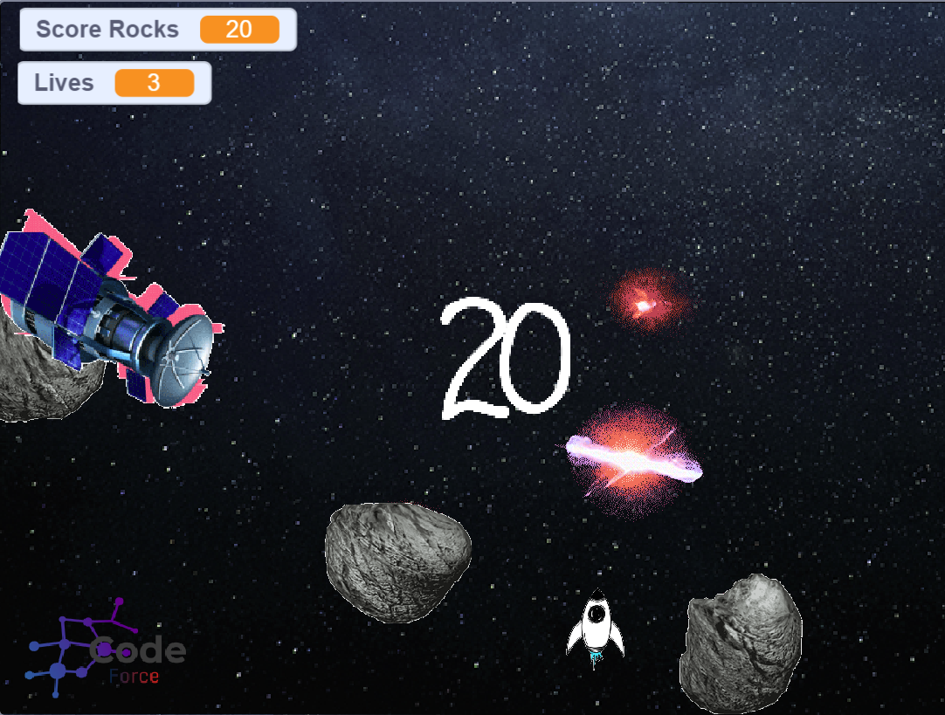
SCRATCH PROJECT

Slide 8

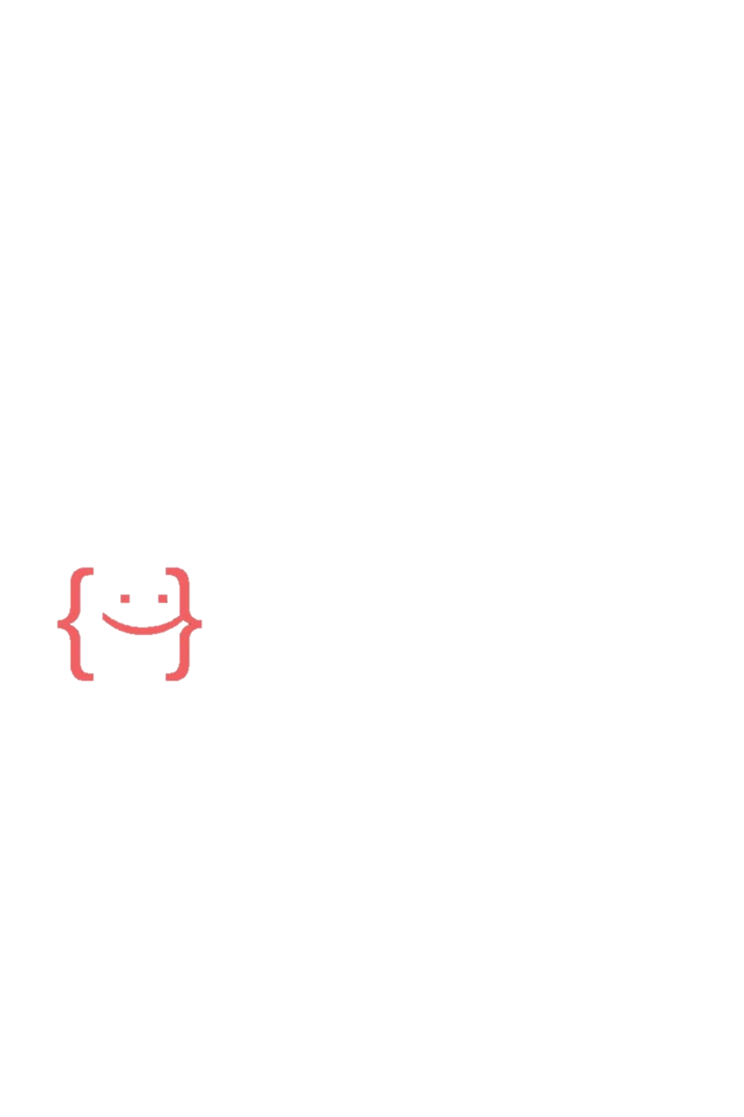
THANK YOU!

