Slide 1
Important of Coding Performance by Optimal Basis Selection in Image Compression Using ICA Basis
March 3, 2022
IMQA2022 OS1-3
Yudai Nakada
Masashi Kameda
Graduate School of Software and Information Science,
Iwate Prefectural University
Notes:
I’d like to thank you for giving me the chance to speak here today.
I’ll present the hybrid method using DCT and ICA basis.

Slide 2
Outline
Introduction
Advantages and disadvantages of DCT and ICA
Motivation
Problem of conventional methods and propose of hybrid method
Method and Results
Selection of ICA_Block and important ICA basis
Conclusion
Discussion of results and future development
Notes:
this is what I’ll be presentation today.
First, I’ll introduce DCT and ICA.
Then, I’ll explain the problem of conventional method and propose of hybrid method.
Followed by explain my proposed method and experimental(イクスぺリメンタル) results.
Finally, I’ll conclude(コンクルード) with a summary.

Slide 3
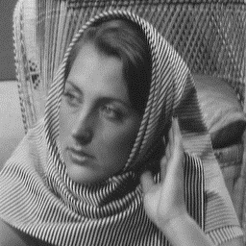

Introduction – Background
Image Coding：
A technology for compressing information in order to transmit and preserved images efficiently
Compression
Original image (66KB)
JPEG image (8.27KB)
A general method for these is Discrete Cosine Transform (DCT)
Notes:
Image coding, which I‘ｍ studying, is a technology for compressing information in order to transmit(トランスミット) and preserve images efficiently(エフィシェントリー).
The image on the right has the same appearance(アピアランス) as the image on the left, but the entropy has been reduced to 1/8.
DCT is well known as image coding method using basis.

Slide 4

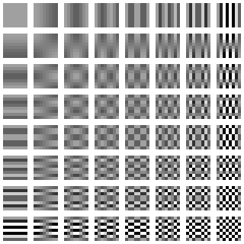
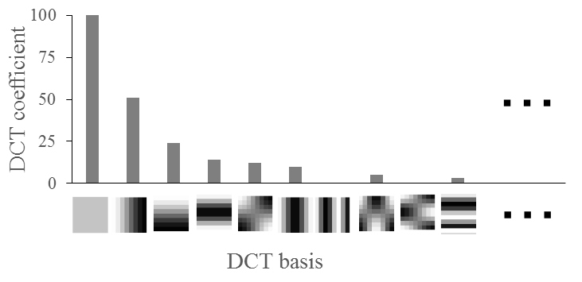


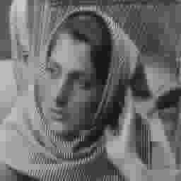

Introduction – Discrete Cosine Transform (DCT)
When frequency transform, most of the signal is concentrated at low frequencies
Quantization based on human visual characteristics
transform
DCT coefficients
×
Input image
DCT bases
DCT basis
Low bit rate removes a lot of local features information …
Effective areas
Reconstructed image
Ineffective areas
Not good at preserving of local features
Notes:
In DCT, when the pixels in a block are converted(コンバーティッド) into frequency components, most of the coefficients are concentrated(コンセントレーティッド) at low frequencies.
Also, because the human eye has the characteristic of not being able to respond to high frequencies such as patterns, we do not remove much of the low frequency information that the human eye can respond to, and remove much of the high frequency information.
This makes it effective in preserving flat features such as skin and background, but at low bit rates, it removes too much information such as patterns, resulting(リザルティング) in visual distortion.

Slide 5
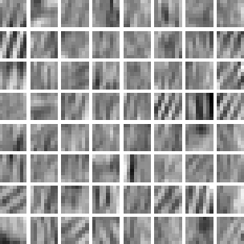
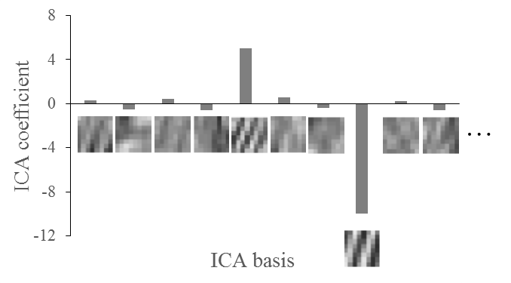
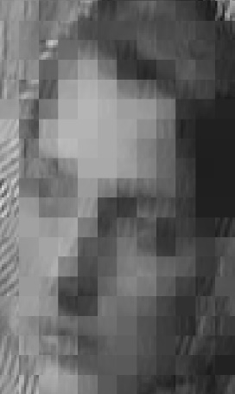


Introduction – Independent Component Analysis (ICA)
Obtain a set of bases of local features in the input image
Can be preserved in small number of bases due to sparsity of coefficients
transform
×
ICA coefficients
Input image
ICA bases
ICA basis
Regular features haven’t sparse coefficients
Local features have sparse coefficients
Can’t be preserved at low bit late
Reconstructed image
Can be preserved at low bit late
Good at preserving of local features
Notes:
On the other hand, ICA can preserve images by basis and its coefficient(コエフィシェント) values, just like DCT.
ICA basis is inherent to the input image and must be shared with the transmission(トランスミッション) partner.
also, quantization of ICA is by restricting(リストリクティング) the basis used for preserve.
Therefore, ICA can preserve local features in a smaller number of bases than DCT.
However, the flat features that DCT is good at cannot be preserved without using more basis than DCT.

Slide 6
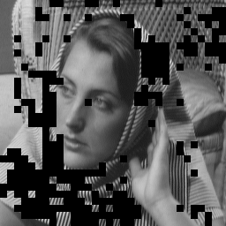

Introduction – Overview of the hybrid method
Combining the advantages of DCT and ICA
DCT and ICA are different effective blocks in a single image
A block is 8×8 pixels
Comparison of effective features of DCT and ICA
Regular features blocks
Local features blocks
Effective blocks of DCT
(DCT_Block)
Effective blocks of ICA
(ICA_Block)
Consideration of a coding method that combines the advantages of DCT and ICA [1][2]
Notes:
As mentioned before, we can see that DCT and ICA have different blocks that they are good at in a single image.
Therefore, hybrid coding method has been proposed, in which the features of the input image can be efficiently preserved(プリザーブ) by ICA, which is difficult(ディフィカルト) to preserve by DCT.

Slide 7
Motivation – Problem of conventional method
How to use DCT and ICA together ?
Segment the area using DCT or ICA
The ICA basis is inherent to the input image
Identify the blocks that ICA is good at
Restrict the number of ICA bases used in the entire image
Research goals
To identify the basis and blocks that can improve the coding performance even when the type of ICA basis is restricted
Notes:
To use DCT and ICA together, the area of ​​the input image must be segmented into DCT_Blocks or ICA_Blocks.
Then, by comparing(コンピアリング) with DCT, we identify(アイデニファイ) the blocks that ICA is good at.
Also, recall that ICA basis is inherent to the input image.
When considering(コンシダリング) additional information, it‘s necessary to restrict the number of ICA bases used in the entire image.
The goal of the hybrid method is to identify the bases and blocks that can improve the coding performance even when the type of ICA basis is restricted.

Slide 8
Motivation – Proposed of hybrid method
Compare the entropy when preserving the same image quality
The entropy increases in proportion to the type of ICA basis
Restrict the number of ICA bases used in the entire image
Step1
Entropy
of ICA
basis
Step2
Entropy
of DCT
coefficients
Entropy
of ICA
coefficients
DCT
ICA
DCT + ICA
Use ICA basis freely
DCT + ICA
Use only
important ICA basis
Notes:
Next, I’ll explain the image of the hybrid method.
This shows the entropy that can be preserved at the same image quality.
ICA has less entropy than DCT, but when additional information is added, it has more entropy than DCT.
(This additional information increases in proportion(プロポーション) to the type of basis.)
Here, by segmenting into areas where DCT or ICA is good at, as in step 1, the entropy of the coefficient only can be reduced more than DCT only.
However, since the number of bases used in the entire image is free, the total entropy will increase more than DCT.
Therefore, by choosing the basis used to only the important basis as in step2, the total entropy will decrease more than DCT.

Slide 9
Method
What is the goal of the proposed method?
Step1 :
Improvement of the quantization method
Step2 :
Improvement of the method of assessing important ICA basis
Goals of the proposed method
The proposed method purpose to improve the coding performance by using the above methods
Notes:
Next, I’ll explain the goal of the proposed method.
In Step 1, we propose a method to improve the quantization of ICA.
Also, In Step 2, we propose improve of the method of assessing(アセッシング) important ICA bases.
Therefore, the proposed method purpose(パーパス) to improve the coding performance by using the above methods.

Slide 10

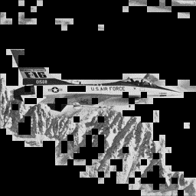
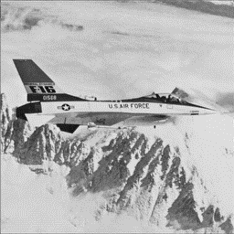
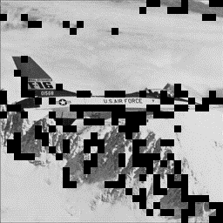
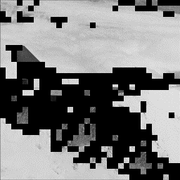
Method – Overview of proposed methods
System diagram of proposed method
Candidate
Proper
DCT_Block
DCT_Block
Input image
Image
segmentation
ICA_Block
ICA_Block
Decision of
ICA_Block
Step1
Determine the quantization priority in ICA
Step2
+
ICA basis
Assess of each ICA basis
Choose
of Important basis
Additional
information
Notes:
This is the system diagram of proposed method.
Step1 propose a method to maximize the image quality of ICA at any bit rate in the input image.
Based on step1, segment the input image into blocks that are good at DCT or ICA.
Then, each ICA base is assessed(アセース) to choose the important ICA bases.
Finally, the proper(プロピアー) DCT_blocks and ICA_blocks are determined, and the important ICA bases becomes the additional information.
This allows us to choose the image into blocks that are good at DCT and ICA, thus(ザス) allowing us to preserve the image more efficiently(エフィシェントリ).

Slide 11

Method – Step1 : Determine the ICA basis
Assessment the image quality when the ICA basis is combined by MSE
MSE (Mean squared error) : Average of the error with the original image
First basis for bit rates
where one bases can be used
Bit rate
Low
High
?
…
+
+
Combine
Which ICA bases minimize MSE to bit rate that can use two bases?
Basis that can minimize MSE when combined with 1st optimal basis
By repeating this process even if there are 3rd or more bases, the optimum combination is determined.
The image quality will be optimal at any bit rate
Notes:
ICA quantization is done by restricting the bases.
In order to quantize, we need to determine the number and types of bases needed to preserve the block.
In practice, the number of ICA bases is determined when the bit rate is specified(スペシフィード).
Therefore, we need to determine what types of bases to use.
For example, if the basis determines which the number of basis 2.
When combined with the 1st optimal basis that minimizes(ミニマイズ) MSE is determined as the optimal combination. By repeating(リピーティング) this process even if there are 3rd or more bases, the optimum combination is determined.

Slide 12



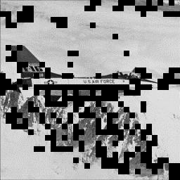





Method – Step2 : Assess each ICA basis
Compare the entropy that can be improved and the additional information for each ICA basis
When preserving using
Diminution of MSE that optimal blocks and semi-optimal blocks can be improved from DCT
Blocks is which image quality is optimal
Blocks is which image quality is semi-optimal
(Red blocks and Blue blocks)
(Only red blocks)
Candidate the ICA blocks
ICA Bases
Correctly assess the effectiveness of each ICA basis on coding performance
Notes:
In this slide, I’ll explain how to assess each basis.
The figure on the left shows in red the blocks that can optimize image quality when using these 3 bases, and in blue the blocks that do not optimize image quality but can improve image quality from DCT.
In the case of only the red blocks were used, so the image quality was improved only to the value shown in the green graph on the right.
In the improvement of image quality, there are also blue blocks in addition to red blocks.
Therefore, in the proposed method, blue and red blocks are used for the assess of each basis.
This allows us to assess the intrinsic(イントリンス) effectiveness(エフェクティブネス) of each basis, as shown by the orange graph on the right.
「アニメーしょん」
This is the same when combining different types of ICA basis.

Slide 13
Method – Step2 : Determine the important ICA basis
Compare the entropy that can be improved and the additional information for each ICA basis
Entropy when using
Image quality
Improved entropy
Additional
information
Entropy
Entropy
of DCT
coefficients
Entropy
of ICA
coefficients
What is Important basis?
The number of bases can be restricted in the entire image
Notes:
Next is a description(ディスクリプション) of the method used to choose the important ICA basis.
On the left is the entropy of DCT only, and in the middle is the entropy of the blocks for which these(ジーズ) ICA bases are optimal or semi-optimal.
The orange circle in the figure on the right points to the important basis of the proposed method.
In the proposed method, the important basis is that the image quality is improve and the entropy is reduce.
Of those(ゾース), choose the basis that gives the highest image quality.
Therefore, the number of bases can be restricted(リストリクト) in the entire(エンタイアー) image and the coding performance can be improved.

Slide 14
Results – Comparison the coding performance
Results of applying the proposed method to the image “Airplane”
Improved coding performance at low and medium bit rates
Notes:
In this slide, I’ll explain the coding performance of the proposed method when it’s applied(アプライド) to the "Airplane" image .
Since ICA_Block is different for each bit rate, we apply the proposed method to each bit rate.
The horizontal(ホライゾンタル) axis of this graph represents(リプレセンツ) entropy and the vertical(バーティカル) axis represents(リプリゼンツ) image quality.
Comparing(コンペアリング) the entropy to preserve the same image quality, we can see that the proposed method improves the coding performance since it has less entropy than DCT only or the conventional method.
We can also see that it ‘s more effective at lower bit rates.

Slide 15


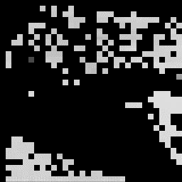
Results
ICA_Blocks and ICA bases used there in each bit rates
25[dB]
29[dB]
31[dB]
ICA is more effective at low bit rates
ICA_Blocks are concentrated in visually flat areas
Notes:
Next, I’ll explain the ICA_Blocks and the choosed important ICA basis for each bit rate when the proposed method is applied.
Looking at the slides, we can see that the proposed method restrict the number of ICA basis to a maximum of 3.
This means that the basis can be chose even at medium rates.
This result is a significant(シグニフィケント) improvement over the conventional method, which can only choose １ or ２ bases at very low bit rates below 25 dB(デシボー).
Comparing(コンペアリング) the 3 images, we can see that ICA is more effective at low bit rates.
Also, since ICA_Blocks are mostly found in visually flat blocks, it ‘s possible that the performance depends(デペンズ) on the input image.

Slide 16
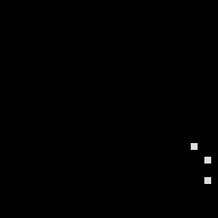

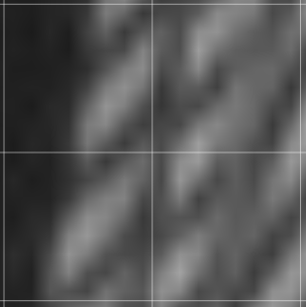


Results – High bit rate and visual evaluation
Results of applying the proposed method to the image “Airplane”
Input image
Proper the ICA blocks
Coding performance could be improved even near 50 dB
visual evaluation
Proposed method
25.6[dB]
DCT only
25.1[dB]
Input image
Origin
Notes:
Finally, I’ll explain the coding performance at high bit rates and the visual evaluation results.
The graph show the coding performance and ICA_Block of the proposed method applied to the image "Airplnae".
We can see from the graph that the coding performance is improved even at a high bit rate of near 50 dB.
The visual evaluation also shows that the proposed method preserves(プリザーブ) the local features of the image better than DCT.

Slide 17
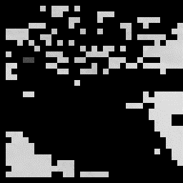

Conclusion
Discussion of results
While researching for a semi-optimal basis,
found the blocks that can improve image quality
even with only average values
31dB
One of the factors
that improved performance even at high bit rates !
Future work
Different bit rates need different ICA_Block, so separate processing is necessary
Reduce the processing cost per bit rates
25[dB] ICA_Block
30[dB] ICA_Block
Notes:
Next is a discussion(ディスカッション) of the results.
While researching for a semi-optimal basis, found the blocks that can improve image quality even with only average values.
We think that this is one of the factors that make the proposed method capable(ケパボー) of improving the coding performance even at high rates.
Finally, is our future work.
Since the proposed method needs separate(セパレーツ) processing for each bit rate, we will reduce the processing cost.

Slide 18
References
[1] M.Kameda, K.Kawamura, “A Still Image Coding Method Using Discrete Cosine Transform and Basis of Independent Component Analysis,” The journal of the Institute of Image Electronics Engineers of Japan, vol.45, no.2, pp.201-211, (2016).
[2] A.Tgashi, M.Kameda, “Selection of Important ICA Basis Based on Comparison of Image Quality Improvement in Still Image Coding Using Basis of Independent Component Analysis,” IEICE technical report, vol.118, no.501, pp.153-158, (2019).
[3] S.Mallat, A.Zhang, ”Matching Pursuits with Time-Frequency Dictionaries, ” IEEE Trans. on Signal Processing, Vol.41, No.12, pp.3397-3415, (1993).
Thank you for your attention !
Notes:
This concludes(コンクルード) my presentation.
I am not good at English, but thank you for listening to my presentation until the end.
Thank you for your attention.

Slide 19


Appendix
Results of applying the proposed method to the image “Airplane”
Improved coding performance at low and medium bit rates
Notes:
付加情報なし版
This slide shows the proposed method without the additional information.
Looking at the graph, we can see that the entropy is increasing due to the additional information.
Therefore, I think that improvement is still possible.

Slide 20
Appendix
Results of applying the proposed method to the image “Airplane”
We were able to confirm improved performance in SSIM as well
Notes:
SSIM版
This slide shows assess of the proposed method by SSIM.
Looking at the graph, we can see that the coding performance has improved as well as PSNR.

Slide 21
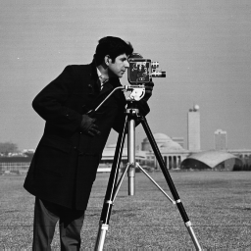
Appendix
Results of applying the proposed method to the image “Cameraman”
Improved coding performance at low and medium bit rates
Notes:
バーバラ版（付加情報無しも表示） cameraman
This slide shows the result of applying the proposed method to the image “cameraman”.
Looking at the graph, We can see that the coding performance is improved as well as the image “Airplane”.
Image “cameraman” also use 3 ICA bases at low rates and 2 ICA bases at medium rates, similar to the image Airplane.

Slide 22

Appendix
Results of applying the proposed method to the image “Barbara”
We were able to confirm improved performance in SSIM as well
Notes:
バーバラSSIM版

Slide 23






Appendix
ICA_Blocks and ICA bases used there in each bit rates
The blocks can improve image quality Even with only average values.
23[dB]
25[dB]
30[dB]
We got the same results as the image “Airplane”
ICA is more effective at low bit rates
ICA_Blocks are concentrated in visually flat areas
Notes:
バーバラ版ICAブロック
This slide shows the ICA_Block and important ICA bases when applying the proposed method to the image “Barbara”.
結果に対する理由：
今回は基底を3個以下に限定しており、その制限下では、局所特徴を保存できないから。
平坦に見えるが細かな輝度の変化が起こっているため、その微細な変化にICAが有効であったから。
中・高レートでは3個以下の基底で画質を再現することは難しいため。

Slide 24
Problem – Overview of conventional methods
System diagram of conventional method [2]
Candidate
Proper
DCT_Block
DCT_Block
Input image
Image
segmentation
ICA_Block
ICA_Block
Decision of
ICA_Block
Step1
Matching pursuits [3]
Step2
+
ICA basis
Evaluate of each
ICA basis in optimal blocks
Focus only on image quality
Determine the quantization priority in ICA
Additional
information
Evaluate of each ICA basis
Decision
of Important basis
Notes:
これは、併用した符号化方式の先行研究のシステム構成図になります。
入力画像を、step1で、mp法による優先度を求め、DCTとICAが得意な領域に分けます。Step2では、累計の画質改善量の比較による、優先度で、最終的に、全体で使うICA基底の種類を減らしていました。

Slide 25



Problem – Step1 : Overview and problem
Step1 : Determine the quantization priority in ICA based by Matching pursuits [3]
Matching pursuits : Calculate the similarity between block
and basis by inner product
Matching pursuits
ICA bases
High
Similarity
Low
＞
＞
＞
…
Low
Priority of quantization
High
Block
…
＞
＞
＞
Quantization by setting the coefficients of the ICA basis with low similarity to 0
Notes:
先行研究のStep1では，MP法を用いた基底選出による領域分割を行っています．
MP法は，1つの領域と基底の内積を求め，領域と似ている順に選出していきます．
そのため，領域と1つの基底の類似度を比較しているため，基底の組み合わせが考慮されていないと考えられます．

Slide 26



Problem – Image segmentation
Adjust the number of ICA bases to the number of DCT bases and compare
Block
Adjust the number of ICA bases to be
less than or equal to the DCT bases
DCT
ICA
18 bases
6 bases
Input image
Compere image quality
26.8dB
VS
27.3dB
Classify blocks to higher image quality
Notes:
先行研究のStep1では，MP法を用いた基底選出による領域分割を行っています．
MP法は，1つの領域と基底の内積を求め，領域と似ている順に選出していきます．
そのため，領域と1つの基底の類似度を比較しているため，基底の組み合わせが考慮されていないと考えられます．

Slide 27
Problem – Step1 : Problem
The minimum number of ICA bases and the number of blocks that
can be better image quality that DCT when quantized at 31dB
Most of the blocks combine multiple ICA bases !
Low
Priority of quantization
High
…
＞
＞
＞
Matching pursuits dose not consider
combinations of bases…
Priority of quantization should be
based on the combination of ICA basis

Slide 28
Problem – Step2 : Overview and problem
Step2 : Evaluate only with the basis that can optimal the image quality of the block
When preserving using
Total MSE that can be improved from DCT
Blocks is which image quality is optimal
Candidate the ICA blocks
Important bases in the conventional method
Optimizes the image quality of the entire image is the important basis
Notes:
Step2では，画質改善量の累積によって全体で使う基底を選出しています．
1つの基底のみで再構成した時の画質の改善量を全ての領域で累積し，最も改善が得られる基底を選出します．
この場合，各基底の得意な表現が明確でないため，表現できる特徴が偏る可能性があります．

Slide 29



Problem – Step2 : Problem
There are other ICA bases besides the optimal one
that are effective in preserving the block
PSNR
(31.3)
Entropy
(0.000551)
ICA Bases
Optimal basis
+1.4
[dB]
-0.000170
[bit/pel]
+0.8
[dB]
-0.000177
[bit/pel]
Block
+0.7
[dB]
-0.000285
[bit/pel]
Candidate the ICA blocks
…
It should be evaluated in terms of both image quality and entropy

Slide 30
提案手法-概要
Step1 ：
基底の組み合わせが考慮されていない基底重要度
課題
Step2 ：
小領域の画質を最大とする基底のみの評価
課題
Notes:
先行研究の課題を踏まえて、本研究では，Step1では、MP法の代わりに，基底間の組み合わせを考慮できる，画質改善量を用いた領域分割手法の提案。
Step2では、基底をどれくらい選出できるのか明確でないため，明確にし，表現可能な基底の特徴に偏りが生まれないように，基底の特徴を明確にします．
これらの処理を先行研究に加えることで，符号化性能の改善を行います．
基底特徴を明確にする処理は，実験中のため，今回は省いています．

Slide 31
ICA基底を用いた符号化方式
目的
画像全体で使う基底の種類を
なるべく少なくしたときに，DCTよりも画質を
高くできる ICA基底 と ICA_Block を明らかにする
Step1：
DCT と ICA のそれぞれ得意な領域に分ける
比較に使用する基底の選出は組み合わせを考慮すること
Step2
付加情報を考慮した 領域 と ICA基底 の選出
選出基底の 得意な表現 がなるべく偏らないこと
Notes:
このように、DCTとICAを併用した手法の目的は、Step2のように、画像全体で使う基底の種類をなるべく少なくしたとき、DCTよりも画質を高くできる領域と基底を選出することです。
そのためには、まず、DCTとICAの得意な領域に分けます。
ここで注意したいのは，DCTとICAの画質をそろえて比較するとき，一定の画質を表すためには，複数の基底を使うため，基底同士の組み合わせを考える必要があります。
また、step2では、付加情報を考えた領域とICA基底を選出します．
ここで注意したいのは，全体で使う基底を選出するため，選出基底の得意な表現が偏ってしまうと，表現の幅が減ってしまうため，偏らないことが重要になります．

Slide 32
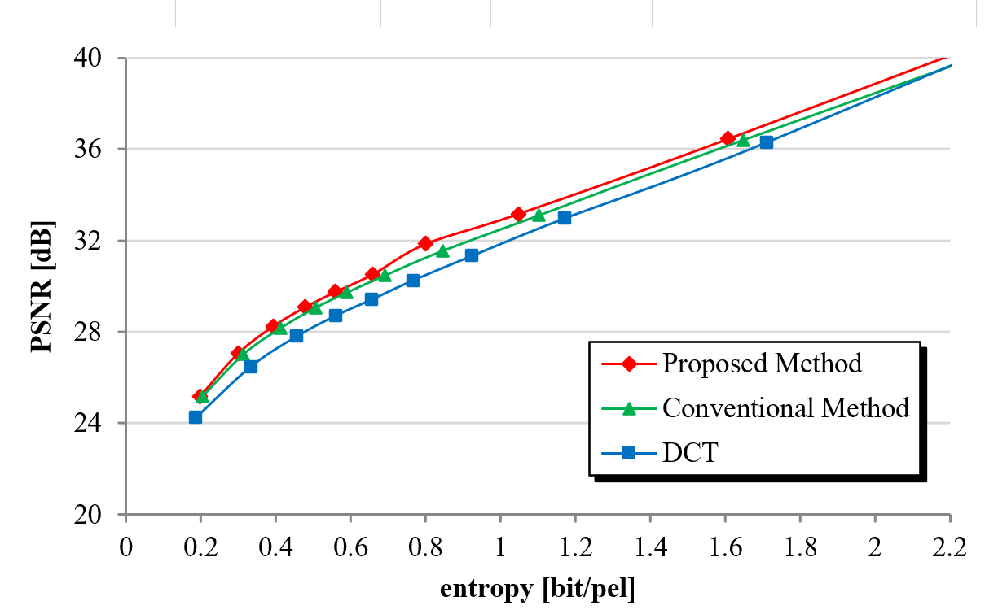
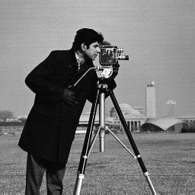
提案手法-Step1 (符号化性能の比較)
別画像での比較 (Cameraman)
Notes:
平均0.07dB改善

Slide 33
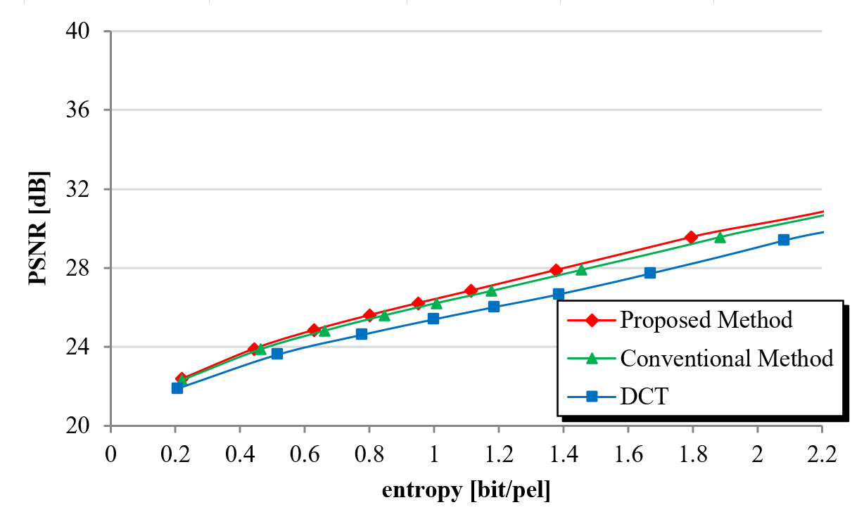
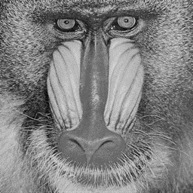
提案手法-Step1 (符号化性能の比較)
別画像での比較 (Mandrill)
Notes:
平均0.01dB改善

Slide 34






提案手法-Step2 (符号化性能の比較)
入力画像：Cameraman（256×256画素）
25dB前後の符号化レートにおいてDCT単独よりも僅かに改善
Notes:
まず初めに、step1の優先度です。
提案手法で用いる、画質改善量MSEとは、画質の良さを求めることができて、低いほど画質がいいことを表しています。
MSEを用いることのメリットは、複数種類の、基底で保存した時の、画質を求めることができます。
これによって、基底の組み合わせを考慮した、優先度を求めることができます。
実際にどう求めるかといいますと、この領域を、基底を一つだけで保存したとき、MSEが一番小さくなる、基底を見つけて除きます。
その後、除かれた基底と、組み合わせたとき、一番MSEが小さくなる基底を除きます。
そして、この二つと組み合わせて、MSEが一番小さくなる、基底を除いていき、基底がなくなるまで続けることで、優先度を求めていきます。

Slide 35




提案手法-Step2 (符号化性能の比較)
入力画像：Mandrill（256×256画素）
25dB前後の符号化レートにおいてDCT単独よりも僅かに改善
Notes:
まず初めに、step1の優先度です。
提案手法で用いる、画質改善量MSEとは、画質の良さを求めることができて、低いほど画質がいいことを表しています。
MSEを用いることのメリットは、複数種類の、基底で保存した時の、画質を求めることができます。
これによって、基底の組み合わせを考慮した、優先度を求めることができます。
実際にどう求めるかといいますと、この領域を、基底を一つだけで保存したとき、MSEが一番小さくなる、基底を見つけて除きます。
その後、除かれた基底と、組み合わせたとき、一番MSEが小さくなる基底を除きます。
そして、この二つと組み合わせて、MSEが一番小さくなる、基底を除いていき、基底がなくなるまで続けることで、優先度を求めていきます。

Slide 36
提案手法-Step2 (選出基底数の比較)
入力画像：Barbara，Cameraman，Mandrill（256×256画素）
輝度変化が平坦な画像ほど 選出基底数が多くなる傾向
Notes:
まず初めに、step1の優先度です。
提案手法で用いる、画質改善量MSEとは、画質の良さを求めることができて、低いほど画質がいいことを表しています。
MSEを用いることのメリットは、複数種類の、基底で保存した時の、画質を求めることができます。
これによって、基底の組み合わせを考慮した、優先度を求めることができます。
実際にどう求めるかといいますと、この領域を、基底を一つだけで保存したとき、MSEが一番小さくなる、基底を見つけて除きます。
その後、除かれた基底と、組み合わせたとき、一番MSEが小さくなる基底を除きます。
そして、この二つと組み合わせて、MSEが一番小さくなる、基底を除いていき、基底がなくなるまで続けることで、優先度を求めていきます。

Slide 37
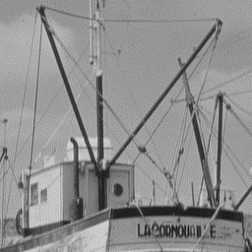
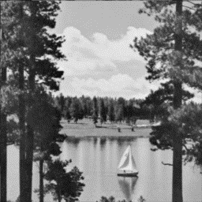
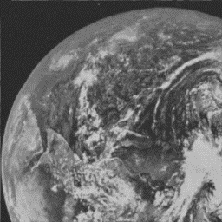
提案手法-Step2 (選出基底数の比較)
入力画像： Airplane, Boat, Sailboat, Earth（256×256画素）
選出基底数の増減は 他の画像でも確認
Notes:
まず初めに、step1の優先度です。
提案手法で用いる、画質改善量MSEとは、画質の良さを求めることができて、低いほど画質がいいことを表しています。
MSEを用いることのメリットは、複数種類の、基底で保存した時の、画質を求めることができます。
これによって、基底の組み合わせを考慮した、優先度を求めることができます。
実際にどう求めるかといいますと、この領域を、基底を一つだけで保存したとき、MSEが一番小さくなる、基底を見つけて除きます。
その後、除かれた基底と、組み合わせたとき、一番MSEが小さくなる基底を除きます。
そして、この二つと組み合わせて、MSEが一番小さくなる、基底を除いていき、基底がなくなるまで続けることで、優先度を求めていきます。

Slide 38





選出前後での比較
入力画像 ： Barbara
符号化レート ： 低レート （0.2[bit/pel]）
選出前
（すべての１領域）
選出後
（基底1領域のみ）
選出領域
（基底0領域含む）

Slide 39

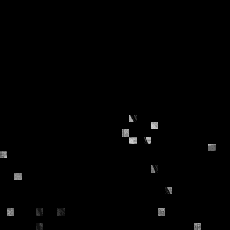
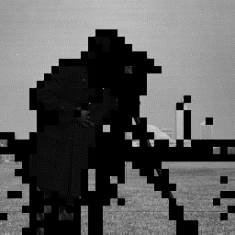
選出前後での比較
入力画像 ： Cameraman
符号化レート ： 低レート （0.2[bit/pel]）
選出前
（すべての１領域）
選出後
（基底1領域のみ）
選出領域
（基底0領域含む）

Slide 40


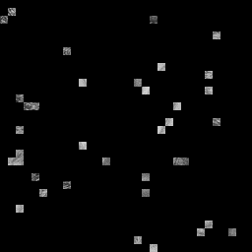
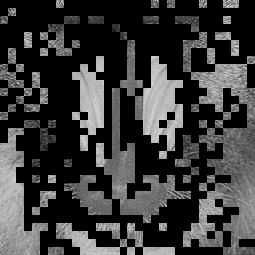
選出前後での比較
入力画像 ： Mandrill
符号化レート ： 低レート （0.2[bit/pel]）
選出前
（すべての１領域）
選出後
（基底1領域のみ）
選出領域
（基底0領域含む）

Slide 41





画像特徴に基づいた分類指標
保存イメージ
ICA領域全体で使える基底：3個
先行研究
提案手法
Notes:
Step2の優先度の保存イメージです。
ここでは、ICA領域全体で3つしか基底が使えないと仮定します。
これは領域で、これは保存に必要な、基底を表しています。
先行手法では、保存に適した、基底の種類や個数に関係なく、一様に基底を使って保存をしていました。
これに対して、提案手法では、類似した特徴を持つ領域を分類して、
そこで使われている基底の優劣をつけることで、
この領域はこの基底を使うことで、ある程度保存ができる。といったように、制限の中でも多くの特徴を保存することができます。

Slide 42
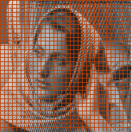
先行研究-概要と課題
量子化と領域分割
ICAの量子化
＞
＞
＞
…
優先度 高
低
DCTの量子化
優先度 高
再構成画像を比較
低
画質とエントロピーが良いほうへ分類
Notes:
領域分割の概要です。
それぞれ求めた優先度の低い基底から削減し、再構成画像を比較し、画質と情報量が優れている方へ分類します。
これにより、ICAで扱う領域とDCTで扱う領域に分割します。

Slide 43



ICA基底を用いた符号化方式
ICAの量子化法
ICA基底群
ICA係数
×
再構成
（1画像 = 1024領域）
8×8画素
（領域）
性能改善に有効なICA基底の選出
Notes:
現状の量子化法です。
DCTでは、パラメータを直接調整することで情報を削減していますが、ICAではその段階まで研究が進んでいないため、
性能改善に有効な基底以外の係数を0にすることで、情報を削減しています。
そのため、符号化性能の改善に有効な基底を探す必要があります。
＠領域の枠をなくす
＠なくていい

Slide 44


画像特徴に基づいた分類指標
基底数による画像特徴の分類
領域特徴によって保存に必要な基底の種類（数）が異なる
平坦な領域
エントロピー 0.7 [bit/pel]
基底数 0
局所的な領域
エントロピー 0.7 [bit/pel]
基底数 9
基底数によって 領域特徴が異なる
基底数に沿った 画像特徴の分類を行う
Notes:
次に分類です。 ICA領域と分割された時に、最適な基底数が出されます。
その時、このように基底数によって領域特徴が異なるため、基底数に沿って画像特徴の分類を行います。
＠基底数の説明（この基底数で保存が可能）
＠なんで分類するのか？
＠領域を再現するときに、基底のいらない領域やたくさんいる領域がある
＠一色他にして全ての領域で同じ基底数を使うのではなく、基底がいらない領域・たくさんいる領域があるから、分ける必要がある。
＠

Slide 45
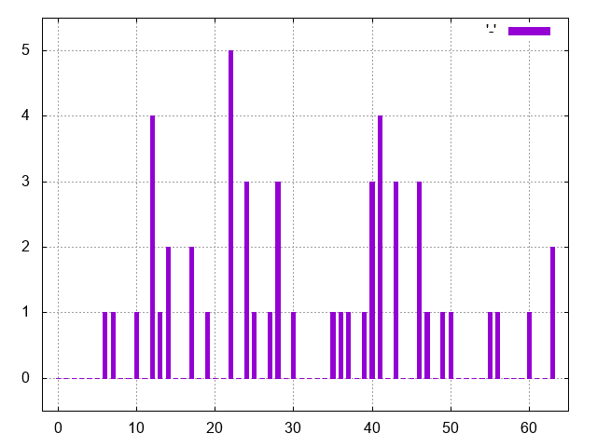
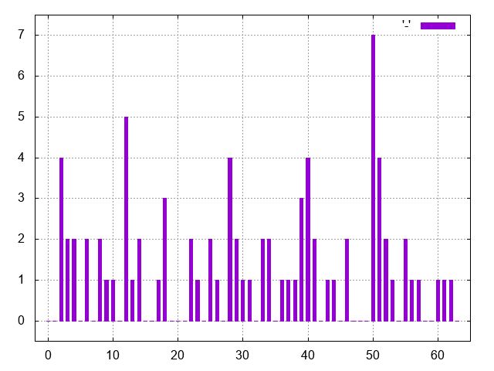
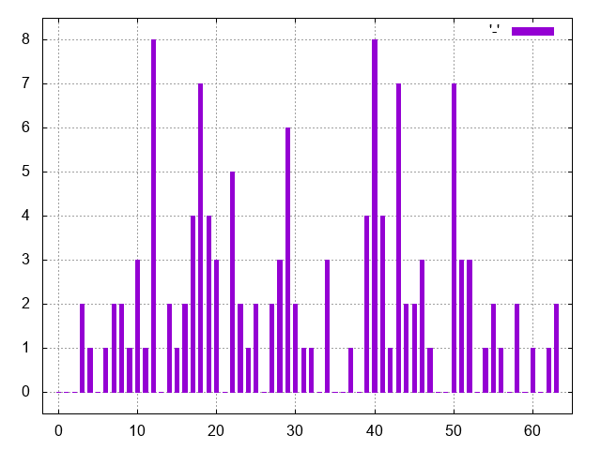
領域分類の結果
基底数による画像特徴の分類
入力画像：Barbara
縦軸： 領域で使用されたICA基底の頻度
横軸： ICA基底の種類
基底数 2
基底数 3
基底数 4
最適基底の数でヒストグラムの特徴が異なる
Notes:
基底数による分類の結果です。横が基底番号、縦が頻度を示していて、基底数でヒストグラムの特徴が異なるため、提案した分類が正しいことが示されました。
各基底のヒストグラムは合計342
＠いらない

Slide 46
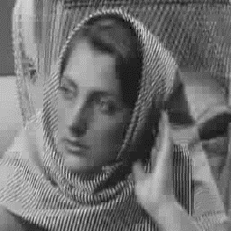

主観評価 -(Barbara)
原画像
提案手法（Step1）
PSNR:25.61 [dB]
従来手法(DCT)
PSNR:25.10 [dB]
Notes:
平均0.07dB改善
Q20

Slide 47

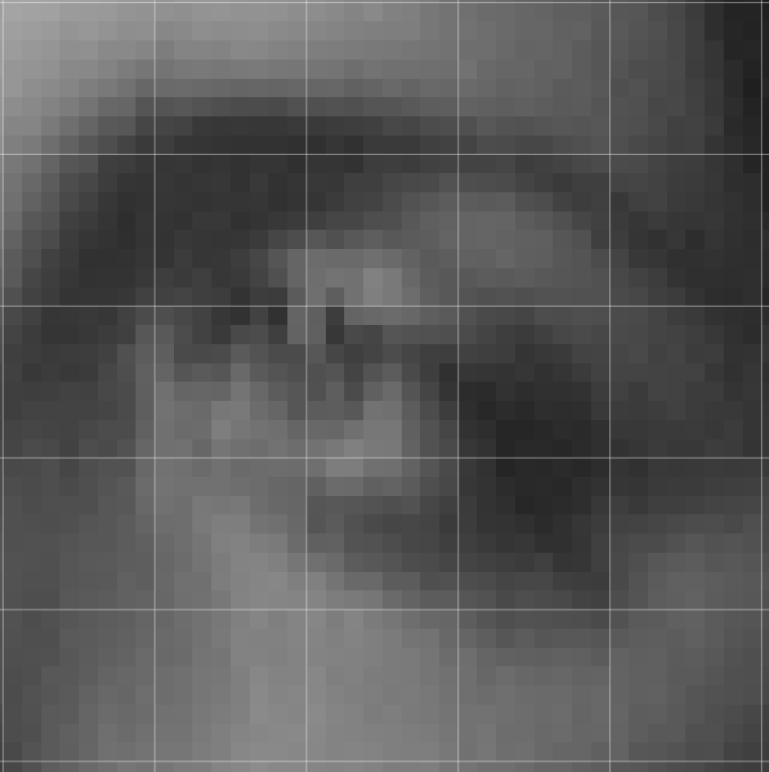

再構成画像 -(Barbara)
基底0個とは？
原画像
基底 0種類
PSNR:20.23 [dB]
原画像の画素値の平均で補正
Notes:
平均0.07dB改善
Q20

