Slide 1
Resonance and Impulse Reaction
Jason Park

Slide 2
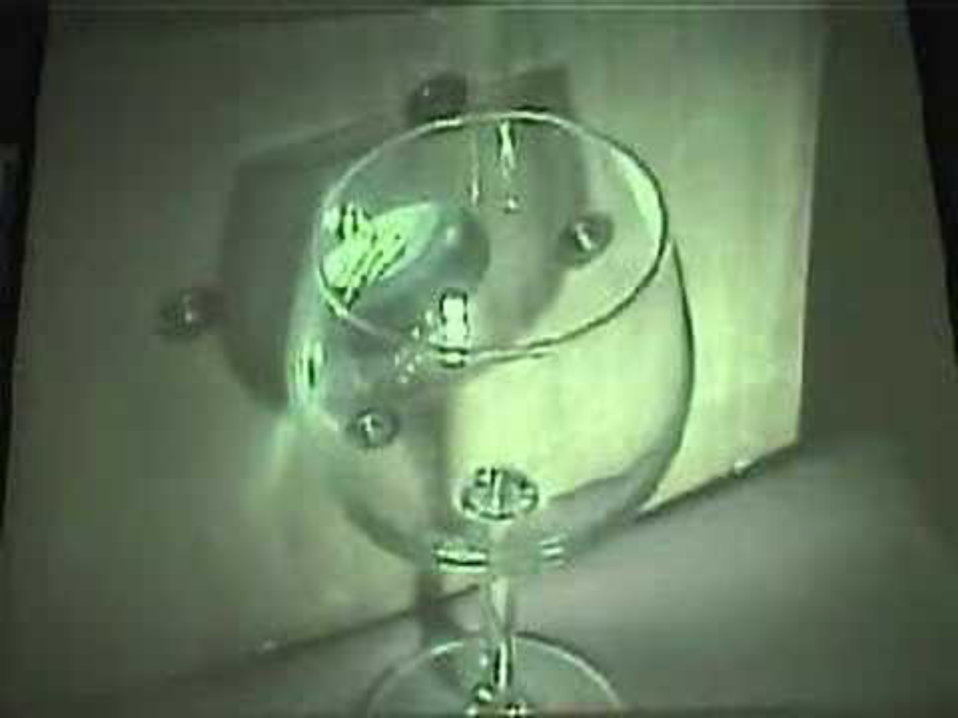
Breaking Glass with only Sound

Slide 3
There was no physical interaction. How did sound break a glass?

Slide 4
The answer is related to the frequency of sound.
What is that specific frequency and how do we find it?

Slide 5
Resonance

Slide 6
RLC Circuit
(Circuit Photo)
R = 100
L = 10mH
C = 0.1uF

Slide 7
'Special frequency’ of the circuit
The frequency value we wanted to find is 5033 Hz in the circuit.
What is the difference between it and other frequnecies?
To find it, we are gonna actually put a sinusoidal voltage source to the circuit.

Slide 8
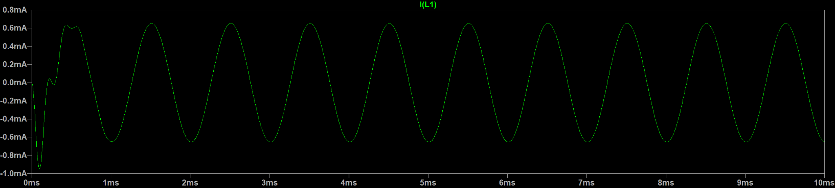
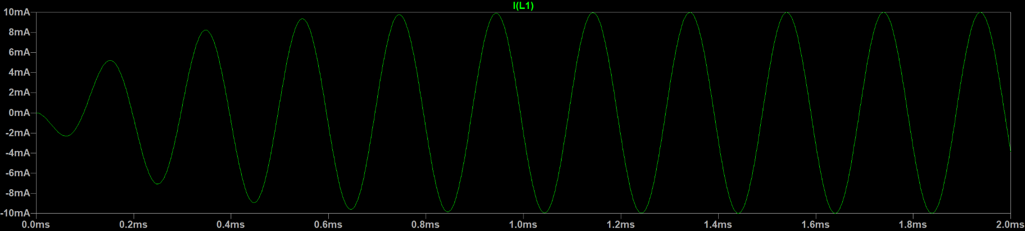
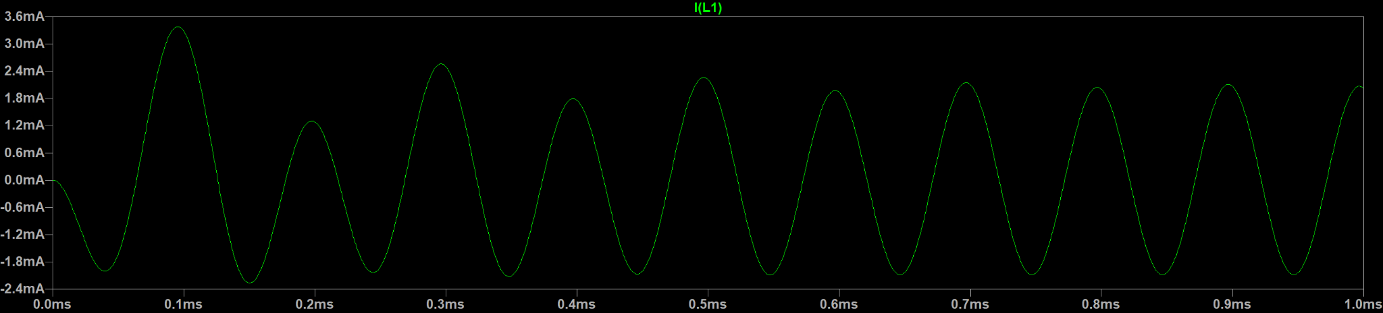
0.6mA
1k:
10mA
5k:
3.0mA
10k:

Slide 9
The amplitude of current graphs differed greatly. The current graph that received 5033 Hz voltage had much bigger amplitude.

Slide 10
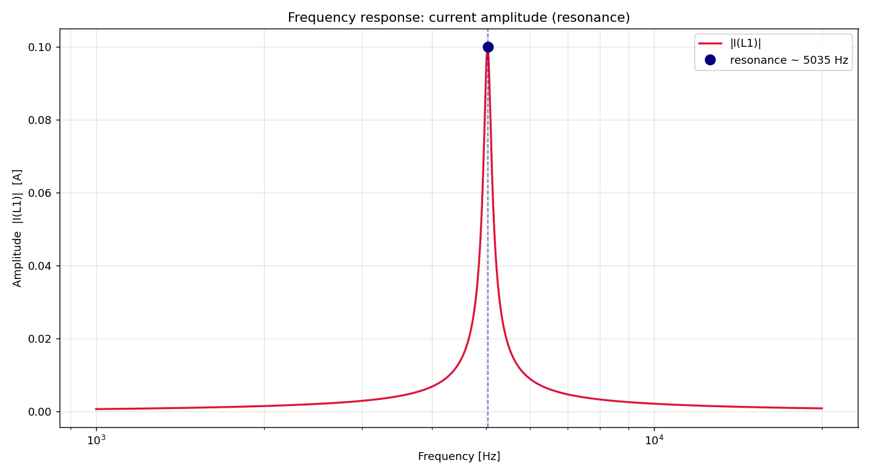

Slide 12
Now let’s put our values

Slide 13
This frequency is called Resonant Frequency, and the phenomenon of amplitude being very large at this frequency is called Resonance
The inductor (L) and capacitor (C) continuously exchange energy with natural rhythm. When the external voltage pushes in step with this rhythm, resonance occurs and amplitude grows.

Slide 14

Think about swing
A swing has its own natural rhythm — a fixed time for each back-and-forth. Push at random times fight the motion — nothing builds up.
But push in sync with that natural rhythm and the small pushes add up, swinging it higher and higher. That perfect-timing build-up is resonance.

Slide 15
RLC circuit had L and C value, so it was easy to find resonant frequency. However, the wine glass doesn’t, because we can ‘model’ the wine glass as RLC circuit but its not actually a circuit. So, do we need to test every frequencies?

Slide 16
Impulse Response

Slide 17
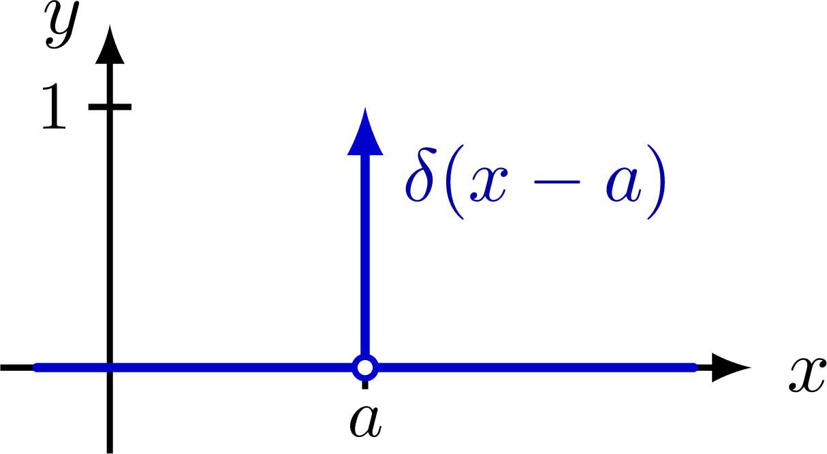
Impulse
An impulse is a sudden, very short "kick" — a large input applied for an instant and then gone (like striking a bell with a hammer or giving a swing one sharp shove).
It’s also called ‘delta function’. Let’s put impulse voltage to the same circuit and observe the response.

Slide 18
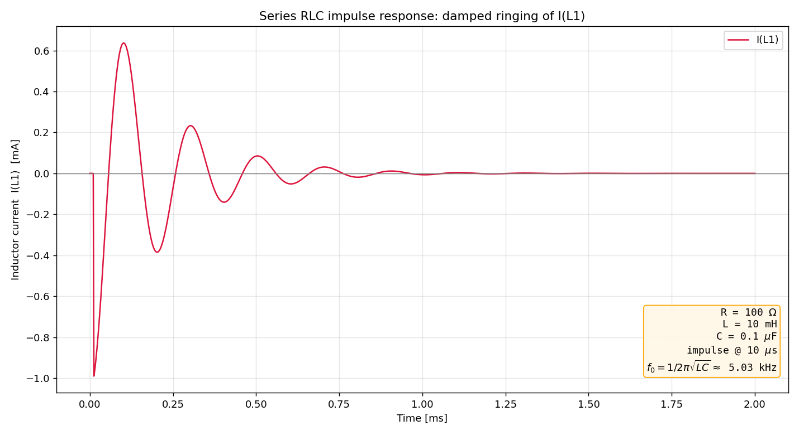

Slide 19
How did the small ‘kick’ create sinusoidal response with resonant frequency?

Slide 20
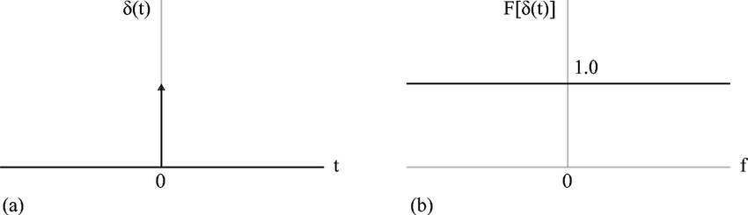
Frequency Domain
In frequency domain, delta function creates a horizontal line. It means that the delta function has every frequencies in same size.

Slide 21
Therefore, the kick inserted sinusoidal voltage sources with different frequencies.
Then, the circuit responses to its natural frequency, or resonance, ignoring others. So only the resonant frequency survived.

Slide 22
Now, how are we gonna protect a structure from resonance? For example, how would architects design a building to protect from wind with resonant frequency?

Slide 23
Tuned Mass Damper

Slide 24
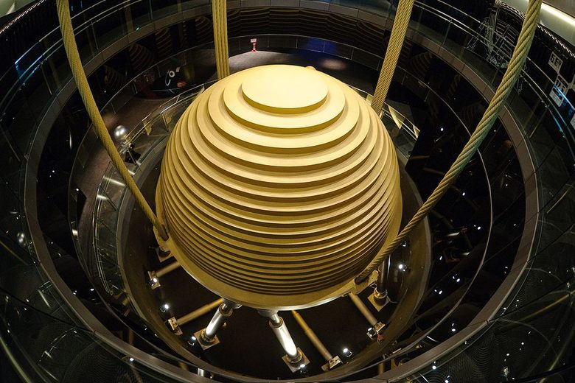
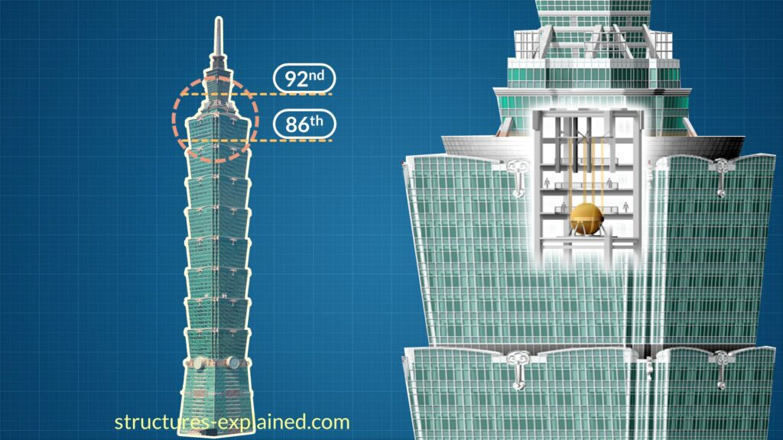
Taipei 101

Slide 25
Taipei 101
The large, heavy sphere is ‘tuned mass damper’, which protects the building.
It reduces effects of resonance by moving to the opposite direction when the building vibrates, absorbing the kinetic energy

Slide 26
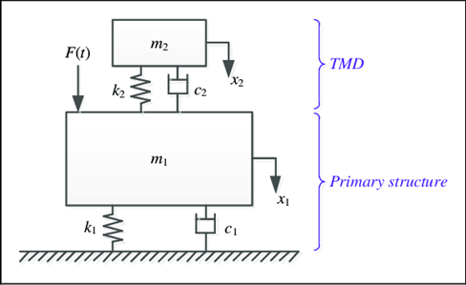
Tuned Mass Damper
m1 = main structure
m2 = tuned mass damper
F = ma
Two DEs:

Slide 27
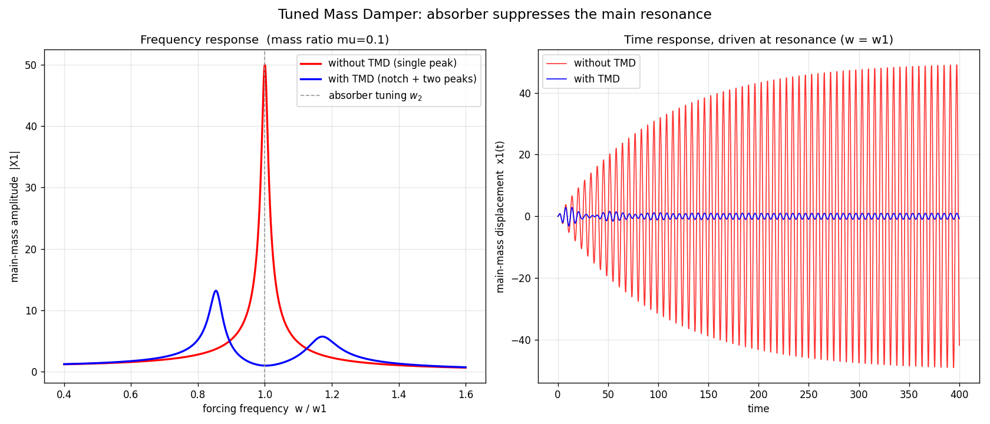
Graph of tuned mass damper

Slide 28
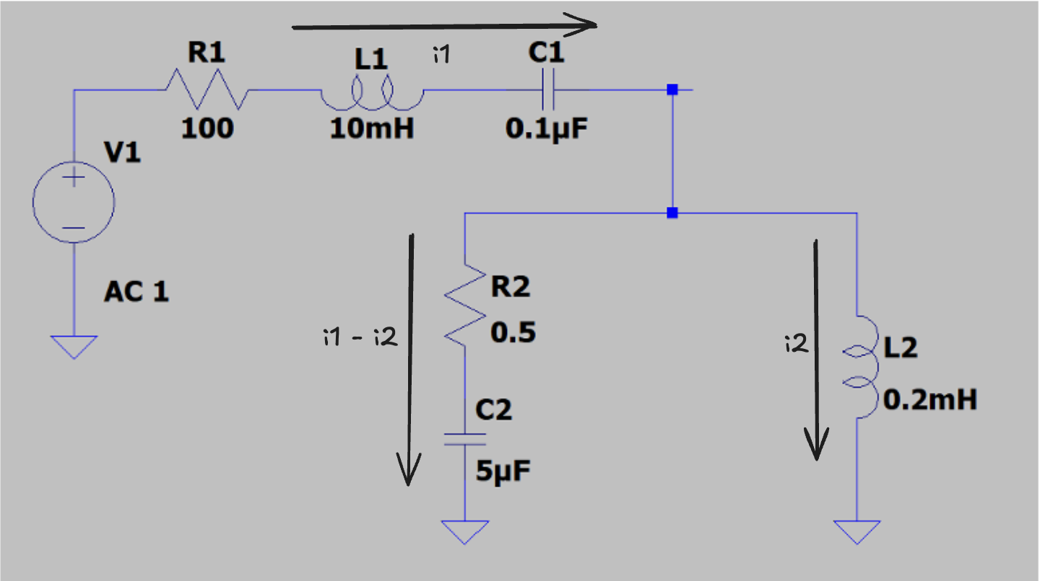
RLC circuit model
Notes:
In the circuit, L of inductors are mass of damper and the building. Therefore, because the damper of building has smaller mass, L2 is much smaller than L1. C of capacitors are reciprocal of spring constants. Therefore, C2 is much larger than C1, because spring constant of mass damper would be smaller.

Slide 29
Derivation

Slide 30
We can see that the differential equations are equivalent, and only coefficients changed.

Slide 31
Setting Value

Slide 32
Without TMD

Slide 33
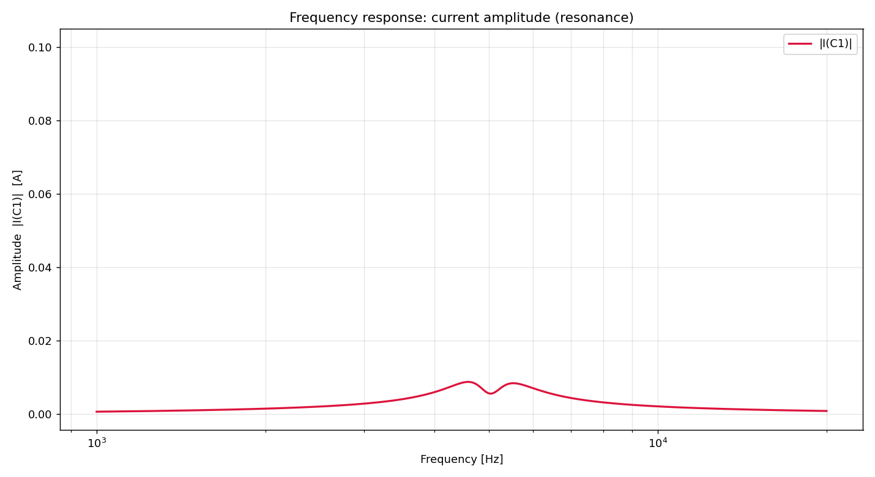
With TMD

Slide 34
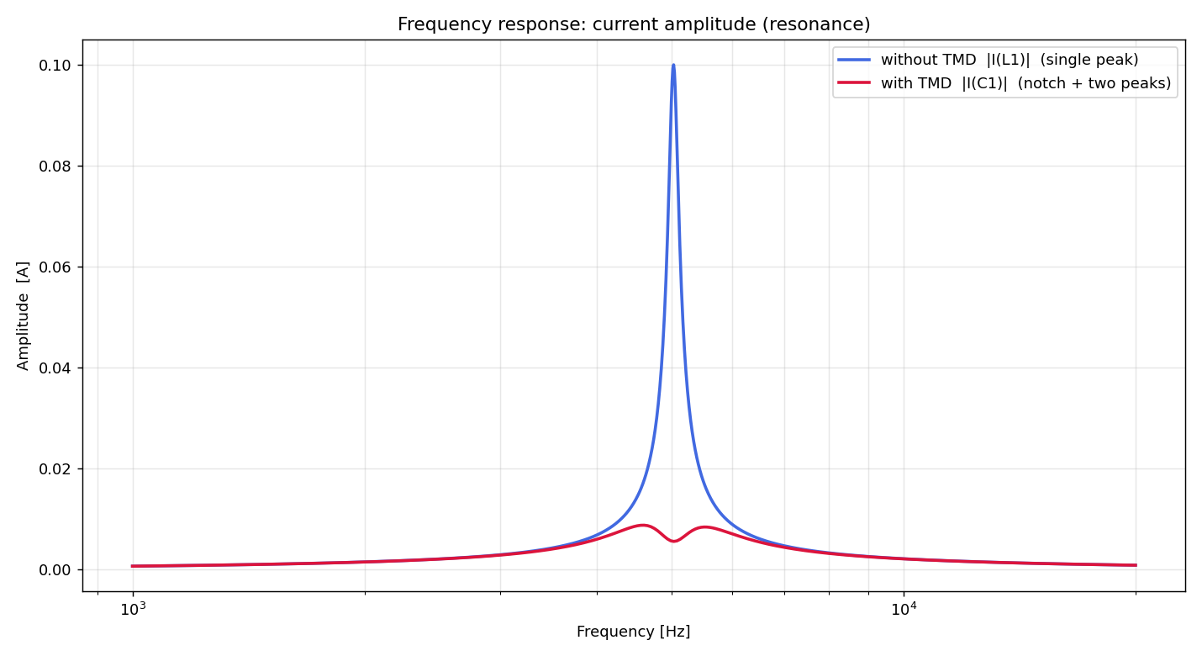
Comparison

Slide 35
We can observe the great decrease in amplitude near the resonant frequency. It doesn’t have a great peak at the resonant frequency. Instead, it has two peaks near the resonance.

Slide 36
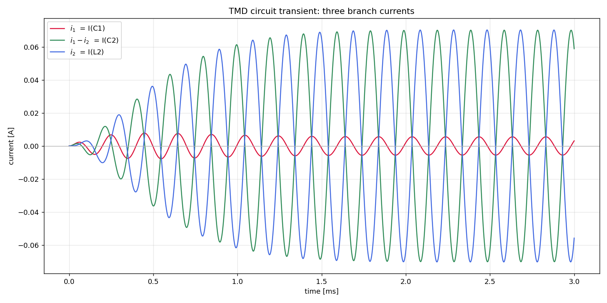
i1, i1 – i2, i2
Notes:
I1 – i2, i2 has a large amplitude. The tuned mass damper rings greatly. Because the I(C2) and I(L2) have opposite phase, they give and back the energy with great amplitude. While, I(C1), which is the main structure, has small amplitude, showing that the main building is protected.

Slide 37
Conclusion

Slide 38
Breaking wine glass with sound was possible due to ‘resonance’. This resonance can be derived by solving differential equation. By observing impulse response, we found that from every frequencies, the circuit only response to the resonant frequency. By that, we were able to find the resonant frequency by just inserting an impulse voltage. Also, one way to prevent resonance in a building was tuned mass damper.

Slide 39


