Slide 1
Operating Systems, network and security
207SE
Lecture 12 - Jobs Doing work

Slide 2
Today
Batch processing
Jobs/Processes
Multiprogramming and multitasking

Slide 3
Some history - Batch processing
Early computers were huge and ran from a console, taking cards or tapes as input and producing printed or hole-punched output
The user prepared the input as a JOB, which had a program, some data and some control information
This JOB was then submitted to the operator, and it would be run over the next week, day, month
The OS in this type of machine just needed to transfer control from one JOB to the next

Slide 4
Batch processing
Historically, the idea comes from having ‘batches’ of similar jobs which could be run without any human interaction
Concept follows through today – there are jobs which we want to automate (and have run in the background)

Slide 5
Batch processing
Some very simple examples are:
  Printing – send a few documents off to print and let the computer take care of it (in fact, quite a lot is done on your behalf)
  Image conversion – you need to apply the same conversion to a number of files. Doing so manually would be very time consuming

Slide 6
Today
Today, a job is synonymous with a process
Job is a more historical term, but should be thought of in the same way as a process (Process has just become the more accepted terminology)
So let’s just recap a little about processes

Slide 7
Processes
Processes are instances of a program running
The program itself is passive
But the process is active, with variables, resources – the essence of it being active
The ‘code’ part of the program is called the text section, and is only part of the process

Slide 8
Processes
So we could have different instances of the same program, which would be different processes
Same text section, different memory location, etc

Slide 9
Processes
Several processes can be related to one program (think explorer, notepad, and the prev. slide)
Processes may also spawn other processes during their running – and this a common thing

Slide 10
Processes
Processes can make system calls to the operating system (should be familiar by now!)
Amongst other things, a process has a process ID, or PID, which is used to uniquely identify it (this is a very important thing to remember!)

Slide 11
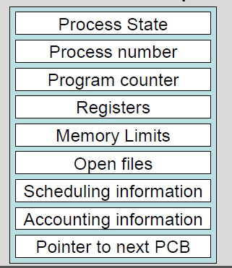
The process control block
Each process is represented in the OS by a Process Control Block (or Task Control Block)
This serves as the ‘repository’ for information about a process
You should be able to recognise a lot of these bits of information which are held about a process
What are they for?

Slide 12
Process states
New – The process is being created
Ready – The process is waiting to run on a CPU
Running – The process is running on a CPU
Waiting – The process is waiting for an event (I/O or a signal)
Terminated – Process has ended execution

Slide 13

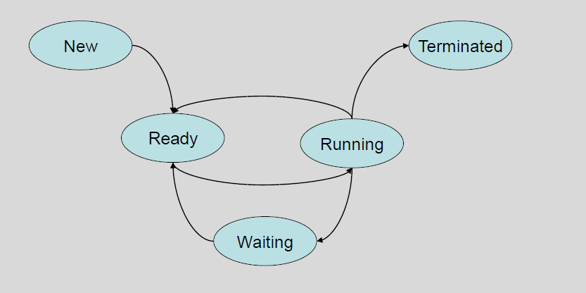
Process states

Slide 14
Multiprogramming and timesharing
The utilisation of the CPU to run several jobs is called scheduling
There are two common themes in modern operating systems and these reflect how the CPU is used with respect to running several jobs (or processes)
Multiprogramming Takes advantage of I/O requests to maximise CPU usage
Multitasking (time-sharing) Gives each process a share of the CPU time, giving the impression of several programs running at once

Slide 15
Multiprogramming
Several jobs in main memory, but only one CPU to run them
The system picks a process in main memory and starts to execute it
At some point, the process will need to wait on some task, commonly I/O

Slide 16
Multiprogramming
The CPU can then SWITCH the job that’s waiting to another job which is ready to run (if that job then needs to wait, another job can be run)
When a job is no longer waiting, it gets to have the CPU back
This maximises the use of the CPU, so that something is always running on it

Slide 17
Multitasking
The extension of multiprogramming is time-sharing (multitasking), which provides for user interaction with the computer
Multiple jobs in main memory are executed by switching between them quickly, making the system responsive to user input, and appearing to run the jobs simultaneously
Since processes can be people using the computer, this means several people can be logged into the same machine and have the effect that it is dedicated for their use

Slide 18
Goals
Multiprogramming
  Have some process running at all times, to maximise CPU usage
Multitasking
  Switch CPU among processes so that users have the impression each program is running simultaneously
An OS may implement both of these goals, depending on its scheduling discipline

Slide 19
Scheduling
Two levels of scheduling which need to be considered in this scenario:
  Job scheduling – There are lots of jobs in secondary store which can run, job scheduling chooses which to take and put in main memory (so they can run)
  CPU scheduling – When several jobs are in main memory (so therefore can run), CPU scheduling manages how they get to use the CPU

Slide 20
Scheduling and queues
When processes enter the system, they join a JOB QUEUE – this represents all of the processes in the system (held in secondary storage)
Processes which have been placed in main memory (from job scheduling), and are ready to execute are kept in a READY QUEUE (they are in the ‘ready’ state)
The process will be selected (dispatched) from the READY QUEUE for processing (they will then be in the ‘running’ state)

Slide 21
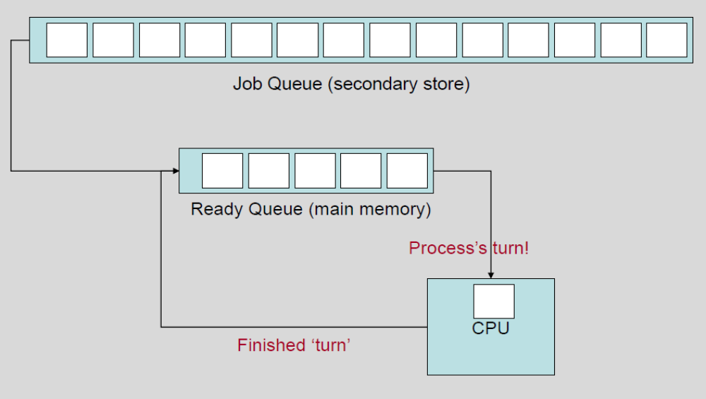

Slide 22
Taking a turn
When the process is executing in the CPU, one of several things could happen (we’ll consider the first two)
1.Process issues an I/O request
2.Process creates a sub-process (think about entering commands on a command line)
3.Process gets removed from the CPU, due to an interrupt (something else is more important), so gets put back in the ready queue

Slide 23
Process issues an I/O request
In this case, a process is taking up CPU time waiting for its request to complete, and so changes its state to ‘waiting’
It then gets switched out to the I/O QUEUE
When the I/O request has completed, the process’s state changes back to ready, and it goes back into the READY QUEUE
Note: because several processes may want to access the same I/O device, the device will also have its own device queue

Slide 24
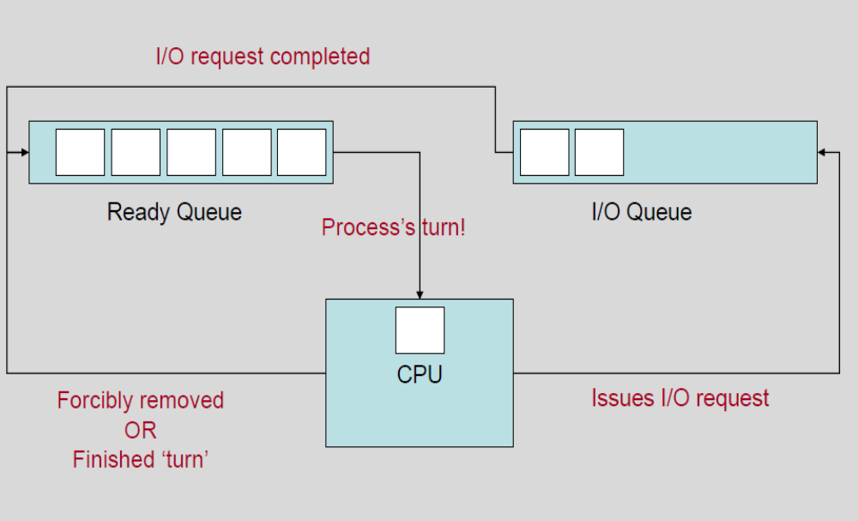

Slide 25
Process creates a sub-process
When a process creates a new sub process, it changes state to ‘waiting’ and waits for the sub-process to finish
The concept is the same as waiting for I/O, the process gets put in the ready queue when its sub-process has finished
Consider that this happens quite a lot when you’re using the terminal in linux…

Slide 26
Process creates a sub-process
When the terminal executes a process on your behalf, it has to wait until that process has finished before it can continue its own operations (taking input from you, mainly)
For the terminal, the program you run is a sub process. For example, if you run emacs from the terminal, you can’t do anything else with that terminal until you exit (in the simplest case, anyway)

Slide 27
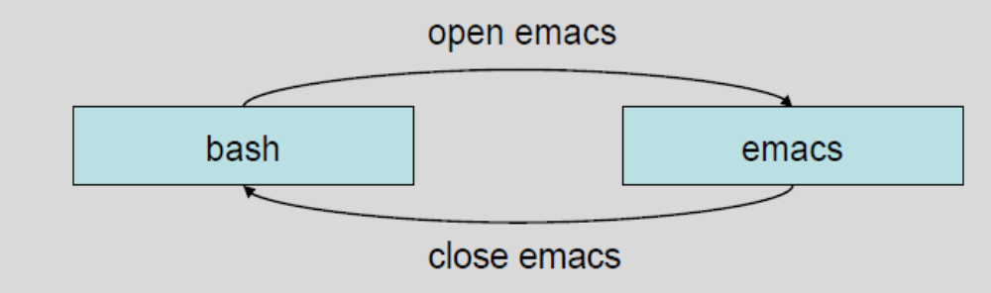
Waiting for a sub-process
The control goes to the sub process (e.g. emacs), and bash won’t have control back until emacs is closed
So bash goes into waiting state, emacs goes on ready queue, and bash goes back to ready state when emacs is closed

Slide 28
Summary
There is a little more to scheduling than we’ve covered today (long-term, medium-term, short-term), but the rest will be covered at a later date, as well as threads!
Important concepts:
  Jobs/processes (states, queues, etc)
  Multiprogramming, multitasking
  Historical significance of batch processing and CPU utilisation
  How this lecture relates to things that REALLY happen in operating systems that you use

Slide 29
Lab Activity 12
Lab task: Write around half a side of A4 comparing multiprogramming and multitasking. You should define what these multiprocessing approaches are, and identify their similarities and differences. You might consider including diagrams to support your findings.

