Slide 1


Team 18: Photometer
Bi-Weekly Update 1 Rigoberto Olivares Hunter Cothran Richard Lopez Sponsor: Max Lesser TA: Rohith Ramanujam Kumar
Intro should take 30 seconds
Notes:
Michelle

Slide 2
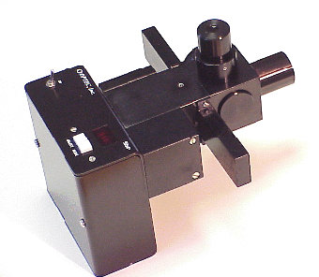
Project Summary
OPTEC’s photometers are outdated, they were designed around 3 to 4 decades ago and make use of components that can be unsafe for the user.
Although effective at measuring light intensity from stars, these photometers can easily malfunction if exposed to high levels of light intensity.
Notes:
Kyle

Slide 3
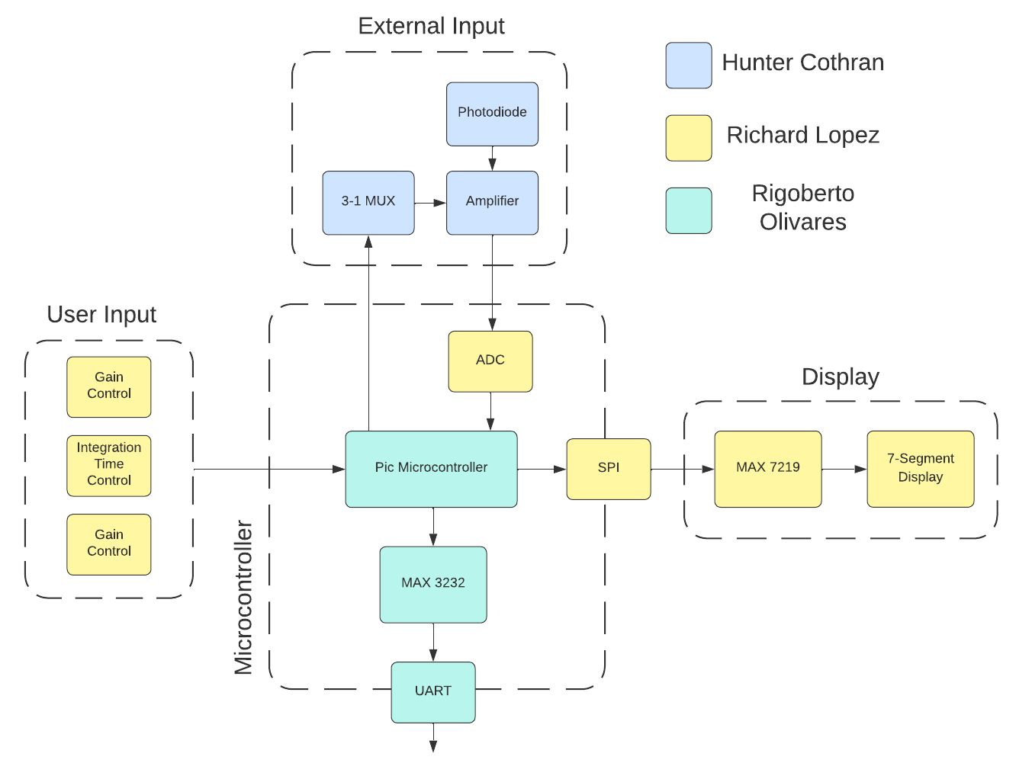
Notes:
Eric

Slide 4
Major Project Changes for 404
Power Supply:
We will be using a linear voltage regulator since it has a wide range of operating temperatures and has less noise than a buck converter
Reasoning: It is necessary for the user of the photometer to be able to easily power the device.
SPI Display:
Old method of parallel multiplexing was complicated and made use of too many I/O pins.
Reasoning: Needed to reduce the number of I/O pins in use to accommodate for other peripherals.

Slide 5
Project Timeline
Accomplishments in ECEN 403:
Photometer protocol was implemented.
Inputs and ADC were implemented.
Display was implemented, but changes were made and need to be implemented.
Photodiode was implemented.
Major Objectives in ECEN 404:
Create the PCB design for our device.
Crete the housing for photometer.
Integrate hardware and software.
Implement changes on the display.
Notes:
Eric

Slide 6
Subsystem 1
Hunter Cothran
Accomplishments since 403 6 hrs of effort | Ongoing progress/problems and plans until the next presentation
Verified previous semester’s operation, Discussed with customer Don various design considerations and next steps | Weigh options between prefab polymer housing options, gutted consumer grade astronomy attachments, and 3d printed/CAD designed housing

Slide 7
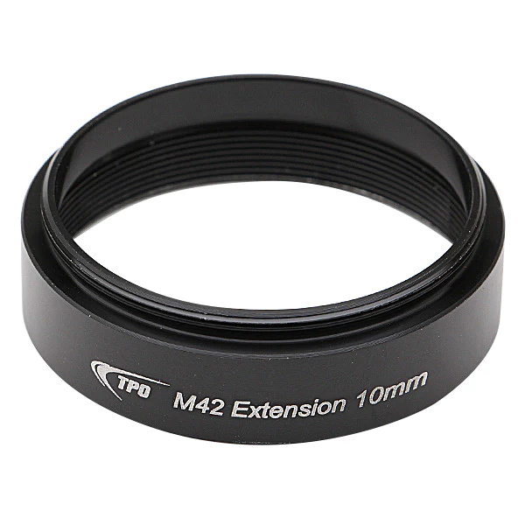
Subsystem 1
Hunter Cothran
Transimpedance Amplifier
TPO M42 Spacers Extension Rings 10mm
Weigh housing options
Create housing

Slide 8
Subsystem 2
Hardware Integration Subsystem
Richard Lopez
Accomplishments since 403 6 hrs of effort | Ongoing progress/problems and plans until the next presentation
Soldered the 7 Segment LED to the MAX7219 Installed Altium and became familiar with it | Test the output of the 7 Segment LED Display Work more with the Altium PCB schematic

Slide 9
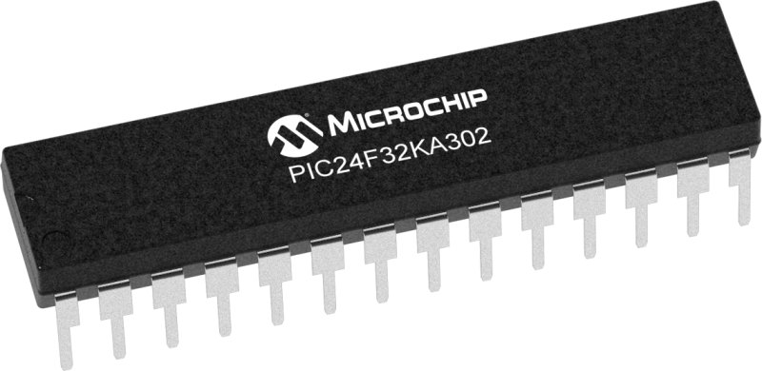
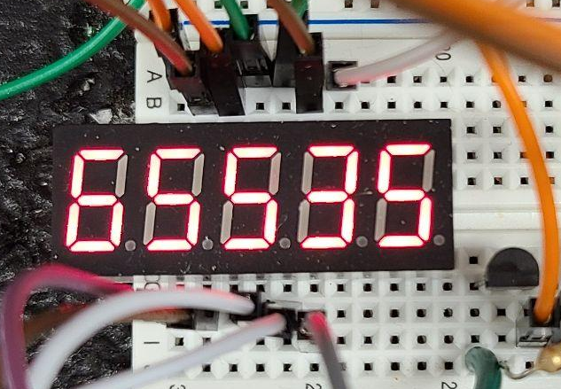
Subsystem 2
Richard Lopez
Microcontroller
Using SPI to output to the 7 Segment
Buttons to control signals to the muxes and power

Slide 10
Subsystem 3: Microcontroller and Power Supply
Rigoberto Olivares
Accomplishments since 403 10 hrs of effort | Ongoing progress/problems and plans until the next presentation
Designed the power supply for the photometer. Revalidated | Validate the power supply was ordered parts arrive. Continue working on software integration.

Slide 11
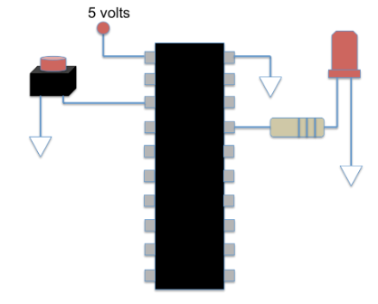
Subsystem 3: Microcontroller and Power Supply
Rigoberto Olivares
Software subsystem from 403 was working, now we must integrate all the software into a single piece.
Currently working on the implementation of interrupts, interrupts will be necessary in ensuring that the MCU can handle inputs from both physical inputs and software inputs.

Slide 12
Parts Ordering Status
Order Date | Item Name | Unit Cost | Number Purchased | Total Cost | Description
09/01/2022 | MAX7219 | $4.95 | 2 | $9.90 | Used for multiplexing the 7 segment display
09/01/2022 | TS14-1212-80-BK-160-SCR-D | $0.25 | 6 | $1.50 | Will be used as input buttons for our circuit
09/01/2022 | L7805ABV | $0.78 | 3 | $2.34 | 9v to 5v voltage regulator for power supply circuit
09/01/2022 | UVR2AR33MDD1TD | $0.28 | 3 | $0.84 | Electrolytic capacitor for power supply circuit
09/01/2022 | RDER71E104K0P1H03B | $0.25 | 10 | $2.50 | Ceramic capacitor for power supply circuit, MCU, and MAX3232
09/01/2022 | K105K20X7RF5TH5 | $0.68 | 10 | $6.76 | Ceramic capacitor for the MAX3232
09/01/2022 | FG26X7R1E106KRT06 | $0.50 | 10 | $5.04 | Ceramic capacitor for MCU
09/01/2022 | M20-9754046 | $1.35 | 1 | $1.35 | Pin headers for create connections for various components
09/01/2022 | LTC2470CMS#PBF | $5.17 | 1 | $5.17 | This ADC will be used in our final design
N/A | TPO M42 Spacers Extension Rings 10mm | $10.99 | 2 | $21.98 | Threading attached to housing
Notes:
Michelle

Slide 13
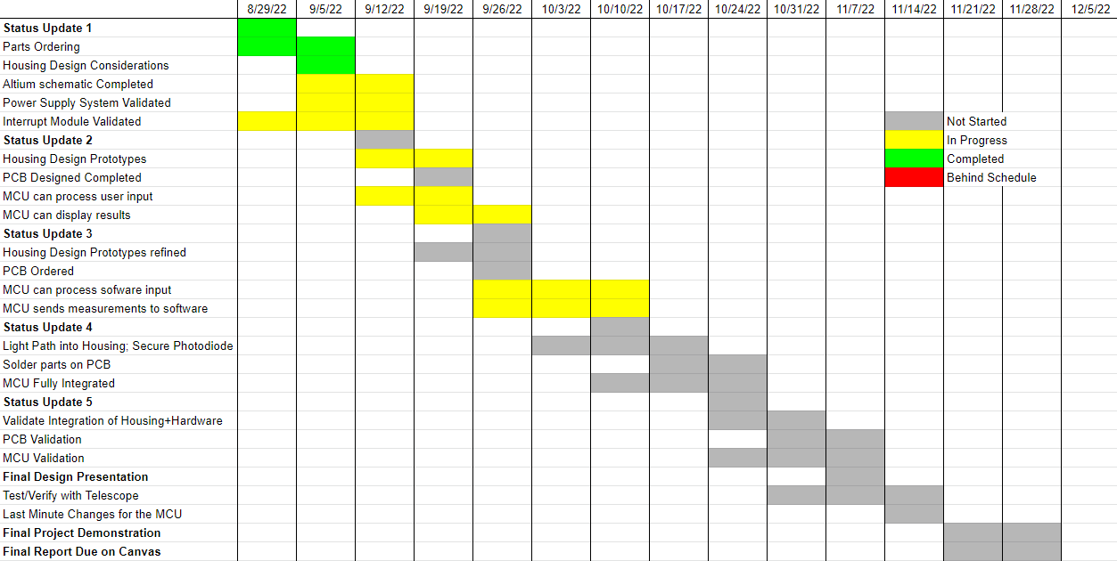
Execution Plan
Notes:
Michelle

Slide 14
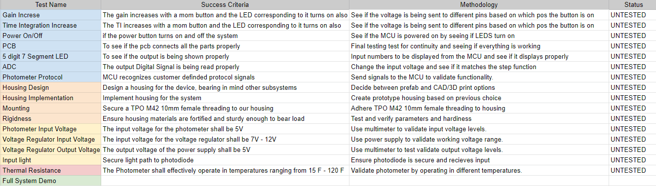
Validation Plan
Notes:
Michelle

Slide 15
Thank You!
Questions?

