Slide 1


Team 18: Photometer
Bi-Weekly Update 2 Rigoberto Olivares, Hunter Cothran, Richard Lopez Sponsor: Max Lesser TA: Rohith Ramanujam Kumar
Notes:
Michelle

Slide 2
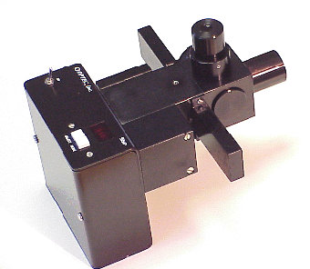
Project Summary
Our customer Don, an astronomer at A&M, desires a modern re-envisioning of an OPTEC photometer, which were designed in the 70s
Astronomers often make their own photometers to measure light of stars, eclipses, etc, with photodiodes in conjunction with simple circuit components, despite ranges of, a universal unit can be derived
A drawback of OPTEC’s original design – photomultiplier tubes (high voltage) and the need to filter light
Picture / Diagram here
Notes:
Kyle

Slide 3
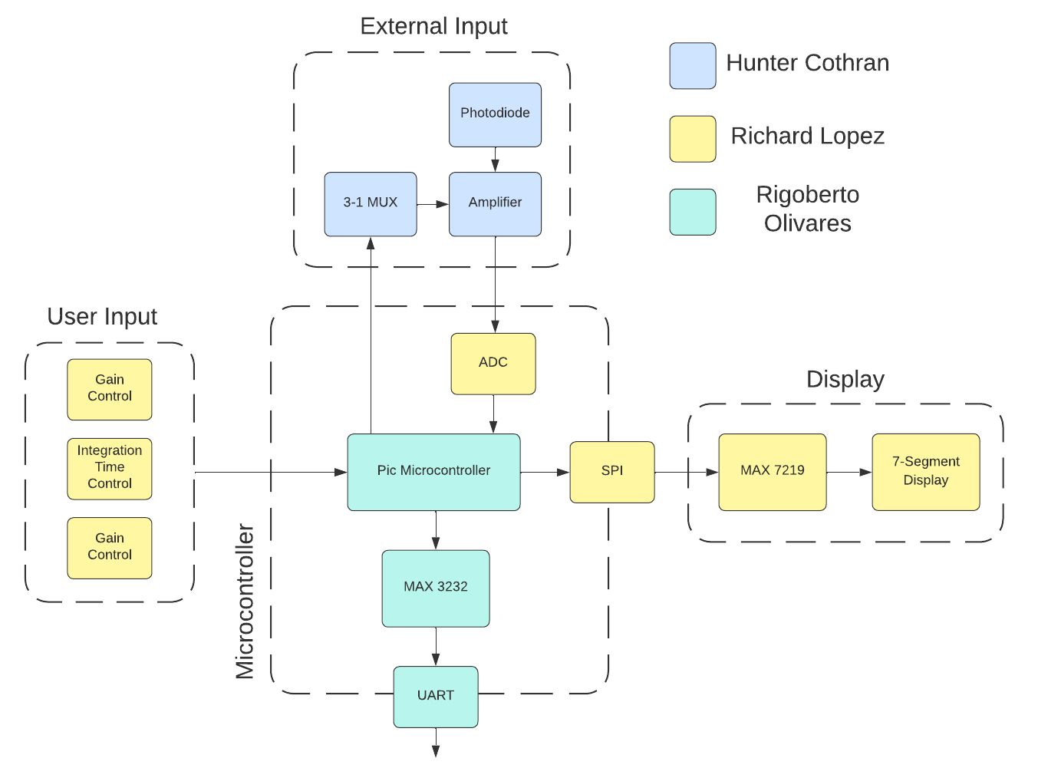
Notes:
Eric

Slide 4
Project Timeline
Subsystem Designs and Testing (completed 9/11) | Integration of Hardware Components (completed 9/17) | PCB Design Completed (to complete by 9/28) | Integration of Software components (to complete by 10/15) | Begin Validation (to complete by 11/2) | Continue Validation (to complete by 11/26) | Demo and Report (to complete by 12/5)
Notes:
Eric

Slide 5
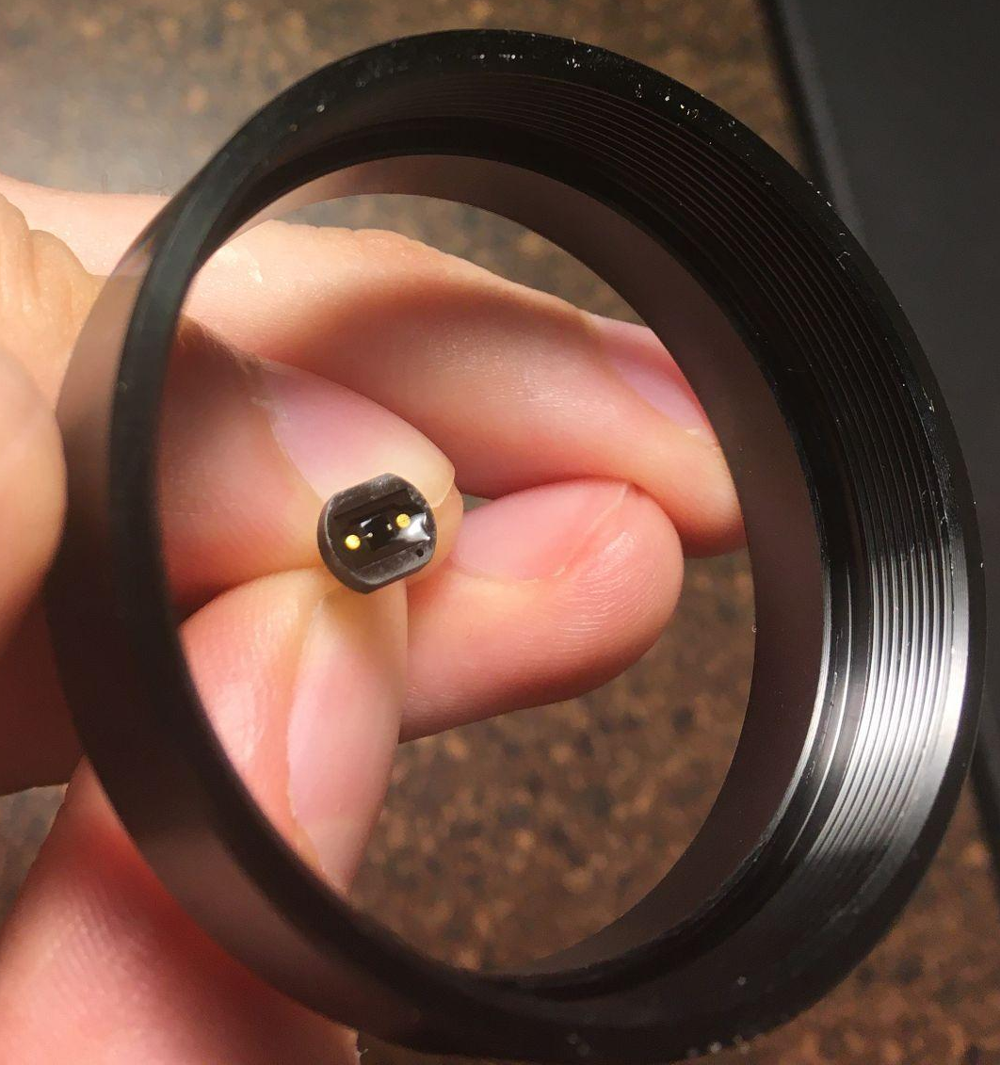
Lightpath, Enclosure, Amplifier
Hunter Cothran
Accomplishments since last presentation 18 hrs of effort | Ongoing progress/problems and plans until the next presentation
Discussed M42 male/female attachment protocol w/ sponsor, researched enclosure options, ordered correct M42 attachments and desired enclosure, photodiode securement experimentation | Refine housing prototype via drill press, sanding, and alignment/securement methods while integrating lightpath and finding optimal means to secure photodiode (acrylic glue)

Slide 6
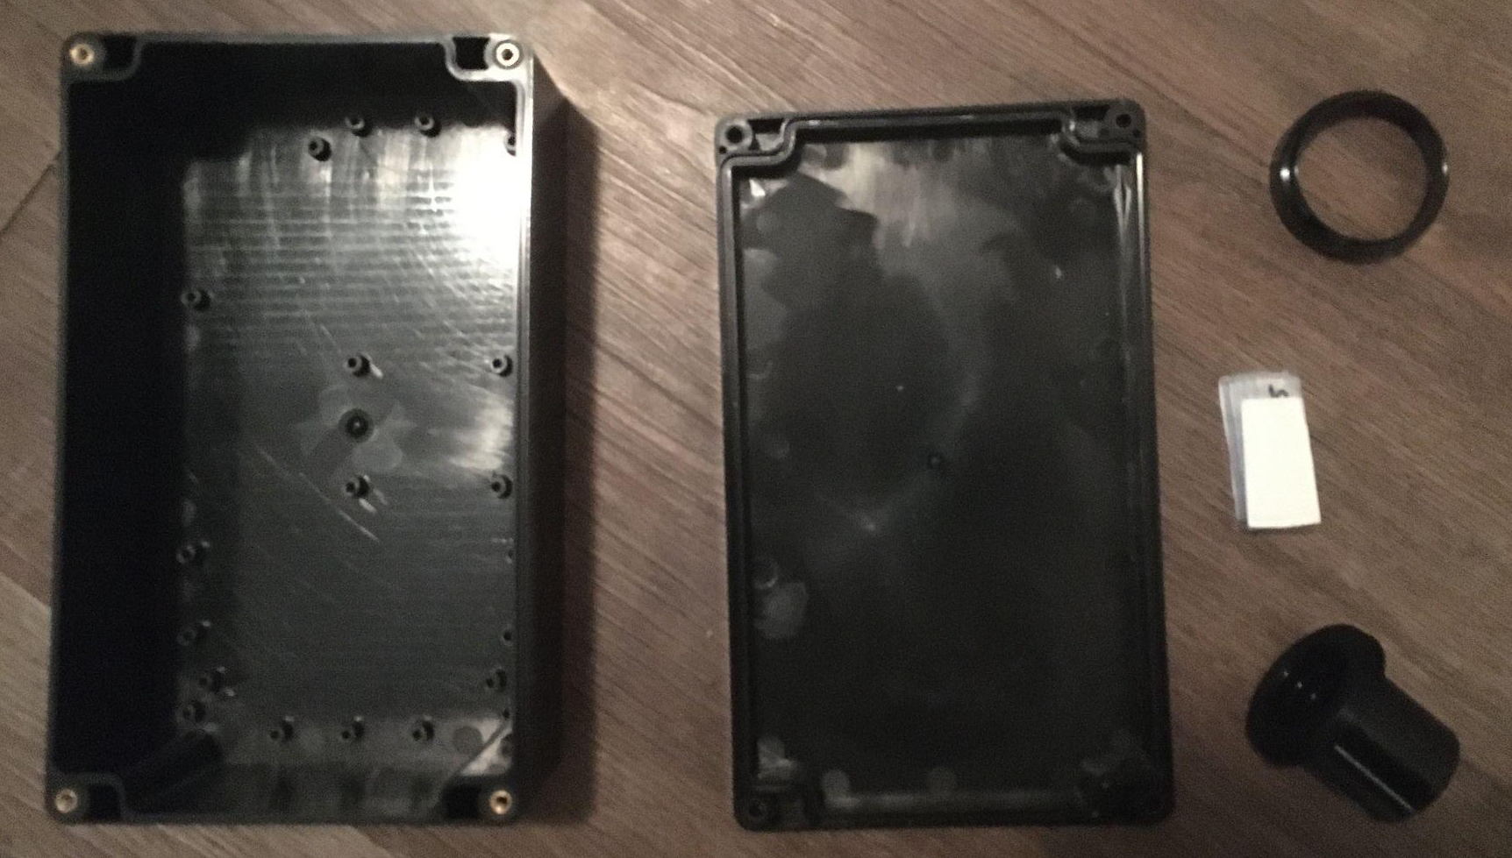
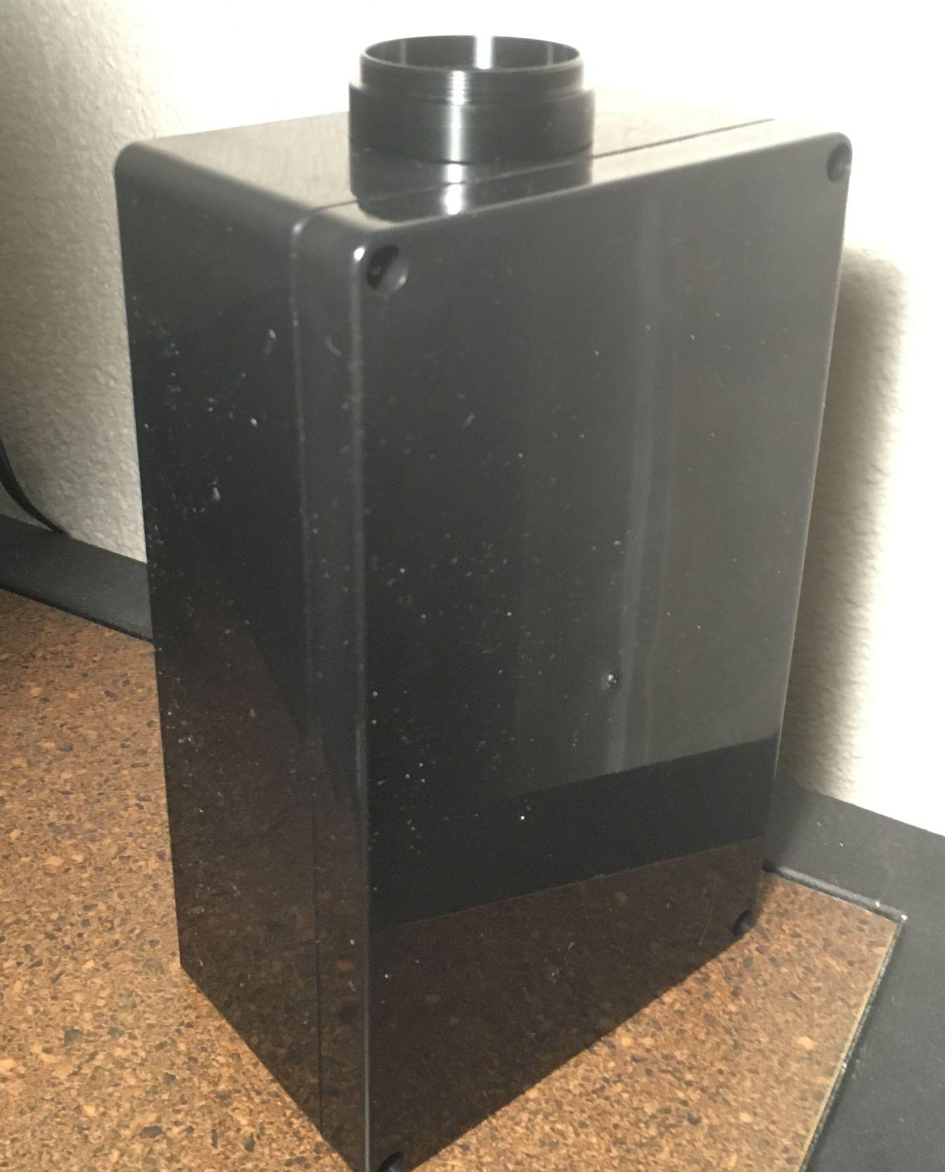
Lightpath, Enclosure, Amplifier
Hunter Cothran

Slide 7
ADC and Output
Richard Lopez
Accomplishments since last presentation 22 hrs of effort | Ongoing progress/problems and plans until the next presentation
Finished PCB Schematic Finishing up the PCB Design in preparation for incorporating everyone subsystem | We are going to order the PCB by Friday. Issues: Had to restart my PCB design this week from scratch.

Slide 8
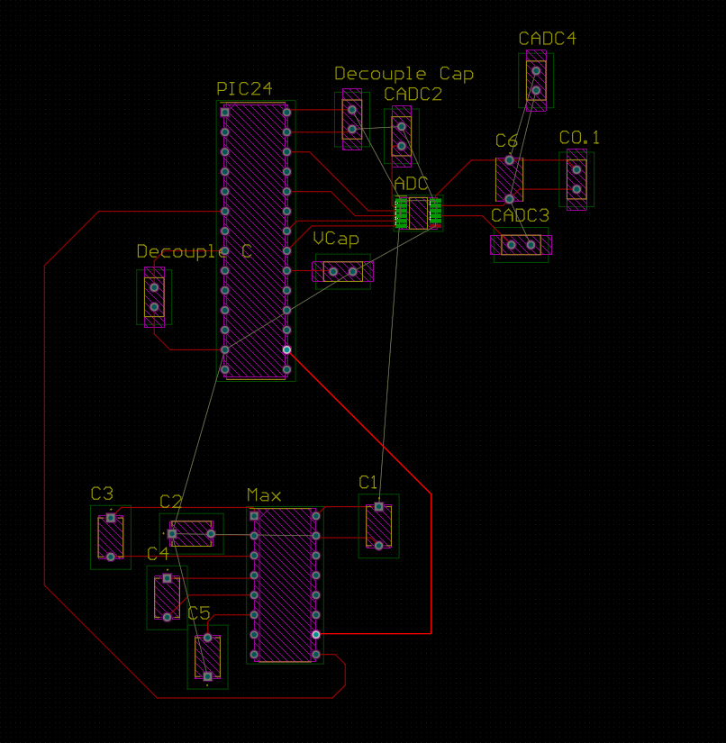
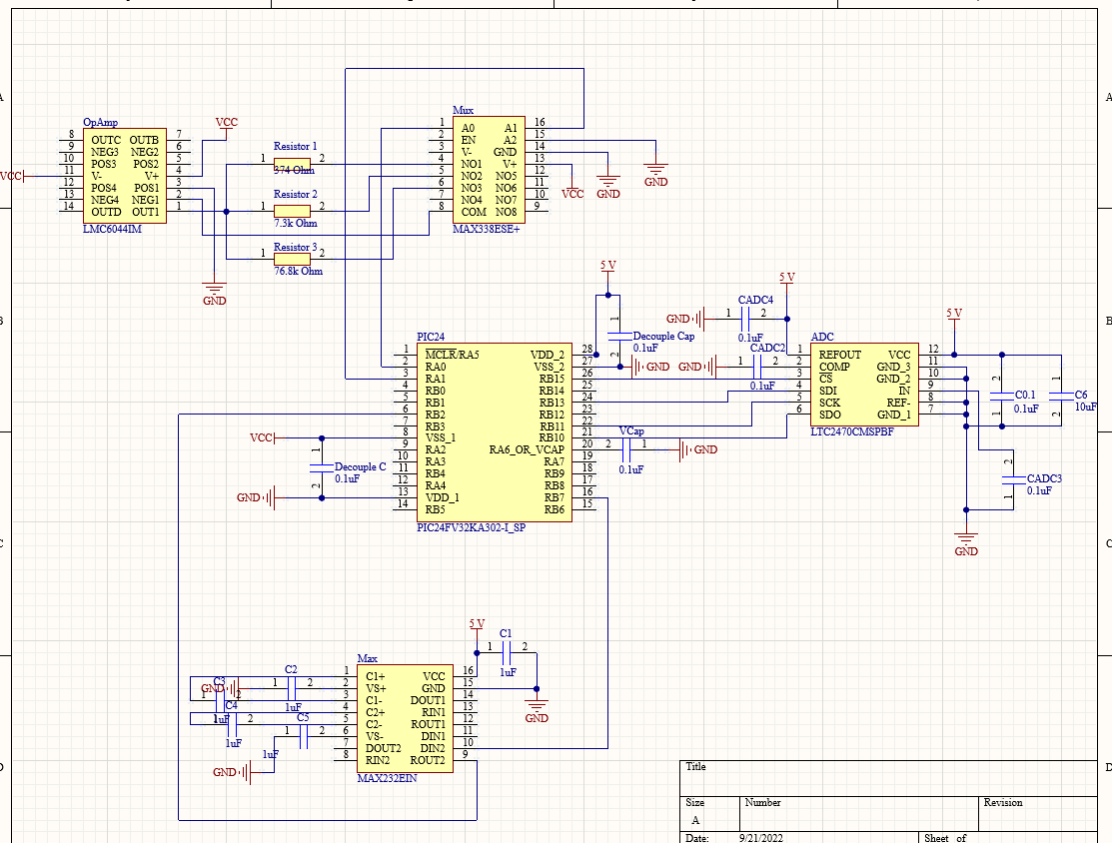
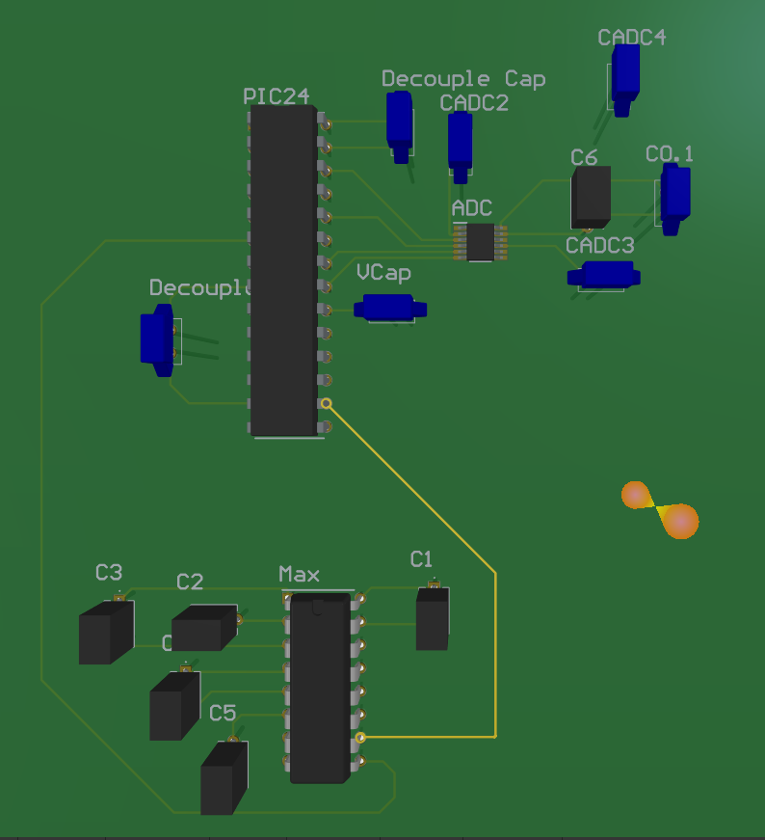
ADC and Output
Richard Lopez

Slide 9
Power Supply and Microcontroller
Accomplishments since last presentation 18 hrs of effort | Ongoing progress/problems and plans until the next presentation
Completed Power Supply schematic and PCB design using Altium. Validated Power Supply by using Voltage ranges from 4.5V to 5.5V. Tested a simple interrupt module in the MCU to verify functionality. | On-going integration of microcontroller software components. Issues were found testing the interrupt module. By this Friday, will fully integrate input buttons with the MCU.

Slide 10
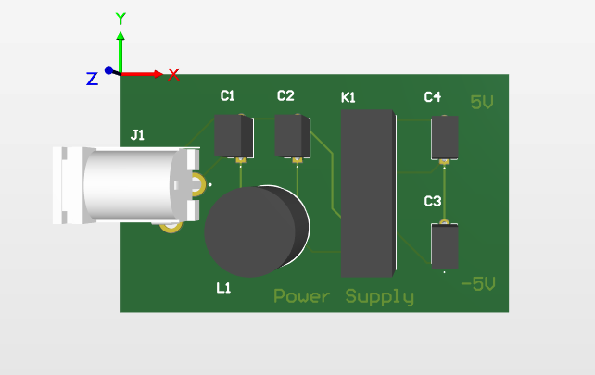
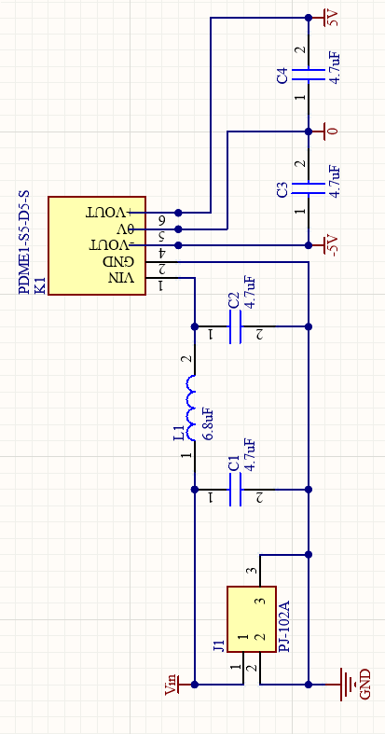
Power Supply Validation

Slide 11
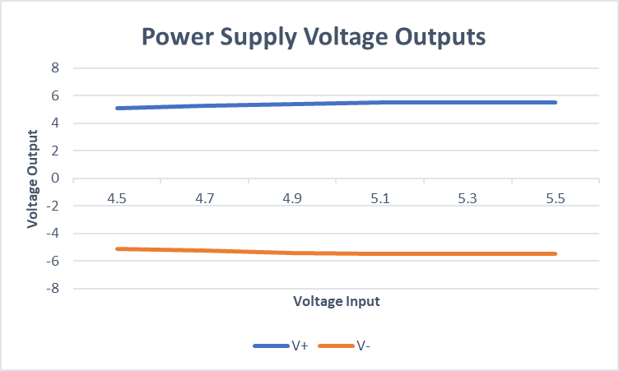
Power Supply Validation
The Power Supply was validated using voltage inputs in the range of 4.5V to 5.5V.
V+ remains close to a constant 5V.
V- remains close to a constant -5V.

Slide 12
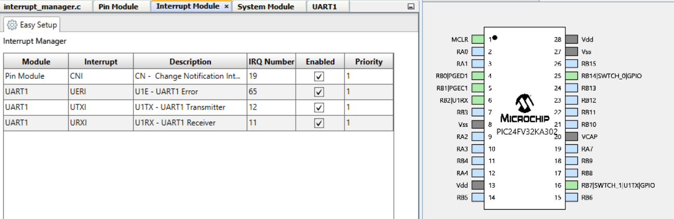
Microcontroller
Tested a simple interrupt module in MPLab. There are issues implementing interrupts, UART, and SPI in the same module. By the end of this week either finish working on interrupts or implement design sequentially.

Slide 13
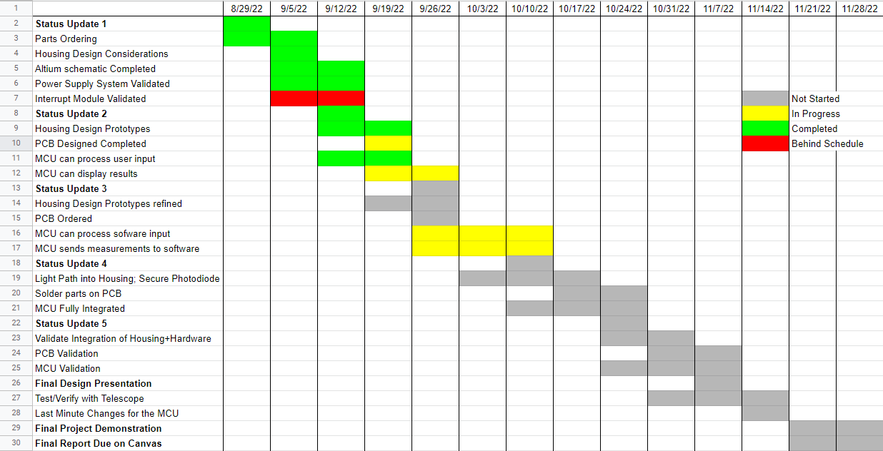
Execution Plan
Notes:
Michelle

Slide 14
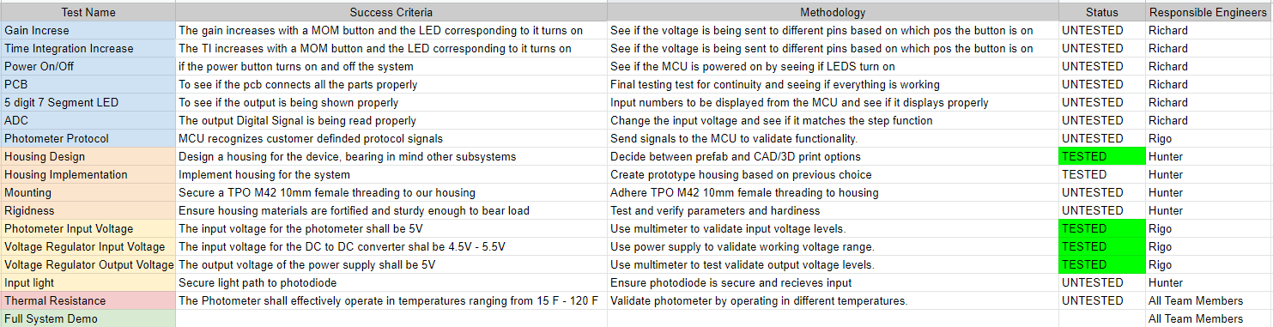
Validation Plan

Slide 15
Thank you!
Questions?

