Slide 1


Team 18: Photometer
Bi-Weekly Update 3 Rigoberto Olivares, Hunter Cothran, Richard Lopez Sponsor: Max Lesser TA: Rohith Ramanujam Kumar
Notes:
Michelle

Slide 2
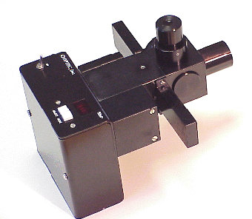
Project Summary
Our customer Don, an astronomer at A&M, desires a modern re-envisioning of an OPTEC photometer, which were designed in the 70s
Astronomers often make their own photometers to measure light of stars, eclipses, etc, with photodiodes in conjunction with simple circuit components, despite ranges of, a universal unit can be derived
A drawback of OPTEC’s original design – photomultiplier tubes (high voltage) and the need to filter light
Notes:
Kyle

Slide 3
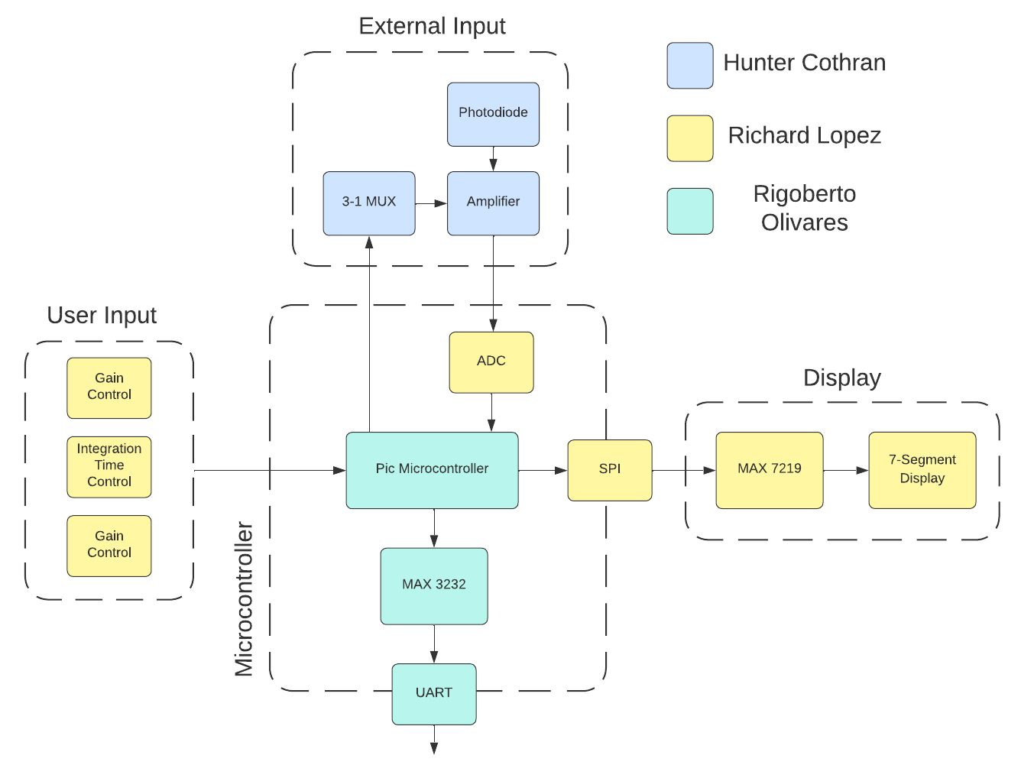
Notes:
Eric

Slide 4
Project Timeline
Subsystem Designs and Testing (completed 9/11) | Finish integration of Hardware components (completed 9/17) | PCB has been designed and ordered (completed 9/28) | Finish integration of Software components (to complete by 10/15) | Finish Validation of Hardware and Software components (to complete by 11/2) | Finish Testing for software and hardware components (to complete by 11/26) | Demo and Report (to complete by 12/5)
Notes:
Eric

Slide 5
Housing and Photodiode
Accomplishments since last update 10 hrs of effort | Ongoing progress/problems and plans until the next presentation
Measured and drilled M42 spacer ring sized hole with a boring drill Used dremel, FEDC hardware Applied glue and epoxy to secure Assisted PCB design Ensure PCB dimensions fit | Yet to finalize photodiode securement/light path design

Slide 6
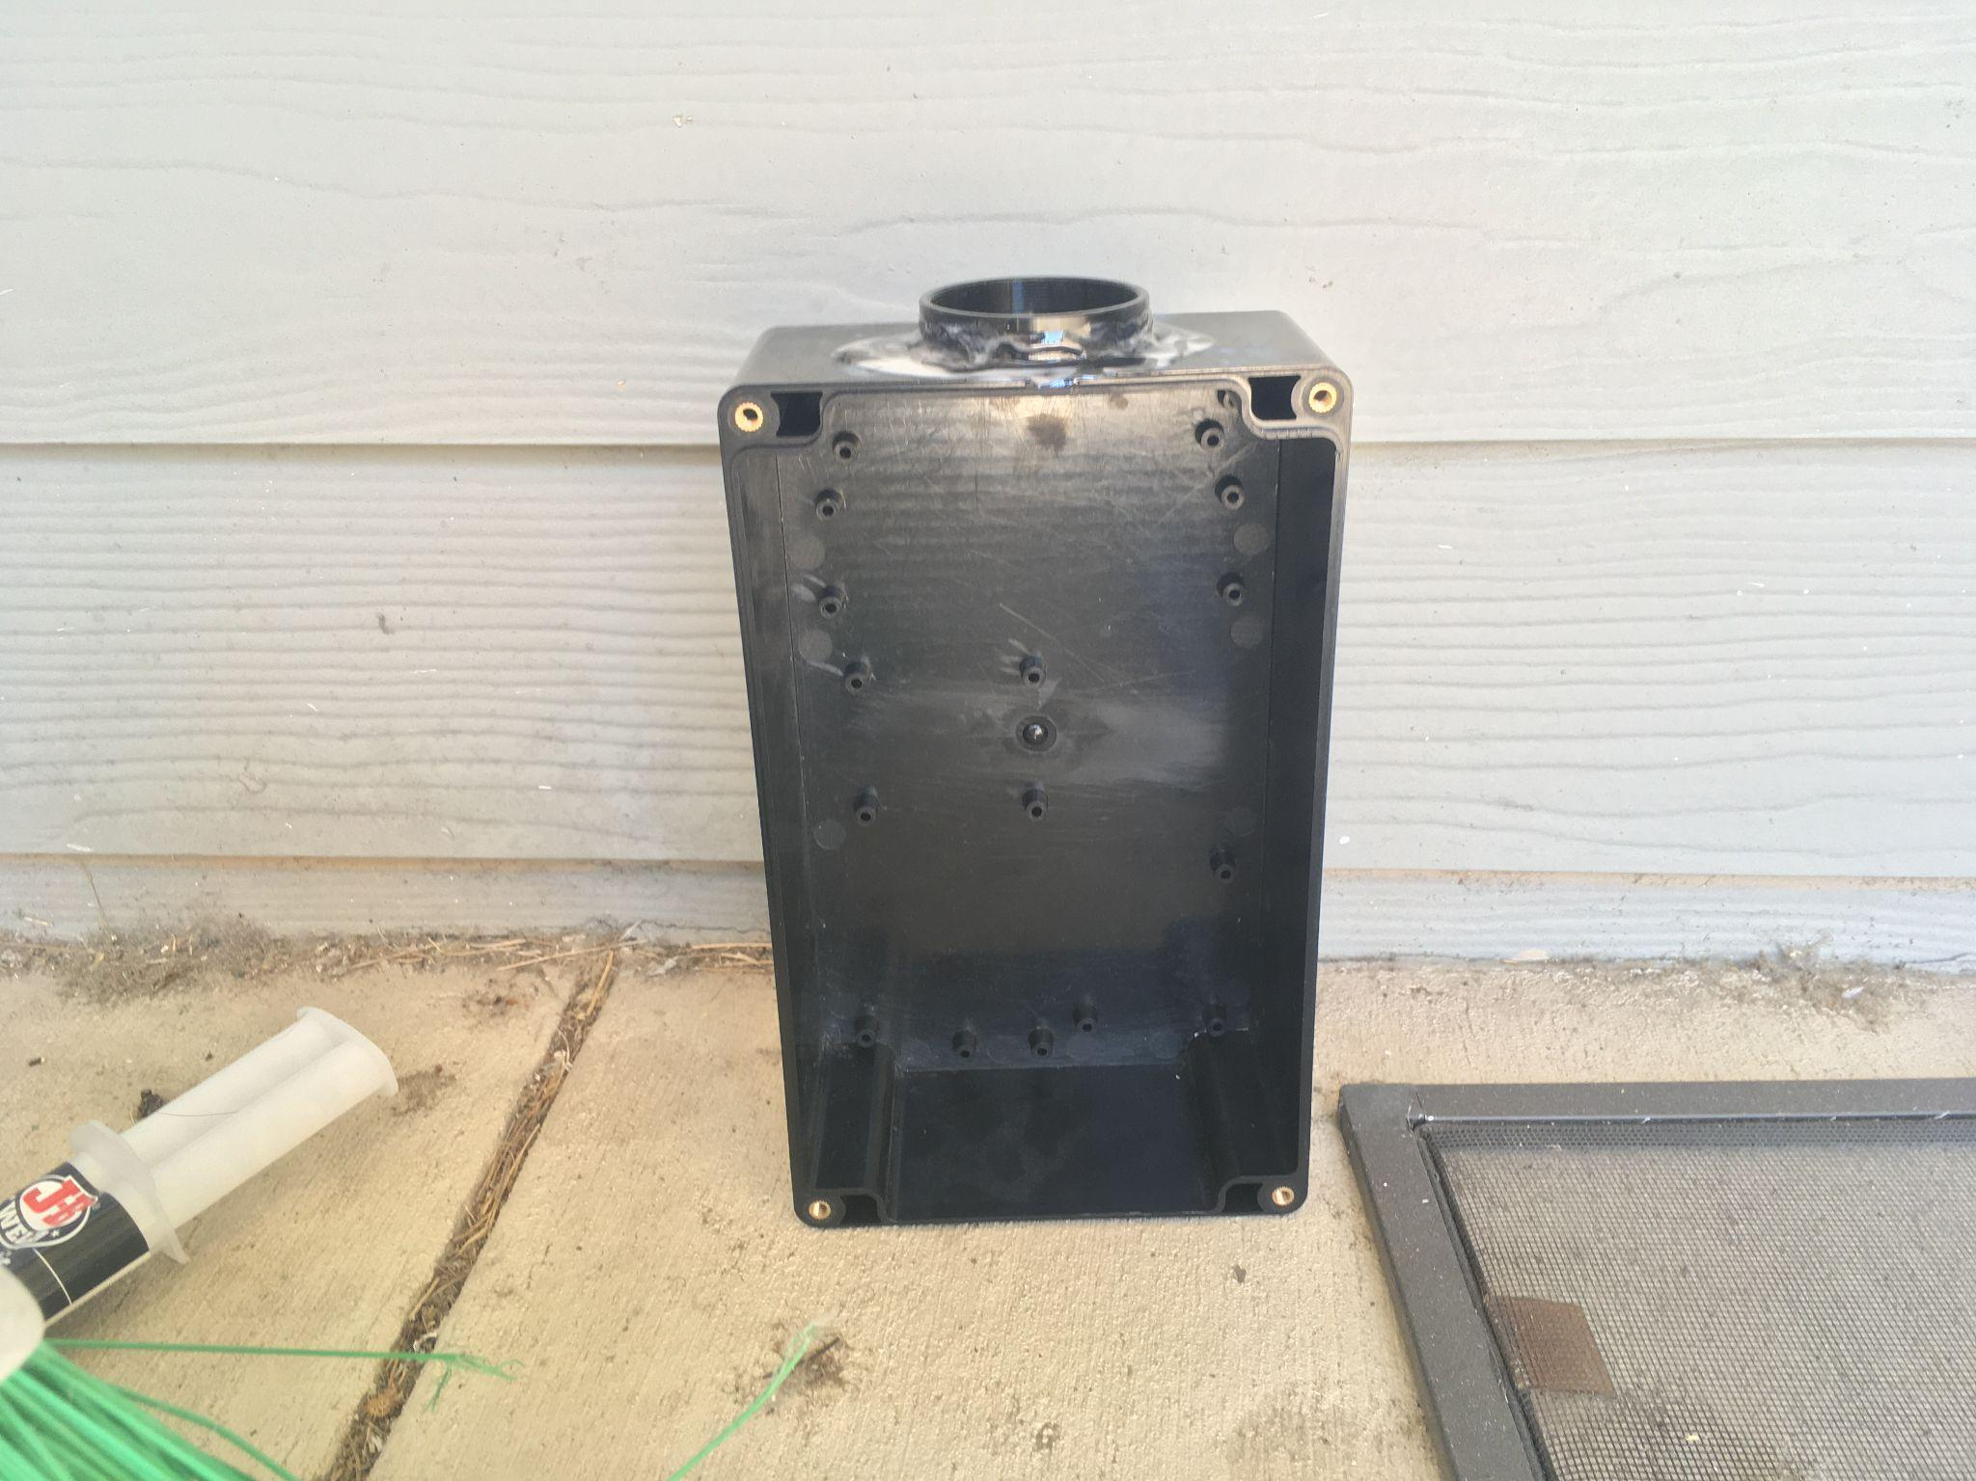
Hunter - Enclosure Plastic/Metal Bonding
Bonding plastic/metal
challenges
Epoxy, Glue
Considerations

Slide 7
ADC and Microcontroller
Accomplishments since last update 15 hrs of effort | Ongoing progress/problems and plans until the next presentation
Finalized the PCB design with Rigo and Hunter and ordered it The PCB arrived this week on Monday | Finish up the SPI with Rigo and output send data from the ADC to the output and also the DB9 Solder on components with PCB

Slide 8
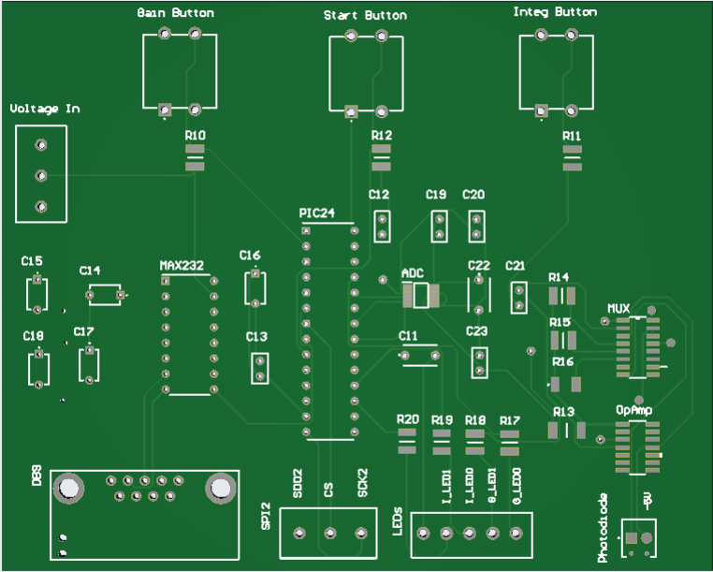
PCB design
Arrived this week
Start soldering and testing for continuity this friday
Start soldering on parts as well

Slide 9
Power Supply and Microcontroller
Accomplishments since last update 18 hrs of effort | Ongoing progress/problems and plans until the next presentation
Completed integration of the 5 digit 7-Segment display. Completed integration of input buttons (hardware side). Received Power Supply PCB. | Complete integration and test functionality of ADC. Complete integration of input buttons and test functionality on the software side. Solder components onto Power Supply PCB.

Slide 10
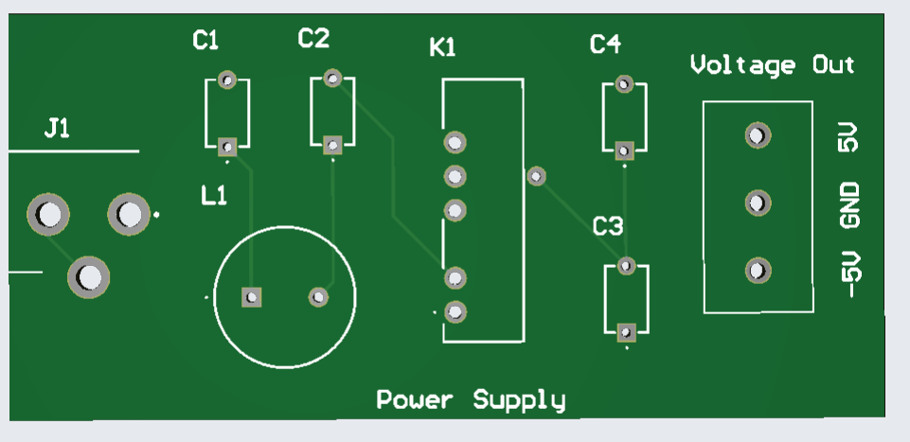
Power Supply
The power supply PCB has been received.
Will be soldering components this Friday during lab time.

Slide 11
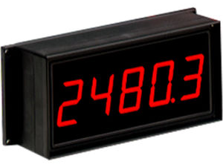
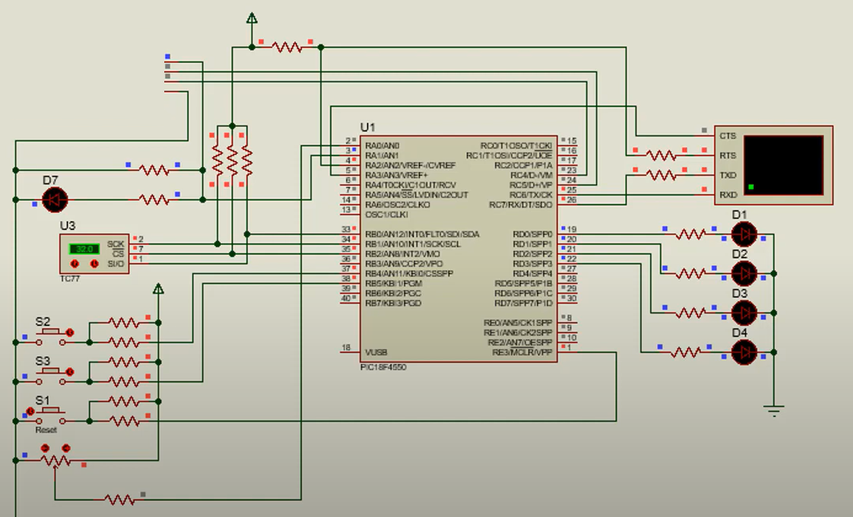
Button Inputs and Display
Tested display by outputting numbers in the range of 0 to 99999.
Gain and integration are displayed using LEDs.
Tested input buttons by lighting corresponding LEDs.

Slide 12
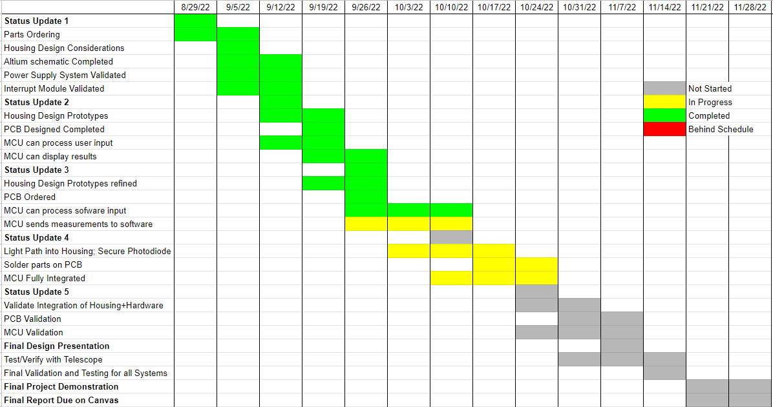
Execution Plan
Notes:
Michelle

Slide 13
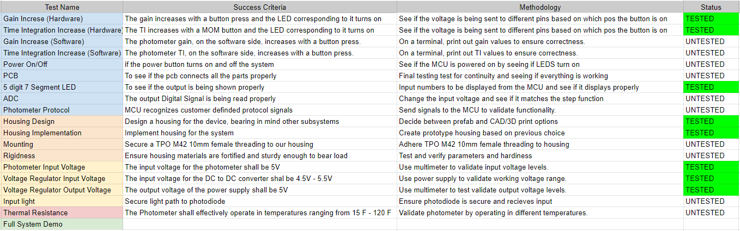
Validation Plan
Notes:
Michelle

Slide 14
Thank You!
Questions?

