Slide 1


Team 18: Photometer
Bi-Weekly Update 4 Rigoberto Olivares, Hunter Cothran, Richard Lopez Sponsor: Max Lesser TA: Rohith Ramanujam Kumar
Notes:
Michelle

Slide 2
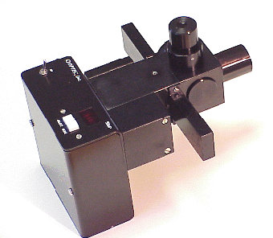
Project Summary (30 seconds)
Our customer Don, an astronomer at A&M, desires a modern re-envisioning of an OPTEC photometer, which were designed in the 70s
Astronomers often make their own photometers to measure light of stars, eclipses, etc, with photodiodes in conjunction with simple circuit components, despite ranges of, a universal unit can be derived
A drawback of OPTEC’s original design – photomultiplier tubes (high voltage) and the need to filter light
Notes:
Kyle

Slide 3
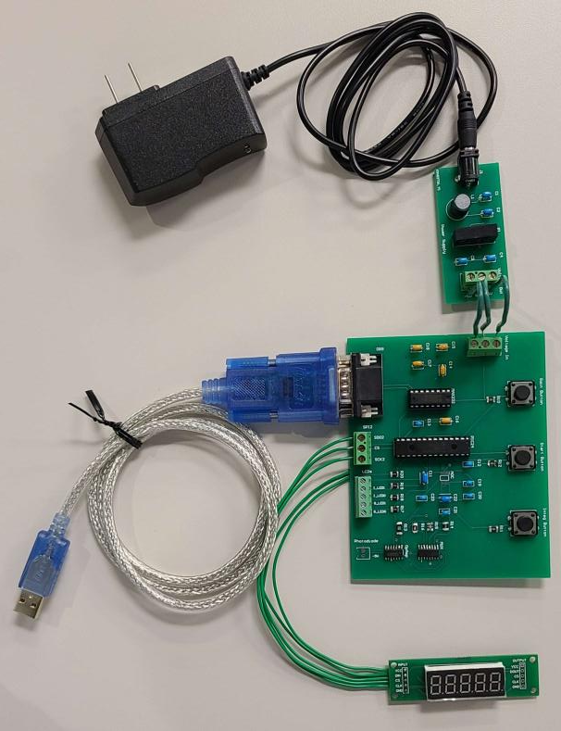
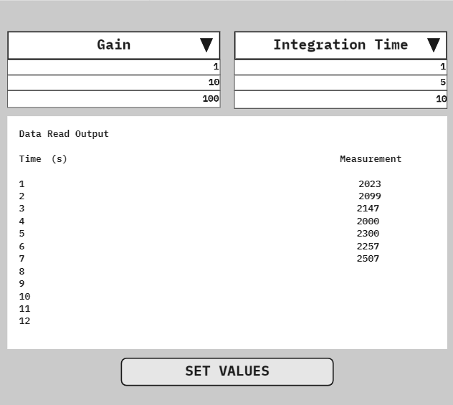
Integrated System Diagram
Notes:
Eric

Slide 4
Project Timeline
Subsystem Designs and Testing (completed 9/11) | Finish integration of Hardware components (completed 9/17) | PCB has been designed and ordered (completed 9/28) | Finish integration of Software components (to complete by 10/15) | Finish Validation of Hardware and Software components (to complete by 11/2) | Finish Testing for software and hardware components (to complete by 11/26) | Demo and Report (to complete by 12/5)
Notes:
Eric

Slide 5
Rigoberto Olivares
Accomplishments since last update 12 hrs | Ongoing progress/problems and plans until the next presentation
All components have been soldered onto the power supply. Validated display components on the PCB. Validated UART protocol components on the PCB. | Issues with ADC implementation. Small issue with the microcontroller and power supply PCB. Validate remaining PCB components.

Slide 6
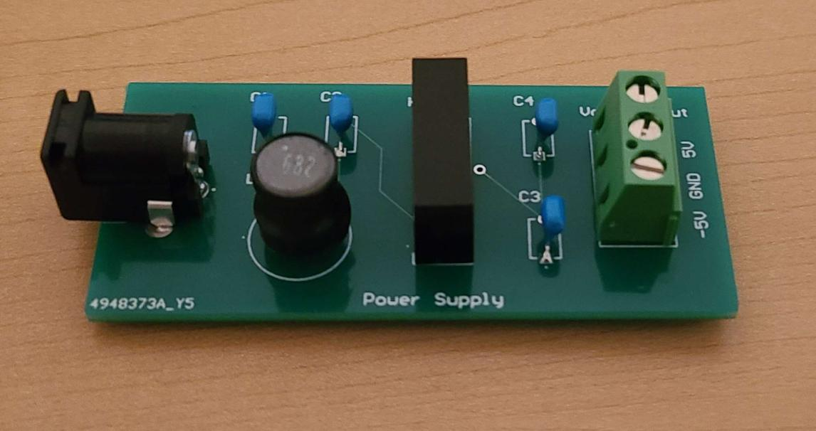
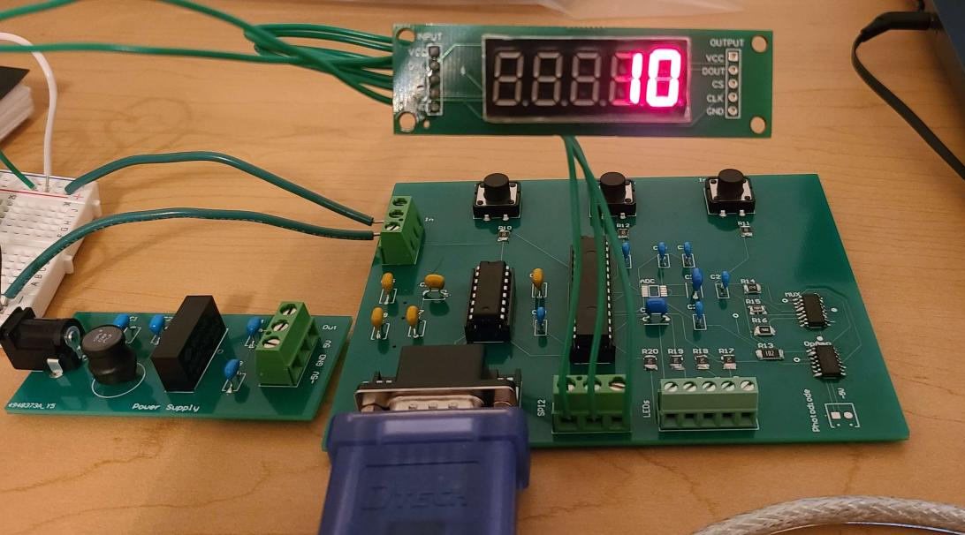
Microcontroller and Power Supply
Validated newly soldered power supply PCB components and measured output voltage.
Barrel connector is incorrect size and must be replaced.
Tested display by inputting values in the range from 0 to 99999.
Microcontroller is not properly grounded, we must short the appropriate pin to ground.

Slide 7
Richard Lopez
Accomplishments since last update 18 hrs of effort | Ongoing progress/problems and plans until the next presentation
Finished soldering the PCB Components | Validating the integration of our subsystems Working with SPI

Slide 8
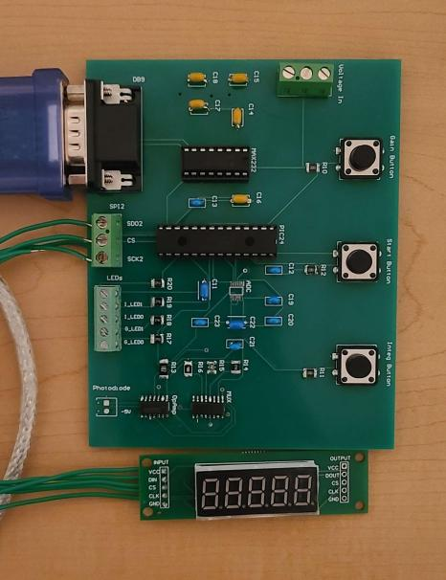
Richard Lopez
Soldered the PCB
Installed Dips for parts to be
reprogrammable or replaceable
In/Progress
Still need to validate all connections
Need to solder ADC

Slide 9
Hunter Cothran
Accomplishments since last update 9 hrs of effort | Ongoing progress/problems and plans until the next presentation
Applied for Red badge Experience using epoxy Ensured that PCB dimensions fit inside enclosure Helped Rigo with PCB and power | Fabricate two prototype enclosures Correctly implement epoxy Utilize red badge and upcoming blitz to bore/dremel necessary holes Secure photodiode and PCB

Slide 10
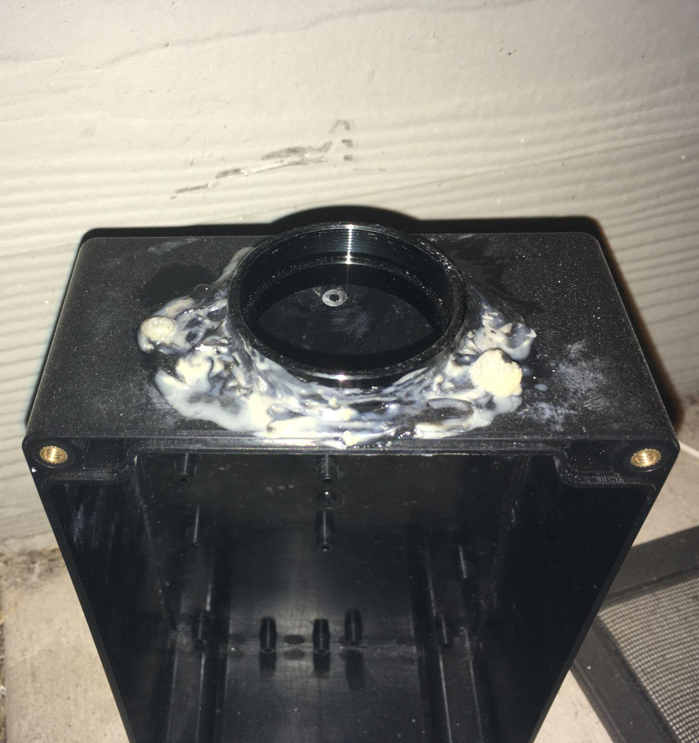
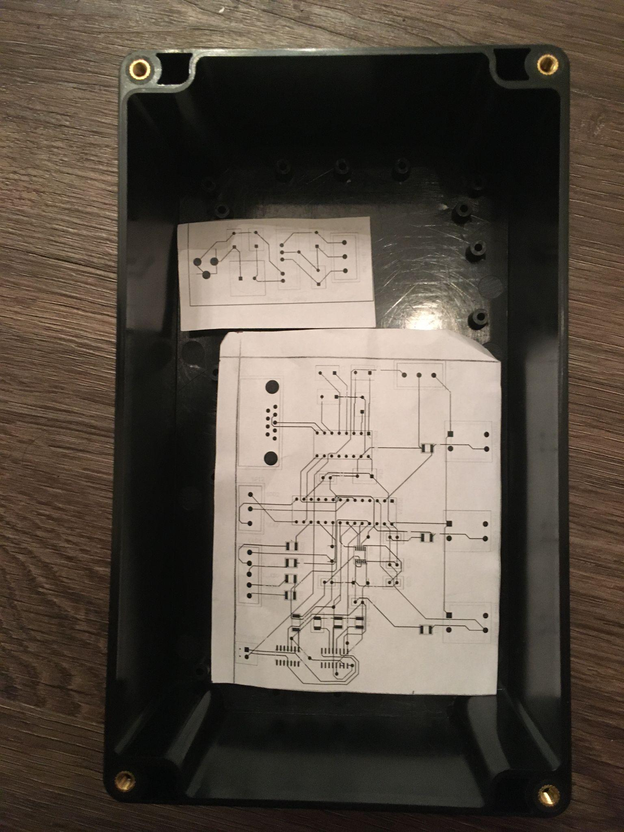

Slide 11
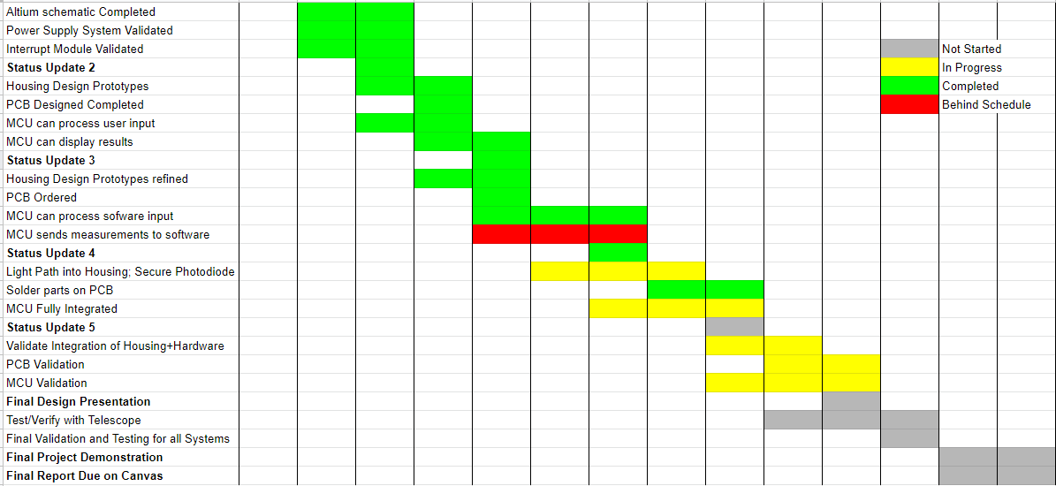
Execution Plan
Notes:
Michelle

Slide 12
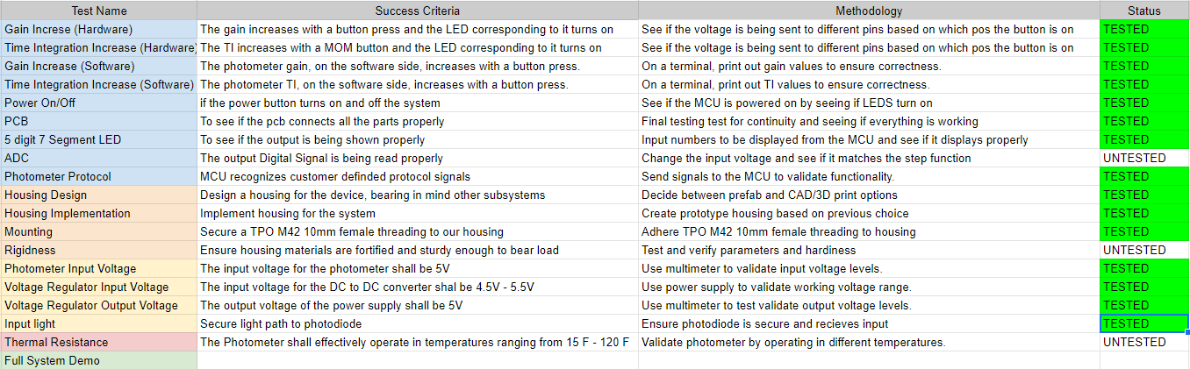
Validation Plan
Notes:
Michelle

Slide 13
Thank you!
Questions?

