Slide 1


Team 18: Photometer
Bi-Weekly Update 5 Rigoberto Olivares, Hunter Cothran, Richard Lopez Sponsor: Max Lesser TA: Rohith Ramanujam Kumar
Notes:
Michelle

Slide 2
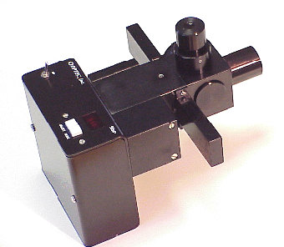
Project Summary
Our customer Don, an astronomer at A&M, desires a modern re-envisioning of an OPTEC photometer, which were designed in the 70s
Astronomers often make their own photometers to measure light of stars, eclipses, etc, with photodiodes in conjunction with simple circuit components, despite ranges of, a universal unit can be derived
A drawback of OPTEC’s original design – photomultiplier tubes (high voltage) and the need to filter light
Notes:
Kyle

Slide 3
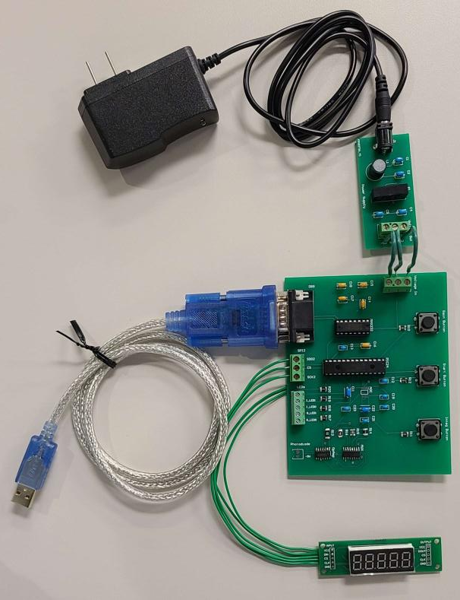
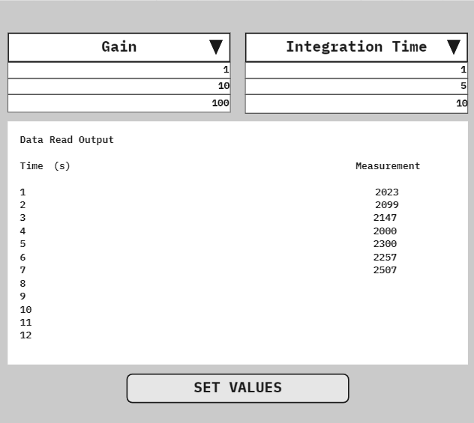
Integrated System Diagram
Notes:
Eric

Slide 4
Project Timeline
Subsystem Designs and Testing (completed 9/11) | Finish integration of Hardware components (completed 9/17) | PCB has been designed and ordered (completed 9/28) | Finish integration of Software components (to complete by 10/15) | Finish Validation of Hardware and Software components (to complete by 11/2) | Finish Testing for software and hardware components (to complete by 11/26) | Demo and Report (to complete by 12/5)
Notes:
Eric

Slide 5
Hunter Cothran
Accomplishments since last update 11 hrs of effort | Ongoing progress/problems and plans until the next presentation
Secured Photodiode Secured Spacer Ring Created backup Enclosure Tested PCB w/ Rigo and got it working | Integrate PCB with enclosure Test system with Don’s telescope

Slide 6
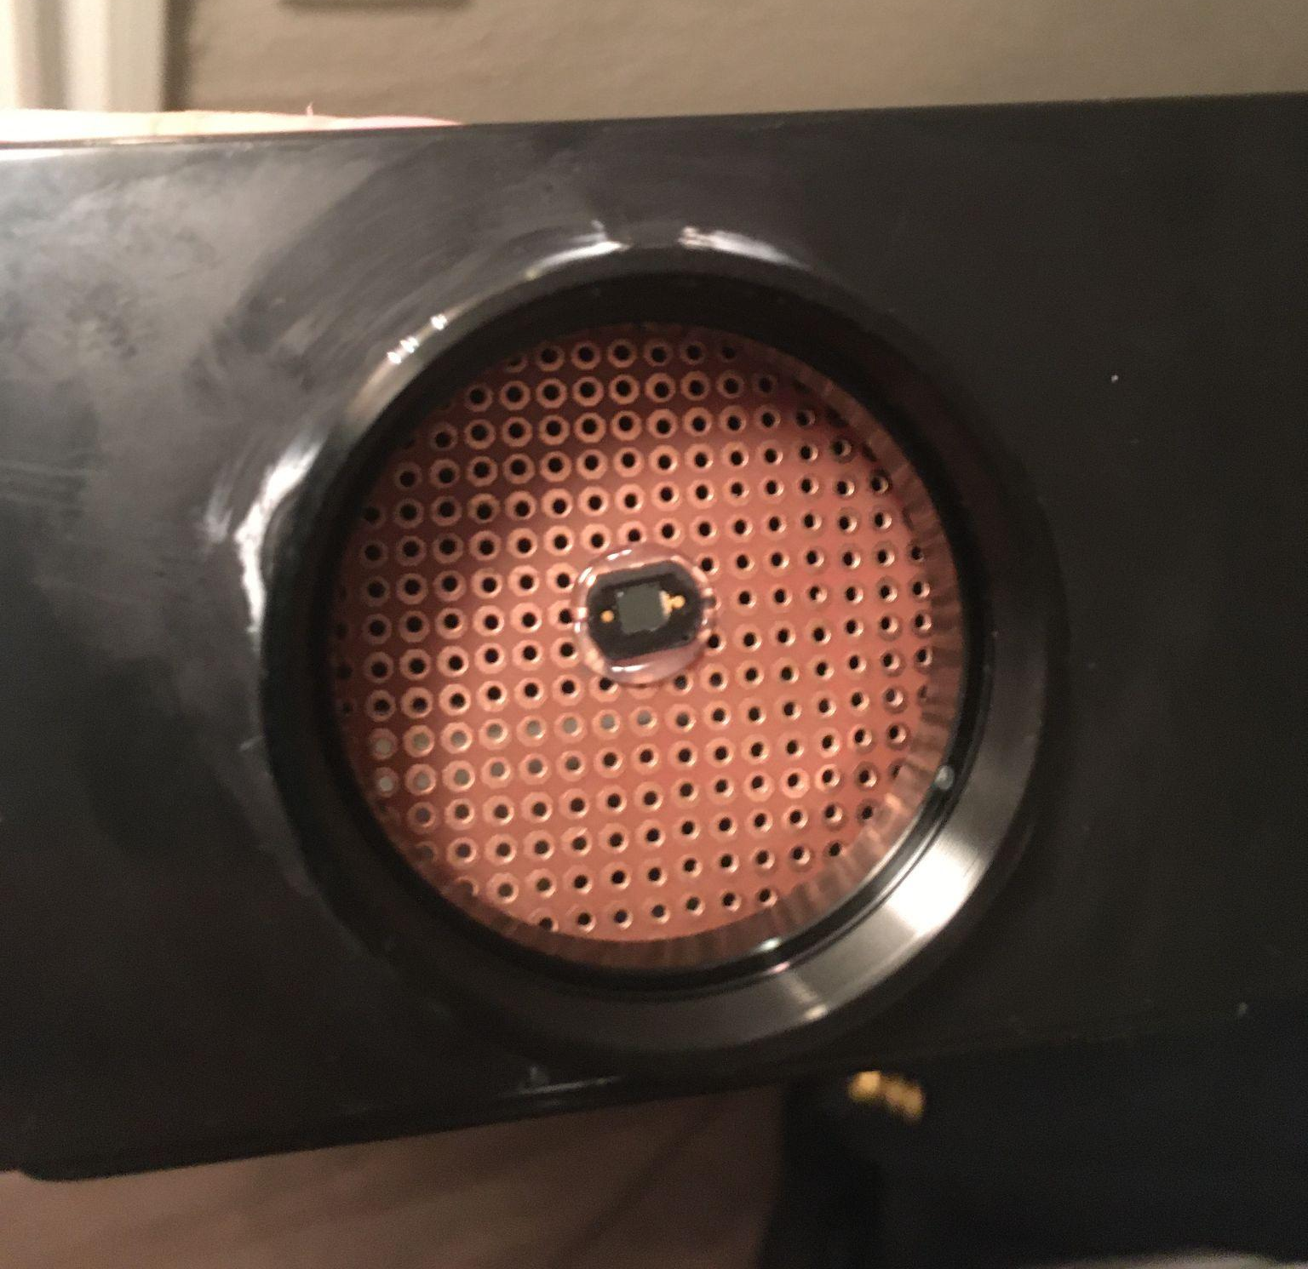
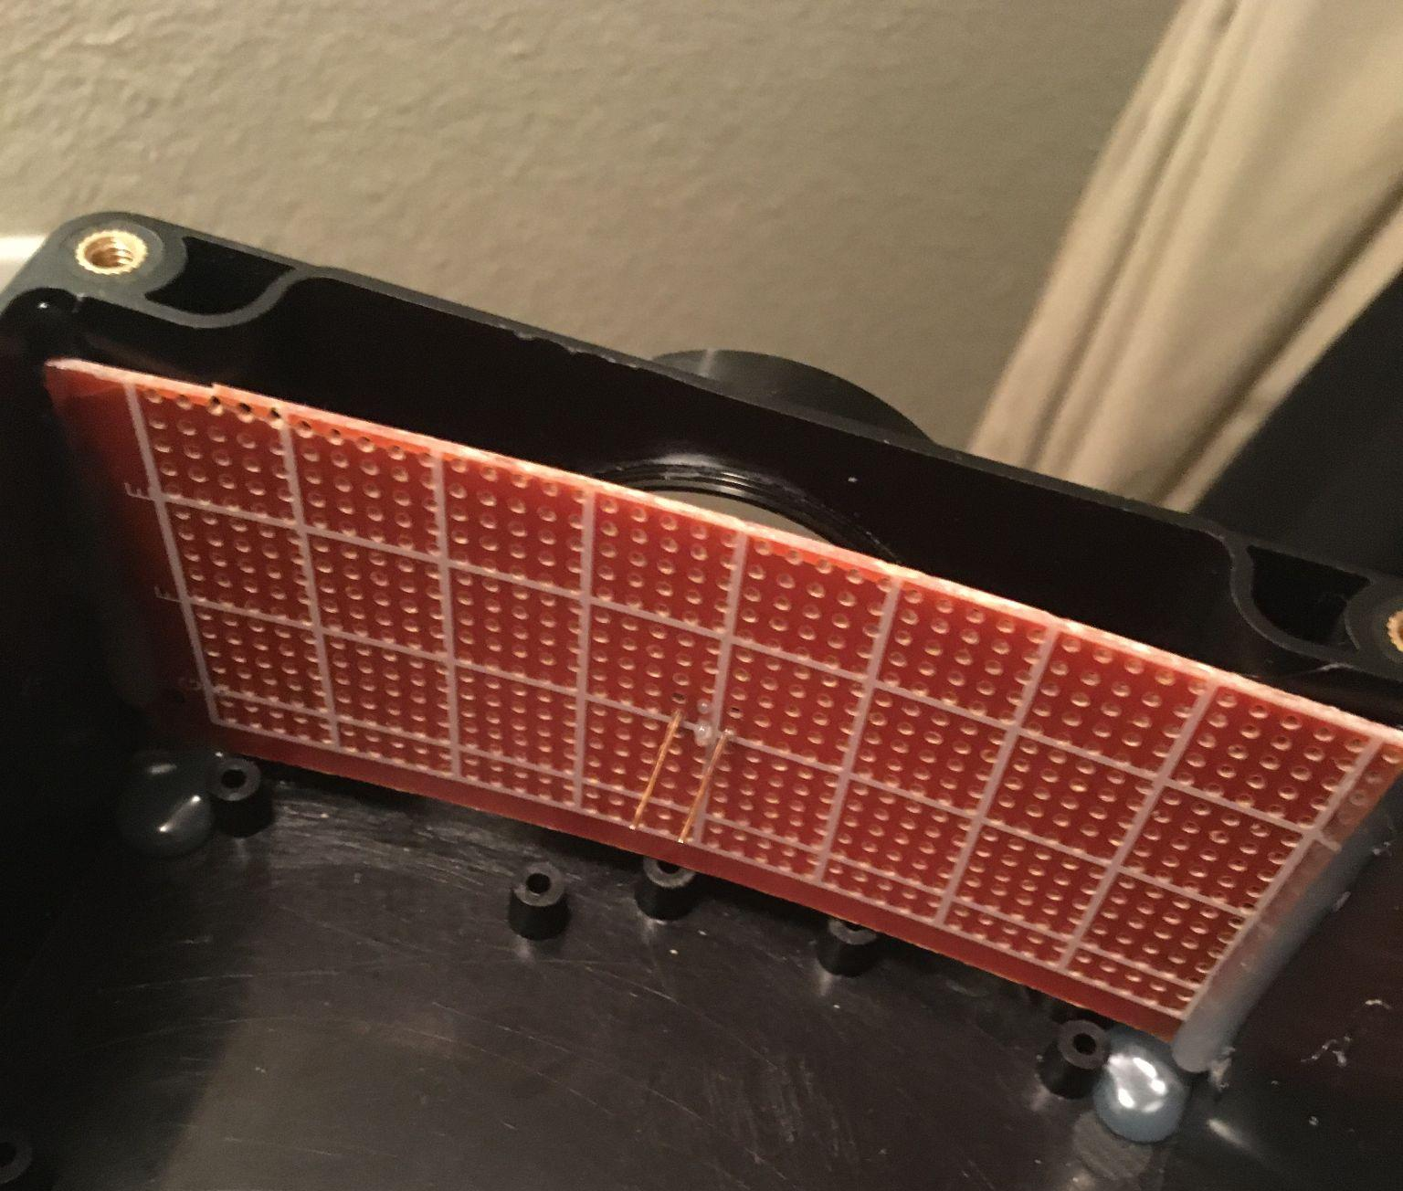

Slide 7
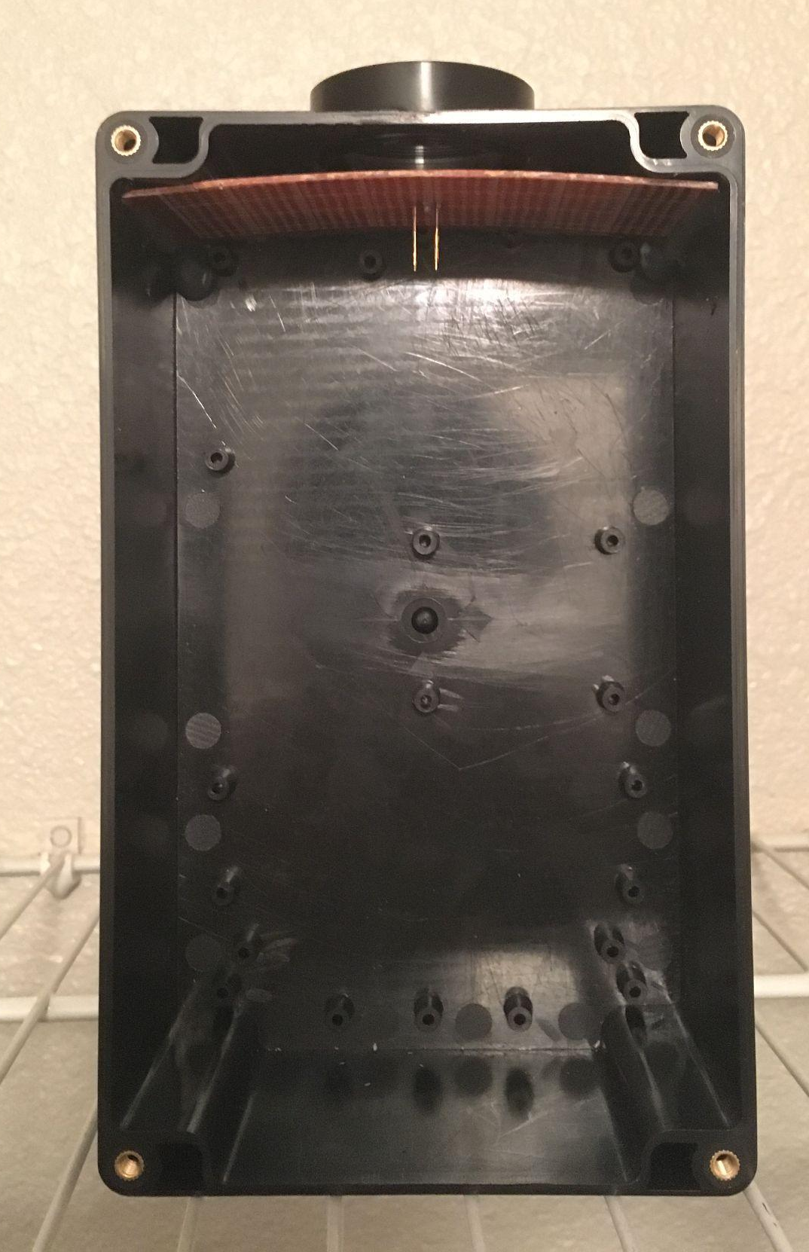

Slide 8
Rigoberto Olivares & Richard Lopez
Accomplishments since last update 10 hrs of effort | Ongoing progress/problems and plans until the next presentation
ADC is working. Tested ADC with various Gains and Light intensity inputs. Fixed issues with our PCB design. | No big issues left to address. Test our system in a realistic environment.

Slide 9

Small Demo

Slide 10
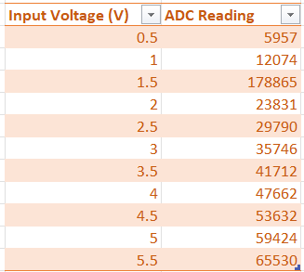
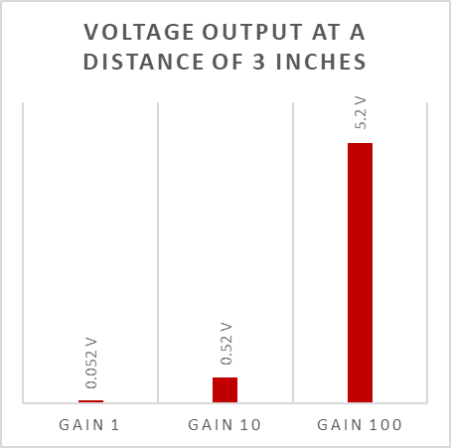
Validation of ADC
Used a constant source of light at a constant distance.
The gain of the photometer was increased.
Output voltage scales by factors of 1, 10, and 100.
Output voltage ranges from 0V to 5.5V.

Slide 11
Validation of ADC

Slide 12
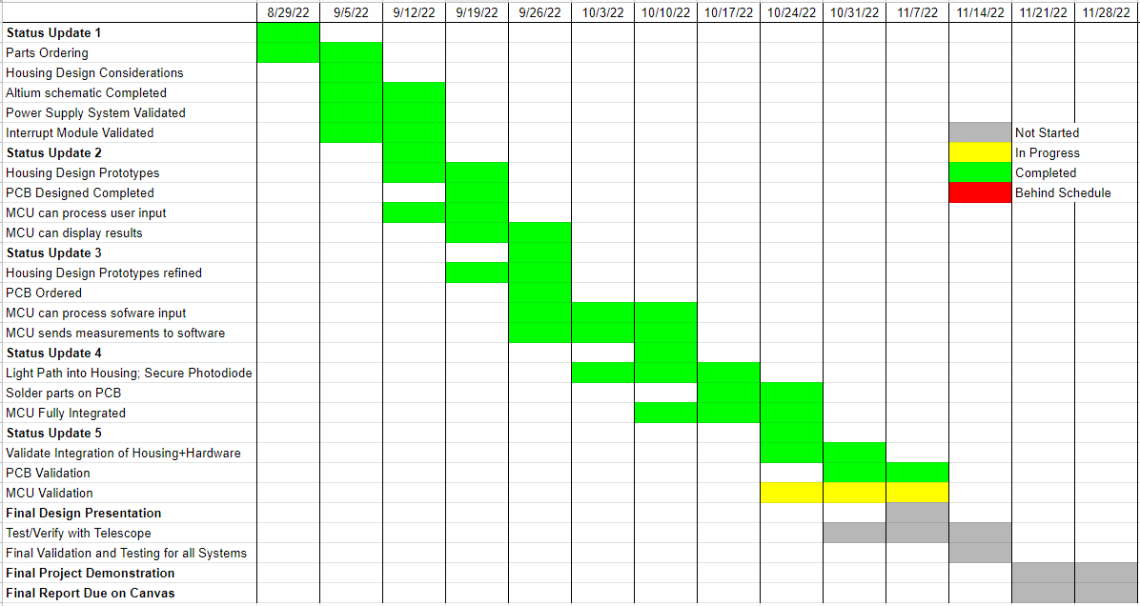
Execution Plan
Notes:
Michelle

Slide 13
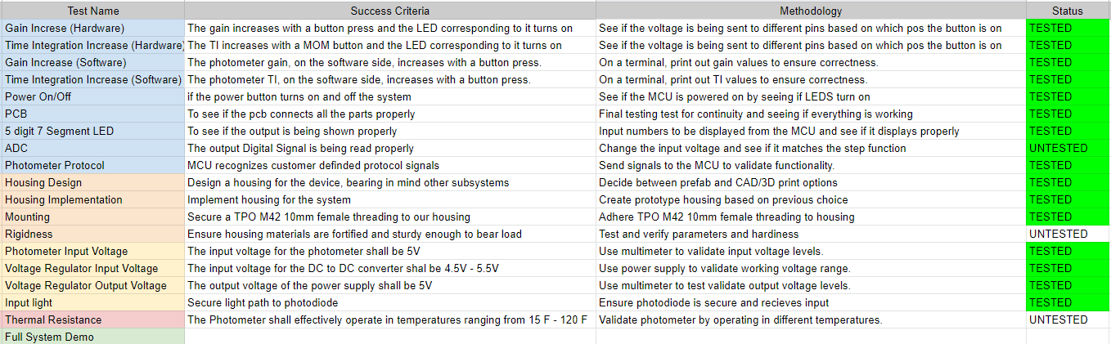
Validation Plan
Notes:
Michelle

Slide 14
Thank you!
Questions?

