Slide 1

Robotic Arm with enhanced reachable workspace
Rigved kulkarni & alec lahr

Slide 2
Agenda
Problem & Motivation
Method
Robot Design
Forward Kinematics
Inverse Kinematics
Simulation
Challenges
Individual Contributions
Conclusion

Slide 3
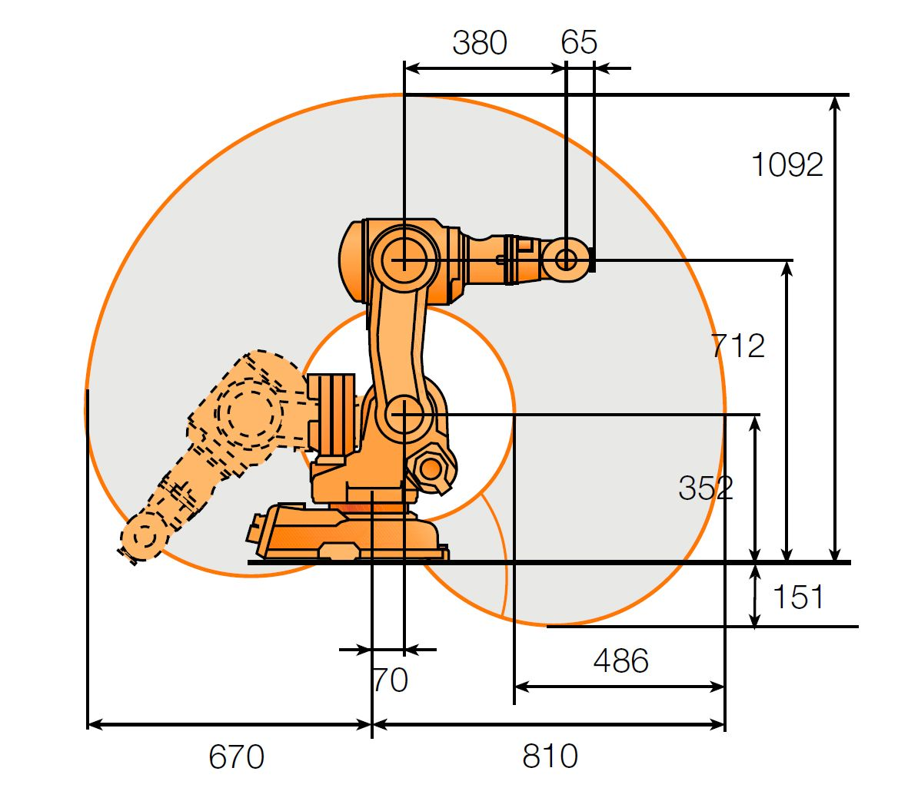
Problem & Motivation
Original project topic: Comau NM45 robot arm
Noticed limited reachable workspace problem
Revised project topic: Design a robot arm with a fuller
reachable workspace

Slide 4
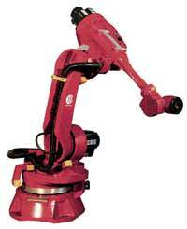
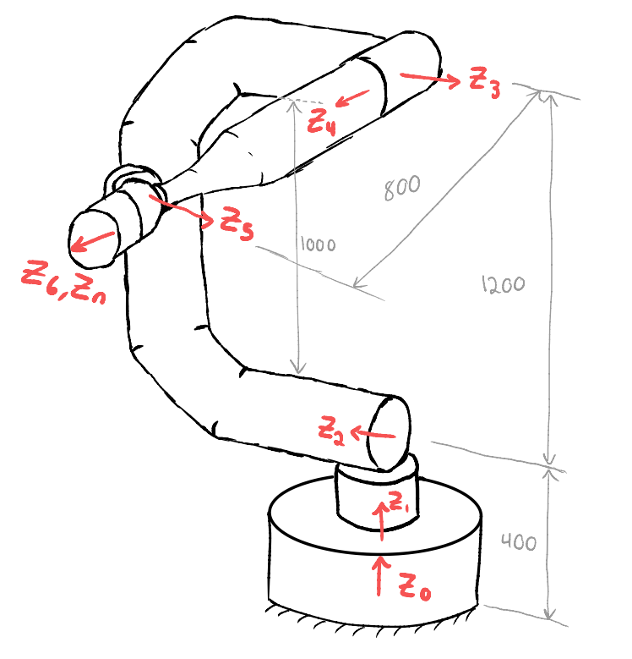
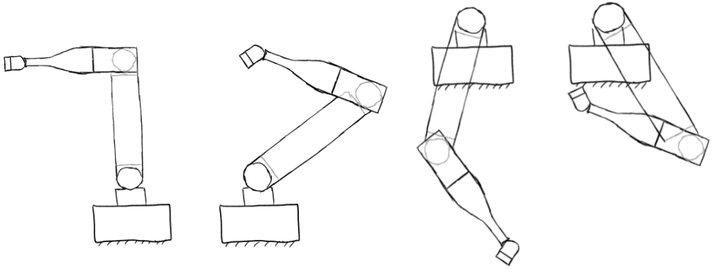
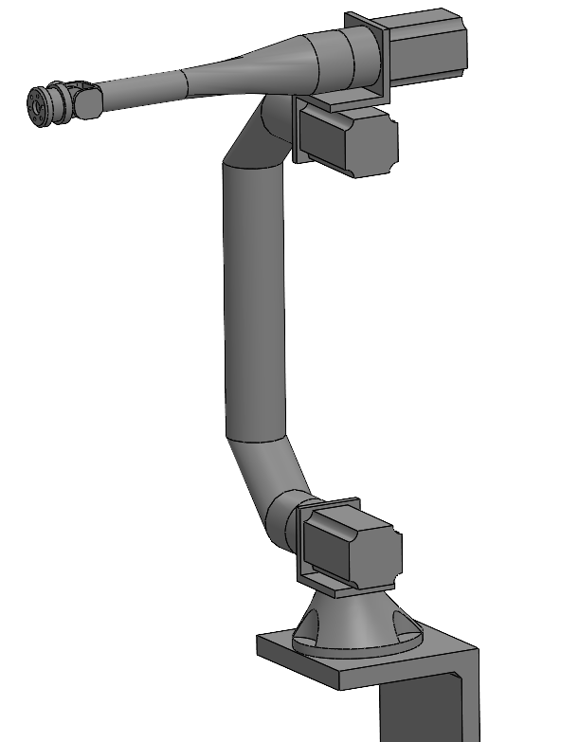
Method
Link 2 geometry
Identify constraints on workspace
Sketch concept design
Create CAD model
Simulate robot

Slide 5

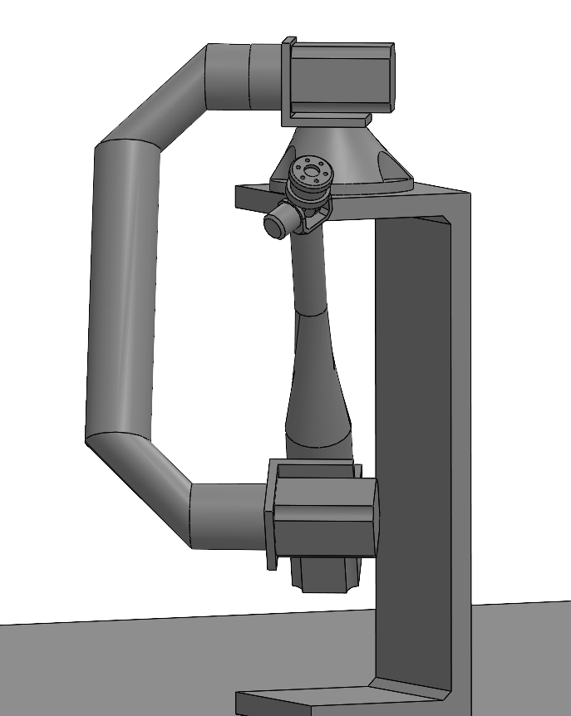
Robot Design
C-Shaped link 2 Spherical wrist

Slide 6
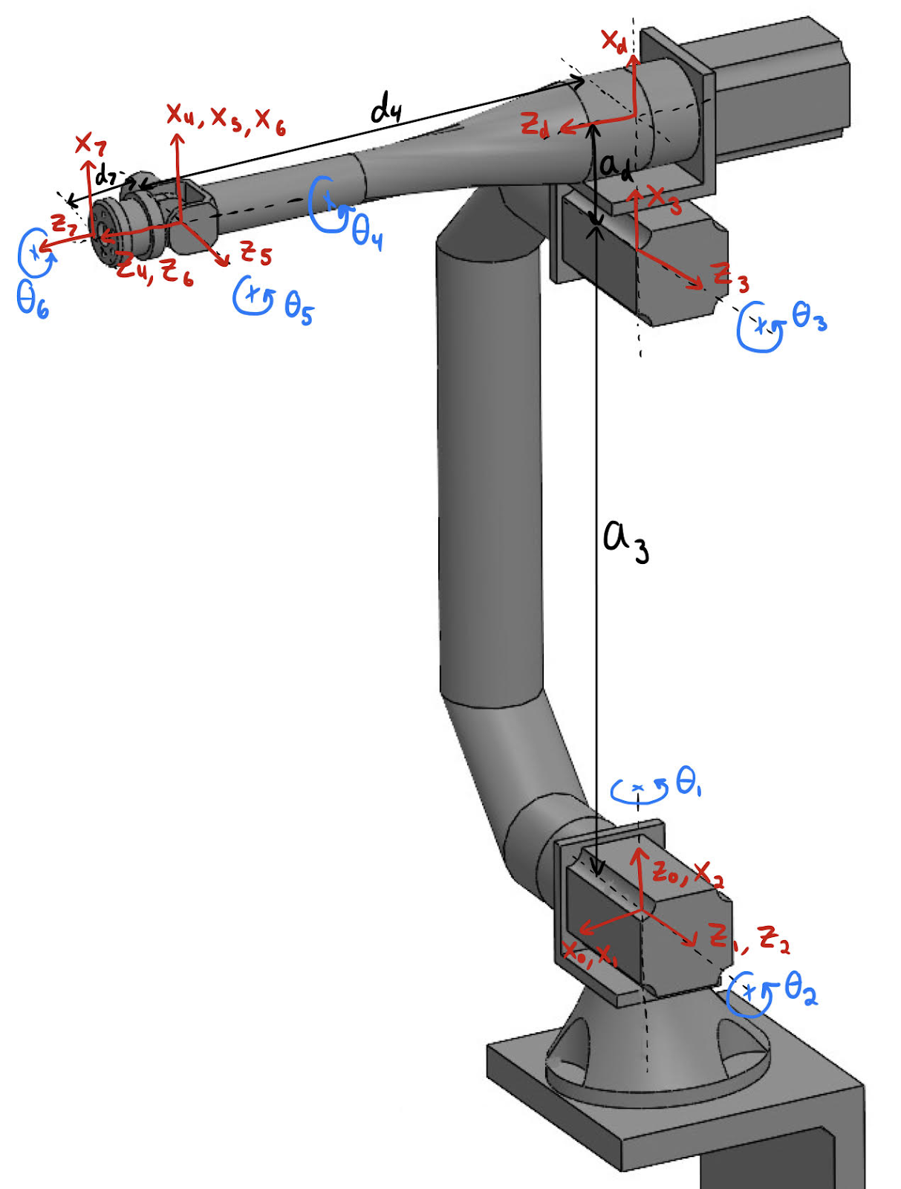
Forward Kinematics
 | α | a | d | Θ
0-1 | -90 | 0 | 0 | Θ₁
1-2 | 0 | 0 | 0 | Θ₂-90
2-3 | 0 | a₃ | 0 | 0
3-d | -90 | a_{d} | 0 | Θ₃
d-4 | 0 | 0 | d₄ | 0
4-5 | 90 | 0 | 0 | Θ₄
5-6 | -90 | 0 | 0 | Θ₅
6-7 | 0 | 0 | d₇ | Θ₆

Slide 7
Inverse Kinematics
Position
Θ₁ = atan2(O_{X}-d₇r₁₃, O_{Y}-d₇r₂₃)
Θ₃ = ±(atan(d₄/a_{d})+acos(-((O_{X}-d₇r₁₃)²+(O_{Y}-d₇r₂₃)²+(O_{Z}–d₇r₃₃)²- a₃² - a₄²) / (2a₃a₄))-π)
Θ₂ = atan2((O_{X}-d₇r₁₃)²+(O_{Y}-d₇r₂₃)², O_{Z}-d₇r₃₃)±atan(a₄sinΘ₃*/(a₃+a₄cosΘ₃*))
Rotation
Θ₄ = atan2(r₁₃, r₂₃)
Θ₅ = atan(sqrt(1 - r₃₃²) / r₃₃)
Θ₆ = atan2(-r₃₁, r₃₂)
Spherical wrist enables
IK separability!

Slide 8
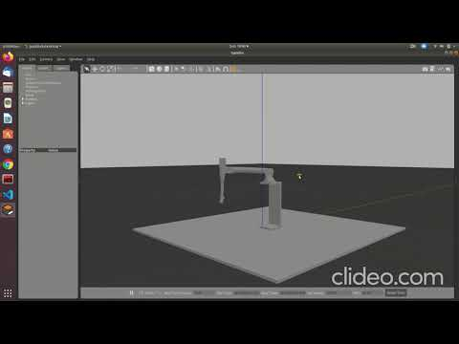
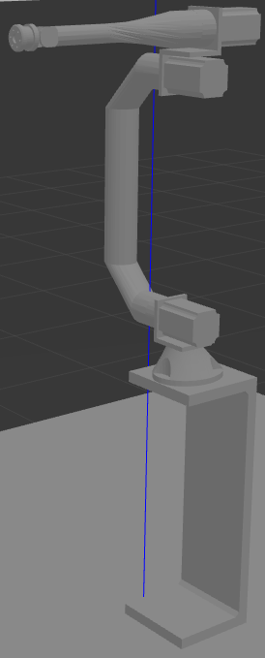
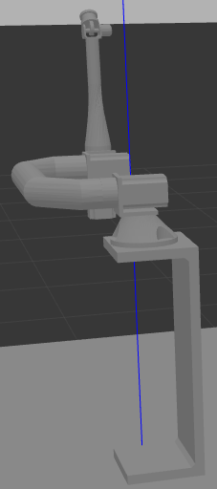
Simulation – Arm reachability
theta1:0, theta2:0, theta3:0, theta4:0,theta5:0, theta6:0
theta1:pi/2, theta2:-pi/2, theta3:0, theta4:pi,theta5:0, theta6:0

Slide 9
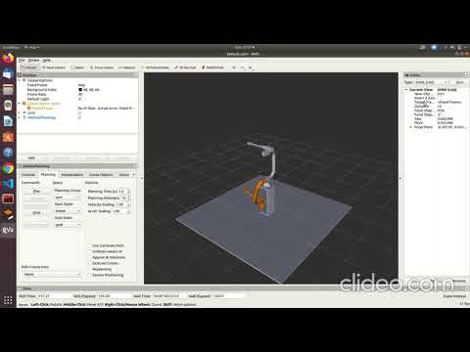
Simulation – motion planning

Slide 10
Challenges
Choosing robot dimensions to avoid self-collision while minimizing weight
Robot toppling due to small base and higher position of center of mass. Countered by increasing the surface area of the base
Unclean reexport to URDF messed up joint origins

Slide 11
Conclusion
Spherically Reaching Robotic Arm benefits:
Increased reachable workspace
Increase in number of configurations for the same end position
Path planning library benefits:
Smoother transition between configurations
Collision free optimal path generation

Slide 12
Individual Contributions
B O T H
Problem formulation
Robot design
A L E C
CAD model
Forward kinematics
Inverse kinematics
R I G V E D
Gazebo & RViz visualization
Path planning algorithm

Slide 13
References
Statista. (2020). Size of the global industrial automation market from 2019 to 2026. https://www.statista.com/statistics/1219772/industrial-automation-market-size-worldwide/
Mark W. Spong, Seth Hutchinson, and M. Vidyasagar John Wiley & Sons (2006), Robot Modeling and Control, ISBN-10 0-471-64990-2
http://wiki.ros.org/
https://answers.gazebosim.org/
https://answers.ros.org/

