Slide 1
Bank Churn
Prediction
By Krishna shinde
(ML Engineer)

Slide 2
Project Introduction
One of the greatest challenges faced by service companies is to retain its customers. The cost involved in targeting new customers is a lot more than the effort to retain the existing ones. One of the greatest challenges faced by service companies is to retain its customers. Keeping this in mind, companies (that also includes banks) try to get some insights into the customer data
Problem Statement
Our goal is to identify those customers who are likely to leave (churn).

Slide 3
Data Source-Describe the data
This data set is provided by NIIT . It contains 10000 samples and 13 features.
we use classification algorithm to solve this type of problems as the predicted columns contains only yes or no.
S.No | Feature | Data Type | Description
1 | customerId | Numeric | Unique Customer ID
2 | Surname | Character | Surname of the customer
3 | Creditscore | Numeric | Credit Score of the customer (cannot be nulls or 0)
4 | Geography | Categorical | Country of origin (this dataset contains only 3 countries)
5 | Gender | Categorical | Gender of customer
6 | Age | Numeric | Customer present age (in years, cannot be nulls or 0)
7 | Tenure | Numeric | Tenure with the bank
8 | Balance | Numeric | Current bank balance of customer
9 | Numofproducts | Numeric / Categorical | Number of bank products currently held/purchased
S.No | Feature | Data Type | Description
10 | Hascrcard | Numeric / categorical | Does the customer own a credit card ?
11 | Isactivemember | Numeric / categorical | Is the customer still active or not ?
12 | estimatedSalary | Numeric | Salary of the customer
13 | Exited | Numeric / categorical | Has the customer churned or not ? (1 -> yes, 0 -> no)

Slide 4
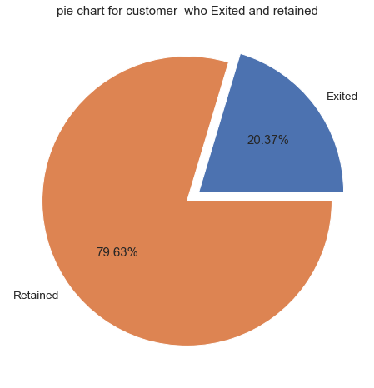
Exploratory data analysis(EDA) --univariate
We can observe from the graph that 20.37% of the customer are leaving from the bank and nearly 80 % customers are retaining .
So our main analysis is on these 20% populations which is 2000 customers out of 10000
To dig further in this and to get insights, we have to do more analysis over the data.

Slide 5
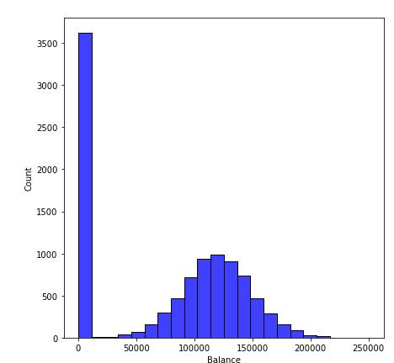
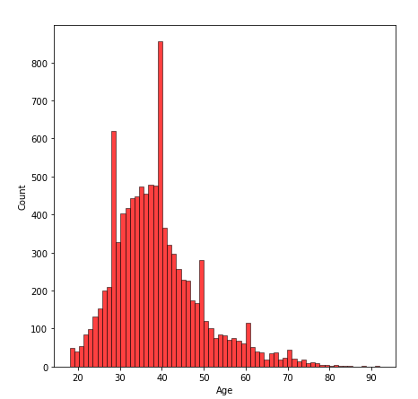
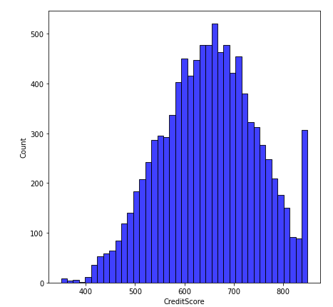
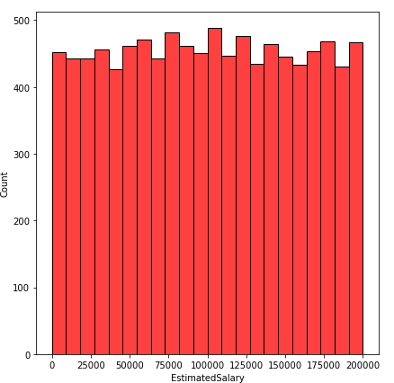
Univariate analysis on the numerical columns
Around 3618 customer are their whose bank balance is zero and rest have balance between 50000-200000.from this 3618 only 500 left the bank and 3118 are retaining.So zero balance is not impacting.
Age of customer is between 20 to 70 ,we can observe that this is normal distribution.
Credit Score of customer is between 400 and 800,this is also distributed normally.
We have uniform distribution of EstimatedSalary,so in data we have all range of salary.

Slide 6
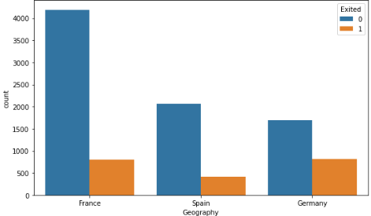
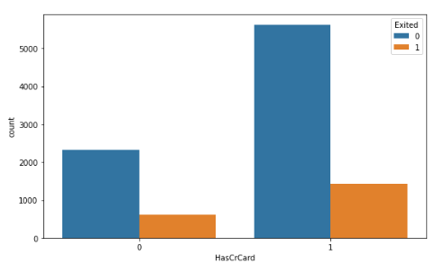
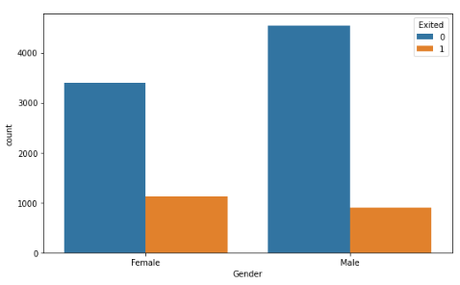
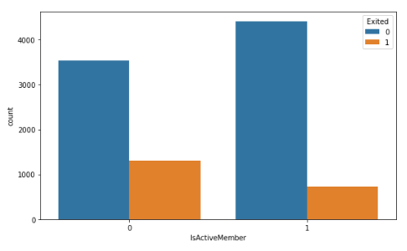
Exploratory data analysis(EDA) –bivariate
The ratio of people leaving/retaining are very low in France compare to other countries.
Those customer who have credit card with them are less likely to leave .we have to give some offers and discounts on applying for credit cards
Females are leaving more compare to males,we should plan something for females customers like providing specials offers for females customers on applying for credit card. For eg,we can offer some goodies to them. We can also provide cosmetics gift vouchers on applying for credit cards
Inactive members are leaving more we can ask the reason from them directly over a call or take a feedback via mail or message.

Slide 7
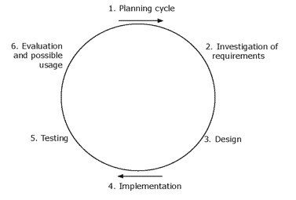
Model building
Planning cycle: -(Choosing the right algorithm . Understanding data)
Investigation of requirements:-what we are looking for.
Design:-model building and fitting
Implementation-predicting the values
Testing-comparison of original and predicted values
6. Evaluation :-evaluating the model using inbuild techniques like confusion matrix

Slide 8
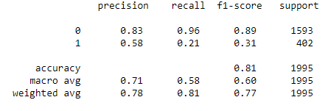
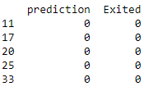

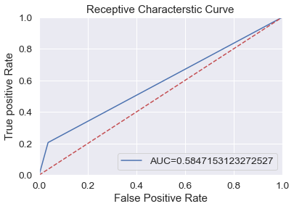
Logistic Regression
Classification Report
Confusion Matrix
Actual VS Predicted
LR: (0.810526)
Accuracy Score = 0.810
Logistic Regression
LR: (0.810526)
Accuracy Score = 0.8105263157894737

Slide 9

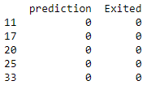
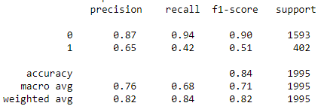
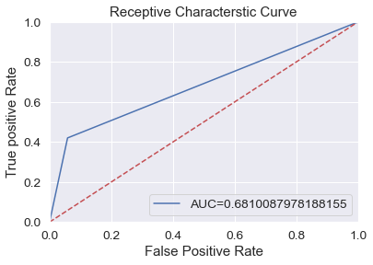
Logistic Regression
Classification Report
Confusion Matrix
Actual VS Predicted
KNeighborsClassifier
KNN: (0.836591)
Accuracy Score = 0.8365914786967419

Slide 10
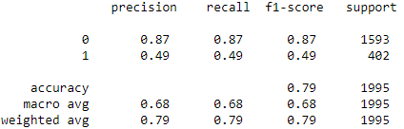
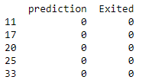


Logistic Regression
Classification Report
Confusion Matrix
Actual VS Predicted
LR: (0.810526)
Accuracy Score = 0.810
DecisionTreeClassifier
CART: (0.792982)
Accuracy Score = 0.7929824561403509

Slide 11
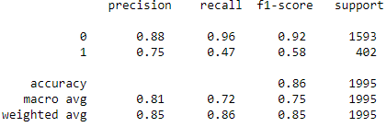

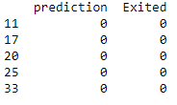
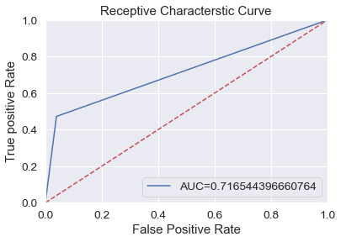
Logistic Regression
Classification Report
Confusion Matrix
Actual VS Predicted
LR: (0.810526)
Accuracy Score = 0.810
RandomForestClassifier
RF: (0.862155)
Accuracy Score = 0.8621553884711779

Slide 12
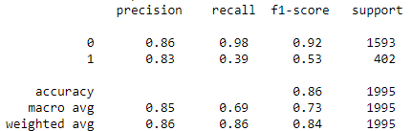
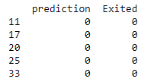


Logistic Regression
Classification Report
Confusion Matrix
Actual VS Predicted
LR: (0.810526)
Accuracy Score = 0.810
SupportVectorClassifier
SVM: (0.861654)
Accuracy Score = 0.8616541353383459

Slide 13
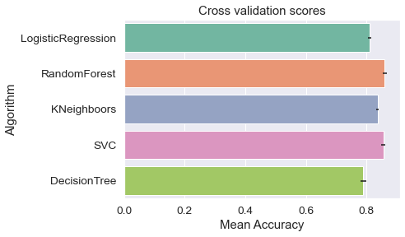
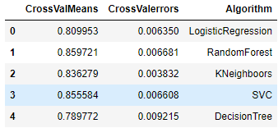
Cross Validation and model Evaluation
Best Algorithm is random forest because it gives best results compare to others classification algorithms

Slide 14
THANK you!!

