Slide 1

Implementing a Just Culture: Understanding the Challenges and Strategies of Building a Fair and Accountable Work Environment
Joe Huffer CSD 380 12/8/2024

Slide 2
What is a Just Culture?
Definition: A culture where the staff are not punished for actions, omissions, suggestions, or decisions taken by them that is proportional to their experience and training; still, gross negligence, willful violations, and destructive acts are not tolerated.
Key Elements of a Functional and Just Culture:
Transparency
Accountability
Continuous Learning

Slide 3
Importance of a Just Culture
The goal and importance of a Just Culture is enforced by the following:
1) It encourages error reporting and near-miss identification that helps improve safety within the environment.
2) Focuses on learning from mistakes instead of blaming and subverting attention/effort.
3) Building trust and establishing a supportive work environment!

Slide 4

Potential “Barriers”
Issues that could arise, and potential barriers to establishing a Just Culture could include:
Blame.
- Humans naturally attribute errors to personal flaws (which is called ‘attribution bias’) - Greater harm leads to harsher punitive action (which is called ‘outcome bias’)
Lack of Transparency/Consistency
- Workers are poorly led or mis/not informed about how errors will be assessed.
- Assessments must be consistent and clear. Inconsistent decision-making can result in confusion or mistrust of the work environment.

Slide 5

Strategies to Overcome “Barriers”
As issues arise, he are some potential solutions to the items mentioned in slide ‘4’:
Blame.
- Avoid quick judgements; use a more systematic approach to analyze context. Also, seek to reduce bias by applying “substitution tests”(ex: “What would a similar person have done in this situation?” see HQCA for more details)
Lack of Transparency/Consistency
- Clearly communicate how decisions are made after incidents occur. Also make sure to educate workers consistently on the principle of accountability in ‘Just Culture’(s).
- Establishing a consistent framework for reviewing incidents, and the responses that follow, can help immensely.

Slide 6
Practical Solutions to “Barriers” and other Challenges
Establish robust error-reporting systems that don’t focus on fear of punishment.
Train employees on the error-reporting that is taking place, as well as the ‘Just Culture’ principles being implemented.
Involve employees in reviewing and learning from incidents. Collaboration and Consistency are key here!
Provide leadership personal that are consistent and encouraged to remain involved – also make sure enough resource is allocated to the ‘Just Culture’ initiatives.
Ensure accountability aligns with measuring safety objectives – the focus should be on worker-security + engagement + encouragement!

Slide 7

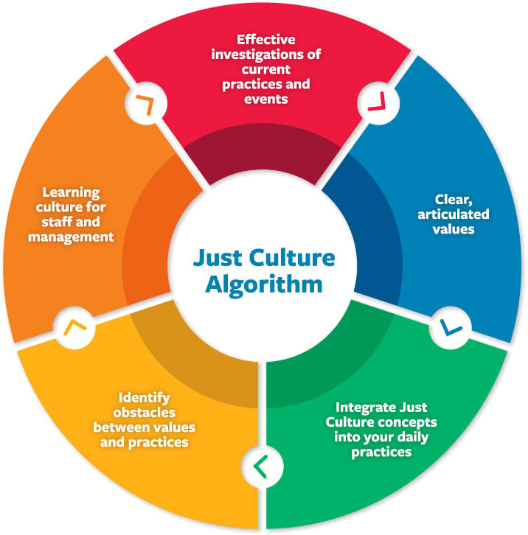
Visual Aid/Algorithm
For more information, see https://www.centerforpatientsafety.org/ or https://www.centerforpatientsafety.org/just-accountable-culture
Effective Investigations of Current Practices and Events: Ensures robust and fair investigations into incidents to uncover root causes.
Learning Culture for Staff and Management: This emphasizes the importance of education and fostering a culture of continuous learning.
Clear, Articulated Values: Focuses on establishing and communicating organizational values clearly to all stakeholders.
Identify Obstacles Between Values and Practices: This step focuses on recognizing misalignments within the organization.
Integrate Just Culture Concepts Into Your Daily Practices: Embeds Just Culture principles into everyday workflows and decision-making processes.

Slide 8
Benefits of a Just Culture
Improved Safety
Systems become more robust and simultaneously less error-prone.
Stronger Trust
Workers feel supported, leading to increased reporting.
Continuous Improvement
Data from errors and near-misses is used to refine processes.
Safety Goals and Company Goals now Align
Organizational focus on accountability improves. Both workers and product are enhanced by transparency and clarity.

Slide 9
Works Cited
Center for Patient Safety. Just and Accountable Culture. Center for Patient Safety, 2024, https://www.centerforpatientsafety.org/just-accountable-culture. Accessed 8 Dec. 2024.
Dekker, Sidney. Just Culture: Balancing Safety and Accountability. Ashgate Publishing, Ltd., 2011.
Health Quality Council of Alberta (HQCA). Overcoming Barriers to a Just Culture. HQCA, 2024, https://justculture.hqca.ca/overcoming-barriers-to-a-just-culture/. Accessed 8 Dec. 2024.
Ingram, Chris. "Breaking Down Barriers: Realising a Just Culture in Healthcare Organisations." LinkedIn, 18 Jan. 2023, https://www.linkedin.com/pulse/breaking-down-barriers-realising-just-culture-chris-ingram/. Accessed 8 Dec. 2024.
Shorrock, Steven. "Why Is It Just So Difficult? Barriers to ‘Just Culture’ in the Real World." Humanistic Systems, 18 Oct. 2023, https://humanisticsystems.com/2023/10/18/why-is-it-just-so-difficult-barriers-to-just-culture-in-the-real-world/. Accessed 8 Dec. 2024.
Vincent, Charles. "Patient Safety Culture: A Review of the State of Play." International Journal for Quality in Health Care, vol. 28, no. 4, 2016, pp. 437-447.

