Slide 1

The Technology Value Stream
CREATED BY: Joe Huffer DATE: October - 2024

Slide 2

Introduction to the Technology Value Stream
UNDERSTANDING THE Technology Value Stream
The Technology Value Stream defines the journey from a business request to technology value delivery. DevOps enhances this stream, reducing delays and optimizing for faster outcomes.

Slide 3

The Definition and Importance of “Lead Time”
IMPORTANCE OF LEAD TIME
Understanding Lead Time helps organizations gauge their delivery speed and identify delays in their workflows to enhance efficiency.
WHAT IS LEAD TIME?
Lead Time measures the overall duration from request to fulfillment. It starts from the moment a request is made and ends with the task's completion.

Slide 4

Defining “Processing Time”
WHAT IS PROCESSING TIME
Processing Time represents the active work duration on a task. It starts when actual work begins and excludes any wait times.
THE ROLE OF PROCESSING TIME
Focusing on Processing Time helps in distinguishing active work from total Lead Time. This clarity aids in improving efficiency.

Slide 5
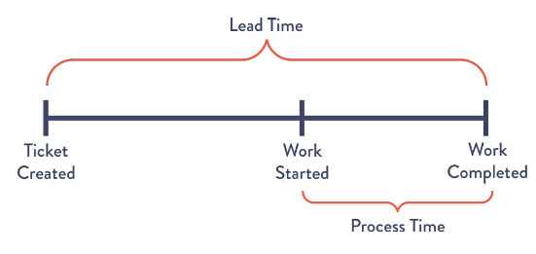
Lead vs. Processing Time
Waiting and it’s relevance in “Lead Time”
ACTIVE WORK AND ITS SIGNIFICANCE
Waiting Time is the inactive phase in the Lead Time while Processing Time reflects only hands-on work.
Processing Time comprises the effort without interruption which is measured distinctly from total Lead Time.
Lead Time includes all time on graphics such as this, whereas processing time includes time from “work started” to “work completed.

Slide 6
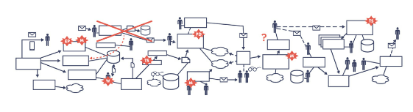
Deployment Lead Times
Organizations face deployment lead times due to various constraints. This affects their agility and ability to deliver value. In many cases, tightly coupled systems, limited test environments, and reliance on manual approvals lead to frequent breakdowns in late-stage integrations. When this occurs, the value stream may look like Figure 1.2 below.

Slide 7
DevOps Ideal: Deployment Lead Times of Minutes
AIMING FOR MINIMAL LEAD TIMES
DevOps aims to transform lengthy deployment lead times into minutes. Modular architectures allow teams to deploy independently, enhancing agility and responsiveness.
Frequent, Small Deployments
The goal is steered towards code changes being small and manageable. Automated and exploratory testing can be performed against these small changes, reducing their risk of failure on a larger scale. With this, small deployments are faster and easier to monitor.
High Autonomy for Small Teams
Another strategy is autonomy. Teams will operate with high levels of autonomy and be independently deploying and managing their own code. Autonomy then empowers the teams to act quickly and responsibly which reduces wait times.

Slide 8
Sources Cited:
Kim, Gene; Humble, Jez; Debois, Patrick; Willis, John; Forsgren, Nicole. The DevOps Handbook: How to Create World-Class Agility, Reliability, & Security in Technology Organizations. IT Revolution Press. Kindle Edition, p. 9-11.

