Slide 1
Marketplace « Foody Heathy »
NOUR BEN RHOUMA
RIHAB EL ARBI
IOT-2A

Slide 2
Product backlog : to be able to :
log in
Sign up
be a salesman
choose a category according to his needs
choose the product to buy and put it in the cart
to validate the cart
pay
choose the language
contact the marketplace managers in case of questions
consult the Frequently Asked Questions page
guide the marketplace visitor through the Free Assessment page
ability for the seller to place his product on the marketplace

Slide 3
for the marketplace managers(admin) to accept the visitor to be a seller
for the marketplace manager(admin) to accept the visitor to be able to publish his product for sale on the marketplace
have loyalty and cashback program :
the visitor get 500 Points when he Sign up to his Account
the visitor get 1 DTN = 1 Point when he Complete purchases through the marketplace
the visitor earn 300 Points when he Refer a friend to the marketplace
the visitor get 5 Points when he Rate our food quality and experience per daily rate
the visitor Get 200 bonus points for his birthday

Slide 4
Update profile
add item to cart
Delete item
Add multiple items
Change item quantity
Accept bank card
Rate and review
Implement forget password function

Slide 5
Sprint backlog:
Create a graphic chart
Create the home page
Create the page for each category
Create the seller's page
Realize the page « FAQ »
Realize the page « log in »
Realize the page « sign up »
Realize the page « contact Us »
Realize the page « loyalty & cashback Program »
Realize the page « Free Assessment »

Slide 6
Burn Down Chart :
A burndown chart or burn down chart is a graphical representation of work left to do versus time. The outstanding work (or backlog) is often on the vertical axis, with time along the horizontal. A burn down chart is a run chart of outstanding work. It is useful for predicting when all of the work will be completed. It is often used in agile software development methodologies such as Scrum. However, burn down charts can be applied to any project containing measurable progress over time

Slide 7
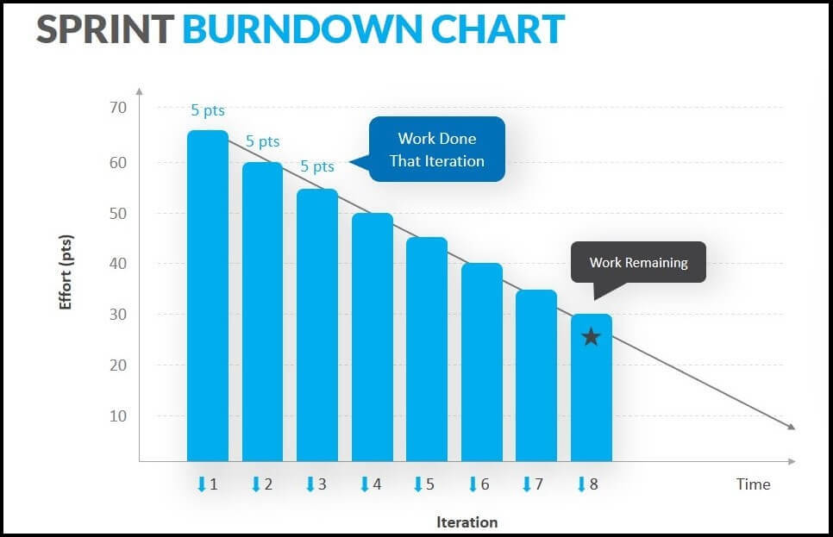
Burn down chart :

Slide 8
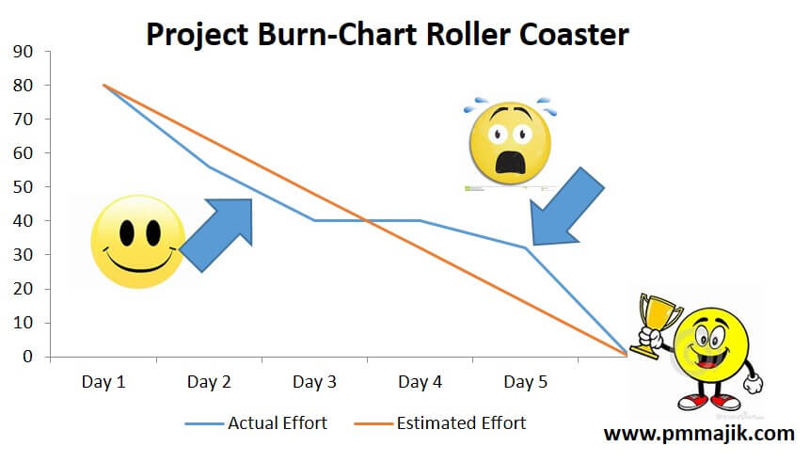

Slide 9
Business Model Canvas :
key partners:
The restaurants
Cafe
Advertisers
Investors
Key activity :
sale of healthy foods
value propositions :
competitive prices
Fast delivery
variety of healthy food offered
to be a salesman
save time
customer relations :
Online
User review
customer segments :
The visitor of the marketplace
key resources :
Healthy food
deliverers
money
employees
distribution channels :
influencer
Marketing
Search engine results
Online platform
cost structures :
costs of food for sale
salaries of the staff
salaries of the delivery people
sources of income :
customer purchases
salespeople's winds

Slide 10

Graphic charter :
our logo will be :

Slide 11
the size of titles will be 36 and their font will be bold and Century Gothic and their color will be green and its color code is #3CB043
the size of subtitles will be 24 and their font will be bold and Century Gothic and their color will be Juniper and its color code is #3A5311
the size of paragraphs will be 18 and their font will be Century Gothic and their color will be black and its color code is #000000

Slide 12
Thank you for your attention !

