Slide 1
Checkpoint Intro_DataBase
By Rihab kouira

Slide 2

MySQL
MySQL, the most popular Open Source relational database management system (RDBMS) with a client-server model, is developed, distributed, and supported by Oracle Corporation.
MySQL is a database management system.
A database is a structured collection of data. To add, access, and process data stored in a computer database, you need a database management system such as MySQL Server.
MySQL software is Open Source.
Open Source means that it is possible for anyone to use and modify the software. Anybody can download the MySQL software from the Internet and use it without paying anything.

Slide 3
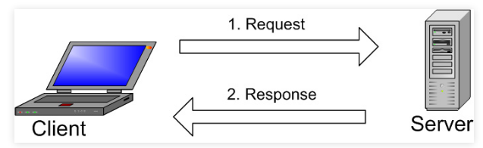
MySQL
How Does MySQL work ?
MySQL creates a database for storing and manipulating data, defining the relationship of each table.
Clients can make requests by typing specific SQL statements on MySQL.
The server application will respond with the requested information and it will appear on the clients’ side.

Slide 4

PostgreSQL
PostgreSQL is a powerful and open source relational database platform. It’s scalable across multiple platforms and is a widely used and well-loved tool.
PostgreSQL comes with many features aimed to help developers build applications, administrators to protect data integrity and build fault-tolerant environments, and help you manage your data no matter how big or small the dataset.
PostgreSQL server is process-based (not threaded), and uses one operating system process per database session.
How Does PostgreSQL work?
PostgreSQL uses SQL for relational queries and JSON for non-relational queries.

Slide 5
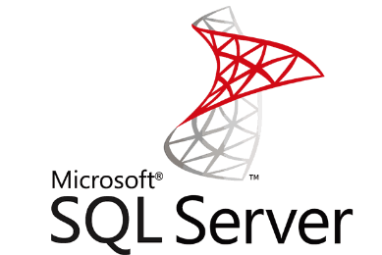
SQL Server
SQL Server is a relational database management system, or RDBMS, developed and marketed by Microsoft.
SQL Server consists of two main components:
Database Engine
SQLOS

Slide 6
SQL Server
Database Engine
The core component of the SQL Server is the Database Engine. The Database Engine consists of a relational engine that processes queries and a storage engine that manages database files, pages, pages, index, etc. The database objects such as stored procedures, views, and triggers are also created and executed by the Database Engine.
SQLOS
Under the relational engine and storage engine is the SQL Server Operating System or SQLOS.
SQLOS provides many operating system services such as memory and I/O management. Other services include exception handling and synchronization services.

Slide 7
A comparison between the three RDBMS
PostgreSQL vs. MySQL is an important decision when it comes to choosing an open-source relational database management system. Both PostgreSQL and MySQL are time-proven solutions that can compete with enterprise solutions such as Oracle and SQL Server.
MySQL has been famous for its ease of use and speed, while PostgreSQL has many more advanced features, which is the reason that PostgreSQL is often described as an open-source version of Oracle.

Slide 8
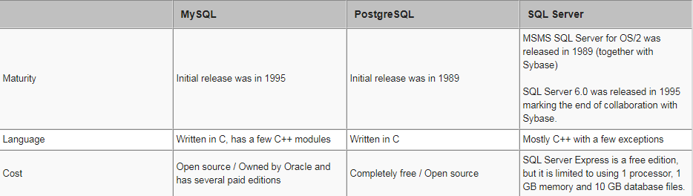
A comparison between the three RDBMS
The following table compares these three RDBMS
General information for MySQL, PostgreSQL and SQL Server

Slide 9
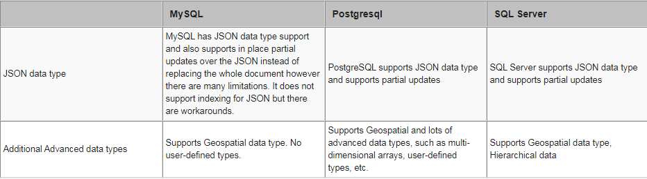
A comparison between the three RDBMS
JSON and Data Type Support for MySQL, PostgreSQL and SQL Server

Slide 10
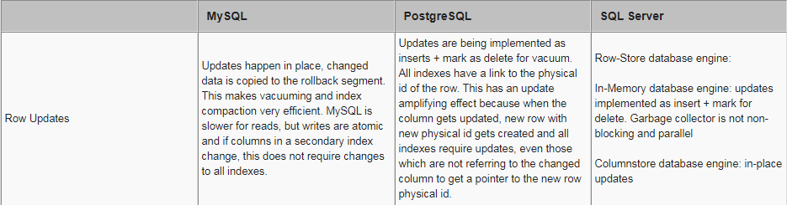
A comparison between the three RDBMS
Data changes for MySQL, PostgreSQL and SQL Server

