Slide 1
ST. CLAIR COLLEGE / GRD 509
Graphic Design Club
Design System → Responsive Website
Brand identity / Primitives / Semantic tokens
Reusable components / Development / System test
BRAND
SYSTEM
BUILD
01

Slide 2

GDC / PROCESS DOCUMENTATION
01 Brand direction
A creative space for students to explore, collaborate, learn, and share work.
Visual direction
• Editorial scale and bold headings
• Geometric and dimensional artwork
• Plum, teal, yellow and neutral surfaces
GDC brand asset from website package
02

Slide 3
GDC / PROCESS DOCUMENTATION
02 Colour primitives and visual language
PLUM
TEAL
YELLOW
INK
PAPER
#805478
#518985
#F4C342
#262629
#F7F5F1
Brand primitives are reused as section surfaces, card variants, text and accents.
03

Slide 4
GDC / PROCESS DOCUMENTATION
03 Primitives → semantic tokens
COLOUR PRIMITIVES
color/brand/primary · secondary · accent
TYPE PRIMITIVES
type/display · heading · body
SPACING PRIMITIVES
space scales for gaps and section padding
RADIUS PRIMITIVES
radius/card for rounded surfaces
Semantic names describe purpose so the same system can support new content.
04

Slide 5
GDC / PROCESS DOCUMENTATION
04 Reusable components & variants
Figma component library: 38 components and 10 component sets (audit of current file).
Explore the Club
Upcoming Events
Interface states
Creative Workshops
Design Challenges
Portfolio Reviews
Creative Lab Sessions
Design Sprint
Portfolio Meetup
Navigation links
Primary button
Default / Hover states
Component sets expose Type variants; interface elements also use interaction states.
05

Slide 6
GDC / PROCESS DOCUMENTATION
05 Responsive layout strategy
DESKTOP
TABLET
MOBILE
1440px
768px
390px
Multi-column content and three-across event cards
Reflow into a vertical card layout and compact navigation
Single-column flow, resized type and touch-friendly spacing
Layouts adapt their navigation, typography, spacing, grids, cards, images and content flow.
06

Slide 7
GDC / PROCESS DOCUMENTATION
06 Completed page structure
Hero / Masthead
About
Featured Work
Tutorials
Club Activities
Upcoming Events
Get Involved
Footer
The same section order is represented in the working HTML project and Figma page.
07

Slide 8
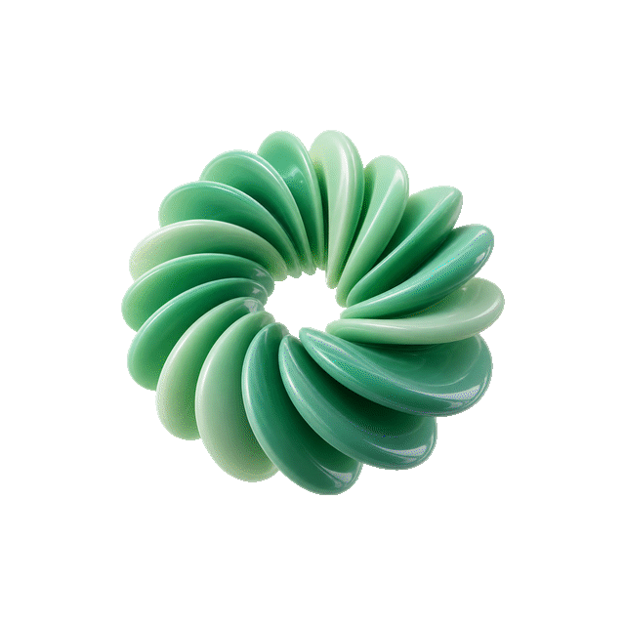
GDC / PROCESS DOCUMENTATION
07 Development workflow
Figma design
↓
HTML + CSS + JavaScript
Code refined using GitHub Copilot and iterative visual comparison with Figma.
Original website visual asset
08

Slide 9
GDC / PROCESS DOCUMENTATION
08 System test: Upcoming Events
New content, existing design system — no new visual language required.
WORKSHOP
CHALLENGE
COMMUNITY
Creative
Lab Sessions
Design
Sprint
Portfolio
Meetup
Experiment and share ideas
Respond to a creative brief
Exchange portfolio feedback
Reused: semantic colours, Inter typography, card radius, spacing, CTA pattern and card variants.
09

Slide 10
GDC / PROCESS DOCUMENTATION
09 Testing and quality checks
• Compare Figma and coded layouts at 1440 / 768 / 390 px
• Test navigation links, menus, hover and scroll interactions
• Verify card readability, image scaling and content order
• Check keyboard navigation, contrast and reduced-motion preferences
• Recheck links and responsive behaviour before submitting
Testing checklist supplied with this submission package.
10

Slide 11
GDC / FINAL SUBMISSION
10 Final hand-in
01 Figma design system and responsive frames
02 Working HTML/CSS/JS project via GitHub
03 Process documentation and Upcoming Events system test
https://www.figma.com/design/T8HZRCspMMC1crtF2xRXg8/GRD-Club?node-id=87-8&t=wcBf1IW6LSE7QOIo-1
11

