Slide 1
RESULTS & ANALYSIS

Slide 2

Baseline: Hyperparameter Tuning of Shape Prior Weight (λ) on 3D-IRCADb-01
Table 2: Effect of λ in composite loss on Dice and IoU for 3D-IRCADb-01 dataset
λ value | Dice (Validation) | IoU (Validation) | Dice (Test) | IoU (Test)
0.08 | 0.1335 | 0.0715 | 0.1282 | 0.0685
0.1 | 0.5879 | 0.4163 | 0.7020 | 0.5408
0.2 | 0.4668 | 0.3044 | 0.5412 | 0.3710
0.6 | 0.2992 | 0.1759 | 0.4035 | 0.2528

Slide 3
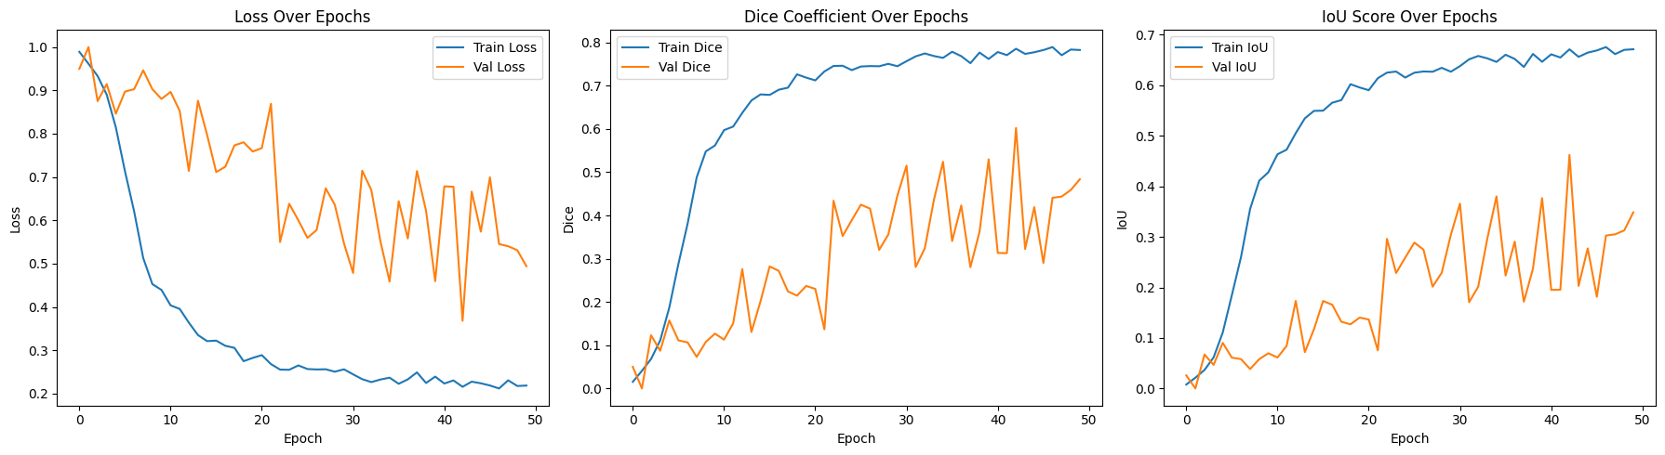
Baseline: Trained from scratch on 3D-irchad-01
Fig. 14. Training and validation performance of the baseline model trained from scratch using a combined loss function (Dice loss + shape prior loss), showing trends in loss, Dice coefficient, and IoU score over 50 epochs.

Slide 4
Baseline: In-Domain Evaluation: UNet++ Trained and Tested on 3D-IRCADb-01
Evaluation on Validset:
Overall Dice Score: 0.5879
Overall IoU Score: 0.4163
Evaluation on Testset:
Overall Dice Score: 0.7020
Overall IoU Score: 0.5408

Slide 5
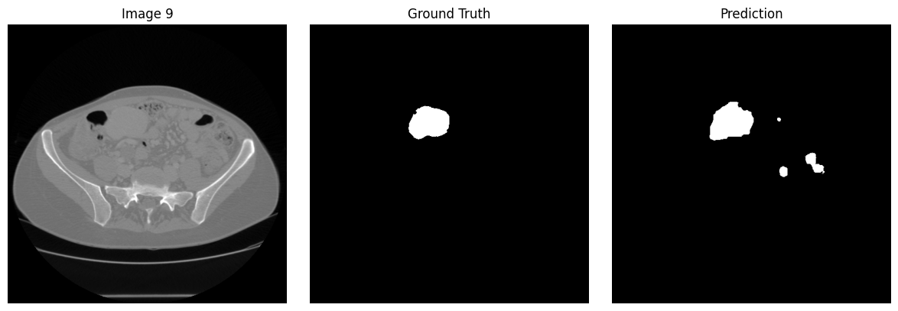
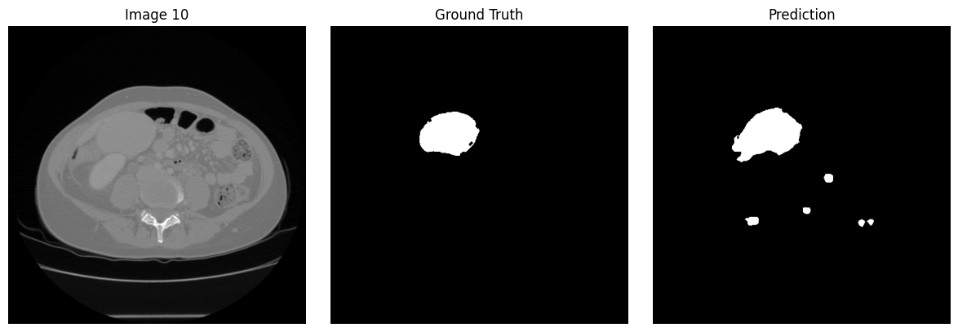
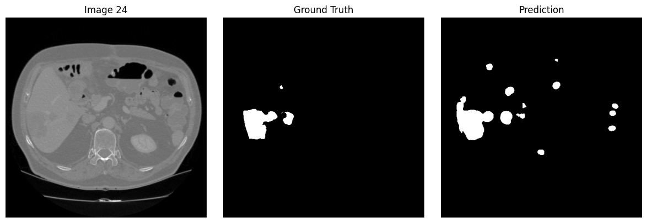
Fig.15: Visual outputs from a model trained from scratch show successful tumor detection, but also highlight false positives in irrelevant regions

Slide 6
Baseline: Cross-Dataset Evaluation: UNet++ Trained on 3D-IRCADb-01 and Tested on SQUH
Evaluation on Validset:
Overall Dice Score: 0.2345
Overall IoU Score: 0.1328
Evaluation on Testset:
Overall Dice Score: 0.2136
Overall IoU Score: 0.1195

Slide 7
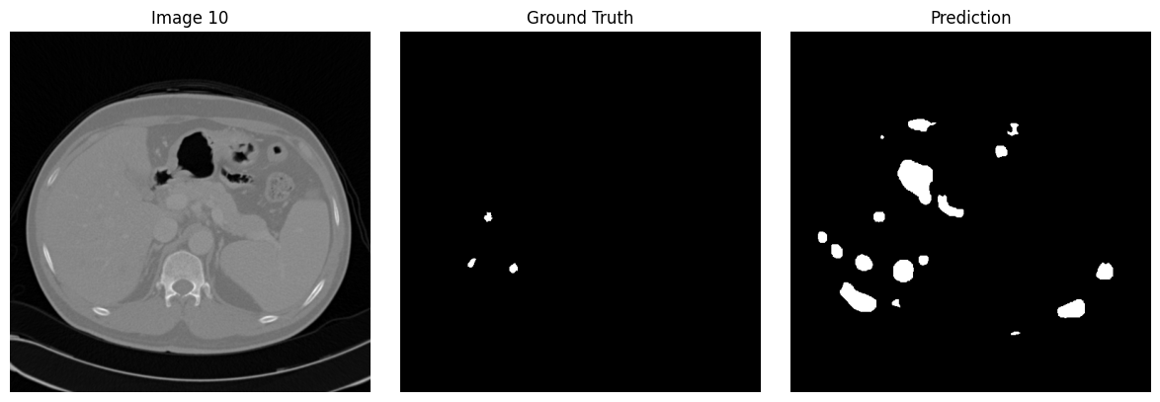
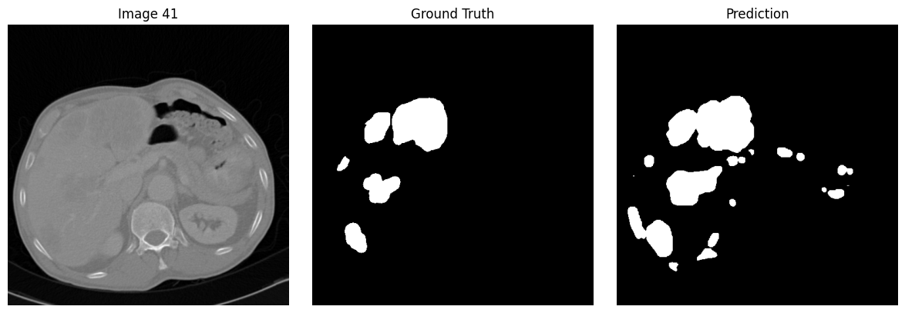
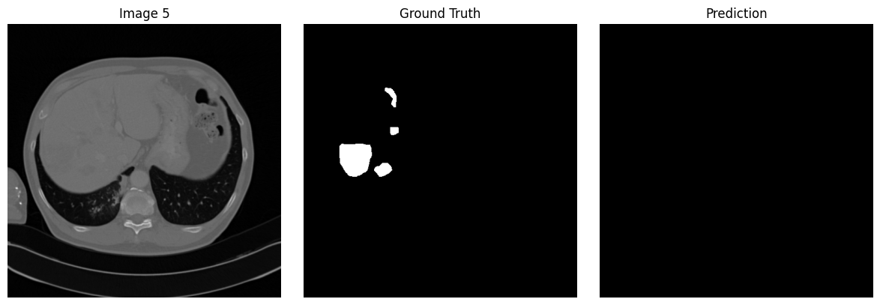
Fig.16 : Visual outputs from a model trained from scratch on the 3D-IRCADb-01 dataset and tested on the SQUH test set illustrate the model’s failure to generate accurate predictions.

Slide 8
Progressive Fine-Tuning from Brain MRI to Liver CT using UNet++
Table 3:Liver tumor segmentation performance of progressive fine-tuning UNet++ on 3D-IRCADb-01 (Dice and IoU)
Model | Test/Dice | Test/ IoU | Valid/Dice | Valid/ IoU
Model 1 | 0.3407 | 0.2053 | 0.2512 | 0.1437
Model 2 | 0.1706 | 0.0932 | 0.1512 | 0.0818
Model 3 | 0.1142 | 0.0606 | 0.0987 | 0.0519
Model 4 | 0.1055 | 0.1055 | 0.0926 | 0.0485
Model 5 | 0.0071 | 0.0035 | 0.0078 | 0.0039
Model6 | 0.0062 | 0.0031 | 0.0067 | 0.0034
Model 7 | 0.0039 | 0.0020 | 0.0052 | 0.0026
Model 8 | 0.0025 | 0.0013 | 0.0028 | 0.0014
Model 9 | 0.0108 | 0.0054 | 0.0156 | 0.0078
Model 10 | 0.0139 | 0.0070 | 0.0203 | 0.0103
Model 11 | 0.0083 | 0.0042 | 0.0123 | 0.0062

Slide 9
Direct transfer learning from brain MRI to liver CT fails to detect relevant tumor regions, highlighting the domain gap between source and target modalities
Fig.17: Qualitative segmentation results on 3D-IRCADb-01 validation set for
progressive freezing strategies using Unet++

Slide 10
Progressive Fine-Tuning with Input Modality Adaptation Module
Table 4:Liver tumor segmentation performance of progressive fine-tuning UNet++with added Input Modality Adapter
Model | Test/Dice | Test/ IoU | Valid/Dice | Valid/ IoU
Model 1 | 0.5383 | 0.3683 | 0.4794 | 0.3153
Model 2 | 0.2509 | 0.1435 | 0.2231 | 0.1256
Model 3 | 0.2182 | 0.1225 | 0.1880 | 0.1037
Model 4 | 0.1882 | 0.1039 | 0.2157 | 0.1209
Model 5 | 0.1309 | 0.0700 | 0.1093 | 0.0578
Model 6 | 0.1119 | 0.0592 | 0.1034 | 0.0545
Model 7 | 0.1203 | 0.0640 | 0.1085 | 0.0573
Model 8 | 0.2134 | 0.1195 | 0.1525 | 0.0825
Model 9 | 0.2266 | 0.1278 | 0.1959 | 0.1086
Model 10 | 0.1858 | 0.1024 | 0.1610 | 0.0876
Model 11 | 0.1223 | 0.0651 | 0.1311 | 0.0702

Slide 11
Adding an input modality adapter and freezing the first layer improves transfer learning performance, enabling partial detection of liver tumor regions despite modality differences
Fig. 18: Qualitative segmentation results on 3D-IRCADb-01 validation set for
progressive freezing strategies using Unet++ with Input Modality Adapter

Slide 12
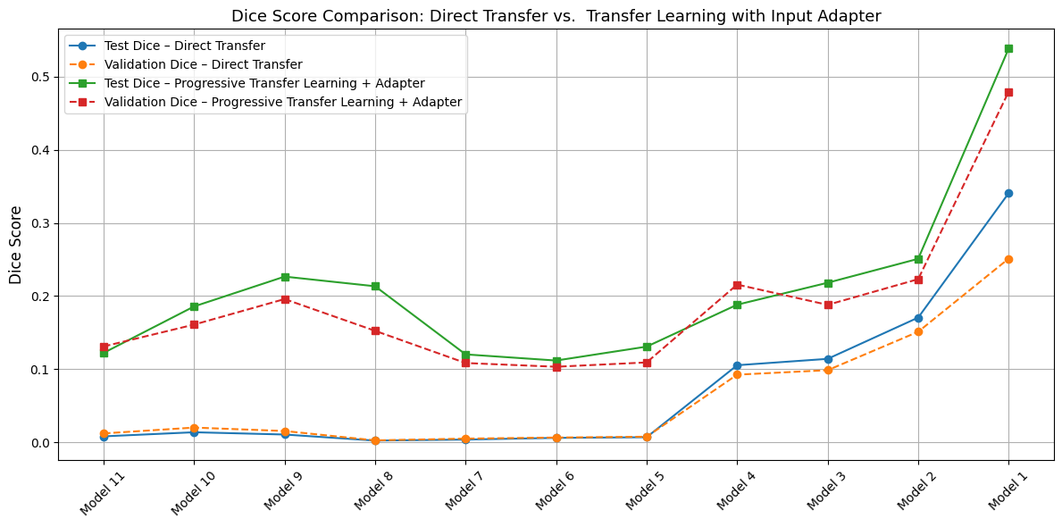
Fig.20:Dice score comparison across freezing strategies

Slide 13
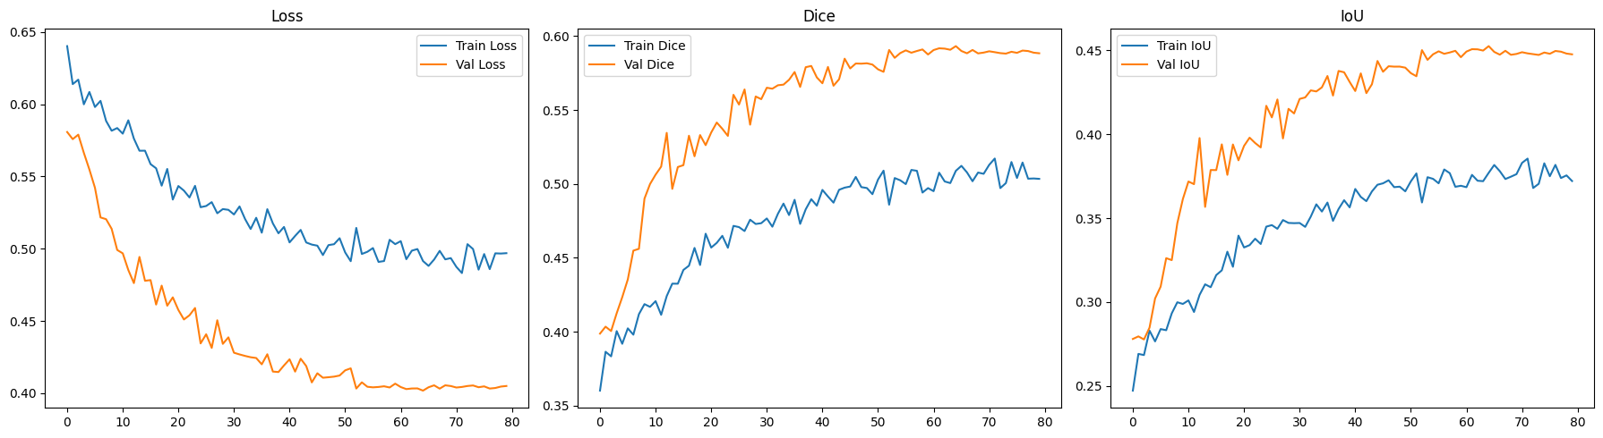
Proposed Architecture: Adapted Dual-Encoder Shared-Tail U-Net (ADEST-U-Net)
Fig.21. Training and validation performance of ADEST-U-Net model using a combined loss function (Dice loss + shape prior loss), showing trends in loss, Dice coefficient, and IoU score over 80 epochs.

Slide 14
In-Domain Evaluation: ADEST-U-Net Trained and Tested on 3D-IRCADb-01
Evaluation on Validset:
Overall Dice Score: 0.7056
Overall IoU Score: 0.5451
Evaluation on Testset:
Overall Dice Score: 0.7189
Overall IoU Score: 0.5611

Slide 15
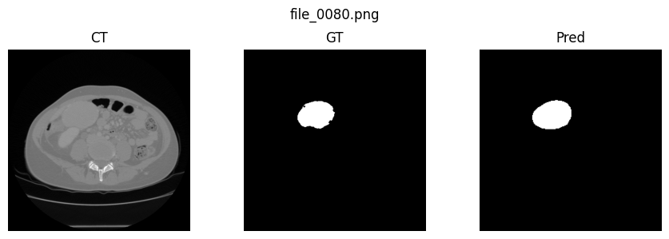
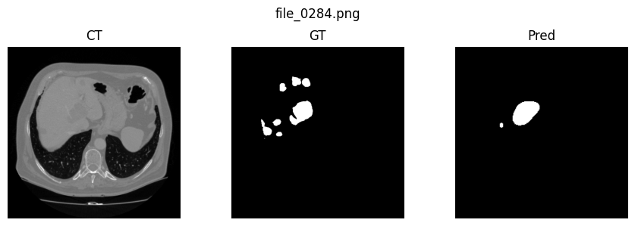
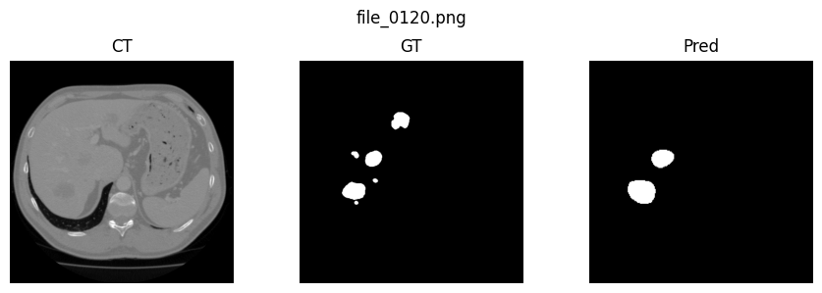
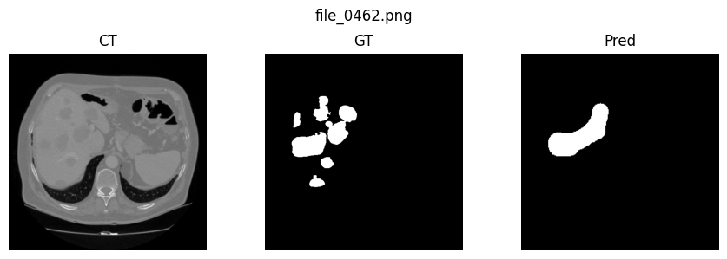
Fig.22:Visual outputs from ADEST-U-Net show effective tumor detection with reduced false positives compared to the baseline. The model demonstrates sensitivity to small tumors however, it restricts segmentation within the liver region.

Slide 16
Cross-Dataset Evaluation: ADEST-U-Net Trained on 3D-IRCADb-01 and Tested on SQUH
Evaluation on Validset:
Overall Dice Score: 0.0635
Overall IoU Score: 0.0328
Evaluation on Testset:
Overall Dice Score: 0.0860
Overall IoU Score: 0.0449

Slide 17
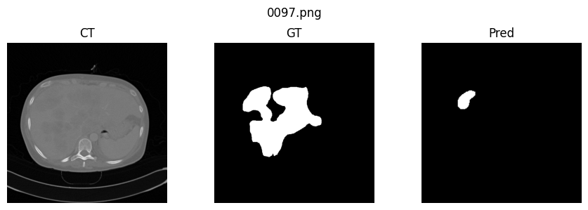
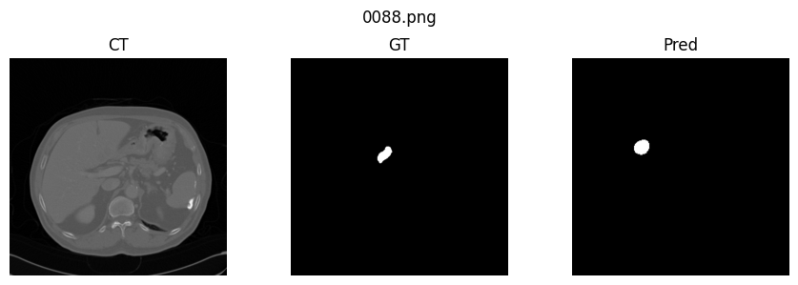
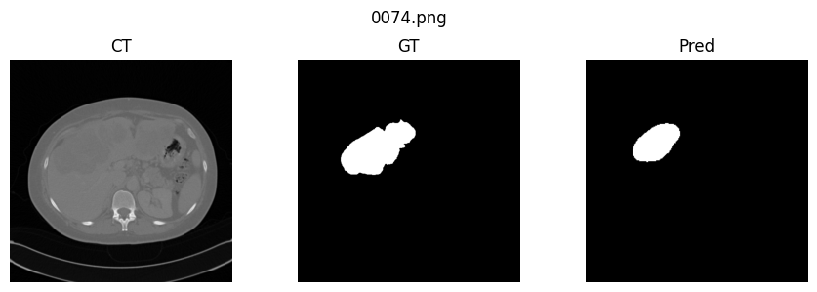
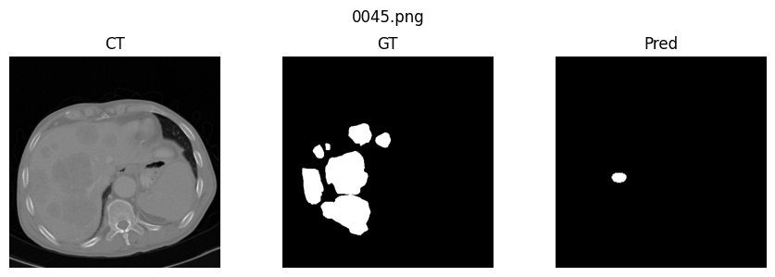
Fig.23:Visual outputs show that while the model generalizes to cross unseen data, tumor regions are often under-segmented compared to the ground truth.

Slide 18
Table 5:Liver tumor segmentation performance of baseline UNet++, fine-tuned UNet++, and proposed ADEST-U-Net on 3D-IRCADb-01 and SQUH CTs.
 |  | 3DIRCAD-01 CTs |  | SQUH CTs
Model | Set | IoU | Dice | IoU | Dice
Baseline UNet++ | Valid | 0.4163 | 0.5879 | 0.1328 | 0.2345
 | Test | 0.5408 | 0.7020 | 0.1195 | 0.2136
Fine-tuned UNet++( 1st layer =forzen) | Valid | 0.3153 | 0.4794 | 0.0087 | 0.0173
 | Test | 0.3683 | 0.5383 | 0.0052 | 0.0103
ADEST-U-Net(proposed) | Valid | 0.5451 | 0.7056 | 0.0328 | 0.0635
 | Test | 0.5611 | 0.7189 | 0.0449 | 0.0860
Note all models trained on 3DIRCADb-01

Slide 19
Table 6:Comparison of liver and liver tumor segmentation Dice scores on the 3D-IRCADb-01 dataset between recent methods and the proposed models.
Model | Liver Segmentation Dice | Liver Tumor Segmentation Dice
HANS-Net (2025) | 0.9482 | 0.8008
ResUNet (2025) | 0.9144 | 0.7584
LCAB-SwinUNet (2025) | — | 0.7138
SWTR-UNet (2023) | — | 0.7900
DPC-Net (2022) | — | 0.7640
ELANRes-MSCA-UNet (2025) | — | 0.7290
Two-stage 2D FCN (2018) | — | 0.6900
Ours – (Baseline UNet++) | --- | 0.7020
Ours – (Adapted Dual-Encoder Shared-Tail U-Net) | --- | 0.7189

Slide 20
Table 7:Segmentation results of baseline UNet++, fine-tuned UNet++ with input modality adaptation, and the proposed ADEST-U-Net on the 3D-IRCAD dataset, reported in terms of TP, FP, FN, precision, and recall (validation and test sets).
Model / Track | Dataset | True Positives (TP) | False Positives (FP) | False Negatives (FN) | Precision | Recall
Baseline (Scratch) | Val. | 124,034 | 147,882 | 26,017 | 0.4569 | 0.8266
 | Test | 170,674 | 119,632 | 25,269 | 0.5870 | 0.8712
(Freeze 1st Layer + IMA) | Val. | 64,432 | 54,307 | 85,619 | 0.5420 | 0.4292
 | Test | 96,084 | 64,931 | 99,859 | 0.5969 | 0.4911
Proposed: Adapted Dual-Encoder Shared-Tail U-Net (ADEST-U-Net) | Val. | 106,656 | 45,624 | 43,395 | 0.7005 | 0.7106
 | Test | 131,678 | 38,726 | 64,265 | 0.7727 | 0.6720

Slide 21
Model Comparison Table
Table 8: Strengths and limitations of each model
Model | Strengths | Weaknesses
Baseline UNet++ | • High recall → detects most tumors | • Severe over-segmentation (false positives outside liver) • Boundary misclassification (false negatives around tumor edges)
Fine-tuned UNet++ + IMA (Frozen 1st Layer) | • Better boundary control than baseline• Reduced over-segmentation | • Lower recall → many tumors under-segmented • Frequently missed small tumors • Brain MRI low-level features not effective for CT
ADEST-U-Net (Proposed) | • Substantially fewer false positives • Predictions confined within liver (no leakage) • Balanced precision & recall | • Still misses very small lesions

Slide 22
Key Challenges in Transfer Learning
Modality gap (MRI → CT):
MRI = soft tissue contrast
CT = density variations
→ Features do not transfer directly
Organ-specific differences:
Brain tumors: sharp boundaries
Liver tumors: heterogeneous, diffuse, irregular
Outcome: Fragmented, incomplete, or scattered tumor segmentations

Slide 23
Scanner & Dataset Variability
CT scans differ by:
Scanner manufacturer
Slice thickness & resolution
Reconstruction protocols & contrast use
Models trained on 3D-IRCADb-01 performed poorly on SQUH dataset
Lesson learned: Multi-center, heterogeneous data is essential for robust generalization

Slide 24
Lessons from Experiments
Naïve fine-tuning across organs/modalities is insufficient
Effective adaptation requires:
Modality-adaptive encoders
Domain adaptation frameworks
Shape priors, dual-encoder designs
Clinically, these strategies ensure safer, more reliable AI deployment

Slide 25
CLINICAL IMPLICATION

Slide 26
Clinical Implications: Annotation Burden
Manual liver tumor annotation = hours per case
AI segmentation → pre-annotation reduces effort to minutes
Benefits:
Faster radiologist workflow
Reduced inter-observer variability
More consistent tumor delineations

Slide 27
Workflow Integration
Embed ADEST-U-Net into:
PACS / Radiotherapy planning systems
Multidisciplinary tumor boards → improved visualization
Interventional planning (surgery, ablation, radioembolization) → define margins & dosing
Screening/follow-up: rapid flagging of suspicious lesions

Slide 28
Path to Clinical Adoption
Next steps:
Validate on multi-center, diverse datasets
Add uncertainty estimation → flag low-confidence cases
Establish regulatory & ethical frameworks
Essential for clinician trust, transparency, and safe deployment

Slide 29
Closing Notes
Cross-organ & cross-modality transfer requires specialized adaptation
Proposed ADEST-U-Net is a step towards clinically reliable AI
Future = scalable, trustworthy segmentation tools integrated into real-world healthcare workflows

Slide 30
CONCLUSION

Slide 31
Conclusion
The proposed ADEST-U-Net achieved a +1.7% Dice improvement compared to the baseline.
The model reduced false positives by 67.6% compared to the from-scratch UNet++ baseline, successfully restricting segmentation to the liver region.
Limitation: Small tumor detection remains limited, especially for subtle, low-contrast lesions.
Future work:
Expand evaluation on larger multi-center datasets.
Improve sensitivity to small tumors.
Explore advanced domain adaptation and clinically informed priors.

