Slide 1
Algebra
By: Riham Katout

Slide 2
Fundamentals
Binary Exponentiation
Euclidian Algorithm for computing GCD
Extended Euclidian Algorithm
Linear Diophantine Equations
Fibonacci Numbers

Slide 3
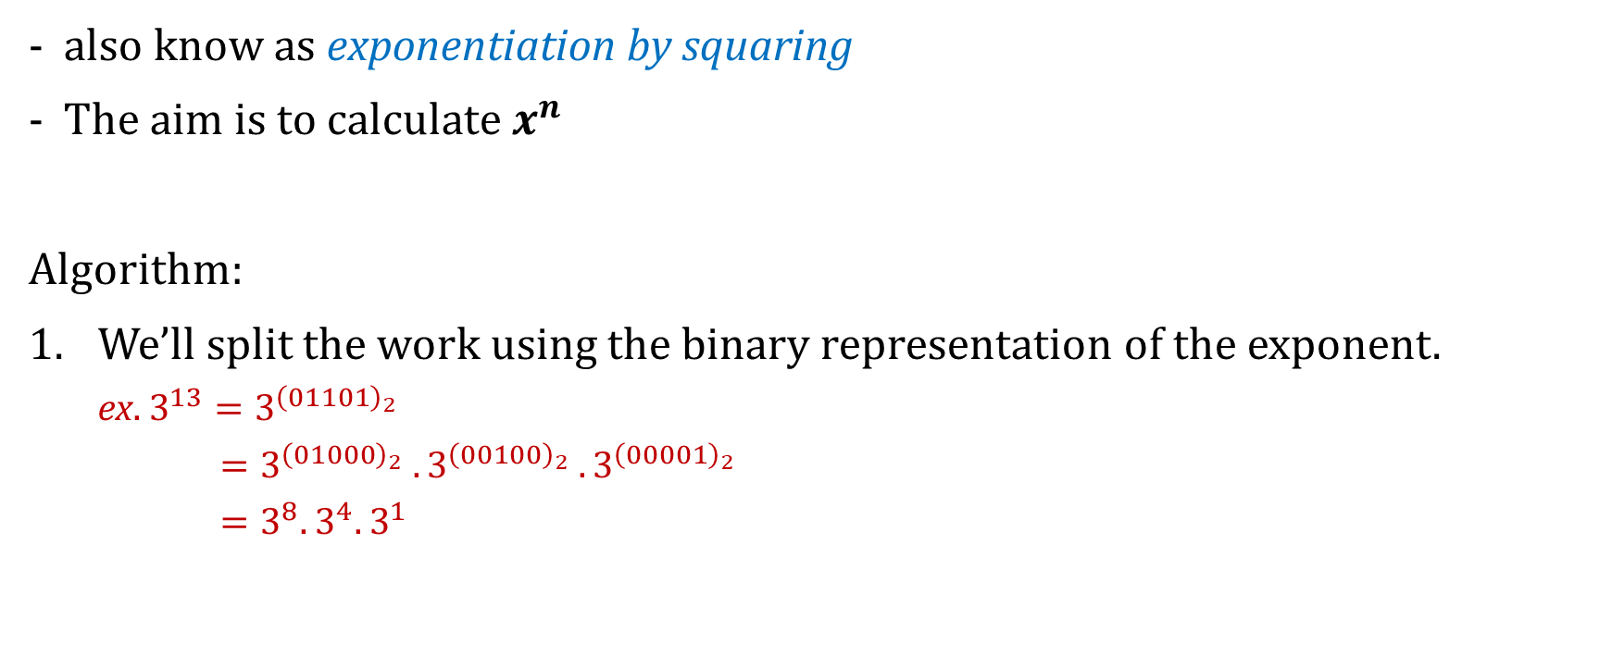
Binary Exponentiation – Algorithm
also know as exponentiation by squaring
The aim is to calculate $x^{n}$
Algorithm:
We’ll split the work using the binary representation of the exponent.
ex. $3^{13}=3^{{\left(01101\right)}_{2}}$
$=3^{{\left(01000\right)}_{2}} . 3^{{\left(00100\right)}_{2}} .3^{{\left(00001\right)}_{2}}$
$=3^{8}.$ $3^{4}. 3^{1}$

Slide 4

Binary Exponentiation - Algorithm
We know that: $a^{2b}={\left(a^{b}\right)}^{2}$
$${ 3}^{1} =3$$
$$3^{2}={(3^{1})}^{2} =9$$
$3^{4}={(3^{2})}^{2} =81$
$${ 3}^{8} ={(3^{4})}^{2} =6561$$
So
$3^{13}=3^{8}⋅3^{4}⋅$ $3^{1}$
$3^{13}=6561⋅81⋅3=1,594,323$

Slide 5
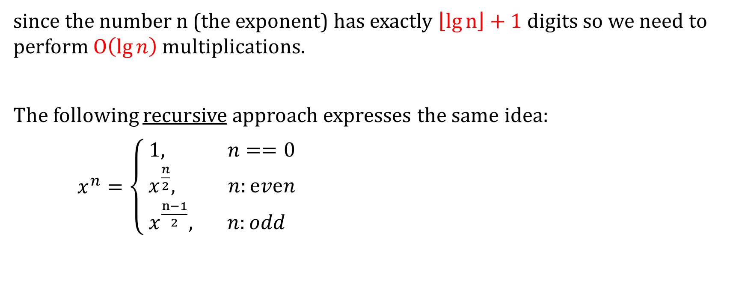
Binary Exponentiation - Algorithm
since the number n (the exponent) has exactly $\left\lfloor \lg{n}\right\rfloor +1$ digits so we need to perform $O\left(\lg{n}\right)$ multiplications.
The following recursive approach expresses the same idea:
$x^{n}=\left\{\begin{matrix} 1, n==0 \\ { x}^{\frac{n}{2}}, n:ⅇvⅇn \\ x^{\frac{n−1}{2}}, n:odd \end{matrix}\right.$

Slide 6
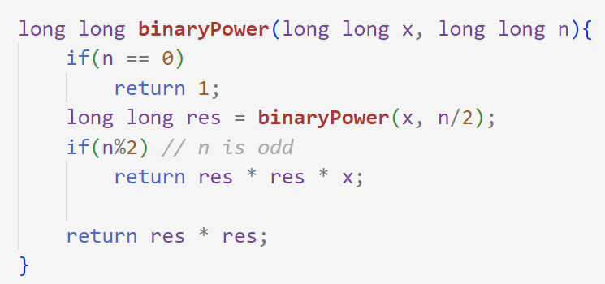
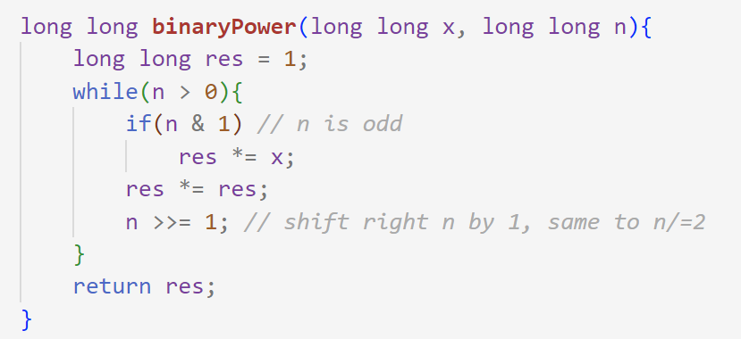
Binary Exponentiation - implementation
recursive approach
iterative approach

Slide 7
Binary Exponentiation - Applications
Effective computation of large exponents modulo a number
Effective computation of Fibonacci numbers
Applying a permutation k times
Fast application of a set of geometric operations to a set of points
Number of paths of length k in a graph
Variation of binary exponentiation: multiplying two numbers modulo m

Slide 8
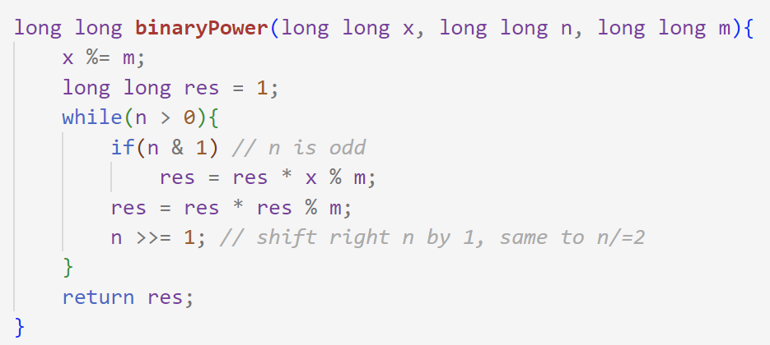

Effective computation of large exponents modulo a number
Problem: compute $x^{n}\operatorname{mod}{m}$ for large x, n
Solution: since we know that the modulo operator doesn’t interfere with multiplications
Problems:
cses-exponentiation

Slide 9

NOTE
It’s possible to speed this algorithm for n >> m.
$$x^{n}≡\left\{\begin{matrix} \\ \begin{aligned}{ x}^{n mod (m−1)} \left(mod m\right), m:prime \\ \end{aligned} \\ { x}^{n mod ∅(m)} \left(mod m\right), otherwise\end{matrix}\right.$$
This follows directly from Fermat's little theorem and Euler's theorem
Problems:
cses-exponentiationII

Slide 10
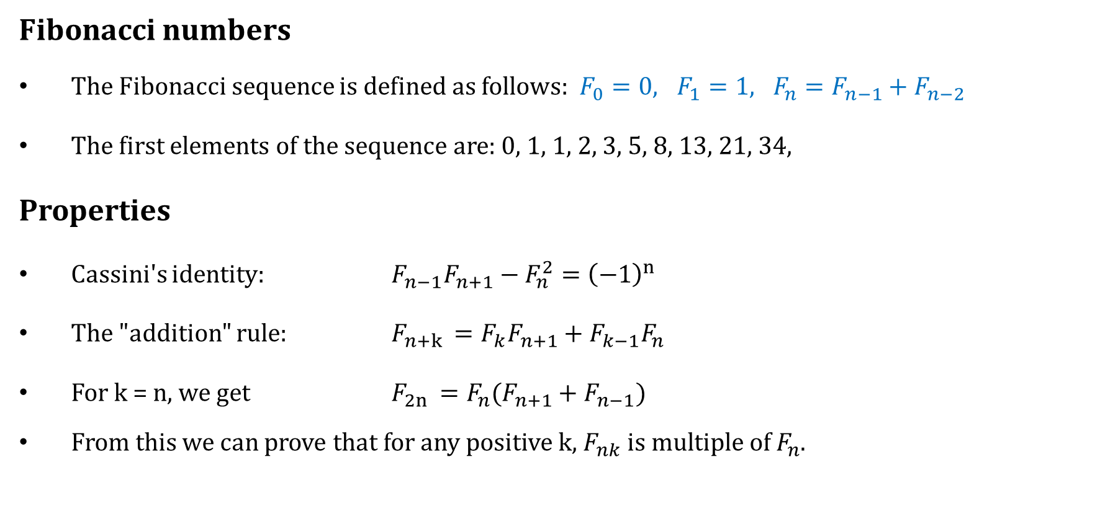
Effective computation of Fibonacci numbers
Fibonacci numbers
The Fibonacci sequence is defined as follows: $F_{0}=0, F_{1}=1, F_{n}=F_{n−1}+F_{n−2}$
The first elements of the sequence are: 0, 1, 1, 2, 3, 5, 8, 13, 21, 34,
Properties
Cassini's identity: $F_{n−1}F_{n+1}−F_{n}^{2}={\left(−1\right)}^{n}$
The "addition" rule: $F_{n+k }=F_{k}F_{n+1}+F_{k−1}F_{n}$
For k = n, we get $F_{2n }=F_{n}(F_{n+1}+F_{n−1})$
From this we can prove that for any positive k, $F_{nk}$ is multiple of $F_{n}$.

