Slide 1
OOPS Concepts in Java

Slide 2
OOPS
Object Oriented Programming Concepts are very important. Without having an idea about
It simplifies software development and maintenance.
The core OOPs concepts:
1. Object
2. Class
3. Abstraction
4. Encapsulation
5. Inheritance
6. Polymorphism

Slide 3
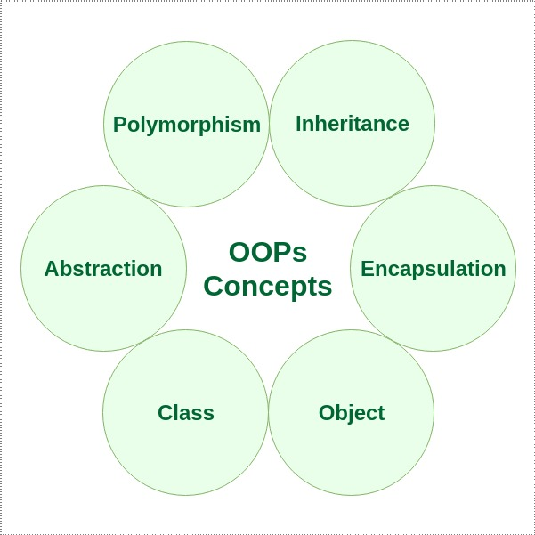

Slide 4
1. Object
An object is a basic unit of Object-Oriented Programming that represents real-life entities. A typical Java program creates many objects, which as you know, interact by invoking methods. The objects are what perform your code, they are the part of your code visible to the viewer/user. An object mainly consists of:
State: It is represented by the attributes of an object. It also reflects the properties of an object.
Behavior: It is represented by the methods of an object. It also reflects the response of an object to other objects.
Identity: It is a unique name given to an object that enables it to interact with other objects.
Method: A method is a collection of statements that perform some specific task and return the result to the caller. A method can perform some specific task without returning anything. Methods allow us to reuse the code without retyping it, which is why they are considered time savers.

Slide 5
Class
A class is a user-defined blueprint or prototype from which objects are created. It represents the set of properties or methods that are common to all objects of one type. Using classes, you can create multiple objects with the same behavior instead of writing their code multiple times. This includes classes for objects occurring more than once in your code.

Slide 6
Abstraction
Data Abstraction is the property by virtue of which only the essential details are displayed to the user. The trivial or non-essential units are not displayed to the user. Ex: A car is viewed as a car rather than its individual components.
In Java, abstraction is achieved by interfaces and abstract classes. We can achieve 100% abstraction using interfaces.

Slide 7
Encapsulation
It is defined as the wrapping up of data under a single unit. It is the mechanism that binds together the code and the data it manipulates. Another way to think about encapsulation is that it is a protective shield that prevents the data from being accessed by the code outside this shield.
In encapsulation, the data in a class is hidden from other classes, which is similar to what data-hiding does. So, the terms “encapsulation” and “data-hiding” are used interchangeably.

Slide 8
Inheritance
Inheritance is an important pillar of OOP (Object Oriented Programming). It is the mechanism in Java by which one class is allowed to inherit the features (fields and methods) of another class. We are achieving inheritance by using extends keyword. Inheritance is also known as “is-a” relationship.
Superclass: The class whose features are inherited is known as superclass (also known as base or parent class).
Subclass: The class that inherits the other class is known as subclass (also known as derived or extended or child class). The subclass can add its own fields and methods in addition to the superclass fields and methods.
Reusability: Inheritance supports the concept of “reusability”, i.e. when we want to create a new class and there is already a class that includes some of the code that we want, we can derive our new class from the existing class. By doing this, we are reusing the fields and methods of the existing class.

Slide 9
Polymorphism
It refers to the ability of object-oriented programming languages to differentiate between entities with the same name efficiently. This is done by Java with the help of the signature and declaration of these entities. The ability to appear in many forms is called polymorphism.
Polymorphism in Java is mainly of 2 types:
Overloading-In Java, Method Overloading allows different methods to have the same name, but different signatures where the signature can differ by the number of input parameters or type of input parameters, or a mixture of both.
Overriding -In Java, Method Overloading allows different methods to have the same name, but different signatures where the signature can differ by the number of input parameters or type of input parameters, or a mixture of both.

Slide 10
Advantage of OOPs over Procedure-oriented programming language
OOP promotes code reusability: By using objects and classes, you can create reusable components, leading to less duplication and more efficient development.
OOP enhances code organization: It provides a clear and logical structure, making the code easier to understand, maintain, and debug.

